Slide 1
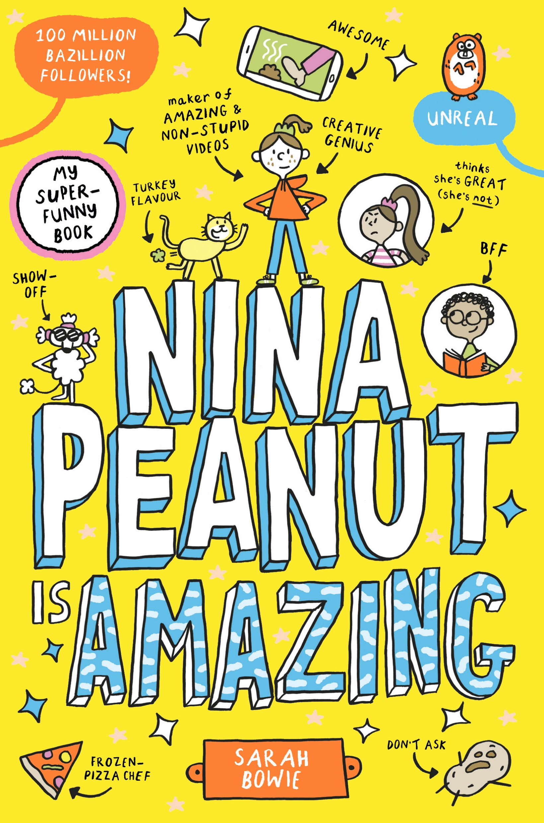
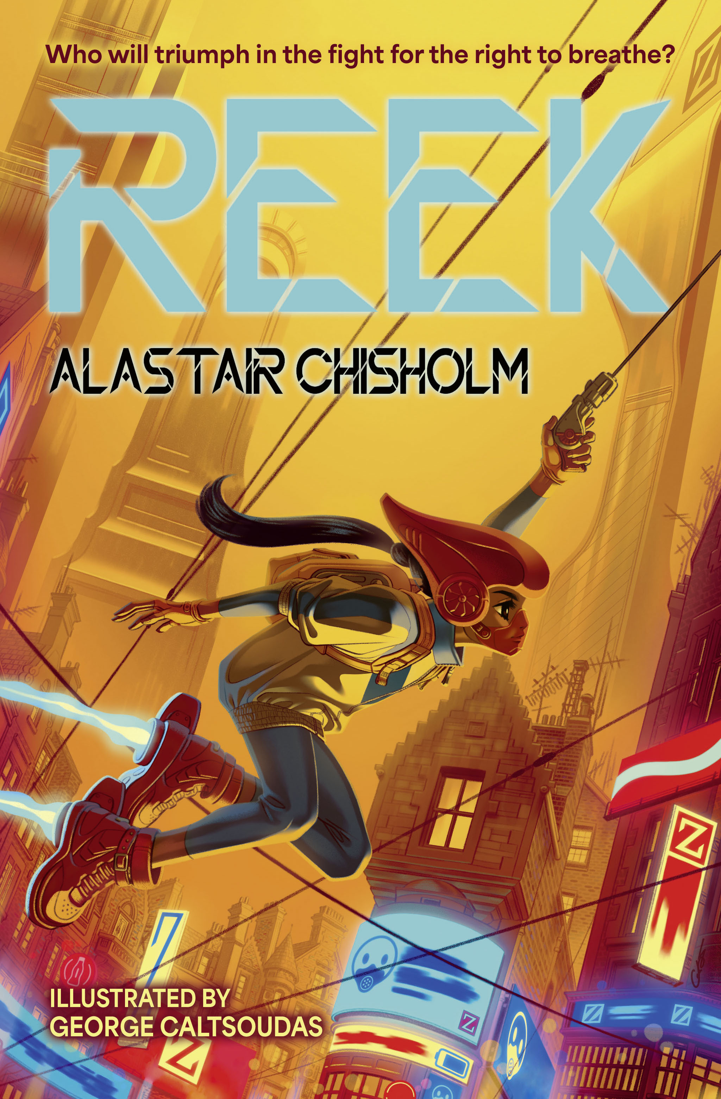
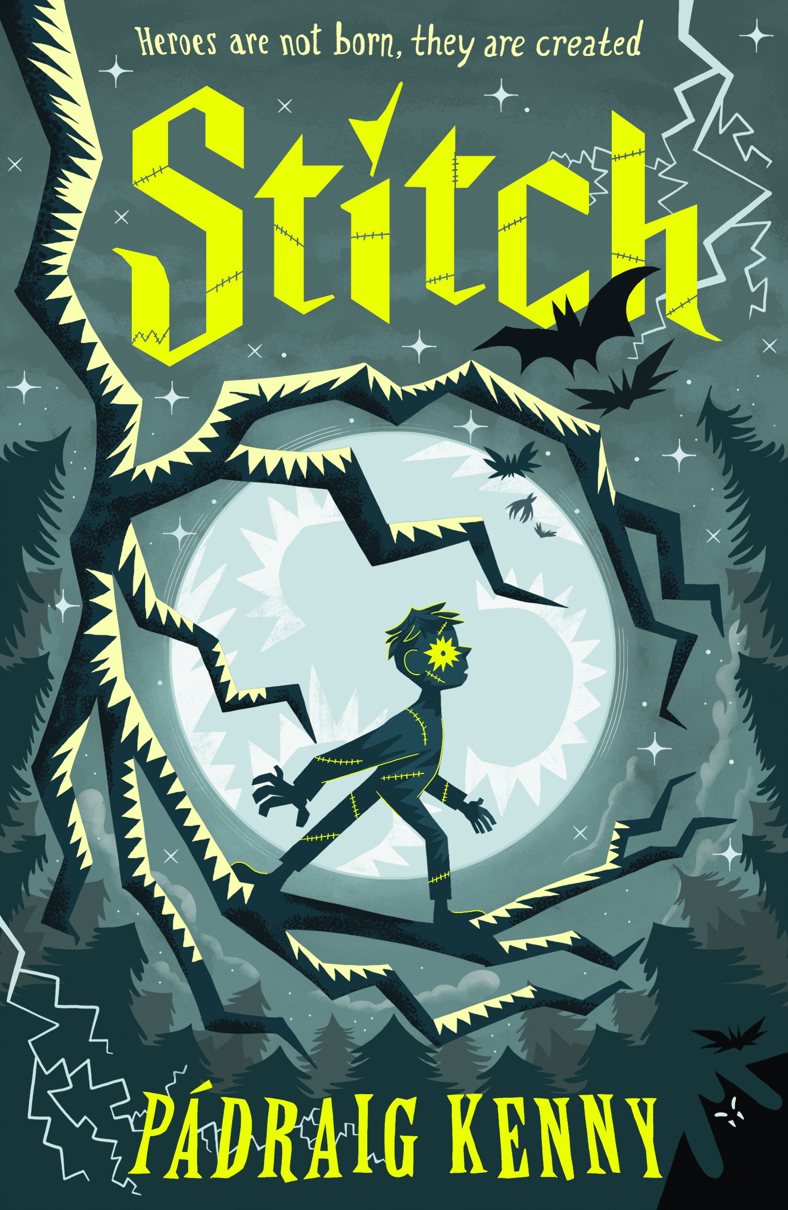
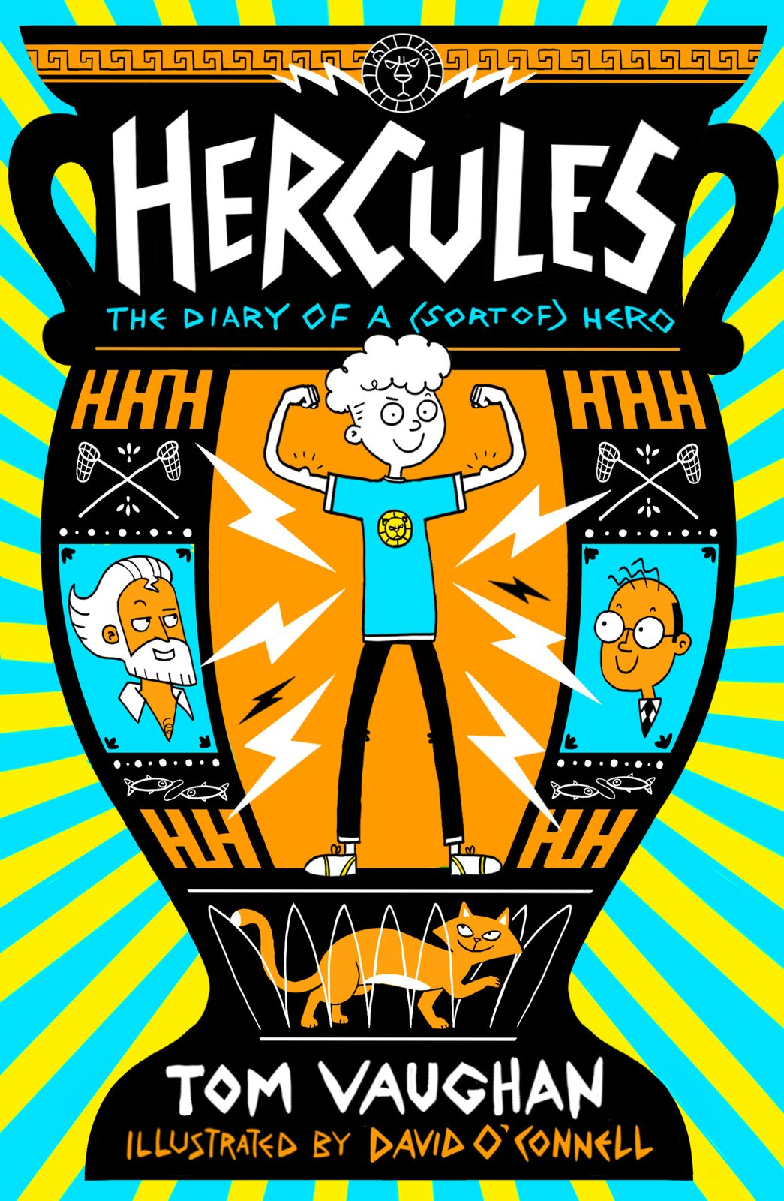
Vote for your 3 favourites
Lost on Gibbon Island
By Jess Butterworth
Nina Peanut is amazing By Sarah Bowie
Reek
By Alastair Chisholm
Stitch
By Padraig Kenny
Hercules: the diary of a (sort of) hero
By Tom Vaughan

Slide 2
Next steps …
Well done for voting for your top 3 Our Best Book books!
Teachers submit your school’s overall top 3 votes using this link by Friday 23rd May 2025: Our Best Book short list vote
Teachers complete your school’s evaluation using this link: Our Best Book 2025 teacher evaluation form
All participating schools’ votes will be added up to select the winning book.
Wednesday 4th June the Our Best Book winner will be announced!

