Slide 1
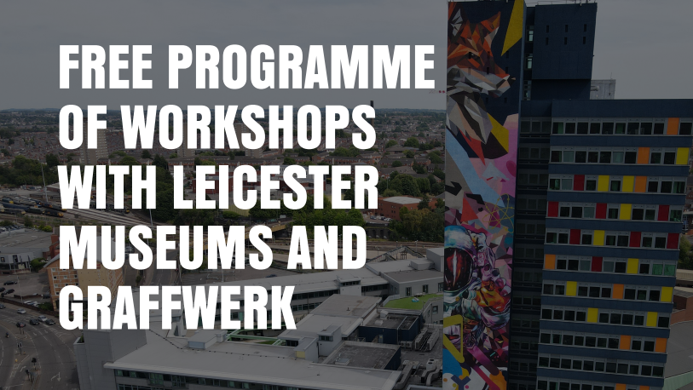


Slide 2

Leicester Arts & Museums and Graffwerk have an exciting opportunity for young people aged 13-19 years who are currently excluded or at risk of exclusion from formal education
We are offering a programme of 10 workshops over five weeks on Tuesdays and Thursdays during the second half of the autumn term.
This programme will run from 31st October – 30th November 2023, 10am-3pm.
The project aims to improve students' attitude and engagement with formal education and will support participants to achieve a Bronze Arts Award (GCSE level).
Each session will include different challenges, skills, and activities, all focusing
on the outcomes of improved engagement at school.

Slide 3
Street Art workshop content & aims overview:
Sessions will include:
Create a friendly and inclusive atmosphere of community and trust.
Street art walking tour
Street art techniques and skills
Theme exploration & expression
Zine making
Street artist guest speaker
Plan and install an arts exhibition, including marketing
Complete Arts Award
Aim – young people will have developed or achieved these key skills:​
Project management​
Working independently
Working as part of a group
Exhibition curation​
Marketing
Arts Award bronze certification

Slide 4
For more information:
Manjit Garcha
Learning Officer
Leicester Museums & Galleries
Manjit.garcha@leicester.gov.uk
0116 454 4574

