Slide 3
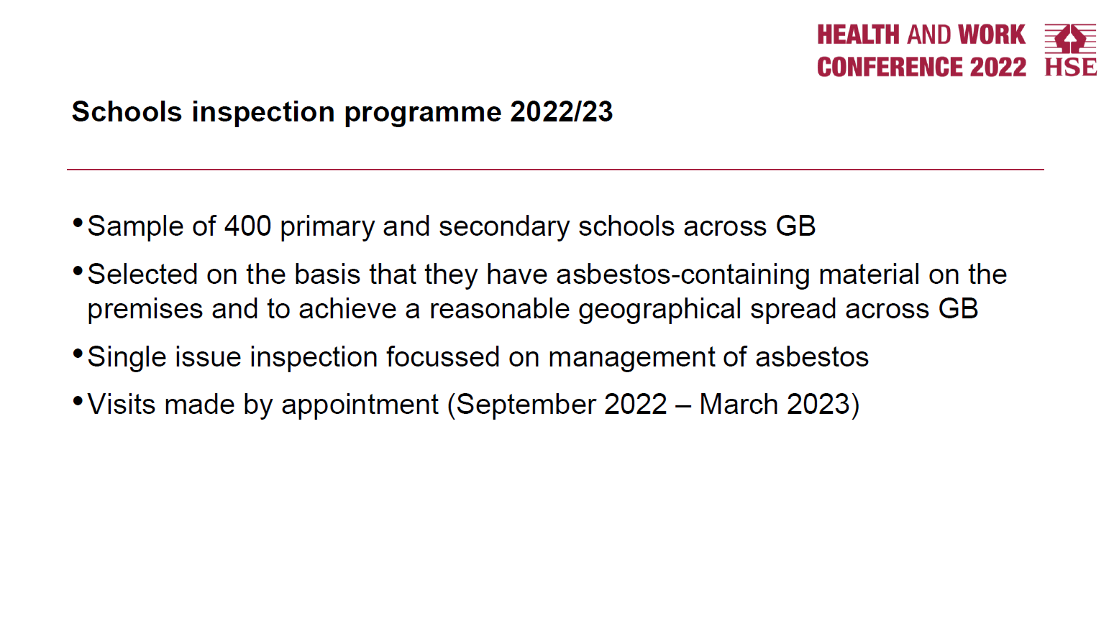

Slide 6
Confirm that there is a copy of the Asbestos Survey/Register on site and readily accessible Confirm that all relevant employees have been made aware of asbestos management issues i.e. the location of the Register and the asbestos locations on site Confirm that the Asbestos Register and any relevant locations are brought to the attention of all contractors / other employees who carry out work on the premises, before work begins. Confirm that relevant staff (i.e. monitoring officers) have attended Asbestos Awareness training Confirm that the condition of all asbestos containing materials are checked every 3 months and monitoring forms returned to the Corporate Asbestos Coordinator/Regulatory Compliance Officer Confirm that the Asbestos Survey/Register has been updated following significant changes i.e. asbestos removal, newly identified suspected asbestos
Audit Questions

Slide 7
Audit Findings 2021/2022

