Slide 1


Christmas Jumper
Swap Shop 2022

Slide 2

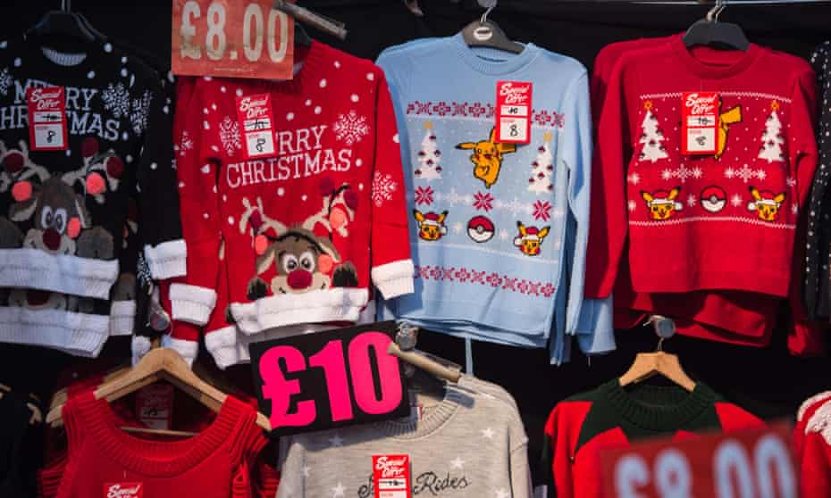
Did you know…?
There are more than 65 million Christmas jumpers in UK homes.
Over 12 million are sold every year!
Many are only worn once.
Nearly all Christmas jumpers contain plastic.

Slide 3
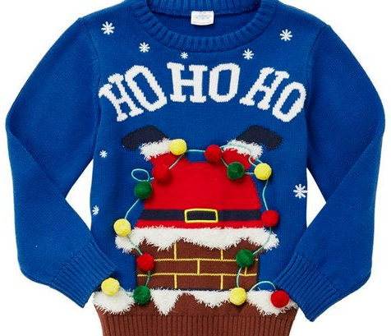


Why is this important?
Christmas jumpers are an example of ‘fast fashion’.
Many are so cheap people throw them away after wearing once.
The environmental impact is huge which needs to be hugely reduced.

Slide 4
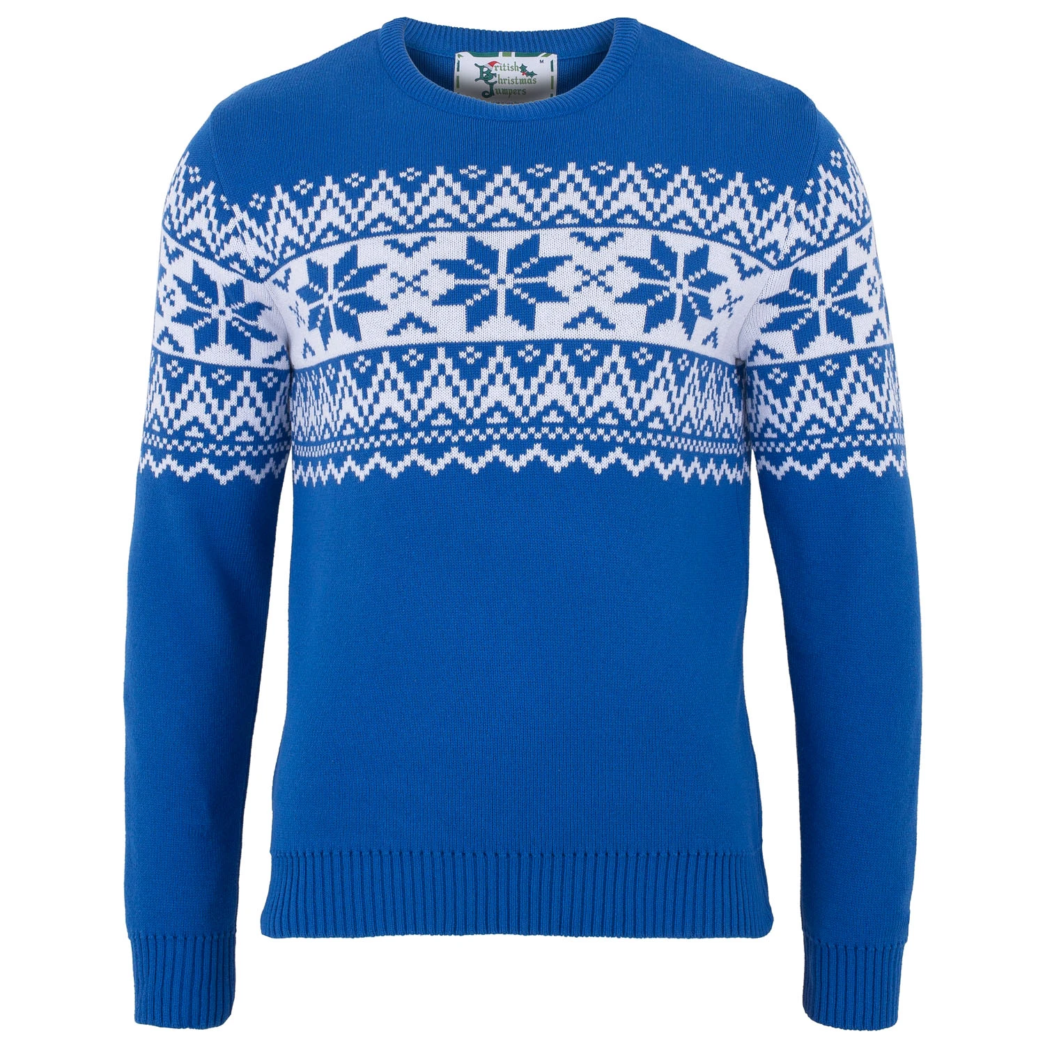
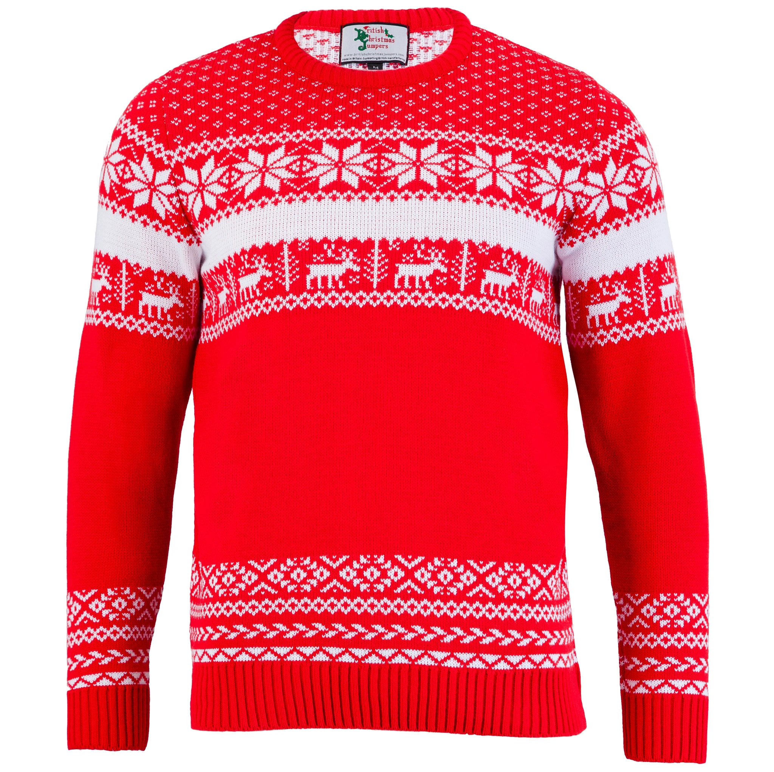

This year we are doing something different at school…

Slide 5
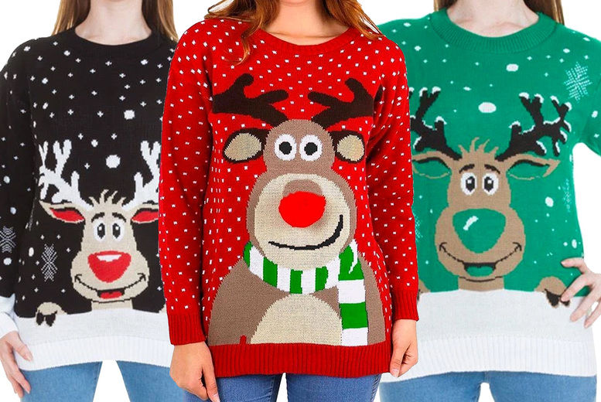
A Christmas Jumper
Swap Shop….

Slide 6
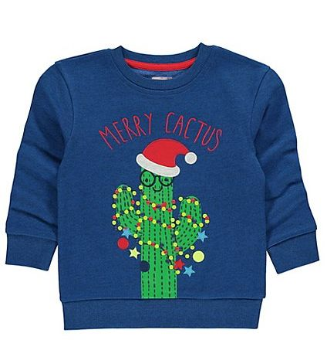
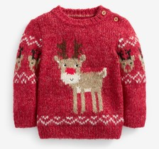
Step 1…..
On these dates you can bring a clean Christmas jumper to this room
You will be given a ticket which entitles you to a donated jumper (keep this ticket safe - it’s important!)
Wednesday 1 December
Thursday 2 December
Friday 3 December

Slide 7
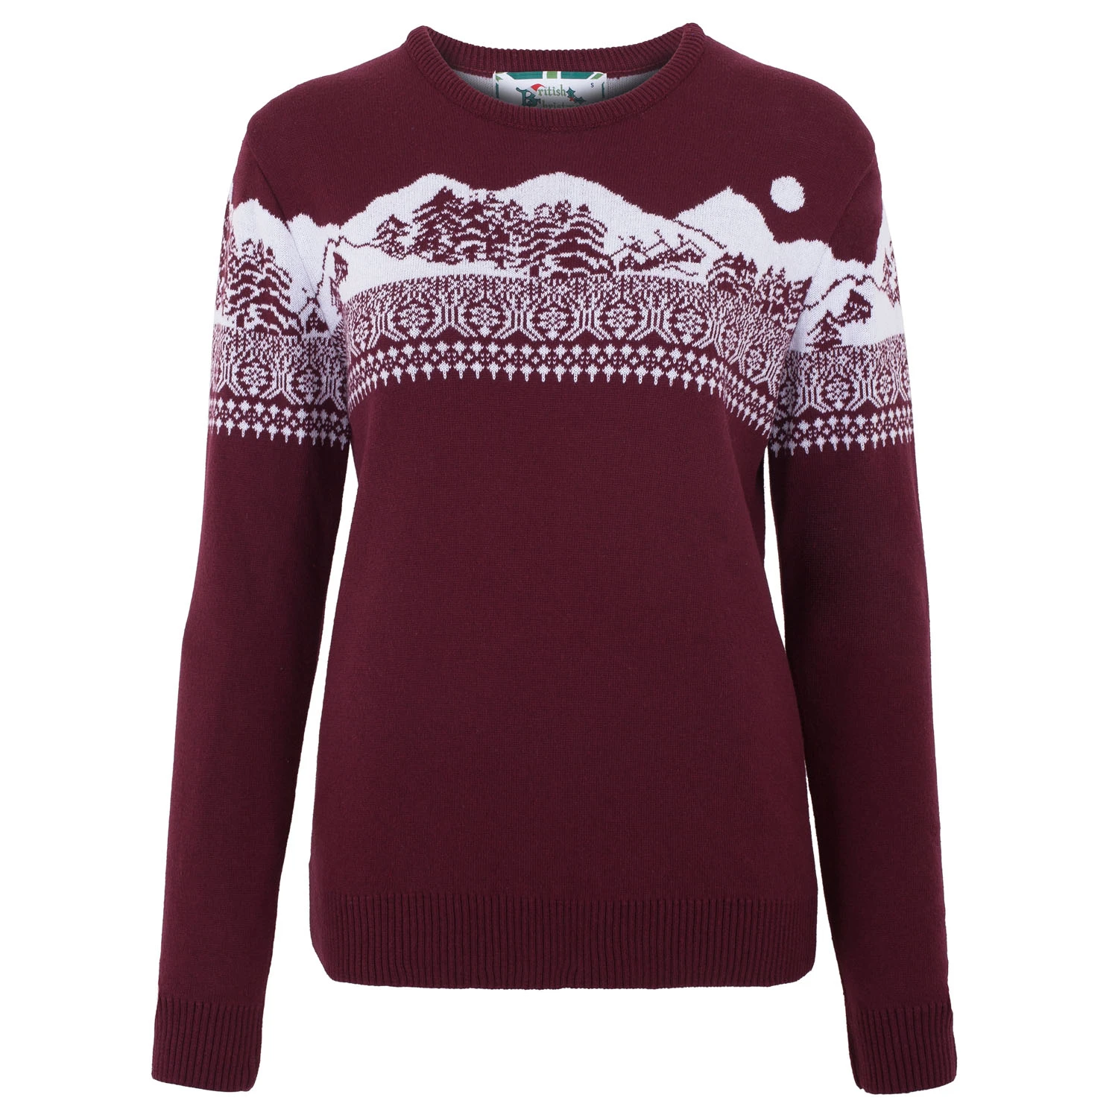
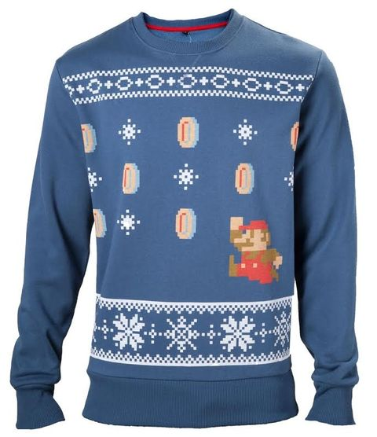
Step 2…..
On these dates, bring your ticket to…. where you will be able to select a donated jumper…
Wednesday 8 December
Thursday 9 December
Friday 10 December

Slide 8
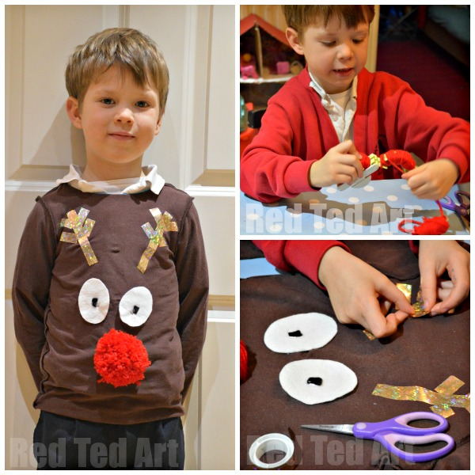
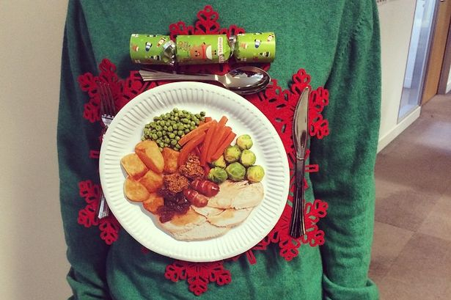
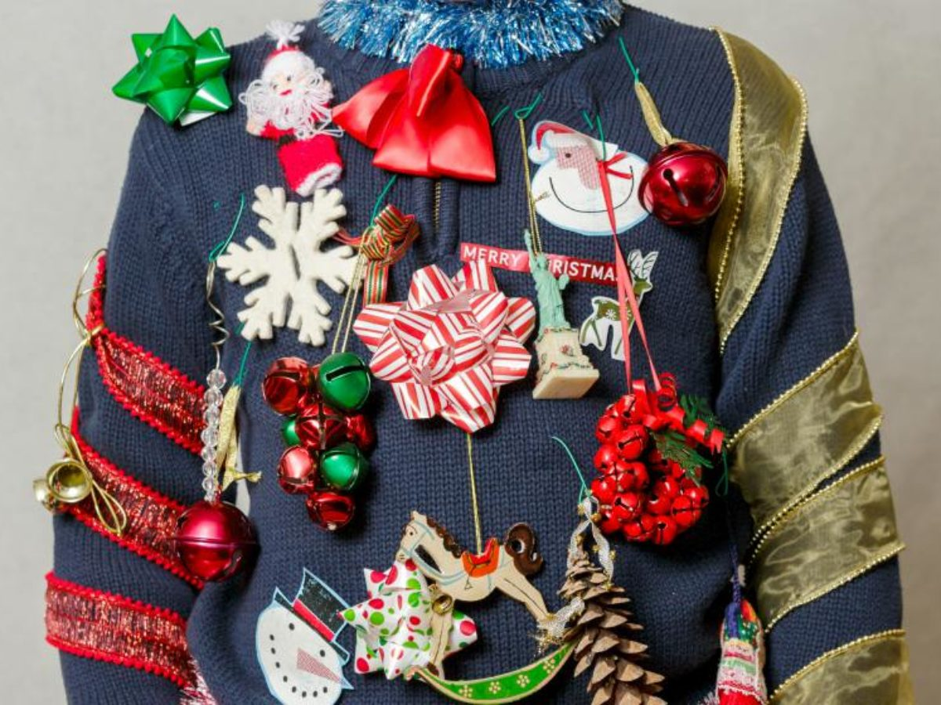
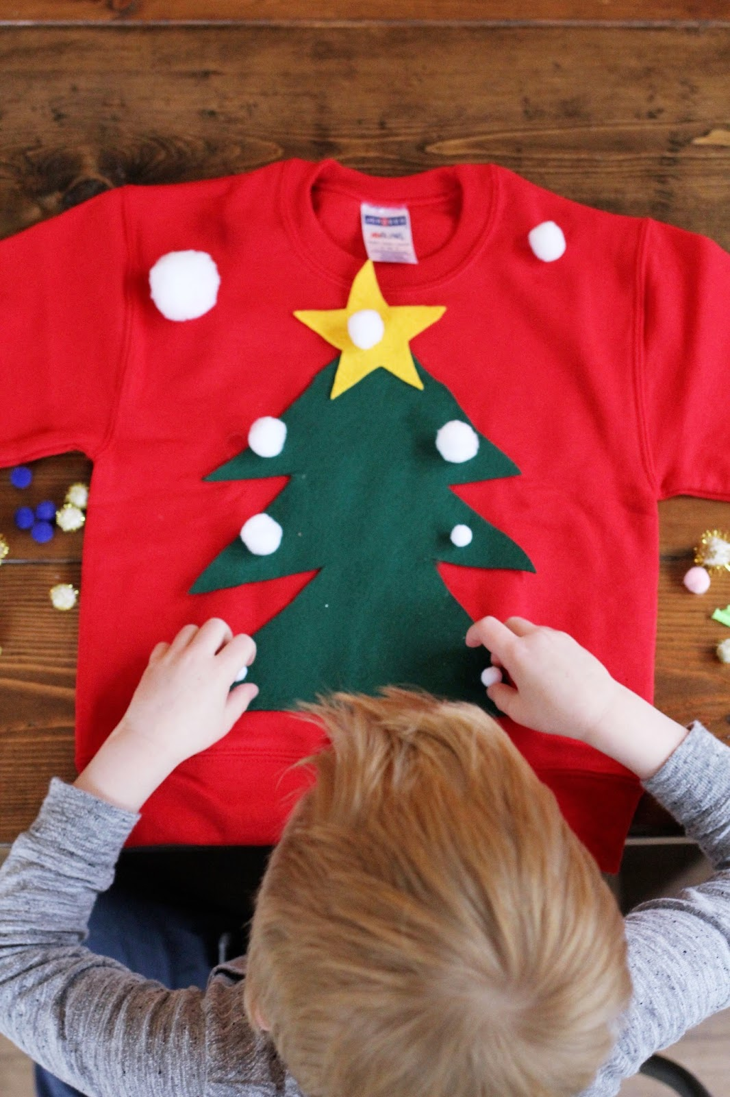
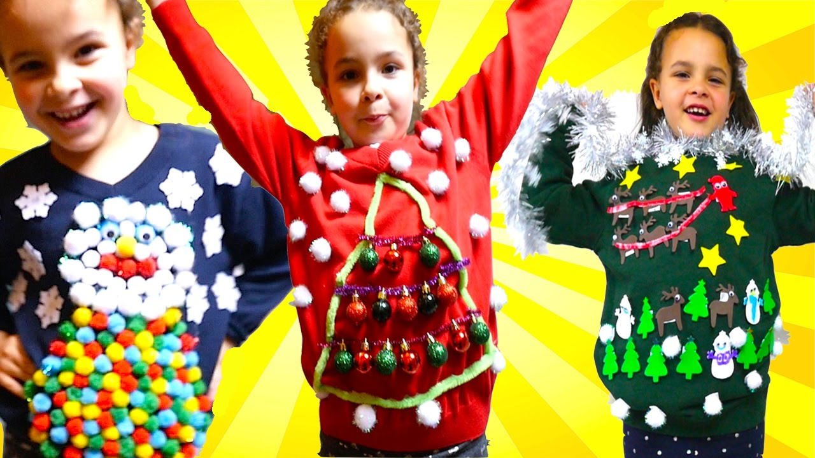
If you don’t have an old Christmas jumper…
We will be having a ‘make your own’ Christmas jumper session in school.
On Monday 11 December – bring in an old jumper
which can be decorated.

Slide 9
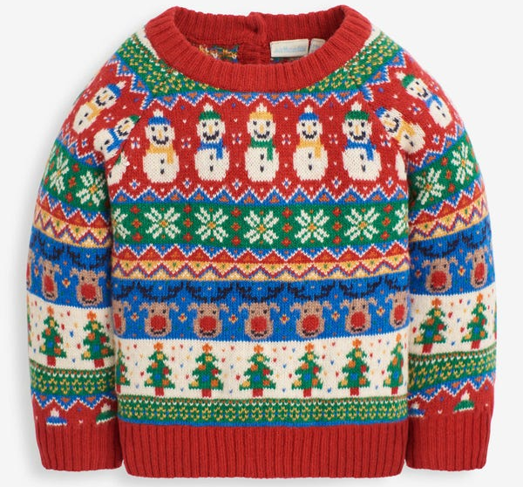
What you need to do next…
Find an old Christmas jumper at home.
Bring in on our donation days – you can also
donate extra jumpers.
Keep your ticket safe.
Collect a donated jumper the week after.
Bring in an old jumper to decorate for Christmas.

