Slide 1






Christmas Jumper
Swap Shop 2022
Guide for school staff
There are more than 65 million Christmas jumpers in UK homes. Over 12 million are sold every year! Many are only worn once. Nearly all Christmas jumpers contain plastic.
Aim of campaign
To reduce the amount of new jumpers bought specifically for Christmas jumper day and reduce the amount of clothing waste as staff and pupils will keep for next year.
Costs
Minimal.
Requirements
Assembly and posters to present in mid-late November 2022.
Space to store jumpers, OPTIONAL: clothes rails and clothes hangers
OPTIONAL: spare jumpers donated.
Tickets for donations (template attached).
Time to arrange in school.
Step 1
Publicise via assembly (template provided), posters (see below) and tutor/class time. Publicise drop off dates and collection dates.
Step 2
Host a drop off area on agreed date/s.
Hand out tickets (numbered), template attached, in exchange for a donation of a jumper (additional jumpers can be accepted). Keep a list of students that have donated – in case they lose tickets!
Step 3
A few days later, arrange a collection date/s (this could be bringing classes/year groups, one at a time or during break/lunch depending on numbers donated.
Step 4
Publicise how many jumpers have saved through the swap shop. Donate any left over jumpers or keep for next year’s swap shop.
Step 5
OPTIONAL: participate in the ‘make your own’ Christmas jumper session.
We’d love to hear how you get on. Get in touch via:
SustainableSchools@Leicester.gov.uk

Slide 2
Christmas Jumper
Swap Shop 2022
Christmas Jumper
Swap Shop 2022
Number:
Date:
Your name:
Number:
Date:
Your name:
Keep this ticket safe – you need it to
collect a donated jumper.
Keep this ticket safe – you need it to
collect a donated jumper.
Christmas Jumper
Swap Shop 2022
Christmas Jumper
Swap Shop 2022
Number:
Date:
Your name:
Number:
Date:
Your name:
Keep this ticket safe – you need it to
collect a donated jumper.
Keep this ticket safe – you need it to
collect a donated jumper.
Christmas Jumper
Swap Shop 2022
Christmas Jumper
Swap Shop 2022
Number:
Date:
Your name:
Number:
Date:
Your name:
Keep this ticket safe – you need it to
collect a donated jumper.
Keep this ticket safe – you need it to
collect a donated jumper.

Slide 3
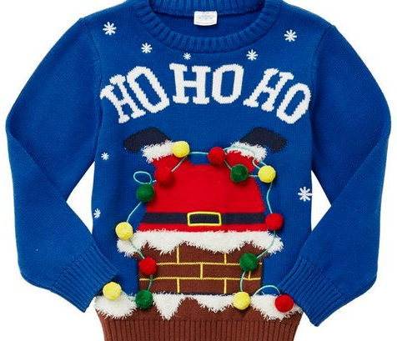
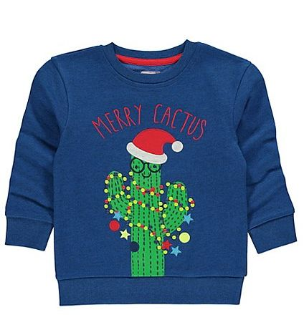
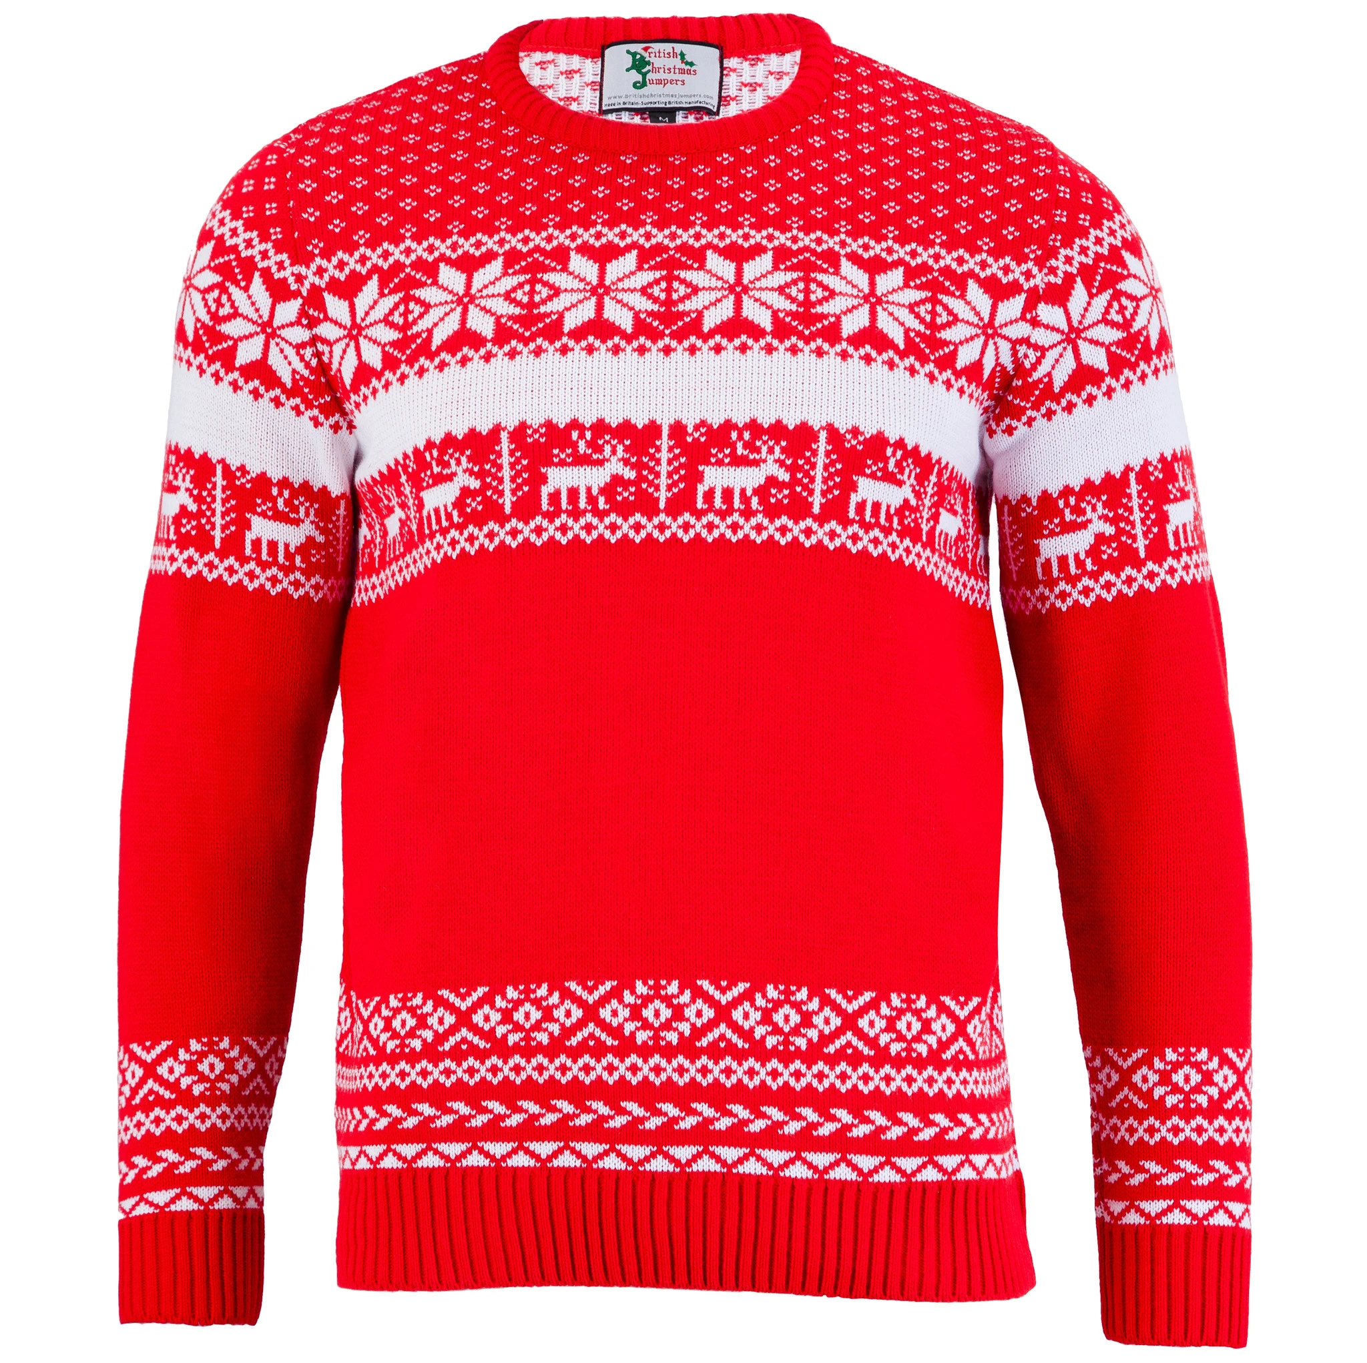
Christmas Jumper
Swap Shop 2022
Reduce waste and save money!
This year we are taking part in a swap shop for Christmas jumpers!
Step 1
On these dates you can bring a clean Christmas jumper to this room
Wednesday 1 December
Thursday 2 December
Friday 3 December
You will be given a ticket which entitles you to a donated jumper (keep this ticket safe - it’s important!)
Step 2
On these dates, bring your ticket to…. where you will be able to select a donated jumper…
Wednesday 1 December
Thursday 2 December
Friday 3 December
For more information speak to:

