Slide 1



Show the Love 2022

Slide 2
What is climate change?
Climate change is the change in conditions in a place over a period of time. This means changes to temperature and rainfall, for example.
Climate change is often called ‘global warming’ because our planet is heating up as a result of climate change.
The effects of climate change are huge:
  Rising sea levels
  Shrinking sea ice
  Changes in habitats for plants and animals
  Extreme weather
  And much more…

Slide 3
What causes climate change?
Harmful gases (called greenhouse gases) make changes to the climate.
Greenhouse gases are made by cars, trucks, aeroplanes and factories.
When these harmful gases go up into the air, they get trapped in the layer protecting the Earth from the Sun.
When the Sun shines onto the Earth, the heat is kept in by these gases. This trapped heat means the earth keeps getting hotter and hotter (global warming).
The more greenhouse gases that are produced, the more the earth will continue to heat up and the more problems we will experience.

Slide 4
Who are The Climate Coalition?
As you have just found out, climate change can be very dangerous!
The Climate Coalition is the UK’s largest group of people dedicated to action against climate change
Made up of over 140 organisations – including the National Trust, Oxfam and RSPB
Formed in 2005 (previously called Stop Climate Chaos)
Create a unified public voice sharing concerns of the nation surrounding climate change
Make sure the voice is heard by people who can make a difference in creating a cleaner, more secure future
Hold the ‘Show the Love’ campaign annually

Slide 5
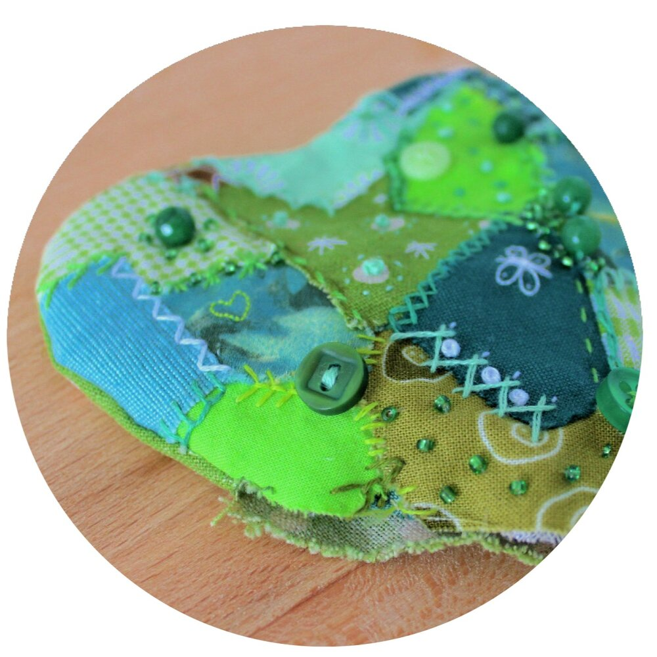
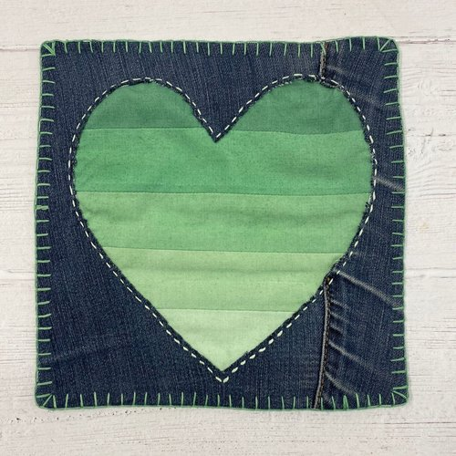

What is the Show the Love campaign?
People make green hearts and send them to their MPs to show that they want to tackle climate change and the nature crisis.
People from all over the UK are involved… schools, businesses, community groups, friends, families and many more.
Simply make a green heart and send it to your MP along with your message highlighting what changes you think should be made to help climate change. There are lots of different ways to do this!

Slide 6
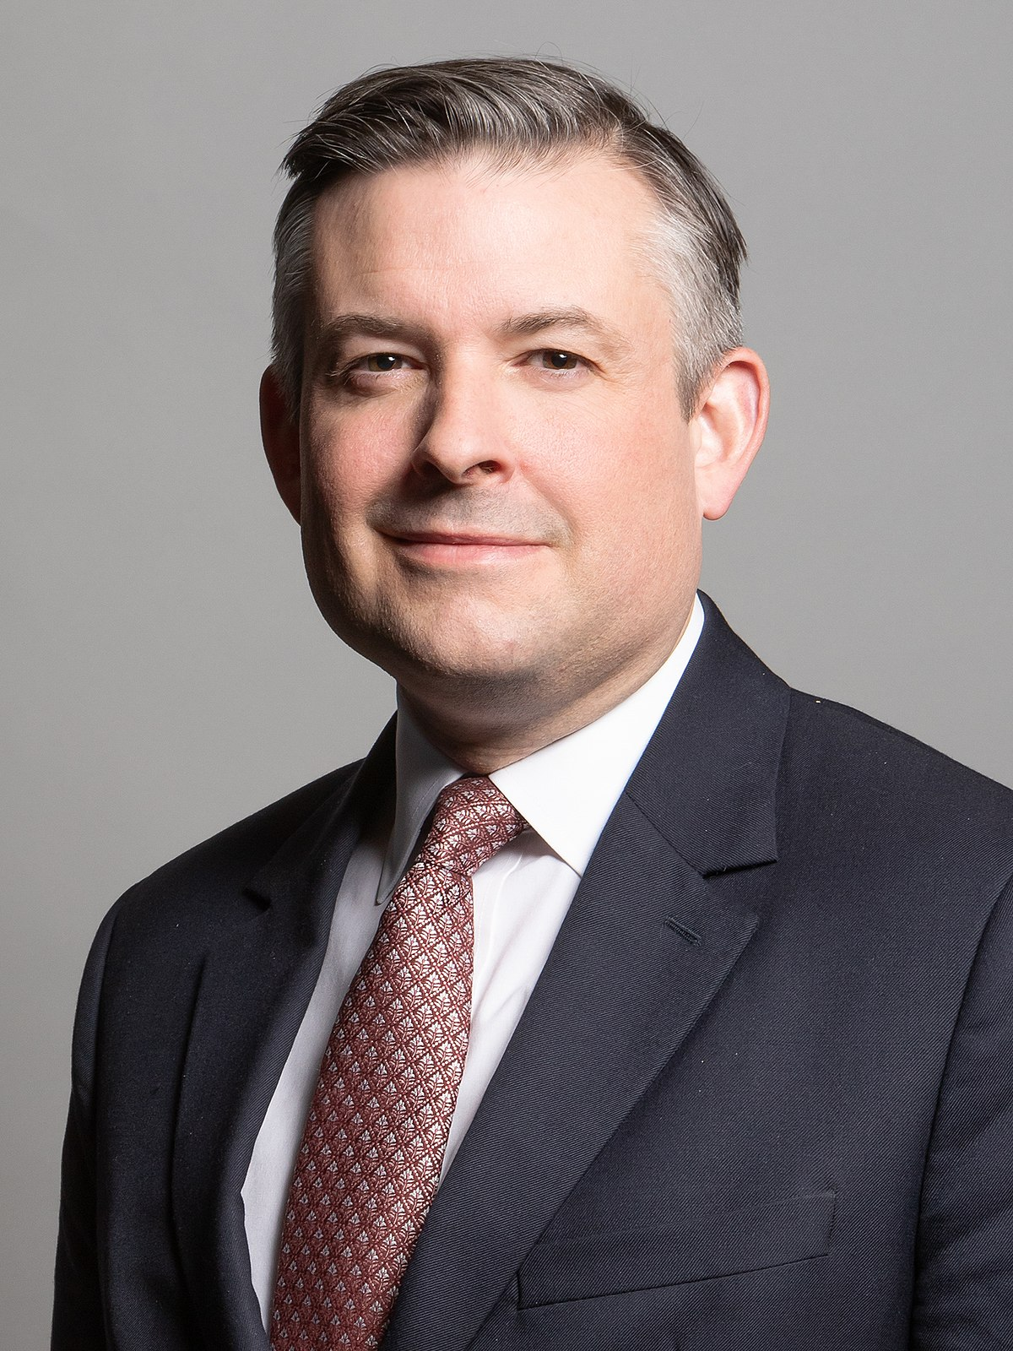
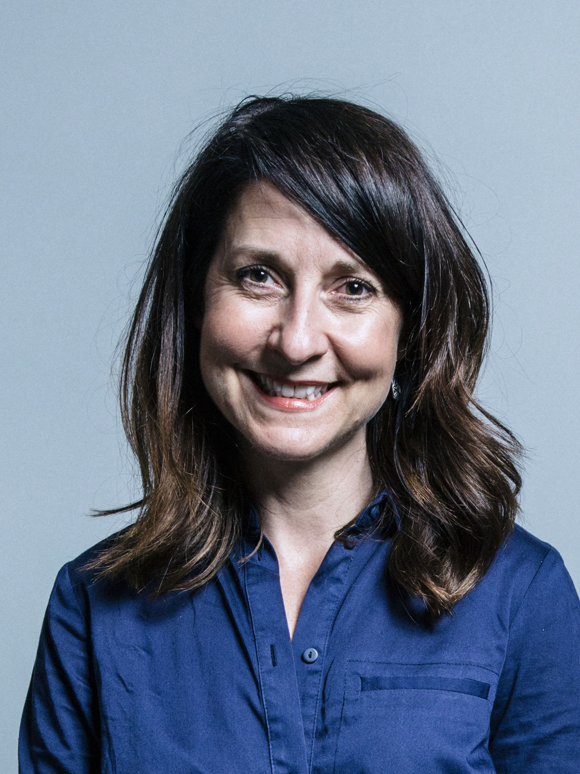
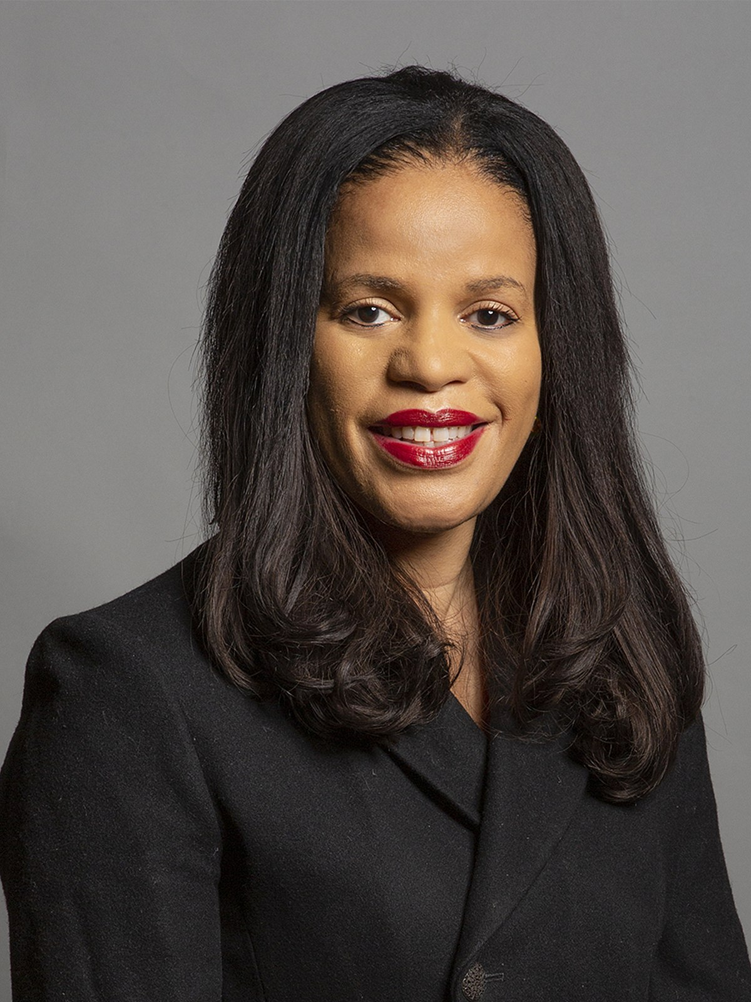
Who is your MP?
It’s really important that you know who your MP is so you can contact them about issues that are important to you (such as climate change!)
There are three MPs working in Leicester.
If you are not sure who represents you, use the following website:
Find MPs - MPs and Lords - UK Parliament
You can use this website to find your MPs address ready to send your hearts to.
Jon Ashworth MP
Leicester South
Liz Kendall MP
Leicester West
Claudia Webb MP
Leicester East

Slide 7
Some of the biggest problems for climate change in Leicester are:
Buildings
Often let out a lot of heat which we want to keep in
Waste energy which has produced harmful greenhouses gases
Transport
Most cars use petrol or diesel which produce greenhouse gases
Heavy use of personal cars in the city centre
Energy
We still get most of our energy (e.g. electricity) from fossil fuels
Fossil fuels release greenhouse gases

Slide 8
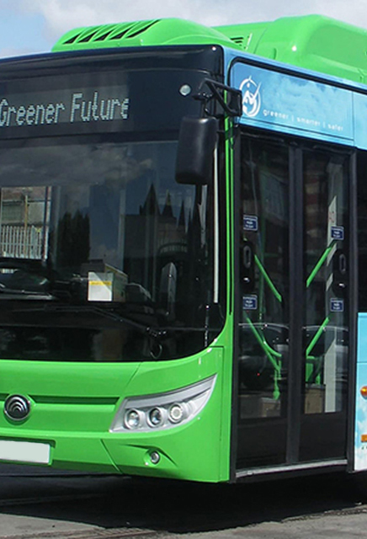
Did you know?
If you live in London, you can get free or discounted travel on public transport if you are under the age of 18!
This means that there are less cars being driven in the centre as people are able to travel for free using the bus services instead!
How do you think this would help Leicester?
What other ‘free’ forms of transport can you think of? How might these benefit people, other than through reducing carbon emissions?

Slide 9
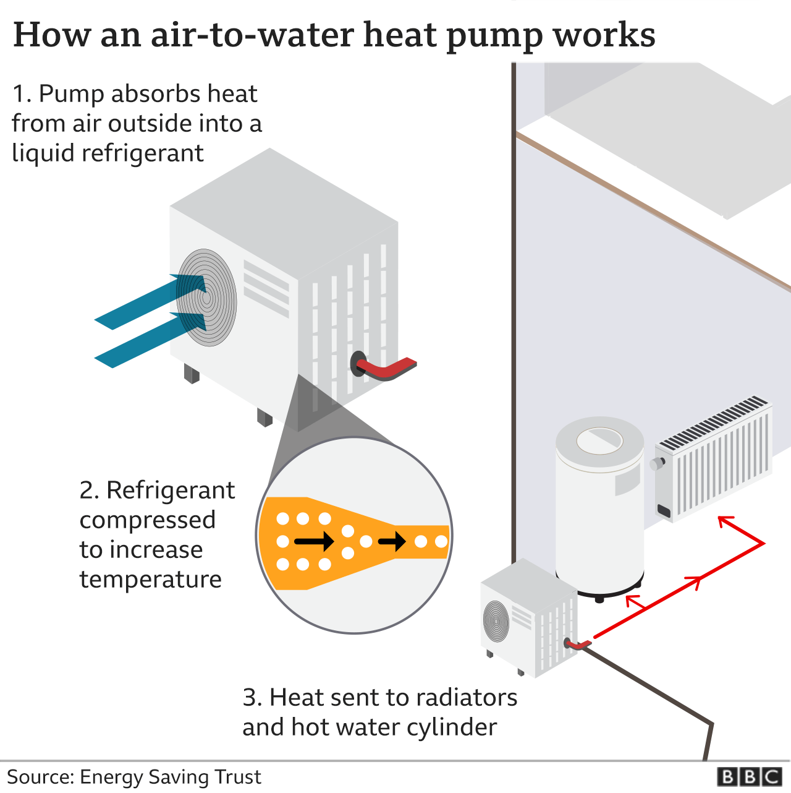
Did you know – heat pumps?
Houses end up wasting a lot of carbon emissions through poor insulation (letting the heat out) or old systems for heating the house that use fossil fuels.
There are ways to improve houses and help keep the heat in.
For example, heat pumps can be added which reduce carbon emissions by using electricity made using renewable energy.
However, this is often very expensive.
What could be done here to help the people of Leicester?

Slide 10
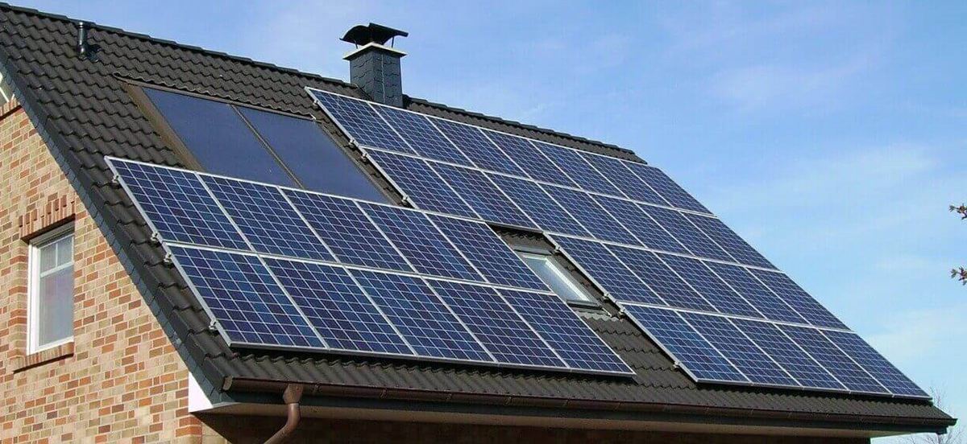
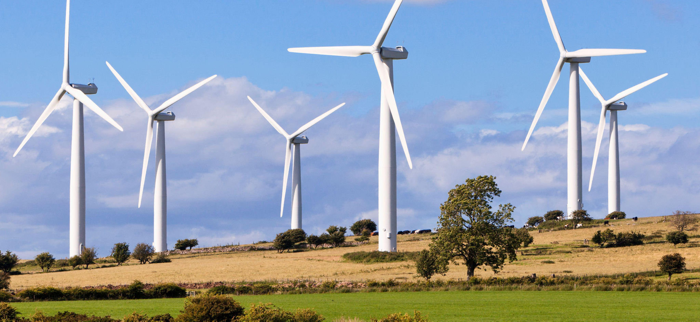
Did you know – solar panels?
There are lots of ways to make ‘renewable energy’ which all have really low carbon footprints!
Renewable sources of energy include:
  Wind
  Solar
However, we still use lots of energy from fossil fuels. Using energy from fossil fuels adds to climate change by releasing the harmful greenhouse gases.
What could we do to change this?

Slide 11



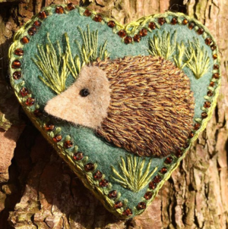

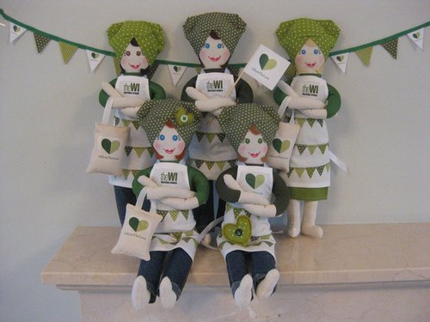
So, what could your green heart look like?

Slide 12
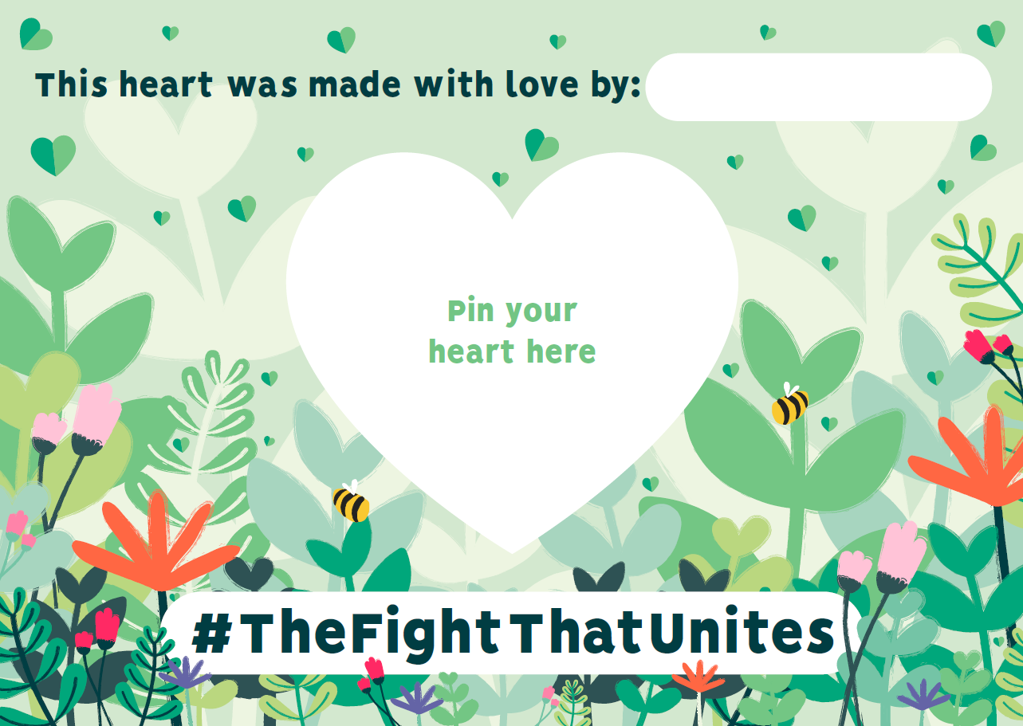
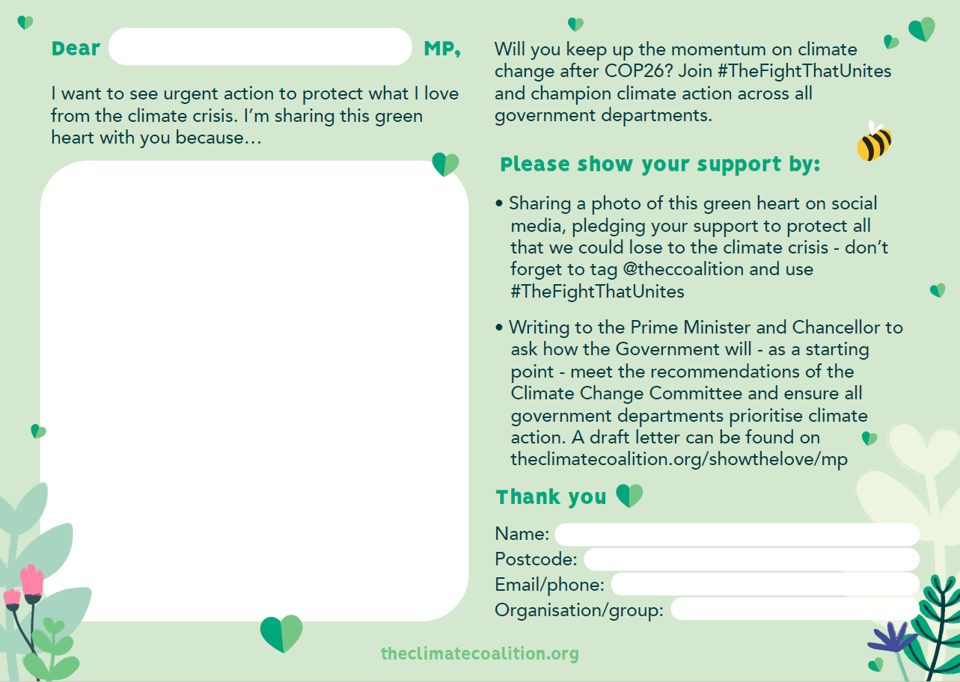
What to do with your heart next
Once you have made your heart, attach it (or a picture of it) to the postcard and write your message to your MP.
Your message should focus on what YOU think the government should do to help stop climate change (buildings, transport or energy?)
If everyone works together, the MPs will see that climate change matters to everyone and will continue to make changes to help save the world.
Let us at the Sustainable Schools team know when you send your hearts and if you get a response!

Slide 13
GET READY FOR GREEN HEARTS EVERYWHERE. FEBRUARY 2022.
Climate change doesn’t care about our differences, and that’s why people here in the UK and across the world are putting them aside and doing what we can to tackle climate change and protect what we love.
Click here see highlights from Show the Love 2021

