Slide 1






Welcome to Carbon Literacy training

Slide 2




House Keeping
Notes:
Timing to include that we may have to cut people off – a lot to cram in! Permission to capture photos.

Slide 3
Aims for today
You will feel more empowered to act on climate change, at school and in own life through
  Knowledge – understanding more
  Motivation – want to make change
  Shared ideas with others
Create actions which are
  Meaningful
  Achievable

Slide 4

Introductions
Notes:
Go around of attendees
How are you?
Hopes for the day? (two-words?)

Slide 5
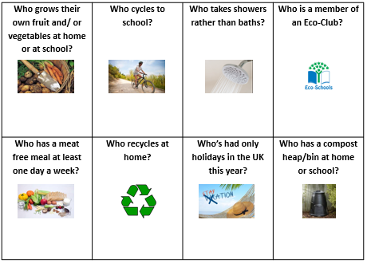
Climate Action Bingo
How many different names in the room can you find to fill your sheet?
Notes:
Shout “Bingo!” or “House!” if you get to eight. Offer a small prize!

Slide 6

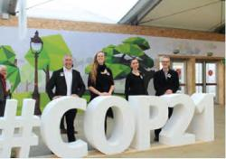
What is Carbon Literacy?
“An awareness of the carbon costs and impacts of everyday activities and the ability and motivation to reduce emissions, on an individual, community and organisational basis”
An Accredited Standard
For individuals and Organisations
Notes:
Ask the question, elicit some ideas, then share the definition used in the project.

Slide 7
What is Climate Change? – What do you know?
Climate Change

Slide 8
Summary of Training
Section 1
Section 2
Climate Change – The Facts
A Zero Carbon World
A Zero Carbon School & City
Greenhouse gases and their sources
Section 3
Communicating Climate Change
Exploring Carbon Footprints
Taking Action

Slide 9
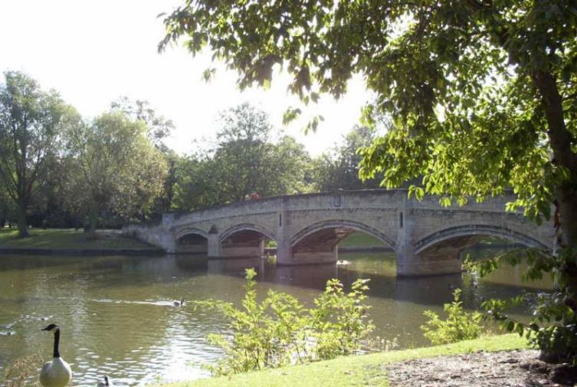

Leicester: Britain’s first Environment City
…now aiming to be a Carbon Neutral city
Notes:
Designated as first Environment City in 1990 due to track record and commitments to environmental protection. Still a key priority for the City Council, most recently through Climate Emergency Declaration in 2019 and consultation until Feb 2020. Universities will work together on climate change.

Slide 10
Greenhouse gases and their sources

Slide 11
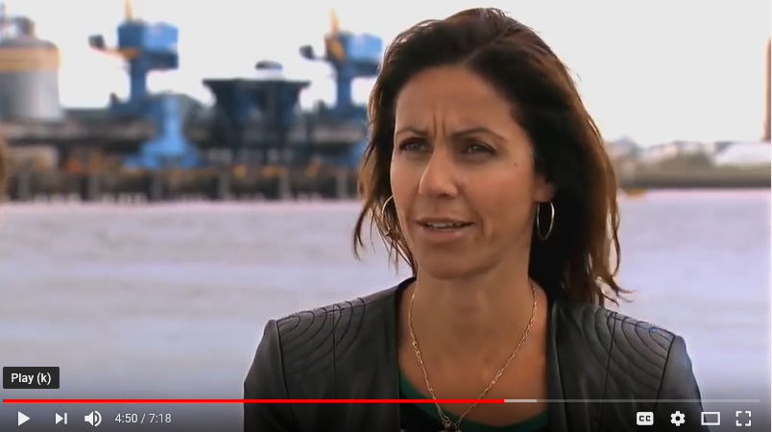
Climate Change in a nutshell…

Slide 12
Why is the Earth getting warmer?

Slide 13
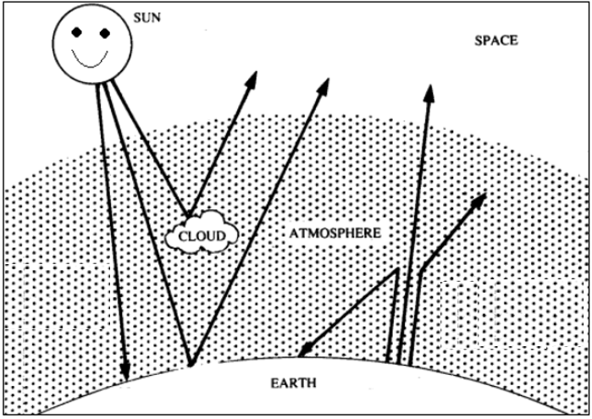
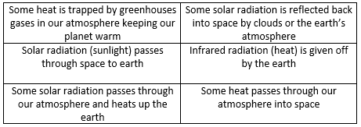
The Greenhouse Effect
Sort the statements into the order they happen
Place them where you think they go on the diagram
More greenhouse gases are being added to our atmosphere (more on this soon). What effect will this have on our planet and why?

Slide 14
The Greenhouse Effect
Some solar radiation is reflected back into space by clouds or the earth’s atmosphere
Some heat passes through our atmosphere into space
Solar radiation (sunlight) passes through space to earth
Infrared radiation (heat) is given off by the earth
Some heat is trapped by greenhouses gases in our atmosphere keeping our planet warm
Some solar radiation passes through our atmosphere and heats up the earth

Slide 15
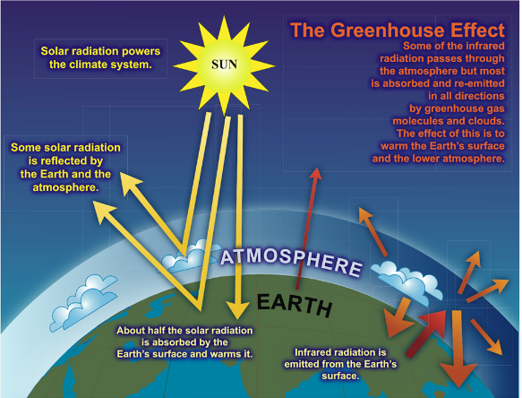
The Enhanced Greenhouse Effect
More Greenhouse Gases in our atmosphere means more heat is trapped, making the earth warmer
Just like putting an extra layer of clothes on makes you warmer

Slide 16





Greenhouse Gases and their Potency
carbon dioxide
CO₂
methane
CH₄
nitrous oxide
N₂O
F gases
(various)
1
28
265
10s-10,000s
mass x Global Warming Potential → common currency tCO₂e
Notes:
NOTE: GWPs are IPCC AR5 values

Slide 17
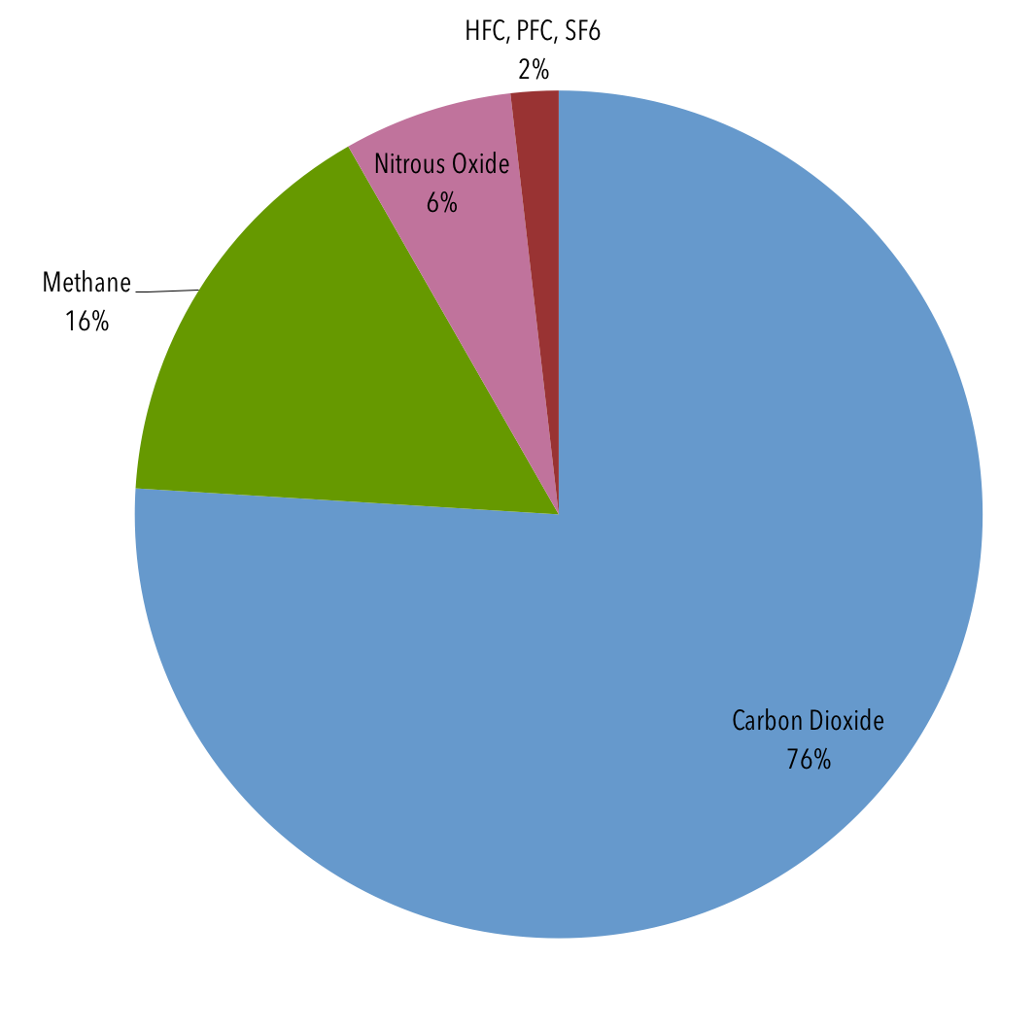
Current contribution of Greenhouse Gases (2015)
Carbon dioxide has the greatest contribution at present
Methane second largest
Notes:
Data from IPCC AR5

Slide 18
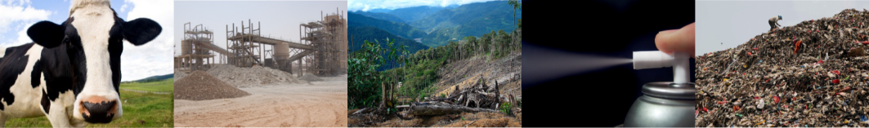
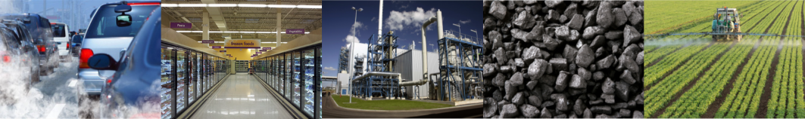
Which activity releases which GHG?
Match the greenhouse gases with their sources!

Slide 19
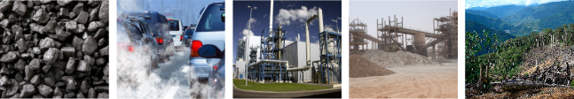

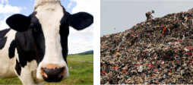
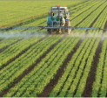

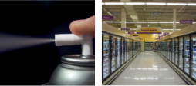
Summary
CO₂
CH₄
N₂O
F
gases

Slide 20
Carbon Footprints
Notes:
Scope 2: 7,766tns (10.5%)
Scope 3: 61,242tns (82.5%)
Energy, Procurement etc
As part of this could go through the University’s Thermal Comfort Policy
Include:
The Approved Code of Practice suggests that the minimum temperature in a workplace should normally be at least 16°C. There is no maximum temperature stated in the Regulations or associated Code of Practice.
In the heating season (October – April), the University aims to achieve 21°C (+/- 2 °C) in all work areas.
Research has shown that on average, reducing a thermostat by one degree saves 10% energy use https://assets.publishing.service.gov.uk/government/uploads/system/uploads/attachment_data/file/128720/6923-how-much-energy-could-be-saved-by-making-small-cha.pdf
Potential workplace action/pledge?

Slide 21

What is a Carbon Footprint?
A measure of the amount of greenhouse gases released to the atmosphere as a result of our activities.
We can calculate the carbon footprint of anything – countries, cities, organisations, individuals, projects, products…

Slide 22
International Carbon Footprints & Vulnerability to Climate Change

Slide 23
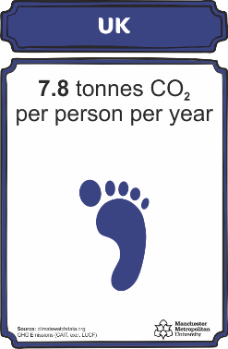
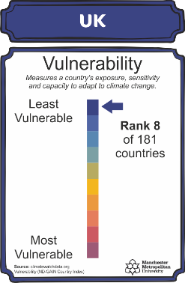
International footprints & vulnerability
Production based footprints
Line up from the countries from the one with the highest footprint to the one with the lowest footprint
Data freely available from cait.wri.org & www.climatewatchdata.org

Slide 24
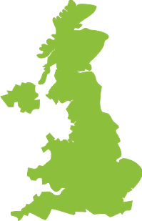
National Carbon Footprints
Production Based
Consumption Based
GHG emissions within national boundaries
Accounts for the balance of trade
-
Exports
+
Imports
UK: 13.2 Tonnes
UK: 7.8 Tonnes

Slide 25
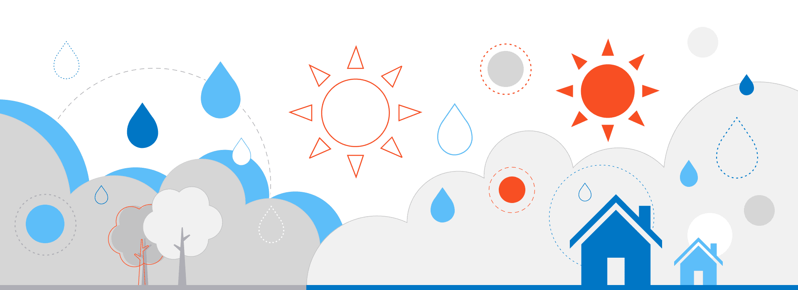
Climate Change and Leicester
What will climate change look like near me?

Slide 26
Climate Change and Leicester
As the world warms, the UK is likely to have hotter, drier summers and warmer, wetter winters, according to the Met Office.
Extreme weather events such as heatwaves and heavy downpours could become more frequent and more intense.

Slide 27
Climate Change and Leicester
Agriculture
  Wet winters prevent plants from developing healthy roots and a hot dry summer stunts their growth.
  The Met Office projects rainy winters, which keep the soil wet into spring, and dry summers of infrequent rainfall will become the norm.
Floods
  Summer rain is likely to become less frequent but could be heavier. Without regular rainfall, the ground has a harder time absorbing water when it finally does come, leading to a greater risk of flash flooding.
  Floods will likely become a staple of warming winters as well.

Slide 28
Climate Change and Leicester
Images of flooding

Slide 29
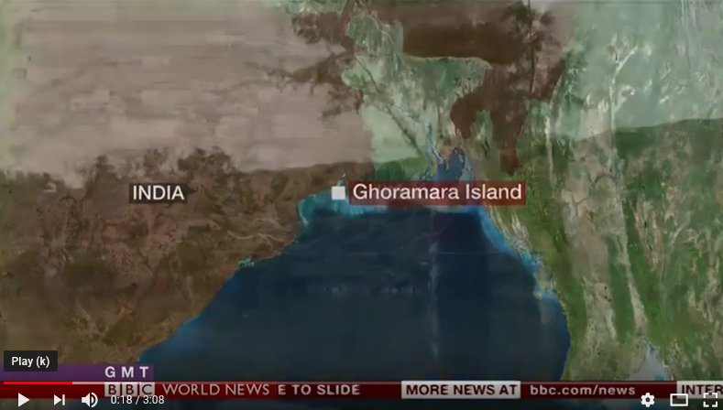
The impact of Climate Change how do we respond?

Slide 30
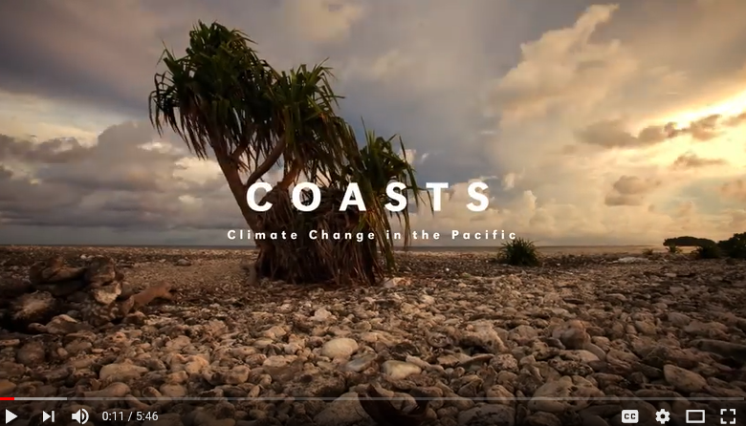
The impact of Climate Change how do we respond?

Slide 31
BREAK

Slide 32
Your Footprint
Try to calculate your own footprint – and check out the top tips for how to reduce it. Record your answers on the worksheet
https://footprint.wwf.org.uk
Other calculators offering more detail:
https://www.carbon-cap.com/climate-solutions-/carbon-footprint-calculator
https://www.resurgence.org/resources/carbon-calculator.html

Slide 33
Visualising the UK consumption based footprint

Slide 34


Visualising Carbon
1 tonne of CO₂
would fill up
5 double decker buses
=
1 tonne
CO₂

Slide 35
Average UK Footprint (13.2 tCO₂e)
Notes:
How does that break down? 1 minute at tables

Slide 36
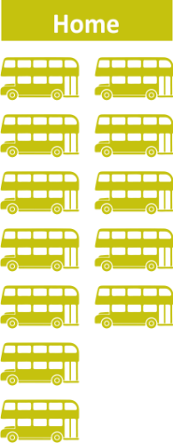
Average UK Footprint (13.2 tCO₂e)
2.4 t
Notes:
12 buses
2.4 t

Slide 37
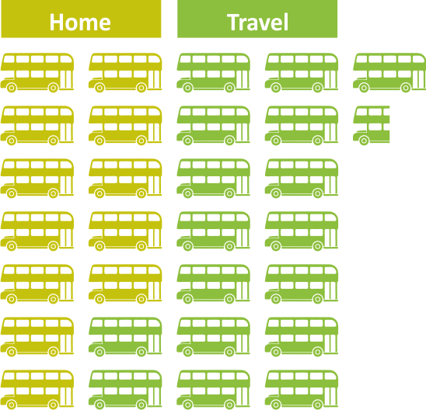
Average UK Footprint (13.2 tCO₂e)
3.5 t
Notes:
Travel
17.5 buses
3.5 t
Fuel in cars (1.4 t / 7 buses),
the carbon embodied in our cars (0.5 t / 2.5 buses),
public transport (0.5 t / 2.5 buses)
flying (1.1 t / 5.5 buses).

Slide 38
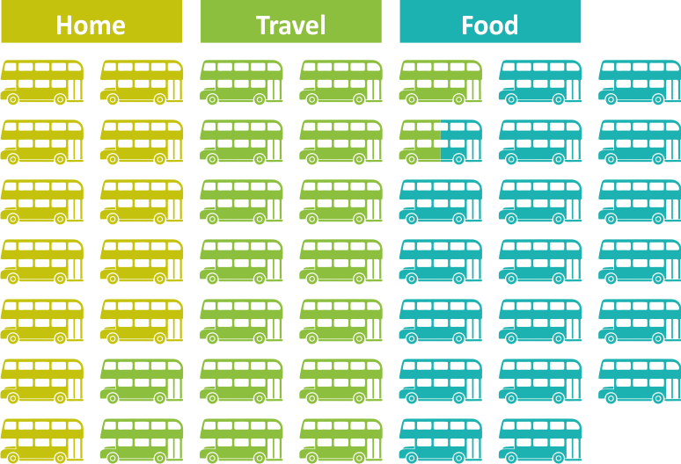
Average UK Footprint (13.2 tCO₂e)
3.7 t
Notes:
FOOD, DRINK & HOTELS: 3.7 t or 18.5 buses.
This includes our diet (3.2 t / 16 buses)
eating out / staying in hotels (0.5 t / 2.5 buses)

Slide 39
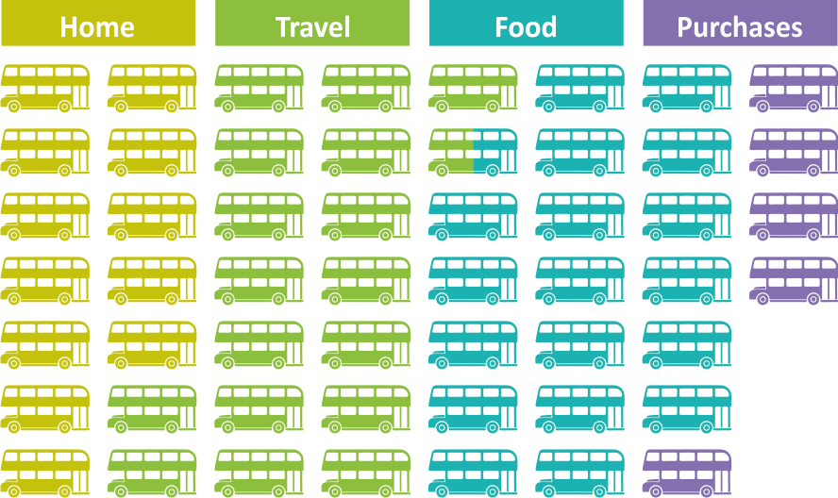
Average UK Footprint (13.2 tCO₂e)
1 t (Goods)
Notes:
SHOPPING & OTHER PURCHASES: All the other things we buy – the physical items (things you can touch) = 1 t or 5 buses.

Slide 40
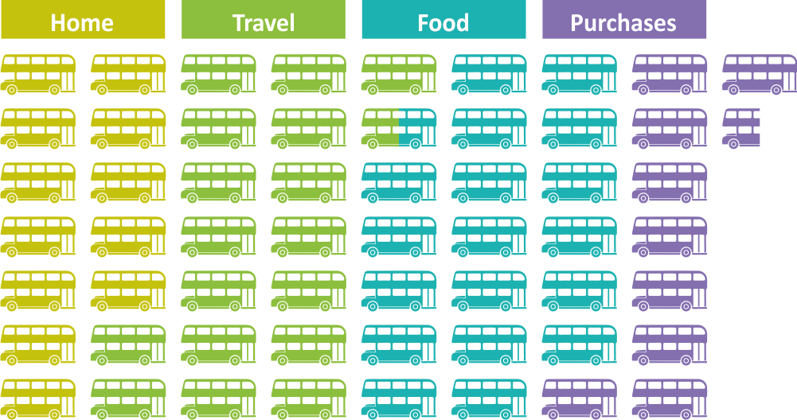
Average UK Footprint (13.2 tCO₂e)
1.9 t (Goods & Services)
Notes:
When we add in all the services we pay for (e.g. internet, banking, etc etc) this is another 0.9 t or 4.5 buses.

Slide 41
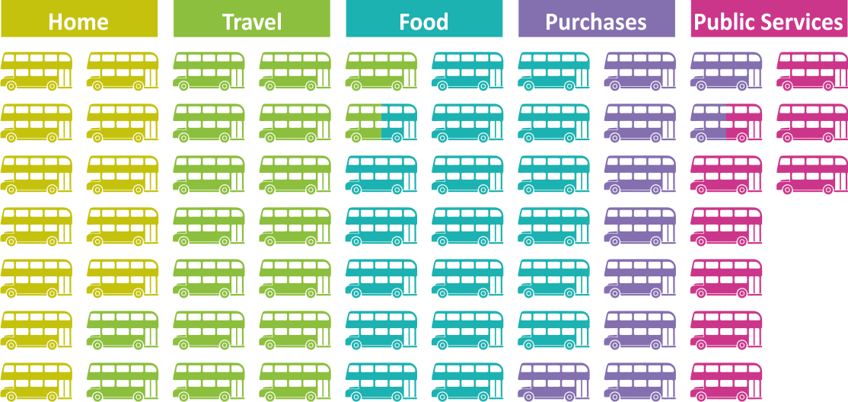
Average UK Footprint (13.2 tCO₂e)
1.7 t
Notes:
Finally – CONSTRUCTION AND PUBLIC SERVICES (e.g. government, schools, NHS etc etc) accounts for 1.7t or 8.5 buses.

Slide 42
Average UK Footprint (13.2 tCO₂e)
2.4 t / 18.2%
3.5 t / 26.5%
3.7 t / 28.0%
1.9 t / 14.4%
1.7 t / 12.9%
Notes:
Finally – CONSTRUCTION AND PUBLIC SERVICES (e.g. government, schools, NHS etc etc) accounts for 1.7t or 8.5 buses.

Slide 43
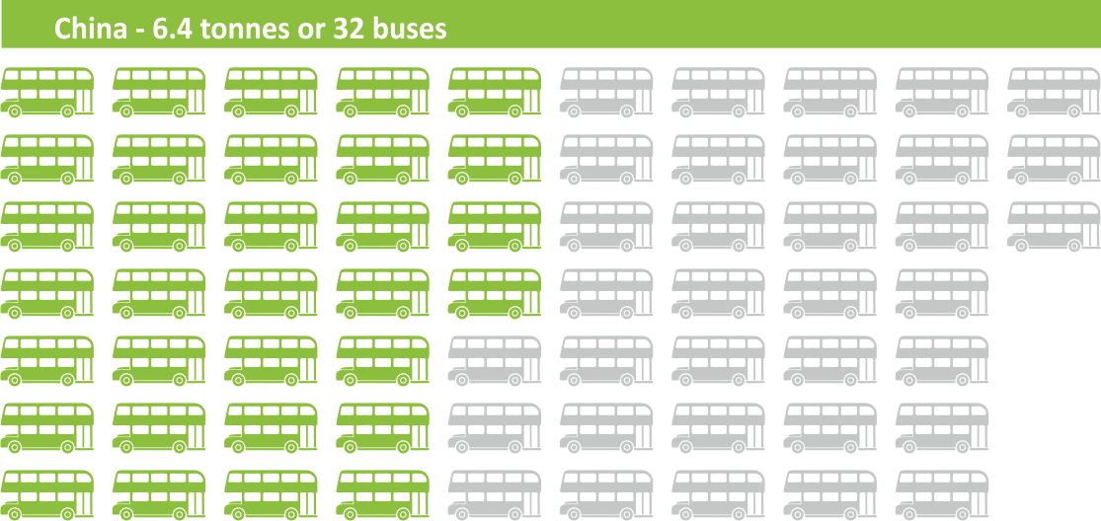
Comparing consumption based footprints
China 6.4: UK 13.2 tCO₂e (2.1x)
China’s production based = 8.7 tCO2e
Notes:
China’s production based = 8.7 tCO2e

Slide 44
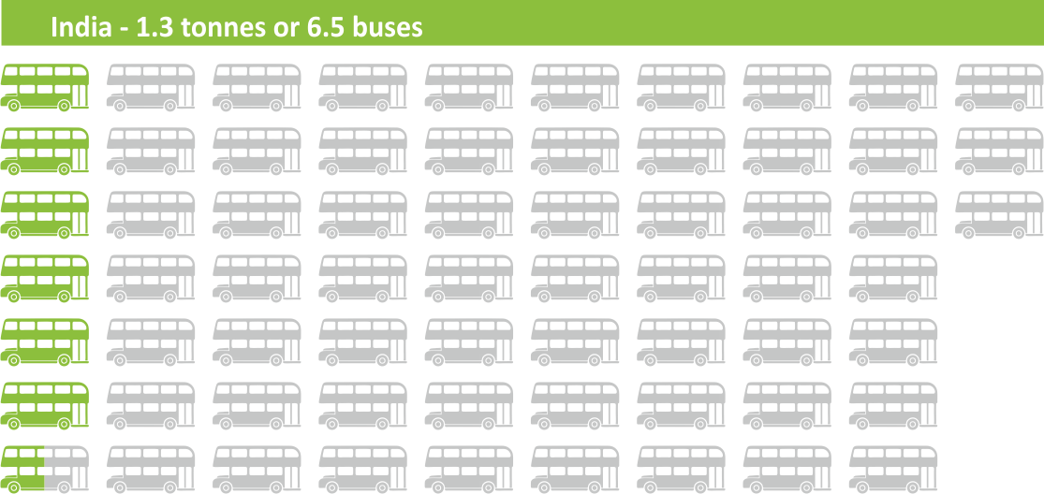
Comparing consumption based footprints
India 1.3: UK 13.2 tCO₂e (10.2x)
India’s production based = 2.4 tCO2e
Notes:
India’s production based = 2.4

Slide 45
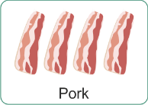

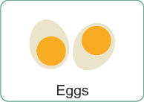
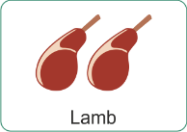




The Carbon Footprint of Food
Put the food protein cards in order from the one with the highest footprint to the one with the lowest…(full life cycle emissions)

Slide 46
The Carbon Footprint of Food
Put the food protein cards in order from the one with the highest footprint to the one with the lowest…(full life cycle emissions)
10.5 kg
5.6 kg
2.3 kg
1.7 kg
1.5 kg
0.6 kg
0.3 kg
0.2 kg
Data Source: Poore & Nemecek 2018 (Conversion to footprint per protein portion size & graphics - R Dunk)
Notes:
University of Oxford researcher Joseph Poore, and Thomas Nemecek of the Agroecology and Environment Research Division in Zurich, Switzerland, looked at the environmental impact of 40 major food products that represent the vast majority of what is eaten globally.
For this story, these were converted to impact per serving sizes based on serving sizes from the British Dietetic Association (BDA) and healthy diet portion sizes from BUPA.
The figures for serving sizes based on the BDA and BUPA suggestions are often lower than portion sizes commonly found in restaurants and what people normally expect, so the figures returned by the calculator on the impact of individuals' consumption are likely to be higher in reality.
Protein-rich foods were calculated using the impact per 100g of protein from Poore and Nemecek's research and data on protein per serving from the BDA, to avoid differences between cooked and uncooked foods.
Things to think about:
- where it comes from
Water use
Land use

Slide 47
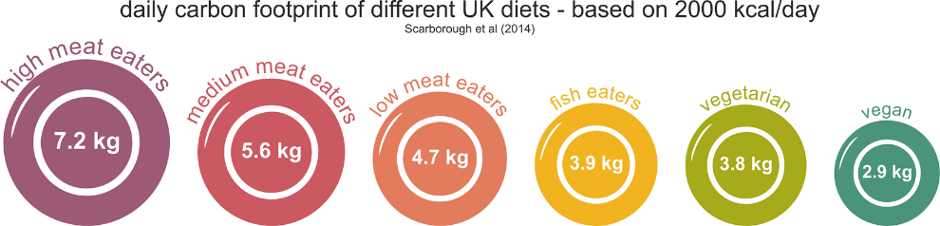
The Carbon Footprint of Food
Notes:
High 100g per day
Medium 50-99g per day
Low <50g per day
Big mac 90g beef
Cheese: part of reason for gap between veggie and vegan.
Key findings
26% of global emissions come from food
Of that, 58% comes from animal products
Of that, 50% comes from beef and lamb
There were also significant trends towards lower saturated fat, higher fibre and higher fruit and vegetable intake (but a higher intake of sugars) as the quantity of animal-based products in the diet decreases.

Slide 48
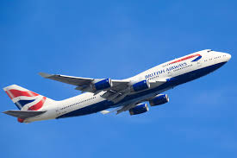
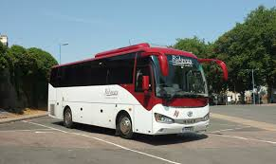
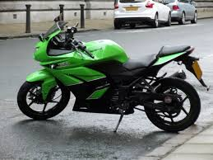
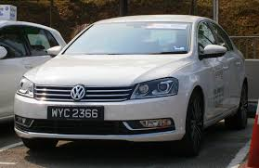
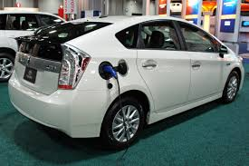
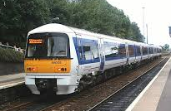
Travel
One way trip to Glasgow
310 miles from the Centre of Leicester
What ways to travel?
Motorbike
Aeroplane (from East Midlands Airport to Glasgow Airport)
Plug-in Hybrid
Coach
Average Petrol Car
Train

Slide 49
Travel
Things to note:
Air travel / coach / bus / train is based on average occupancy of the vehicle
Covers electric train not diesel
Cars / motorbike the vehicle regardless of passenger number

Slide 50
Travel
Smallest
emissions
Largest
emissions

Slide 51
Travel
Smallest
emissions
Largest
emissions
0.01 tCO₂e
0.02 tCO₂e
0.03 tCO₂e
0.04 tCO₂e
0.09 tCO₂e
0.19 tCO₂e
+ car travel to airport 0.02 tCO₂e
www.carbonfootprint.com/calculator.aspx

Slide 52
Summary: Holiday Travel
Consider carbon footprint of mode – e.g. alternatives to flying
Full cars share out the per person footprint
Combine trips, travel for longer instead of short trips
Consider more local versions of desired experience
Useful sources: seat61.com; loco2
Don’t look at cost comparison to flight

Slide 53
QUIZ: The Urgency of Taking
Action on Climate Change

Slide 54
Quick Quiz
Coming up are some multiple choice questions
I will read the question.
You will then have 30 seconds in your groups to discuss and agree the answer and hold up your flash card…

Slide 55
Weather and Climate
https://www.bbc.co.uk/news/science-environment-46398057

Slide 56
Question 1: The Scientific Consensus
What proportion of climate scientists do you think support the consensus opinion that human activities are causing climate change?
A
65-75%
B
75-85%
C
85-95%
D
>95%

Slide 57
1: The Scientific Consensus
What proportion of climate scientists do you think support the consensus opinion that human activities are causing climate change?
A
65-75%
B
75-85%
C
85-95%
D
>95%

Slide 58
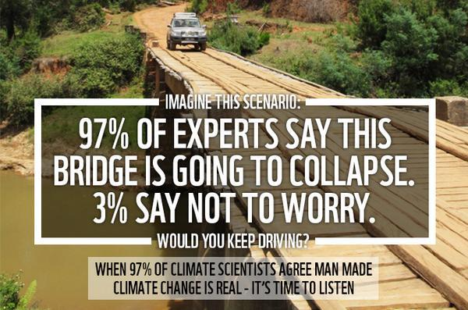
The Scientific Consensus

Slide 59
2: The Story So Far…
So far we have experienced around ____ of warming…
A
1ºC
B
1.5ºC
C
2ºC
D
2.5ºC

Slide 60
2: The Story So Far
So far we have experienced around ____ of warming…
A
1ºC
B
1.5ºC
C
2ºC
D
2.5ºC

Slide 61
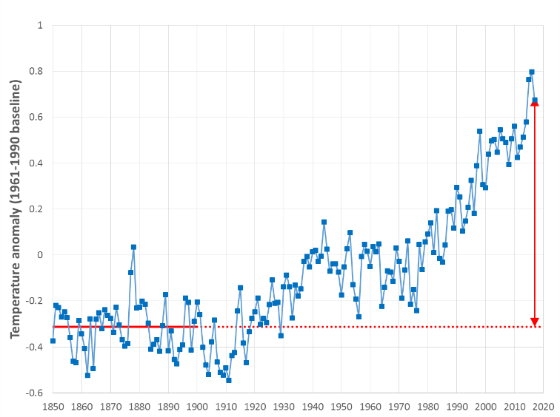
The Story So Far…1°C of Warming
Data from the Climate Research Unit (CRU) HadCRUT4 - combined land and marine temperature anomaly (global annual average)
Relative to average T from 1850-1900, 2017 was ca. 1°C warmer
1 degree of warming

Slide 62
3: Safe Limits
The Paris Agreement aims to keep the rise in global temperatures well below ___ and to pursue efforts to limit it to ____
A
2 & 1ºC
B
2 & 1.5ºC
C
3 & 2ºC
D
2.5 & 2ºC

Slide 63
3: Safe Limits
The Paris Agreement aims to keep the rise in global temperatures well below ___ and to pursue efforts to limit it to ____
A
2 & 1ºC
B
2 & 1.5ºC
C
3 & 2ºC
D
2.5 & 2ºC

Slide 64
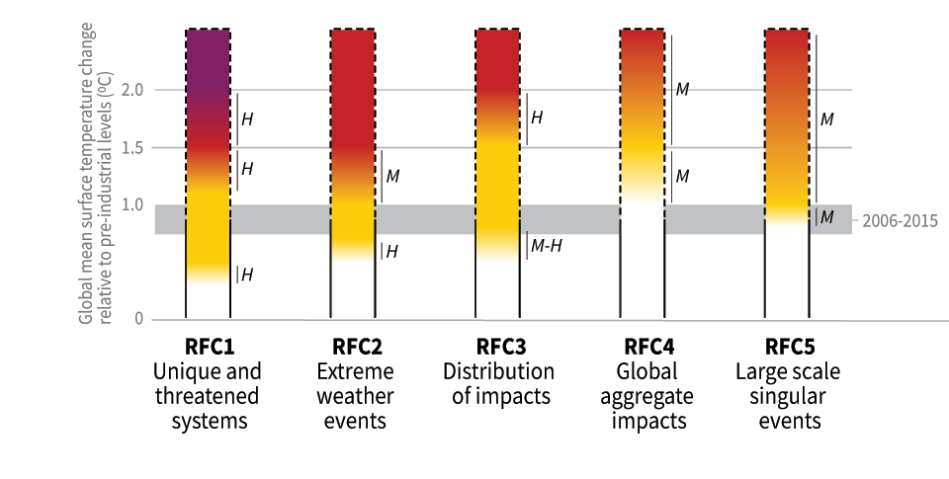
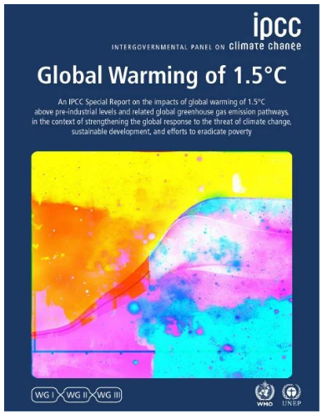

Five Reasons for Concern
Level of additional risk/impact associated with climate change
undetectable
moderate
high
very high
Notes:
RFC1 Unique and threatened systems: ecological and human systems that have restricted geographic ranges constrained by climate-related conditions and have high endemism or other distinctive properties. Examples include coral reefs, the Arctic and its indigenous people, mountain glaciers and biodiversity hotspots.
RFC2 Extreme weather events: risks/impacts to human health, livelihoods, assets and ecosystems from extreme weather events such as heat waves, heavy rain, drought and associated wildfires, and coastal flooding.
RFC3 Distribution of impacts: risks/impacts that disproportionately affect particular groups due to uneven distribution of physical climate change hazards, exposure or vulnerability.
RFC4 Global aggregate impacts: global monetary damage, global-scale degradation and loss of ecosystems and biodiversity.
RFC5 Large-scale singular events: are relatively large, abrupt and sometimes irreversible changes in systems that are caused by global warming. Examples include disintegration of the Greenland and Antarctic ice sheets.

Slide 65
4: Safe Limits
To have a reasonable chance of achieving this, global emissions would need to reach net zero emissions by…
A
2040
B
2045
C
2050
D
2055

Slide 66
4: Safe Limits
To have a reasonable chance of achieving this, global emissions would need to reach net zero emissions by…
A
2040
B
2045
C
2050
D
2055

Slide 67
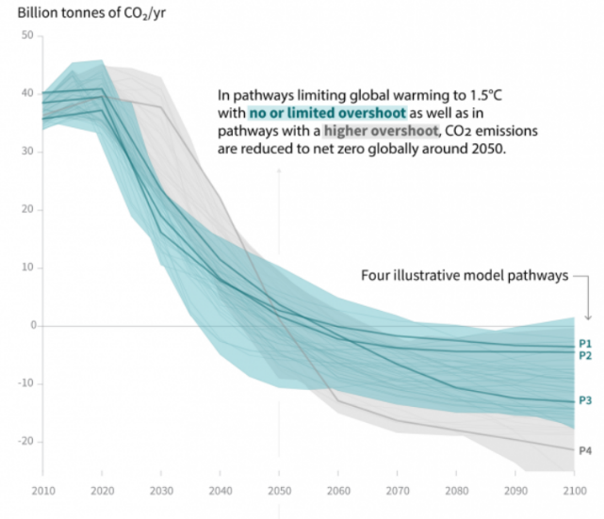
Safe Limits – Net Zero Globally by 2050
Notes:
The main panel shows global net anthropogenic CO2 emissions in pathways limiting global warming to 1.5°C with no or limited (less than 0.1°C) overshoot and pathways with higher overshoot. The shaded area shows the full range for pathways analysed in this Report. The panels on the right show non-CO2 emissions ranges for three compounds with large historical forcing and a substantial portion of emissions coming from sources distinct from those central to CO2 mitigation. Shaded areas in these panels show the 5–95% (light shading) and interquartile (dark shading) ranges of pathways limiting global warming to 1.5°C with no or limited overshoot. Box and whiskers at the bottom of the figure show the timing of pathways reaching global net zero CO2 emission levels, and a comparison with pathways limiting global warming to 2°C with at least 66% probability. Four illustrative model pathways are highlighted in the main panel and are labelled P1, P2, P3 and P4, corresponding to the LED, S1, S2, and S5 pathways assessed in Chapter 2. Descriptions and characteristics of these pathways are available in Figure SPM.3b. {2.1, 2.2, 2.3, Figure 2.5, Figure 2.10, Figure 2.11}

Slide 68
5: Safe Limits
The UK has set a target to reach net zero carbon by…
A
2040
B
2045
C
2050
D
2055

Slide 69
5: Safe Limits
The UK has set a target to achieve net zero carbon by…
A
2040
B
2045
C
2050
D
2055

Slide 70
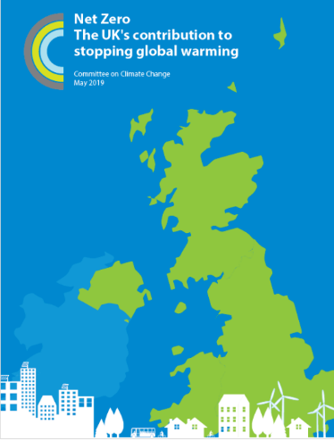
UK Climate Change Act (2008)
Original Goal:
80% reduction from
1990 levels by 2050
Revised Goal:
Net zero carbon
by 2050
Notes:
At the time, there was no globally agreed temperature goal. So we judged, based on the available climate science, that an appropriate global climate objective would be 2°C, and to avoid an extreme danger threshold of 4°C.
An 80% reduction in greenhouse gases by 2050, from their 1990 level, was our best estimate of the appropriate UK contribution to that goal. We said it was “challenging but feasible” and that it carried a cost – of 1-2% of GDP – which was affordable to avoid a much greater economic cost in the future.
Parliament agreed – and since then we have been advising on the best, most cost-effective route to get there under the framework of carbon budgets and government plans that are required.
But a great deal has changed since 2008. The UK has signed the Paris Agreement, which expects greater ambition from developed countries – and references 1.5 degrees as a global temperature goal. Global emissions have continued to rise – making one of our 2008 scenarios for peak global emissions in 2016 look very optimistic. And other shifts have occurred too – crucially, our understanding of the path to full decarbonisation and the costs of some the key technologies.
The CCC’s task is now – effectively – to re-run the 2008 analysis in light of this new information. But underlying it remains the same basic problem as before – that fossil fuels are the underpinning of the modern economy – and that they are warming our planet.
Falls in cost for some of the key zero-carbon technologies mean that achieving net-zero is now possible within the economic cost that Parliament originally accepted when it passed the Climate Change Act in 2008.

Slide 71
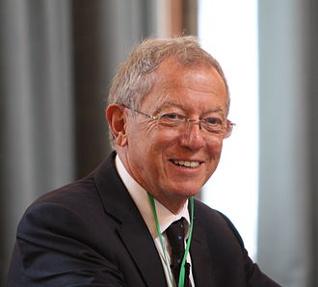
Our Fair Share?
Prof Sir David King (ex-chief scientist) has called for the UK to advance its climate targets by 10 years – bringing the date for cutting emissions of greenhouse gases to almost zero from 2050 to 2040.
Source: BBC (2019) “Faster pace of climate change is 'scary', former chief scientist says” https://www.bbc.co.uk/news/science-environment-49689018

Slide 72
Imagining a Zero Carbon World:
Postcards from the Future

Slide 73



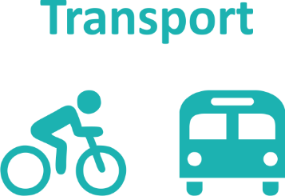
What does a Zero Carbon World look like?

Slide 74






Postcards from the Future - Carbon Neutral Leicester
Leicester City Council’s plans address the six themes below
What needs to happen to make the vision reality?
Draw a picture of what Leicester would look like in the future (you have 5 minutes!)
At Work
At Home
Our Consumer Choices
Travel and Transport
Waste and Recycling
Land Use, Green Space & Development

Slide 75
At Home
Context: Heating of homes and the use of electricity for lighting, appliances and gadgets causes about a third of carbon emissions in Leicester from our direct fuel and energy use. To reduce these emissions, housing will need to be made a lot more energy efficient and heating will need to change. A big increase in renewable energy will be needed too. Many people will need help to make these changes.
Homes will need to be very highly insulated to keep warm using much less energy. This will mean that fewer people get health problems from cold homes.
Everyone will need to replace gas heating and hot water with low-carbon alternatives. Most often this will mean using heat pumps. They use electricity to extract heat from the ground or air.
In areas with denser housing, low-carbon heat networks will be the best answer. These provide heat and hot water to whole neighbourhoods through underground pipes. In the future hydrogen could also replace gas as a fuel for boilers.
The move away from gas will increase electricity demand. Homes will need to have their own renewable energy like solar panels. These will provide power to the house and owners could get money for selling back excess electricity.
Houses will need ‘smart’ systems such as remote control for heating and lighting, and batteries to store extra energy from solar panels. They will also need to be able to charge electric cars.
Homes will also need to be kept cool without air conditioning, as this uses a lot of energy. This might mean fitting shades and shutters, or planting trees for shade.
Water use will need to fall, as low rainfall could become more of a problem.

Slide 76
Our Consumer Choices
Context: As well as the carbon emissions we produce within the city, we are also responsible for emissions elsewhere produced from making and delivering the products and the services we buy in from outside. They could add at least another 40% to the total. For the city to become carbon neutral we have to do something about them too..
All of us will need to become well-informed about the climate impacts of what we buy – so that we can make climate-friendly choices.
Customer demand for climate-friendly products and services will need to convince shops, manufacturers and suppliers to provide them.
Customer demand will need to convince manufacturers to produce long-lasting products which can be repaired. Disposable and short-lived products cause extra carbon emissions when they have to be replaced.
The overall consumption of beef, lamb and other meat, eggs and dairy produce will need to be a lot lower than today. There will need to be much more emphasis on plant-based ingredients. ‘Food miles’ will need to reduce too.
Air travel will need to reduce a lot unless zero-carbon flights become possible.

Slide 77
Travel and Transport
Context: Travel and transport are a large source of carbon emissions in Leicester. These emissions come from petrol, diesel and LPG vehicles. Leicester’s population is expected keep growing, so more people will need to access work and facilities. If changes are not made this will add to Leicester’s carbon emissions.
A much greater share of journeys will need to be made by walking, cycling and public transport. A city-wide network of walking and cycling routes, along with improved public transport, will be among the improvements needed to make this possible.
Journeys that can’t be taken by walking, cycling or public transport will need to be made by ultra-low emission vehicles. These will mainly be electric vehicles, although new HGVs may need to be hydrogen-powered.
Electric charging-points will need to be widely available across the city. The electricity grid in Leicester may need upgrading to allow this. More solar panels will help provide some of the electricity needed.
Some electric cars will need to be part of ‘vehicle-to-grid’ systems. These store surplus renewable electricity from solar panels in electric car batteries. They help the electricity grid by selling it to the grid when demand is high.
Alternative travel and transport services, such as ride-sharing, electric car clubs and e-bike share could be used more instead of private car journeys.
Services and facilities will need to be easy to access without car journeys. This includes making them accessible online, and available nearby within communities.

Slide 78
Waste and Recycling
Context: Disposal and treatment of waste uses a lot of energy, which causes carbon emissions. Things that are sent to landfill also produce greenhouse gases when they decay. More emissions come from producing new things to replace what is thrown away. The best way to reduce waste is to follow the ‘Waste Hierarchy’: avoid making waste, and then re-use anything that is made. Things that can’t be re-used should be recycled. If there is anything left it is better to recover energy from it, with sending it to landfill the worst option.
Households will need to produce less waste. This will mean not buying things that will be wasted, buying products and services that are produced sustainably and re-using and repairing what they already own.
Businesses and organisations will need to produce less waste from what they make and sell and the services they provide. Products and packaging will also need to be easier for consumers to re-use, repair and recycle.
As much waste as possible will need to be recycled. The council will need to support homes to do this through the city’s waste collection service. Businesses and organisations will need make sure their waste is disposed of responsibly. Food and garden waste will need to be composted.
Where waste can’t be recycled, it will need to be used for energy instead of landfilled. This includes a small amount of Energy-from-Waste and biogas.

Slide 79
At Work
Context: The gas and electricity used by businesses and other employers is one of the largest sources of carbon emissions in the city. Commuting by employees, travel for work, and the transport of goods causes carbon emissions too. The materials bought and used by businesses also have a carbon footprint. To reduce these emissions employers’ buildings will need to be much more energy efficient and heated differently. They will need to have renewable energy sources fitted. Employers will also need to make sure their products and services are sustainable. This includes using recycled materials and making products easier to reuse and recycle.
Businesses and other employers will need to use low or zero carbon heating and cooling systems and generate their own renewable electricity wherever possible. Workplaces will also need to be more highly insulated to reduce their heating need.
Business processes and equipment will need to be much more energy and resource efficient. Production processes will need to be carbon neutral – using renewable energy generated on-site where possible.
All items and materials procured by businesses and organisations will eventually need to come from sustainable sources, for example using recycled materials.
Customers will expect the good and services they use and buy to be sustainable and zero carbon, so businesses and organisations will need to achieve this to stay competitive.

Slide 80
Land Use, Green Space, Development
Context: Leicester’s population is expected to keep growing. An estimated 29,104 homes will need to be built by 2036, along with more employment sites, schools, facilities and infrastructure. This could add to Leicester’s carbon footprint unless new development is designed to be carbon neutral. The climate is also expected to change, with more chance of heatwaves and long dry spells, but also more frequent intense rainfall. New buildings will need to be designed to cope with these challenges.
All new buildings will need to be designed and built to be carbon neutral. This means they will need to be very highly insulated and use low-carbon heating instead of gas heating. Renewable energy such as solar panels will need to be installed.
New buildings will need to keep cool in hotter weather without using air conditioning, as it uses a lot of electricity. They will also need to use less water. To reduce the risk of flooding they will need to disperse heavy rainfall without overwhelming drains and rivers.
Building materials made with much less energy, or with renewable energy, will need to be used. To prevent deforestation, all timber used for construction will need to come from sustainably managed forests.
Travel to and from new developments will need to be easy, convenient and safe on foot, by bike and on public transport. There will need to be charging points for electric vehicles too.
Tree cover will need to be maintained and increased where possible. New planting will need to provide for recreation, wildlife, flood prevention and respite from heatwaves. It will also need to absorb carbon emissions.

Slide 81
Feedback
What are the top 3 things you think should happen in Leicester?
What can you do yourself and in your team to help make this happen?
At Work
At Home
Our Consumer Choices
Travel and Transport
Waste and Recycling
Land Use, Green Space & Development

Slide 82
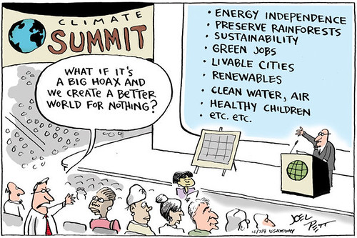
A Zero Carbon World is a positive place
Notes:
Discussion of how these changes could be positive for a range of reasons – health, community, etc.

Slide 83
A Zero Carbon School and City…

Slide 84
A typical school’s emissions…

Slide 85
Changes in Leicester City Council Gross Emissions
 | 2008/09 | 2018/19 | % reduction
Corporate Buildings | 29,794 | 14,598 | 51%
Schools | 21,018 | 15,233 | 27.5%
Travel | 4,597 | 3,986 | 13%
Public Lighting | 12,445 | 3,172 | 75%

Slide 86
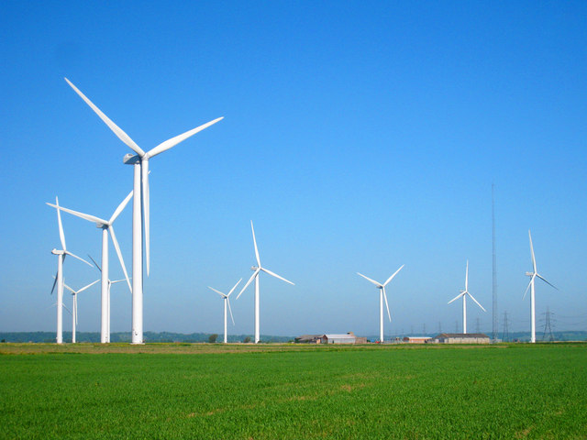
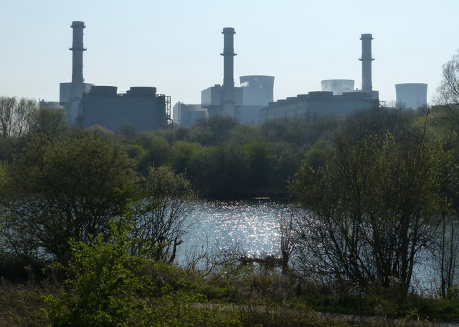
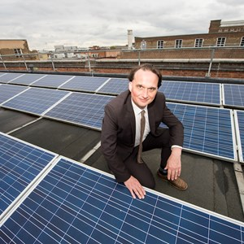
A Cleaner Grid
Notes:
Increase in wind, PV, and gas replacing coal (picture of West Burton, where new gas station and old coal)
Images from https://www.flickr.com/photos/eltpics/17326595666 and https://www.geograph.org.uk/photo/5007945 and
https://www.geograph.org.uk/photo/5366543 https://www.flickr.com/photos/deccgovuk/15282222229

Slide 87




What is happening in Leicester?
Green BELLE – grants to 93 businesses
Euston Street Stores 179.9 kWp PV system
District heating, largest municipal network in UK
Marriott School has had a new Net Zero block build with 4 classrooms, toilets and break out rooms

Slide 88



What is happening in Leicester?
Electrification of bus network
Green Fox Community Energy -
Green Lane Infant School, Highfields Primary, Sparkenhoe Community Primary School and Uplands Infant School
634 kWp PV systems on council buildings generating 524,954 kWh/y

Slide 89

The carbon footprint of the City
Leicester City Carbon Footprint Comparison between 2005 and 2017
2005
Emissions
2017
Emissions

Slide 90

Examples of what schools are doing in Leicester….
Eco-Schools: 107 registered - 90 Bronze, 79 Silver, 52 Green Flag – highest in England for local authorities
LED and Solar Panel (PV) projects
Ashden LESS CO₂ and BESS Energy
Active Travel and Transport projects
(Sustrans and Living Streets)
Recycling
City catering – ‘meat free day’

Slide 91
A Post-COVID Future

Slide 92

COVID-19 and Carbon Emissions
Notes:
Many positive stories, visible Himalayas, lower air pollution however it should not be viewed as an environmental success.

Slide 93
Decreased emissions
Daily global CO₂ emissions decreased by 17% by early April 2020 compared with the mean 2019 levels
Just under half from changes in surface transport
Flights down
  90% in Europe
  50 % US
  65% overall
At their peak, emissions in individual countries decreased by 26% on average.
The impact on 2020 annual emissions depends on the duration of the confinement, with a low estimate of –4%, if pre-pandemic conditions return by mid-June, and a high estimate of –7%, if some restrictions remain worldwide until the end of 2020.

Slide 94


Slide 95



Slide 96

What does the future hold?
To keep the world on track to stay under 1.5°C this century, the world needs similar cuts for the foreseeable future to keep this target in view
Many climate researchers are optimistic that this deadly pandemic has taught governments some critical lessons that they can apply to the problem of rising temperatures
The big challenge is to ensure the recovery has a green focus

Slide 97

What does the future hold?
Requires both top-down measures such as those that can only be put in place by governments but also they require bottom-up individual behavioural changes
Proven that major changes can be made short-term but long-term action and thinking is needed
Global cooperation, not division

Slide 98
Taking Action on Climate Change

Slide 99

Taking Action: Know Your Power
One person is enough to create great change!
2018 - On her own at the age of 15 Greta Thunberg began sitting outside the Swedish parliament on Fridays holding a sign saying “School strike for climate”
2019 - The school climate strike movement known as ‘Friday’s for Future’ has grown to the point where millions of children and adults have attended the strikes all over the world
Greta has also been nominated for the Nobel Peace Prize & won the Gulbenkian prize for humanity
We all have unique opportunities to take a lead in our role or community, or to support and follow others. See: TED: How to Start a Movement

Slide 100

Spheres of Influence
Who can you influence to take action on climate change?
How would you influence these people?
What systems could you influence?
  Think about changing rules, policies, norms, purpose or enabling people to act
  See: “How to Change a System”

Slide 101

Declaring a Climate Emergency
A practical guide for Colleges, Schools
and Multi Academy Trusts
List of potential actions for your school
Climate Emergency - action plan
Declaration of Climate Emergency
Local support for the climate emergency
schools.leicester.gov.uk/climate-emergency

Slide 102
What does declaring an emergency mean?
On 1 February 2019 Leicester City Council declared a Climate Emergency. The declaration is an acknowledgement that:
  climate change is happening, and threatens the wellbeing of everyone in Leicester and worldwide
  the speed and scale of global and local action to tackle the problem needs to be dramatically increased.
In its declaration, the Council committed to developing a new action plan to address the emergency through our own services and projects

Slide 103
What happens next?
Discuss your plans with students and staff.
Select actions which you plan to achieve, make them manageable but also remember we are in a Climate Emergency.
Make sure your actions have a duration, responsibilities and an evaluation.
Take your action plan to the Governing Body or Trustees to ensure that you have their support.
You can submit your action plan to the City Council which we will publicise as part of our wider action plan.
Start your action plan!
Review regularly to check and maintain your progress.

Slide 104


Templates and documents
Available at: schools.leicester.gov.uk/climate-emergency

Slide 105

Individual actions

Slide 106
Communicating Climate Change

Slide 107
Why is it important to be able to communicate about climate change?

Slide 108
Adapt your message to your audience
Use appropriate language
What type of message is most suitable for your audience?

Slide 109
Avoid information overload
Information on its own won't change
people's mind or behaviour
People don’t absorb information they don’t think is relevant to them
Can you create a setting where people are interested and willing to listen?
BLAH
BLAH
BLAH
BLAH

Slide 110


Climate change can feel distant
Relate it to people's lives & experiences
Flooding in Bangladesh and Manchester
✗
✓

Slide 111

Appeal to peoples values

Slide 112

Acknowledge the value-action gap
We all have an ongoing conflict between what we believe in and what we actually do
Help people to acknowledge and explore these complexities

Slide 113

Be careful with every little helps
If everyone does a little, we’ll achieve only a little” (MacKay, 2008)
Try to frame small steps as the beginning of a long journey

Slide 114

Be careful with moneysaving appeal
It may not work in the long term

Slide 115

Avoid Scare Tactics
Scary stories can make us shut down and ignore the subject altogether
Paint a vision of a desirable future!

Slide 116

Illustrate with Stories & Examples
Stories can inspire and bring life to dry facts
Use your own story to inspire others
Speak from the heart

Slide 117

Listen ☺

Slide 118










Top 10 Tips
Information on its own won’t change minds or behaviours
Be careful with ‘every little helps’
Adapt your message to your audience
Be careful with money saving appeals
Connect climate change to lives and experiences
Avoid scare tactics – paint a vision of a desirable future !
Illustrate with stories and examples
Appeal to values
Acknowledge and explore the value – action gap
Listen

Slide 119
Consider some scenarios…
Headteacher
Business manager
Teacher
Premises officer
Governors
Other students
The council (and local MPs)
Businesses which work with the your school e.g. catering, waste management, energy suppliers, contractors
WHAT could you say?
HOW would you say it?
WHY use those ideas?

Slide 120
The Climate Classroom
At the end of this course we are expecting you to communicate with others in a ‘Climate Classroom’
This could be staff meeting, parents event/evening, STEM event, in a public space, after school
  Activities
  Presentations/projects
  Leaflets
  Flyers
  Pledge wall
You have 40 minutes to design and make an activity which will be presented back to the group

Slide 121
Your Final Take Home Feelings / Messages
Notes:
What have you learned today?
Does anyone want to share their pledges?
Can anyone offer help with any of the pledges that people mention?

Slide 122
Find Out More
Climate Library reading list
Skeptical Science - This website presents the broader picture of climate change by explaining the peer reviewed scientific literature.
Young People's Trust For the Environment - resources that help to teach children about the importance of looking after our environment and the need to develop and live by sustainable methods.
NASA Climate Kids - tells the story of our changing planet through the eyes of the NASA missions studying Earth. The site is full of games, activities and articles that make climate science accessible and engaging.

