Slide 1

#EcoTeach Webinar
How to apply for your Green Flag
The webinar will begin shortly...

Slide 2
#EcoTeach Webinar
How to apply for your Green Flag
Lee Jowett, Environmental Education Coordinator
Amy Peace, Graduate Project Officer

Slide 3

#EcoTeachMeet Webinar Series
Overview of #EcoTeach format and dates/times of webinars
What Environmental Education Leicester is
Eco-Schools – and how it fits into the big picture
How to apply for your Green Flag
Q & As
Other opportunities coming up

Slide 4
Overview of #EcoTeach Webinar format and dates/times of webinars
Weekly at 10am during term time – lasting up to an hour, Leicester focused but suitable for everyone.
Recording and PowerPoint with links available afterwards at schools.leicester.gov.uk/eco-schools
During the presentation, ask questions in the chat box.
Questions and answers at the end – either directly ask or in chat box depending how many people are attending.

Slide 5

What is Environmental Education Leicester?
Provide free support to all Leicester School.
Communications with schools – social media (Twitter, Facebook, Instagram, YouTube), monthly eBulletins and quarterly newsletter.
TeachMeets, Eco-Schools Roadshow, Eco-Schools & Food for Life Celebration, Sustainable Schools Celebration bi-annual.
Focus on the Eco-Schools Award.
Delivery of energy and litter focused projects.
Project support and partnership working with internal and external organisation.

Slide 6
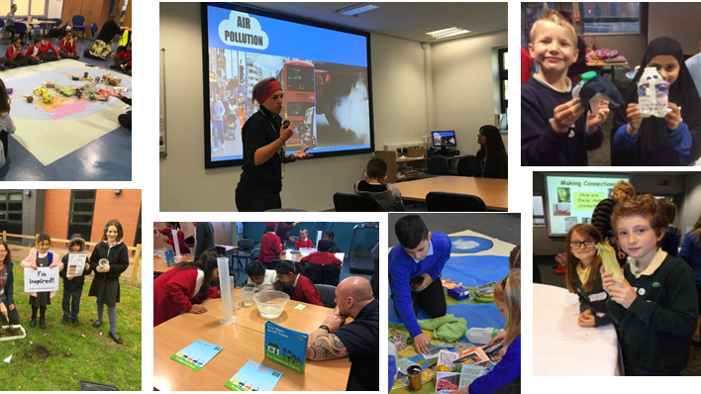
Eco-Schools Roadshow

Slide 7

Eco-Schools and Food for Life Celebrations

Slide 8
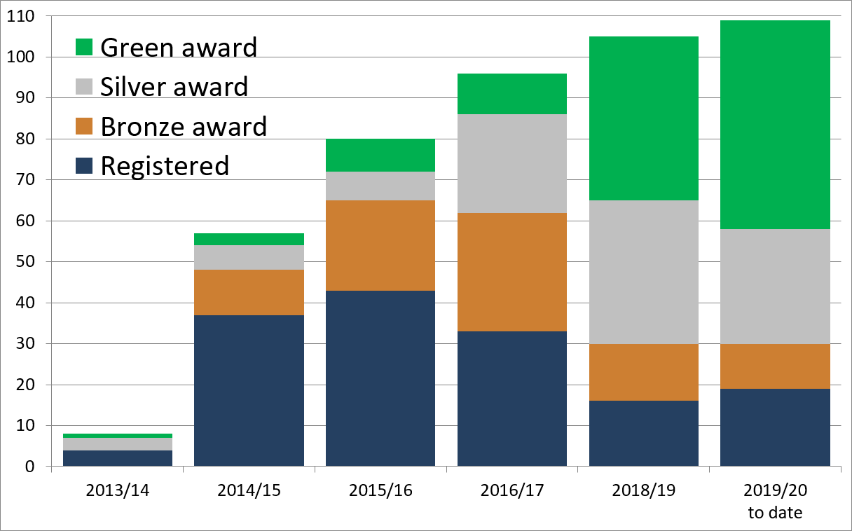

Eco-Schools – Our Work in Leicester
Promoted Eco-Schools as an award since September 2014 (114 schools)
109 registered on the programme
of those, 90 have achieved bronze
of those, 79 have achieved silver
of those, 51 have achieved Green Flag
  Potentially another 3 or 4 new
  And 3 or 4 renewals before the end of term

Slide 9
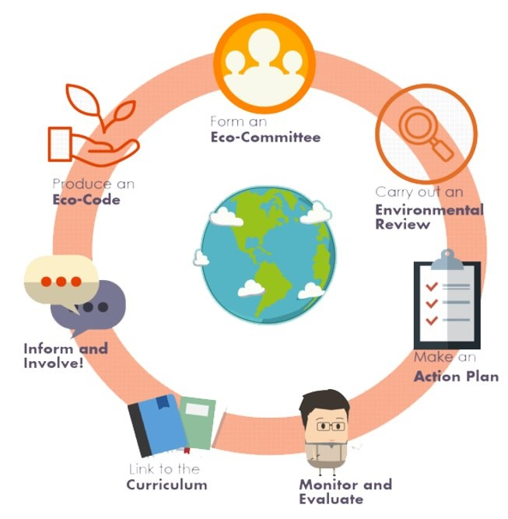

Eco-Schools Programme
7 step model

Slide 10

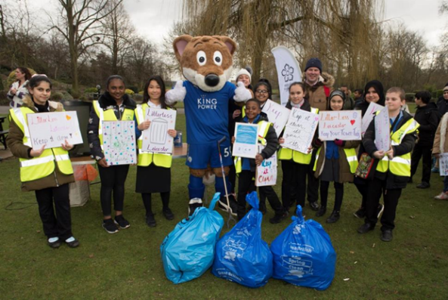
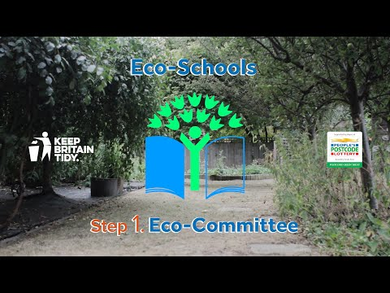
Step 1
Eco-Schools model - 7 steps 1
EYFS resources
Primary resources
Secondary resources
Step 1 – Eco-Committee, the heart of an Eco-Schools action and learning
  At least one pupil form each year group
  Meet at least once per half term
  Share responsibility for running meetings
  Records of minutes are kept
  Minutes displayed on the Eco-board
  Representative from parents, governors or senior leaders

Slide 11
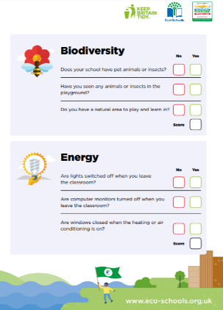
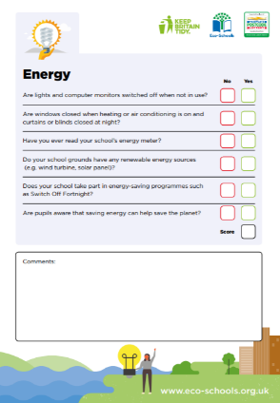
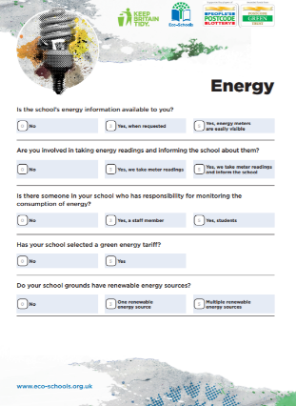
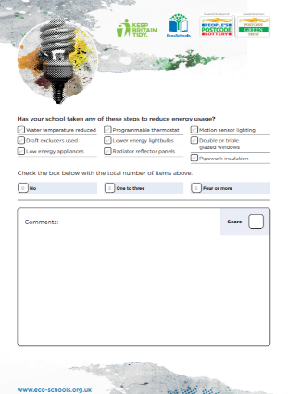
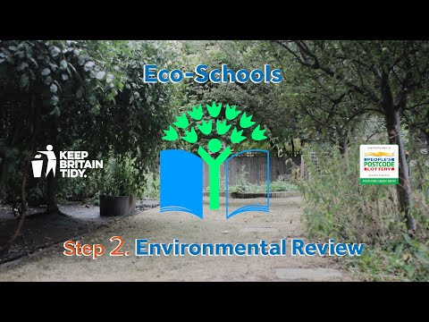
Step 2
Eco-Schools model - 7 steps 1
EYFS resources
Primary resources
Secondary resources
Step 2
EYFS
Primary
Secondary
Step 2 – Environmental Review – investigating the school's environmental performance
  Covers all 10 Eco-Schools topics
  A copy is displayed on the notice board
  It is updated/reviewed at least every 2 years (best practice is annually)

Slide 12
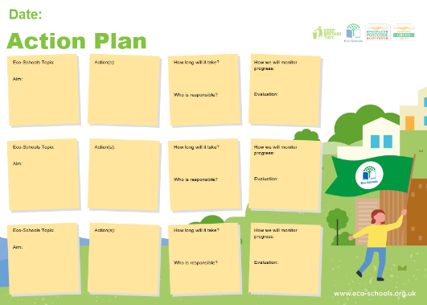
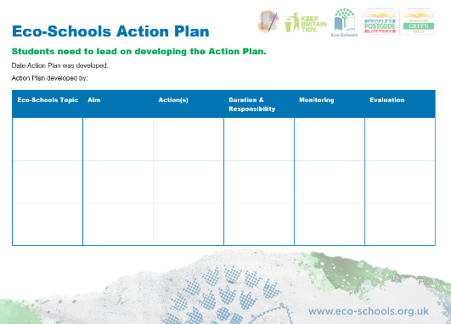
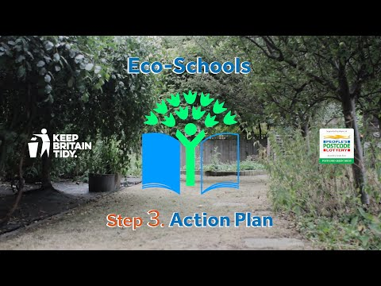
Step 3
Eco-Schools model - 7 steps
EYFS resources
Primary resources
Secondary resources
Step 3
Step 3 – Action Plan – Decide on topic actions, based on the result of the Environmental Review
  The action plan is influenced by the review
  Pupils take responsibility for learning on the topics
    3 for the first green flag
    5 for the renewal (changing 2 with each subsequent application)
  Contains timescale, who is responsible and how it will be monitored
  Shared with the whole school
  A copy is displayed on the noticeboard

Slide 13
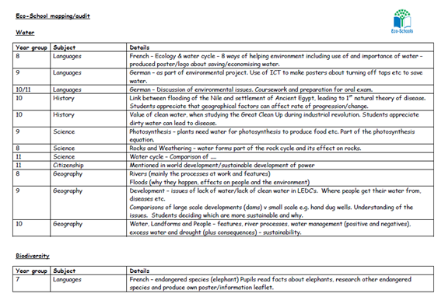


Step 4
Step 4
Eco-Schools model - 7 steps
EYFS resources
Primary resources
Secondary resources
Step 4 – Curriculum Links – making links between the school's environmental activity and the curriculum
  Environmental issues are covered in at least three areas in your school curriculum, evident in schemes of work, pupils work and/or lesson plans (for first green flag this can be the same year group)
  They do not need to be the same topics as your Action plan

Slide 14
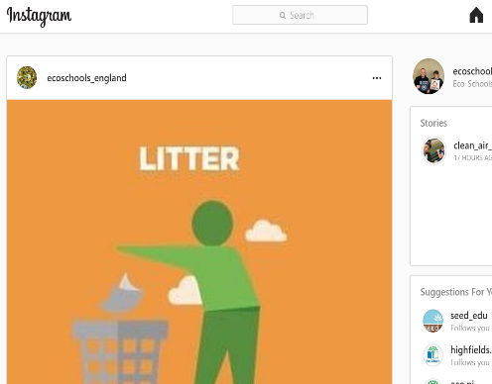
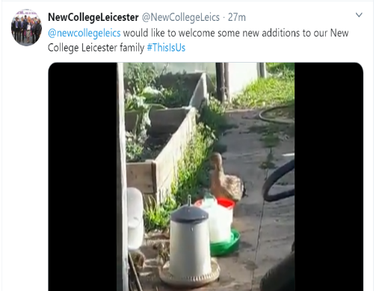
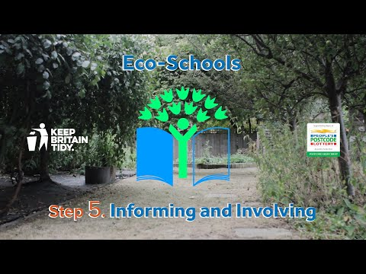
Step 5
Eco-Schools model - 7 steps
EYFS resources
Primary resources
Secondary resources
Step 5
Step 5 – Informing and involving – Let the whole school and wider community know what the Eco-Committee is doing
  A prominent noticeboard in school
    Covering the 7 steps and 3/5 topics
    Members of the committee
    Environmental review
    Environmental action
    Examples of monitoring and evaluation
    Eco-code
  Variety of mediums to communicate
  The whole school and wider community is informed

Slide 15
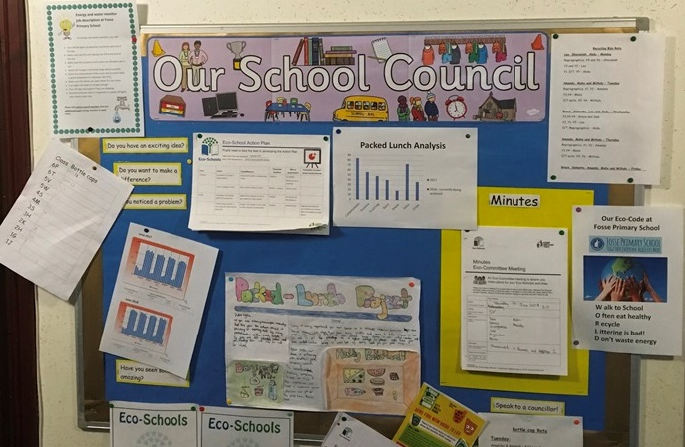

Step 6
Eco-Schools model - 7 steps
EYFS resources
Primary resources
Secondary resources
Step6
Step 6 – Monitoring and Evaluation – Measuring change and finding out what works and what doesn't
  The committee monitors the effectiveness of the topics via data collections, surveys, before and after photographs
  It is communicated with the whole school
  Data has been analysed to help pupils develop further topic actions
  Data has been used in the curriculum e.g. graphs and charts in math

Slide 16

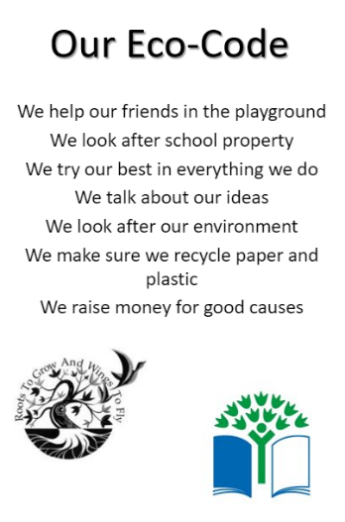

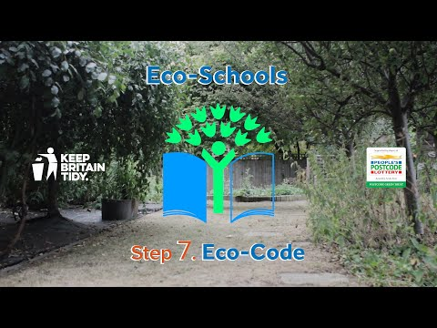
Eco-Schools model - 7 steps
EYFS resources
Primary resources
Secondary resources
Step 7
Step 7 – Eco-Code – Creating a call to action that the whole school can get behind
  There is an agreement statement for your school drawn up by pupils
  It reflects the topic actions you are working on
  It is displayed around school e.g. classrooms, hall and the office
  The majority of pupils and students understand is

Slide 17

Eco-Schools model 10 topics

Slide 18
How to apply for your Green Flag
Once you have worked through the Eco-Schools Seven Steps, for three topics, it is time to apply for an international Eco-Schools Green Flag award
Step one – login to your Eco-Schools account at www.eco-schools.org.uk
The Green Flag application as simple and quick
It should take no longer than thirty minutes to complete and can be completed with your Eco-Committee

Slide 19

Eco schools website 1

Slide 20
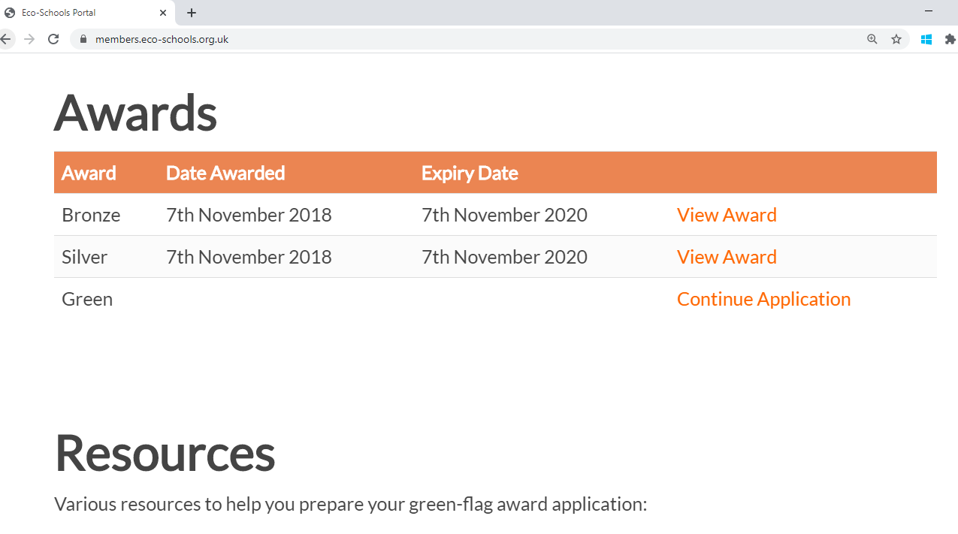
Eco schools website 2

Slide 21
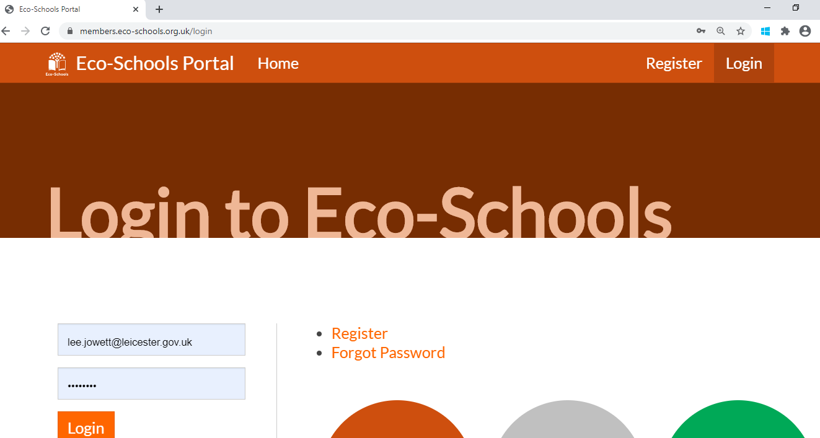
Eco schools website 3

Slide 22

Eco schools website 4

Slide 23
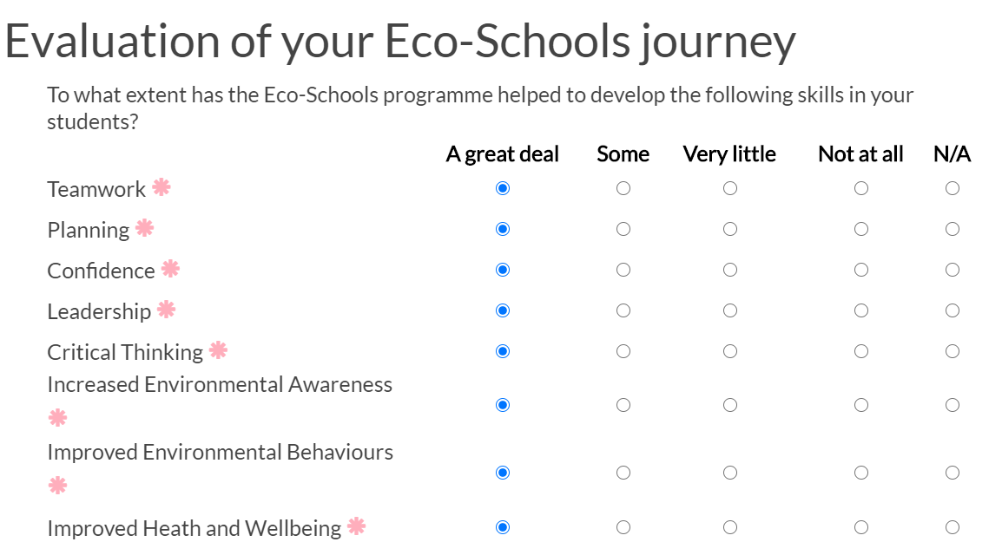
Eco schools website 5

Slide 24
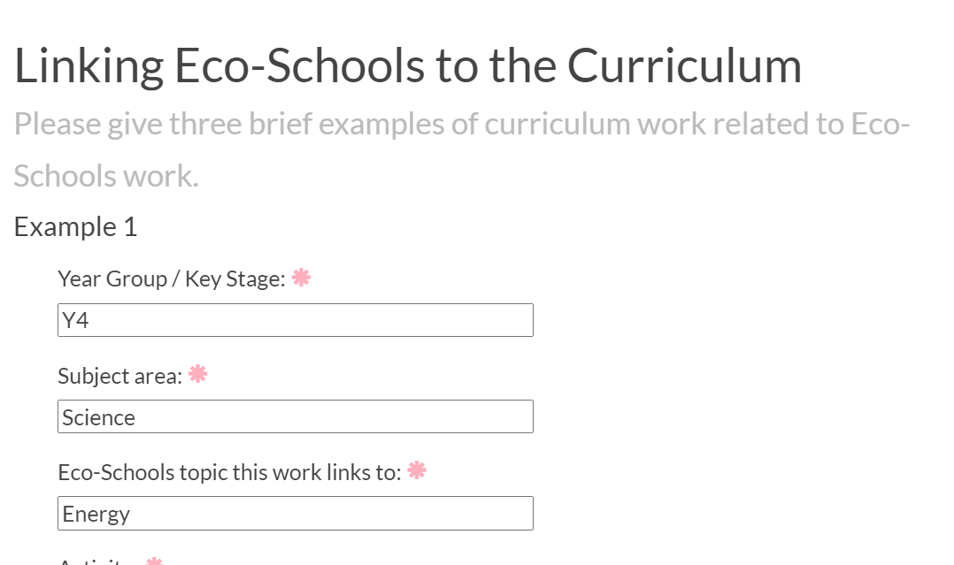
Eco schools website 6

Slide 25
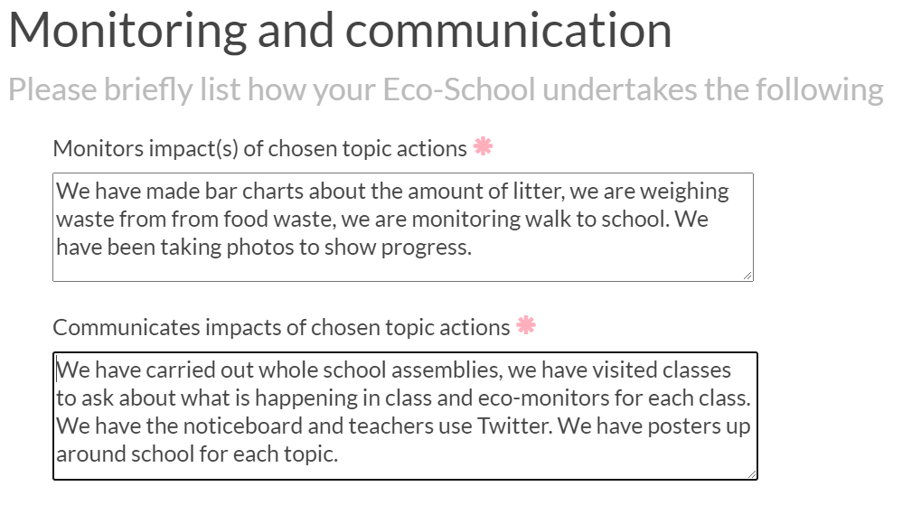
Eco schools website 7

Slide 26
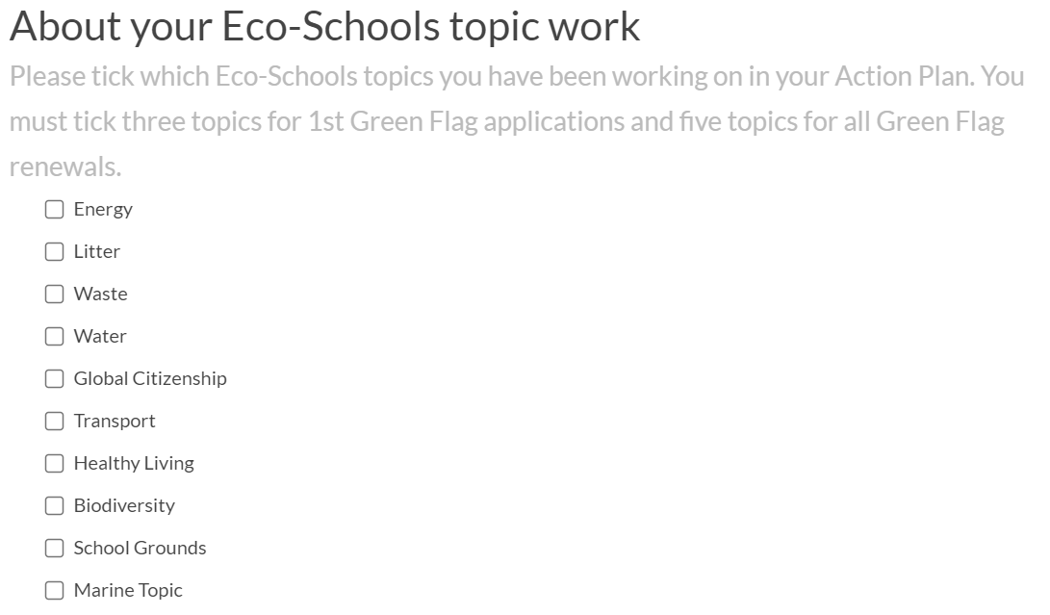
Eco schools website 8

Slide 27
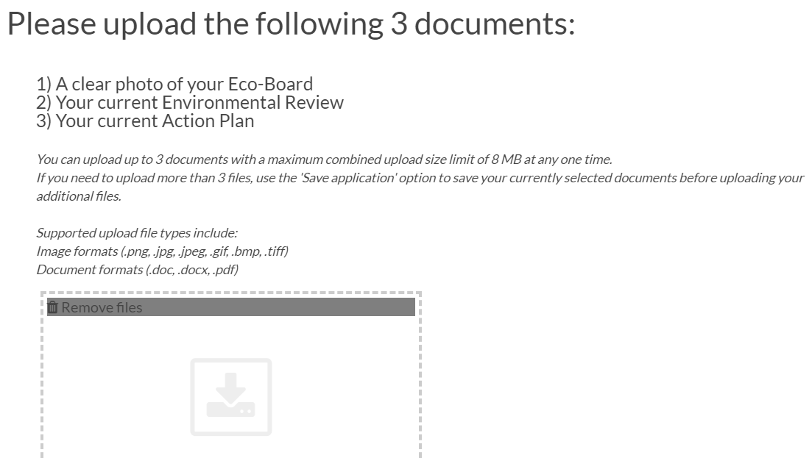
Eco schools website 9

Slide 28
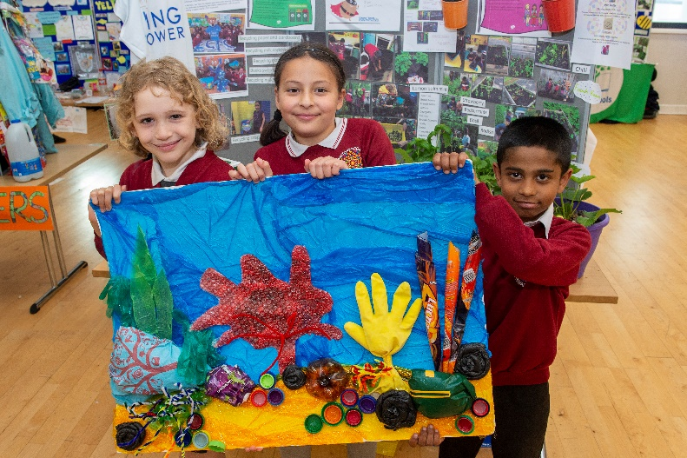
The online Green Flag application asks for:
Three brief examples of the curriculum work your school has completed linked to any of the ten topics
A brief description of how you have monitored and communicated your topic actions
Tick box and simple questions relating to your Eco-Schools topic actions
Submission of evidence

Slide 29

Evidence
As well as completing a Green Flag application, you will also be asked to submit the following documents (please read Uploading Evidence below before completing your Green Flag application):
Your completed Environmental Review
Your Action Plan
A clear photograph of your Eco-Board

Slide 30
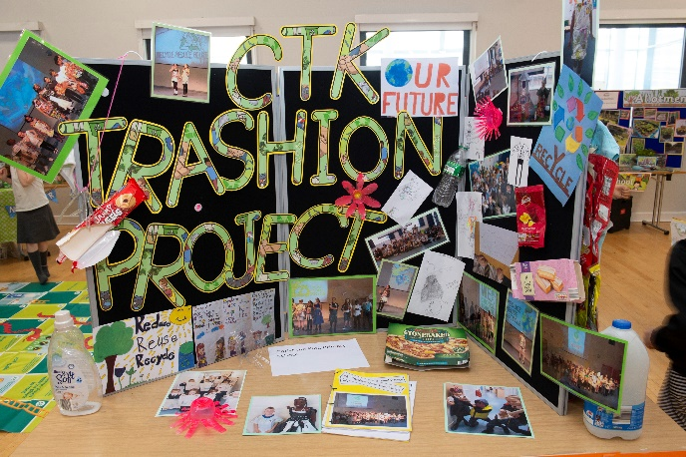
Uploading evidence – Environmental Review
You should use the official Eco-Schools Environmental Review
Completed by the Eco-Committee, scanned in and then uploaded – please do not worry about typing it up
On the front of your Environmental Review, write the names of everyone who has completed it and their corresponding year group
This will help the Eco-Schools team make sure that students from each year group have participated in Step 2 (for at least renewals)

Slide 31
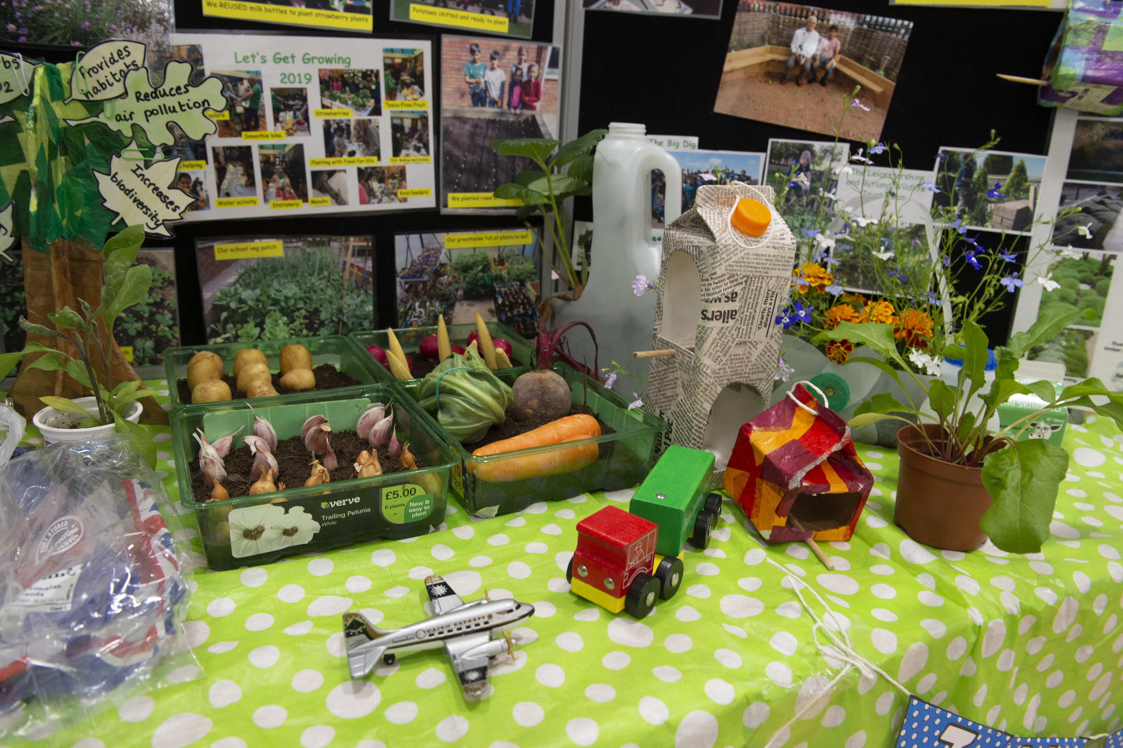
Uploading evidence – Action Plan
Your Action Plan should also be on the official Eco-Schools template and scanned in.
Please don’t try to write up your Action Plan neatly – it needs to be seen as a working document.
If some of your actions have failed, still include them on your Action Plan
Incomplete or ongoing actions are seen as a positive, as Eco-Schools work should always be ongoing e.g. an assessor would expect to see evidence that a planting area has been created or prepared rather than completely finished

Slide 32
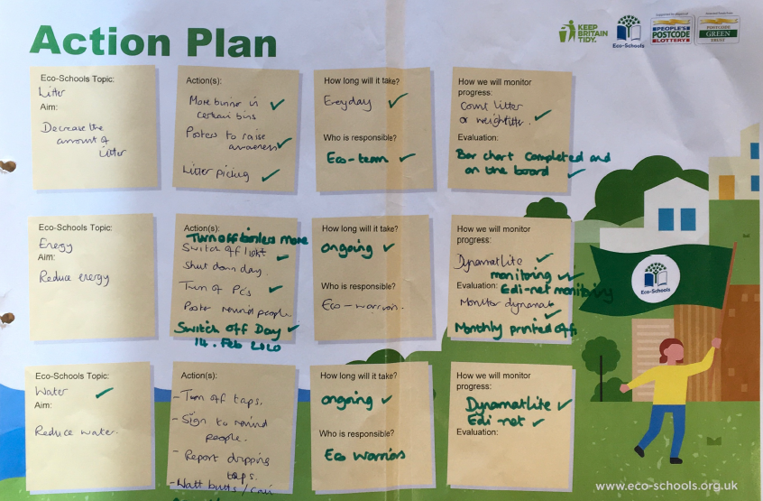
Action Plan 1

Slide 33
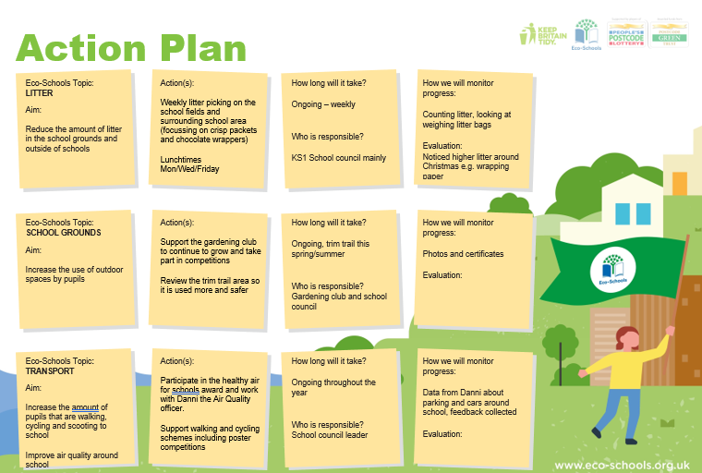
Action Plan 2

Slide 34
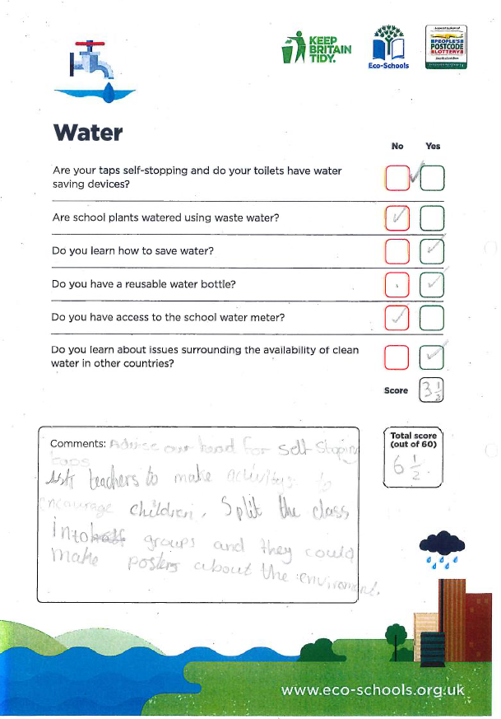
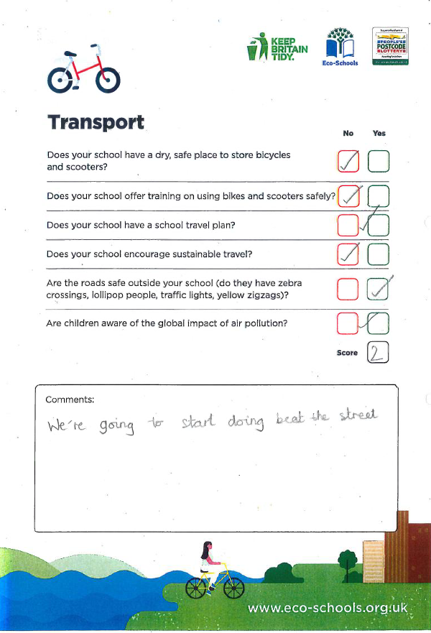
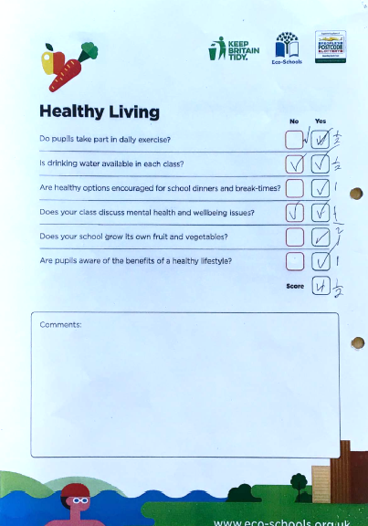
Environmental Review examples

Slide 35
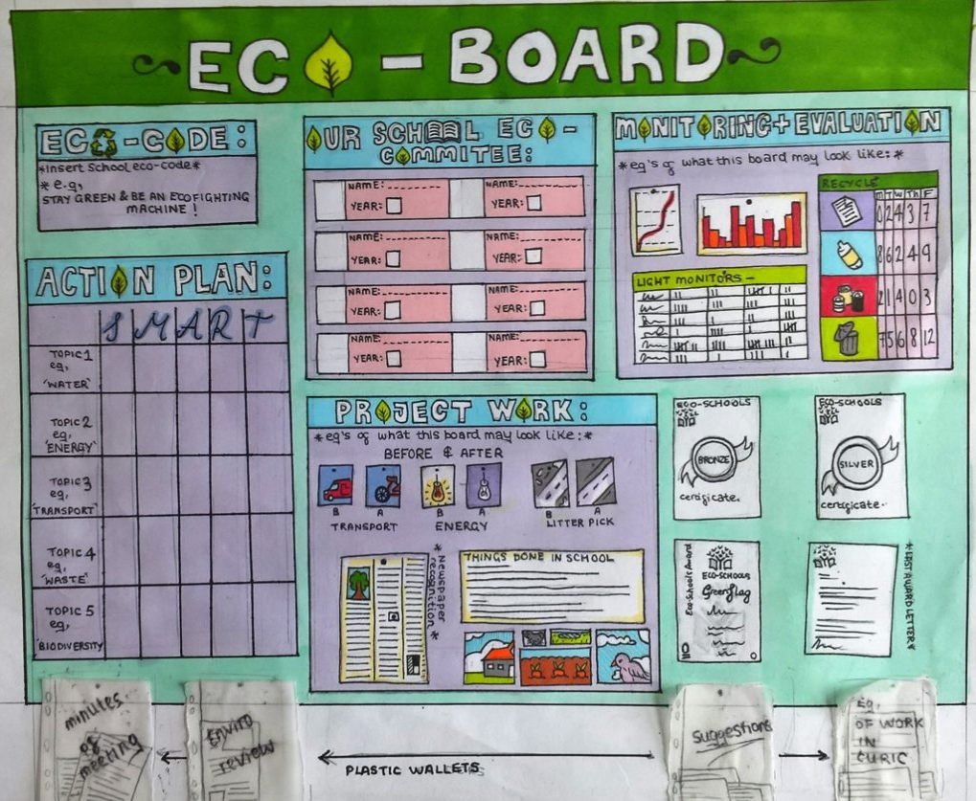
Uploading evidence
Eco Board
The Eco-Board is one of the most important pieces of evidence when desk-assessing Green Flag applications
The Eco-Board is designed to have evidence of each of the Seven Steps in one place that is accessible to the whole school and its community

Slide 36
Uploading evidence – Eco Board
Your Eco-Board should contain:
Photos of your Eco-Committee (if possible) and corresponding year group – there needs to be someone from every year group (at least on your renewal)
Meeting Minutes
A copy of your Environmental Review
A copy of your Action Plan
Curriculum work examples
Photos of your project work
Examples of Monitoring and Evaluation, including one example
that links to the curriculum (graphs or charts) (at least on your renewal)
Your Eco-Code
Previous Eco-Schools certificates and awards
A place for non-Eco-Committee members to make suggestions.

Slide 37
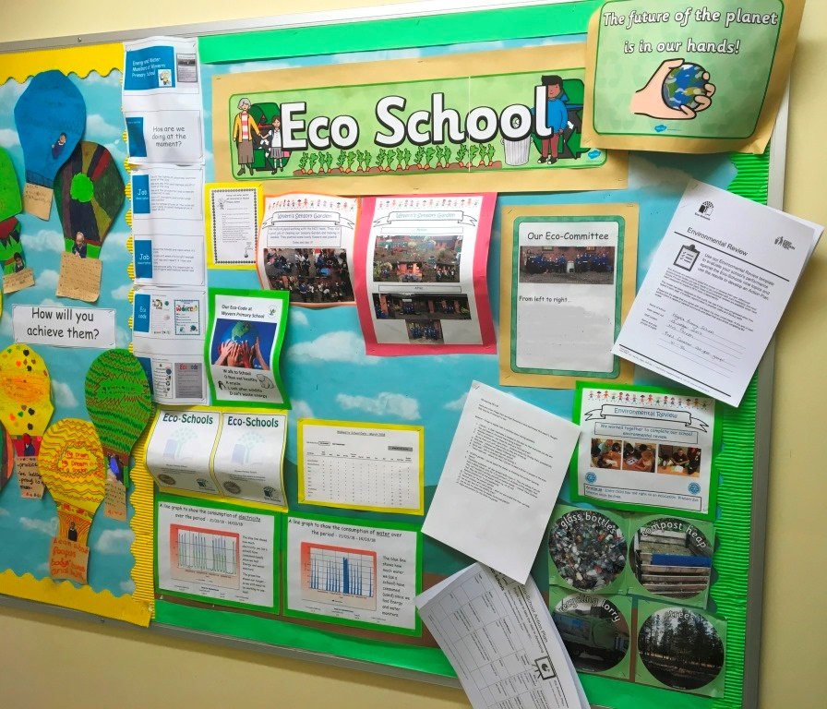
Eco Board 1
Eco-Committee
Meeting Minutes
Environmental Review
Action Plan
Curriculum work examples
Photos of your project work
Examples of Monitoring and Evaluation,
Your Eco-Code
Previous Eco-Schools certificates
A place for non-Eco-Committee members to make suggestions.

Slide 38
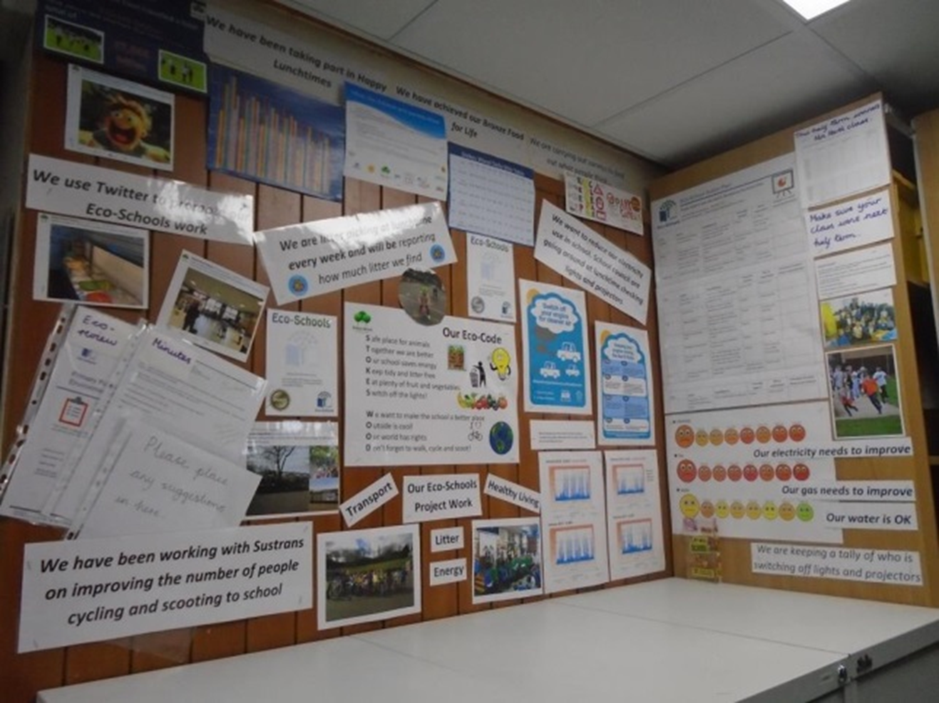
Eco board 2
Eco-Committee
Meeting Minutes
Environmental Review
Action Plan
Curriculum work examples
Photos of your project work
Examples of Monitoring and Evaluation,
Your Eco-Code
Previous Eco-Schools certificates
A place for non-Eco-Committee members to make suggestions.

Slide 39
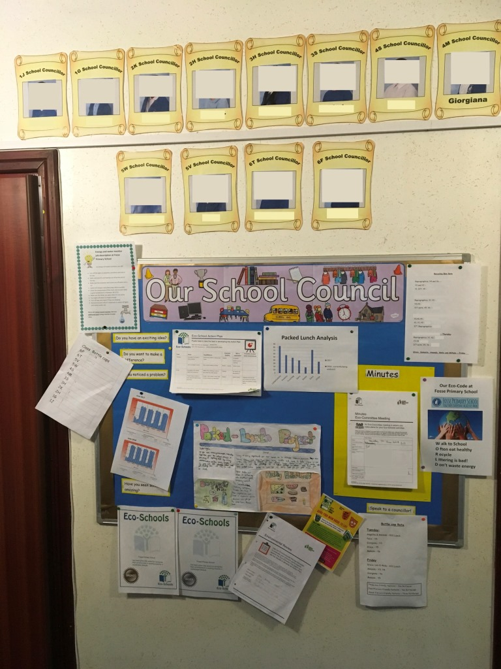
Eco board 3
Eco-Committee
Meeting Minutes
Environmental Review
Action Plan
Curriculum work examples
Photos of your project work
Examples of Monitoring and Evaluation,
Your Eco-Code
Previous Eco-Schools certificates
A place for non-Eco-Committee members to make suggestions.

Slide 40
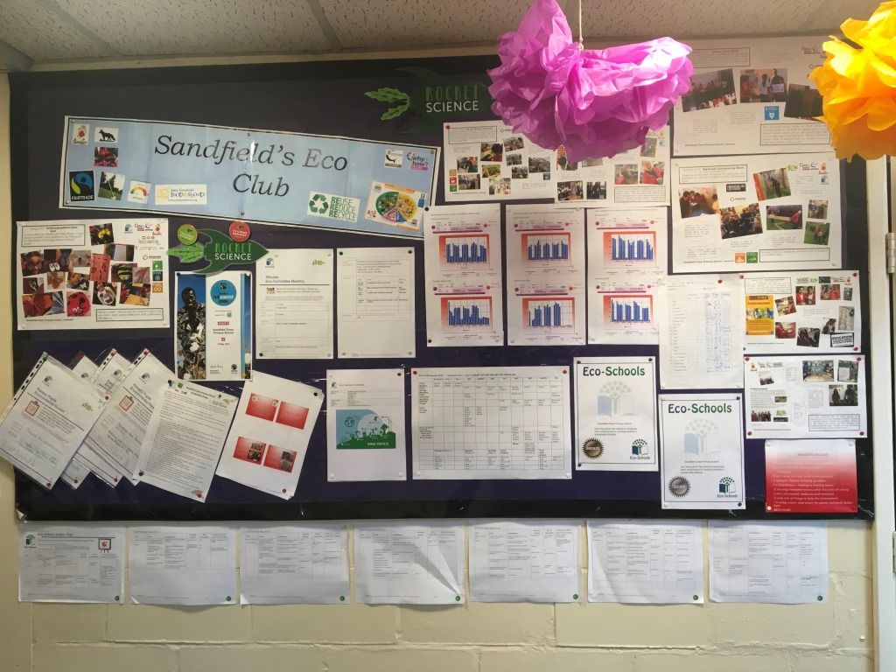
Eco board 4
Eco-Committee
Meeting Minutes
Environmental Review
Action Plan
Curriculum work examples
Photos of your project work
Examples of Monitoring and Evaluation,
Your Eco-Code
Previous Eco-Schools certificates
A place for non-Eco-Committee members to make suggestions.

Slide 41
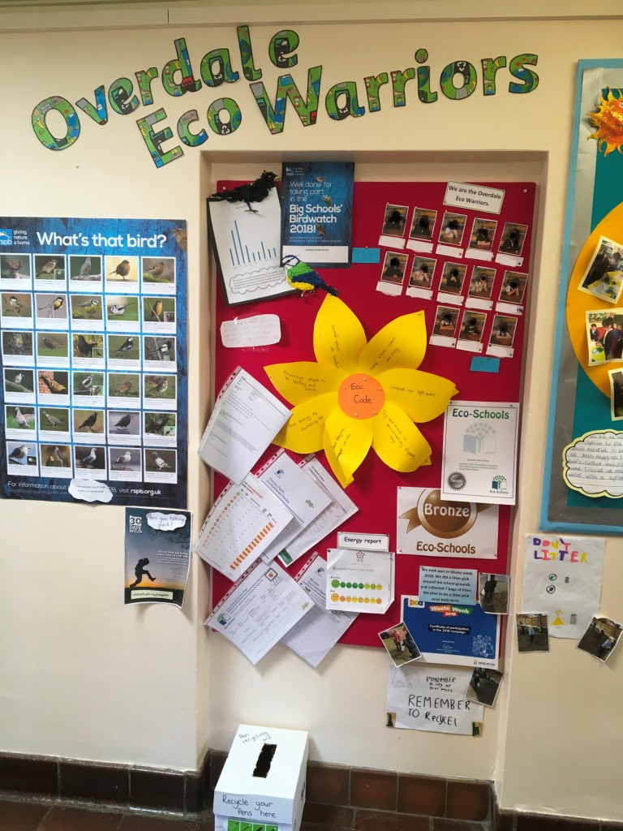
Eco board 5
Eco-Committee
Meeting Minutes
Environmental Review
Action Plan
Curriculum work examples
Photos of your project work
Examples of Monitoring and Evaluation,
Your Eco-Code
Previous Eco-Schools certificates
A place for non-Eco-Committee members to make suggestions.

Slide 42
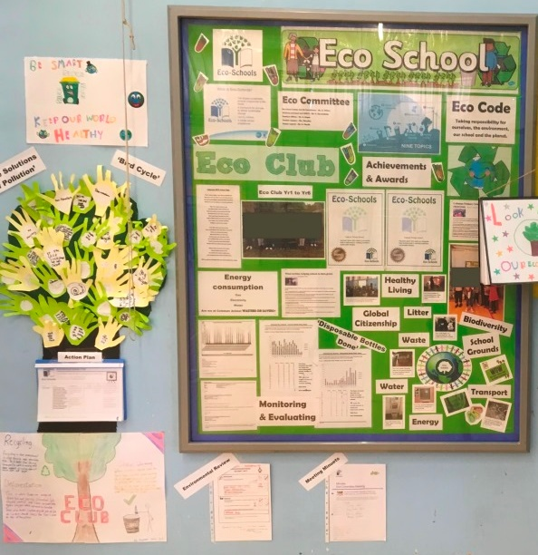
Eco-Committee
Meeting Minutes
Environmental Review
Action Plan
Curriculum work examples
Photos of your project work
Examples of Monitoring and Evaluation,
Your Eco-Code
Previous Eco-Schools certificates
A place for non-Eco-Committee members to make suggestions.

Slide 43

Selecting dates
Finally, you will also need to select at least three dates when your school is available to be assessed
As Eco-Schools relies on volunteer assessors choosing as many dates as possible is recommended
Before an assessor is assign to your school, it will be confirmed if you school is still available on the date the assessor has chosen​

Slide 44
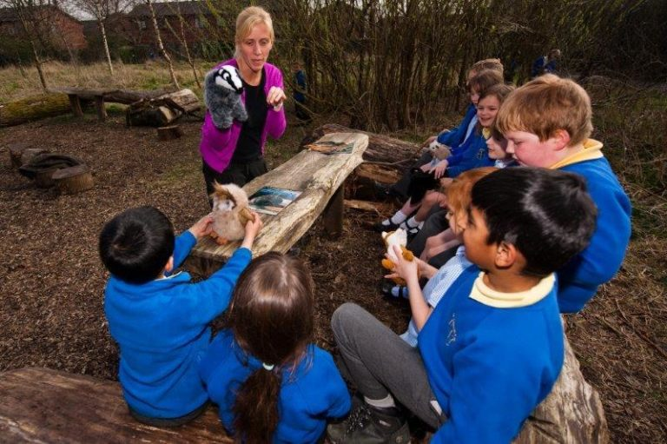
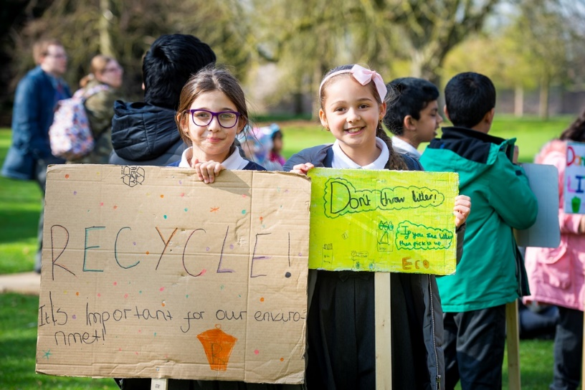
Preparing for your Green Flag Assessment Visit
In the days before your Green Flag Assessment, you should meet to discuss your achievements whilst working towards a Green Flag
You may also decide to gather evidence that helps demonstrate these achievements, for example: newsletters, photos, curriculum work and any monitoring your school has completed
Some Eco-Committees decide that they would like to prepare a short presentation for their Eco-Schools assessor – but not compulsory

Slide 45
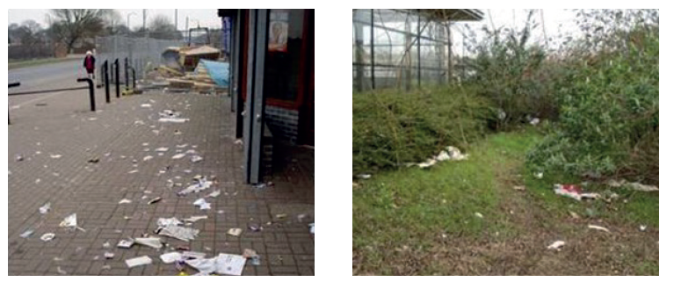
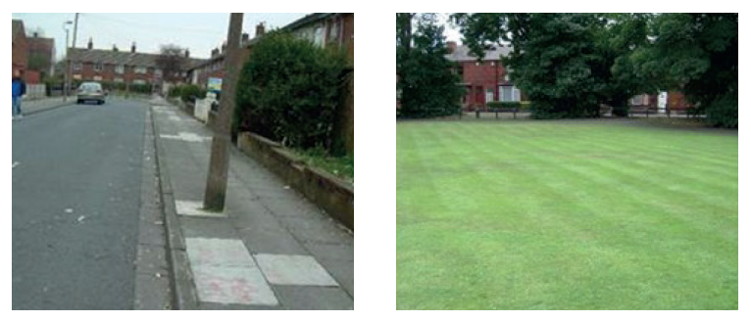
Preparing for your Green Flag Assessment Visit 2
Please Note: Even if your school has not picked the Litter topic in your Action Plan, your school will be graded on how much litter is present in your school grounds
You may want to organise a litter pick or picks in the days leading up to your assessment

Slide 46

The day of your Green Flag Assessment Visit
Green Flag assessment visits are a positive experience: they are one of the most rewarding parts of the Eco-Schools programme. The Eco-Schools team view assessor visits as a celebration and chance for schools to show off all of their hard work.
The Eco-Schools team only send an Eco-Schools Assessor to a school when, having desk-assessed their application
Eco-Schools programme is it is designed to be student-led, this should be reflected in your assessment visit – let the Eco-Committee lead the visit!
An assessment visit usually lasts between 1.5 and 2 hours and during that time the assessor will grade your school against each of the Eco-Schools Seven Step criteria and on the amount of litter in your school grounds.

Slide 47

The day of your Green Flag Assessment Visit 3
The most common format of an assessor visit is:
A meeting with the whole Eco-Committee (the Eco-Committee can deliver a presentation if they have prepared one).
A tour of the school with the Eco-Committee (stopping at the Eco-Board and viewing evidence of any topic work actions).
A chance for the Eco-Coordinator to talk to the Eco-Schools Assessor alone and show any additional evidence they may have gathered to support the Green Flag application.
A chance for the Eco-Schools Assessor to talk to a member of senior leadership (if possible) to deliver feedback.
Please Note: Eco-Schools carry out safeguarding checks on each of our volunteer assessors, however, they are not DBS checked as at no time during an assessment visit should they be left alone with students.

Slide 48

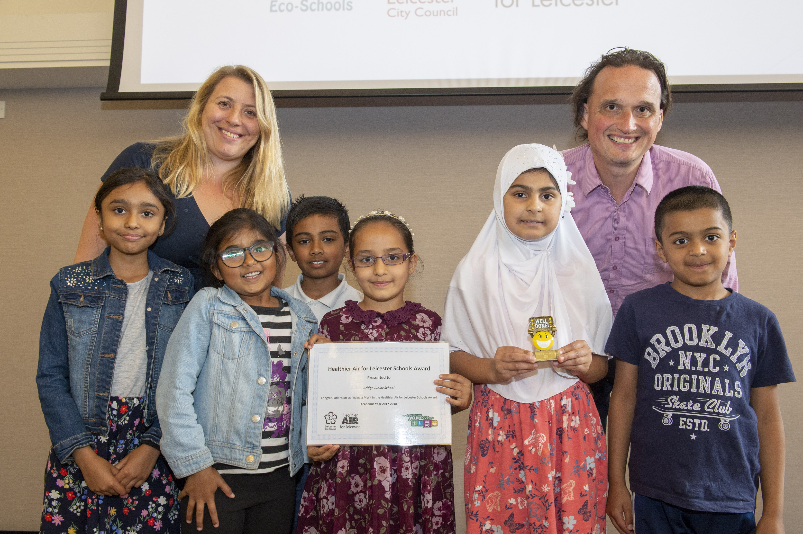
After your Green Flag Assessment Visit
The Eco-Schools Assessor will not tell you the outcome of your
assessment visit, they will contact the Eco-Schools team your
school within 48 hours. There are three possible assessment
results:
  Pass
  Pass with requirements
  Defer
The is one award: the Green Flag, so do not be disappointed to receive a pass
with requirements – you have still achieved a Green Flag
A pass with requirements grade simply means there is an aspect of the Green
Flag Seven Step Criteria that you will need to address when working towards
your next Eco-Schools Green Flag in two years’ time

Slide 49
After your Green Flag Assessment Visit 2
After you have found out your result, the Eco-Schools team will send you an invoice for £200 +VAT.
Unfortunately, as a charity, Eco-Schools has to charge for a Green Flag assessment to cover the cost of a Green Flag as well as administration and assessor expenses.
Once your school has paid the invoice, the Eco-Schools team will send your certificate, Green Flag and letter containing any requirements to work on in the future.
Upon logging in to your Eco-Schools account, you will also now have access to the Eco-Schools logo to use on your school’s website or letter-headed paper.
Leicester Schools can have their Green Flag Sponsored by several organisations – there is a short application form

Slide 50
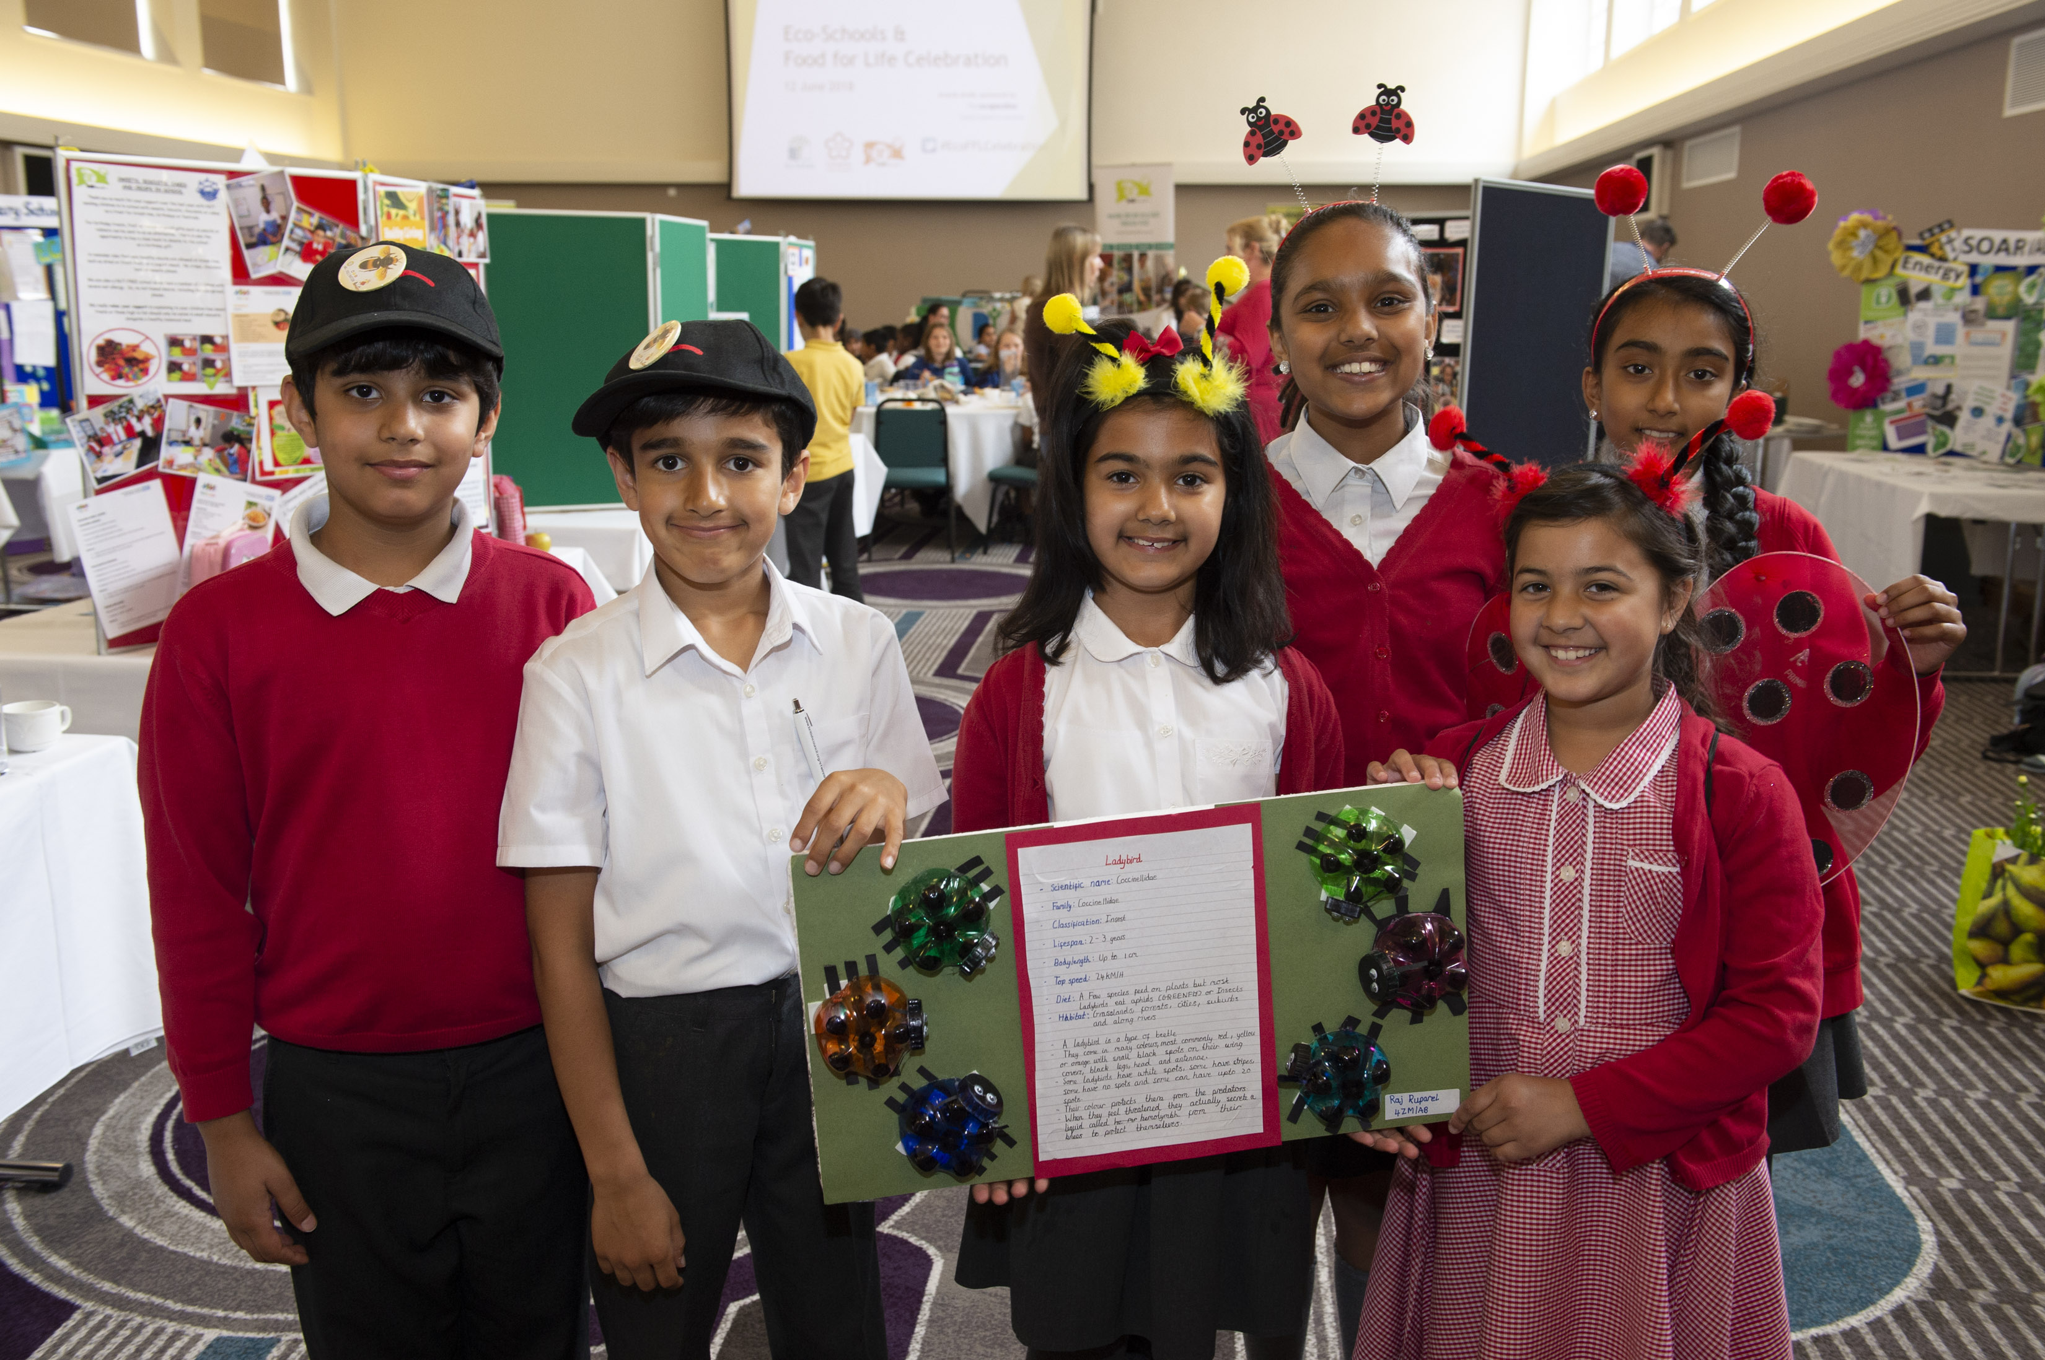
After your Green Flag Assessment Visit 3
Your Green Flag award lasts for two years
For your next Green Flag application you are expected to work on five Eco-Schools topics (this includes continuing the three topics from your initial Green Flag and two, new additional topics)
With every subsequent renewal we ask you to change a further two topics, until eventually your school will have covered all ten topics – just not all at once!

Slide 51
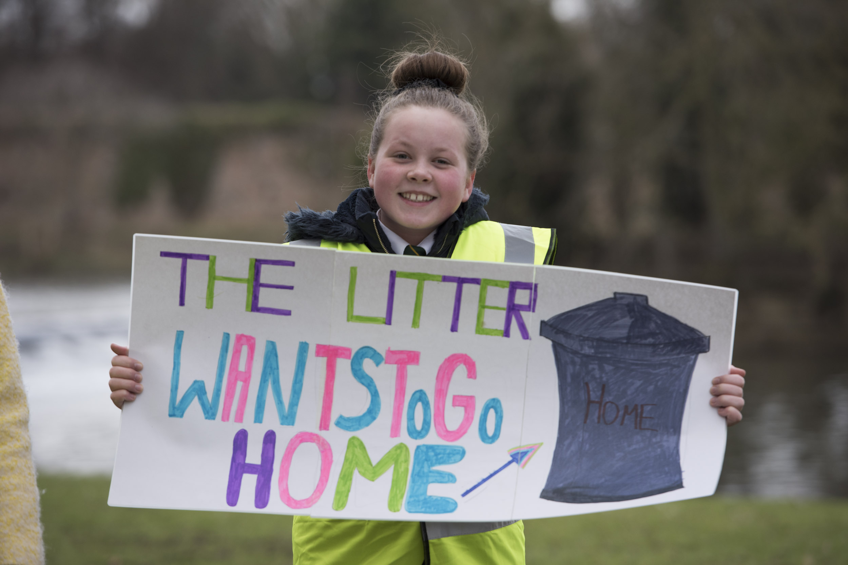
Renewing your Green Flag
Your Green Flag award lasts for two years and for your next Green Flag application you are expected to work on five Eco-Schools topics (this includes continuing the three topics from your initial Green Flag and two, new additional topics).
With every subsequent renewal we ask you to change a further two topics, until eventually your school will have covered all ten topics – just not all at once!

Slide 52


Water fountain competition
Leicester Water Fountain
Competition​

Slide 53


BESS ​
Energy​
schools.leicester.gov.uk/BESS-Energy​

Slide 54

Declaring a Climate Emergency in School
On 1 February 2019 Leicester City Council declared a Climate Emergency. The declaration is an acknowledgement that:
  Climate change is happening, and threatens the wellbeing of everyone in Leicester and worldwide
  The speed and scale of global and local action to tackle the problem needs to be dramatically increased.
In its declaration, the Council committed to developing a new action plan to address the emergency through our own services and projects .
What action you can do:
Discuss your plans with students and staff .
Select actions which you plan to achieve, make them manageable but also remember we are in a Climate Emergency.
Make sure your actions have a duration, responsibilities and an evaluation.
Take your action plan to the Governing Body or Trustees to ensure that you have their support.
You can submit your action plan to the City Council which we will publicise as part of our wider action plan.
Start your action plan!
Review regularly to check and maintain your progress .
schools.leicester.gov.uk/climate-emergency

Slide 55
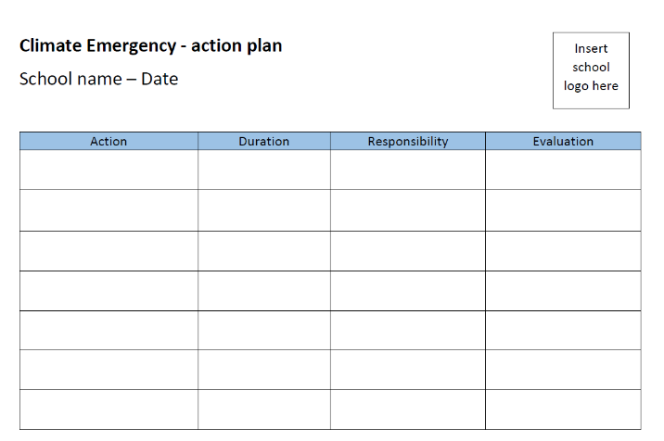

Climate Emergency Documents
Templates and document available at schools.leicester.gov.uk/climate-emergency

Slide 56
Other opportunities coming up
UN Climate Change Learn Online
  Climate Change: From Learning to Action (8 hours)
  Children and Climate Change (6 hours)
  Cities and Climate Change (2 hours)
  Human Health and Climate Change (2 hours)
  Module 1 of Open Online Course on Gender and Environment (6 hours)
Off School website - a free website full of ideas for home learning and fun activities. Head to the Activity Zone for 100s of films, created by teachers, across loads of great topics and themes!

Slide 57
How can we help next academic year?

Slide 58

Questions and Answers

Slide 59






Keeping in Touch
EcoSchoolsLCC
EnvEducationLeicester
EcoSchoolsLCC
EcoSchoolsLCC
schools.leicester.gov.uk/eco-schools
Eco-Schools@leicester.gov.uk
(sign up for newsletter and eBulletins)

