Slide 1
#EcoTeach Webinar Marine Holding screen
The webinar will start here soon…

Slide 2
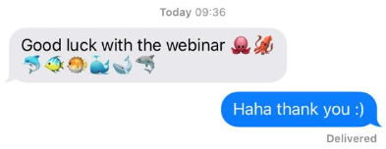
#EcoTeach Webinar Marine
Alex Cameron, Daniel Coles and Roshni Jose
Flood Risk Engineers
Nicola Holt, Environmental Engagement Manager
Lee Jowett, Environmental Education Coordinator
Leicester City Council

Slide 3
#EcoTeachMeet Webinar Series
Overview of #EcoTeach format and dates/times of webinars
What Environmental Education Leicester is
Eco-Schools – and how it fits into the big picture
Marine projects
Q & As
Other opportunities coming up

Slide 4
Overview of #EcoTeach Webinar format and dates/times of webinars
Weekly at 10am during term time – lasting up to an hour, Leicester focused but suitable for everyone.
Recording and PowerPoint with links available afterwards at schools.leicester.gov.uk/eco-schools
During the presentation, ask questions in the chat box.
Questions and answers at the end – either directly ask or in chat box depending how many people are attending.

Slide 5
What is Environmental Education Leicester?
Provide free support to all Leicester School.
Communications with schools – social media (Twitter, Facebook, Instagram, YouTube), monthly eBulletins and quarterly newsletter.
TeachMeets, Eco-Schools Roadshow, Eco-Schools & Food for Life Celebration, Sustainable Schools Celebration bi-annual.
Focus on the Eco-Schools Award.
Delivery of energy and litter focused projects.
Project support and partnership working with internal and external organisation.

Slide 6
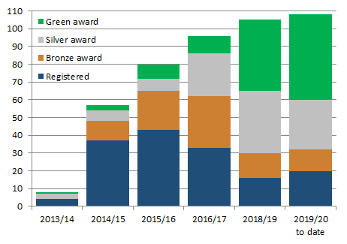
Eco-Schools – Our Work in Leicester
Promoted Eco-Schools as an award since September 2014 (114 schools)
109 registered on the programme
of those, 91 have achieved bronze
of those, 78 have achieved silver
of those 52 have achieved Green Flag

Slide 7
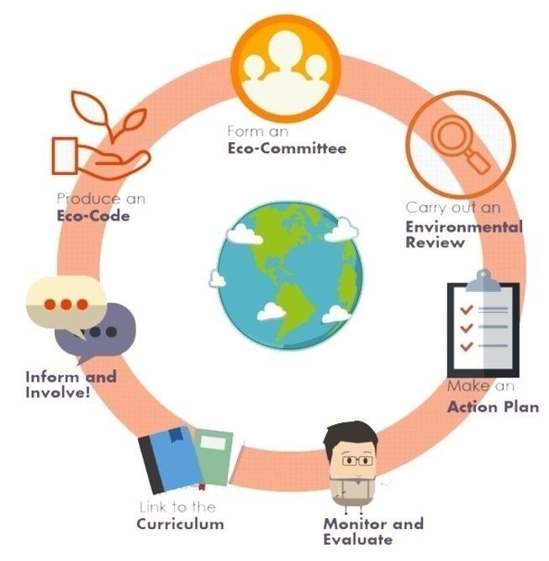
Eco-Schools Programme 7 step model

Slide 8
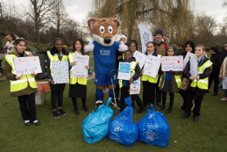
Step 1
Eco-Schools model - 7 steps 1
EYFS resources
Primary resources
Secondary resources
Step 1 – Eco-Committee, the heart of an Eco-Schools action and learning
At least one pupil form each year group
Meet at least once per half term
Share responsibility for running meetings
Records of minutes are kept
Minutes displayed on the Eco-board
Representative from parents, governors or senior leaders

Slide 9
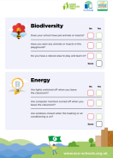
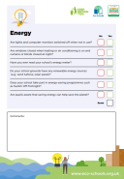
Step 2
Eco-Schools model - 7 steps 1
EYFS resources
Primary resources
Secondary resources
Step 2
EYFS
Primary
Secondary
Step 2 – Environmental Review – investigating the school's environmental performance
Covers all 10 Eco-Schools topics
A copy is displayed on the notice board
It is updated/reviewed at least every 2 years (best practice is annually)

Slide 10
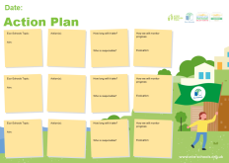
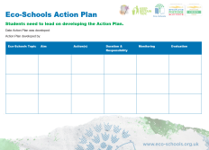
Step 3
Eco-Schools model - 7 steps
EYFS resources
Primary resources
Secondary resources
Step 3
Step 3 – Action Plan – Decide on topic actions, based on the result of the Environmental Review
The action plan is influenced by the review
Pupils take responsibility for learning on the topics
3 for the first green flag
5 for the renewal (changing 2 with each subsequent application)
Contains timescale, who is responsible and how it will be monitored
Shared with the whole school
A copy is displayed on the noticeboard

Slide 11
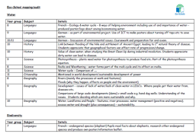
Step 4
Step 4
Eco-Schools model - 7 steps
EYFS resources
Primary resources
Secondary resources
Step 4 – Curriculum Links – making links between the school's environmental activity and the curriculum
Environmental issues are covered in at least three areas in your school curriculum, evident in schemes of work, pupils work and/or lesson plans (for first green flag this can be the same year group)
They do not need to be the same topics as your Action plan

Slide 12
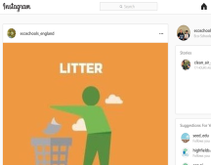
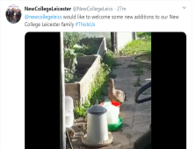
Step 5
Eco-Schools model - 7 steps
EYFS resources
Primary resources
Secondary resources
Step 5
Step 5 – Informing and involving – Let the whole school and wider community know what the Eco-Committee is doing
A prominent noticeboard in school
Covering the 7 steps and 3/5 topics
Members of the committee
Environmental review
Environmental action
Examples of monitoring and evaluation
Eco-code
Variety of mediums to communicate
The whole school and wider community is informed

Slide 13
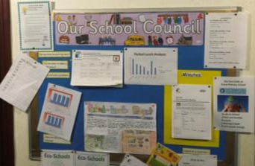
Step 6
Eco-Schools model - 7 steps
EYFS resources
Primary resources
Secondary resources
Step6
Step 6 – Monitoring and Evaluation – Measuring change and finding out what works and what doesn't
The committee monitors the effectiveness of the topics via data collections, surveys, before and after photographs
It is communicated with the whole school
Data has been analysed to help pupils develop further topic actions
Data has been used in the curriculum e.g. graphs and charts in math

Slide 14
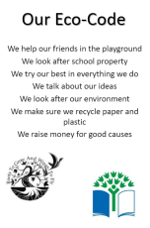
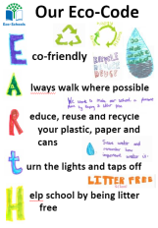
Eco-Schools model - 7 steps
EYFS resources
Primary resources
Secondary resources
Step 7
Step 7 – Eco-Code – Creating a call to action that the whole school can get behind
There is an agreement statement for your school drawn up by pupils
It reflects the topic actions you are working on
It is displayed around school e.g. classrooms, hall and the office
The majority of pupils and students understand is

Slide 15
Eco-Schools model 10 topics

Slide 16
Key things to think about in topics
Whole school opportunities
Informing everyone about the work
Links to curriculum areas e.g. science (materials), DT (construction, materials), English (persuasive writing) and maths (data handling)
Monitor impact of actions – weights and counting items – however photos before and after projects & surveys
Reflected in your Eco-code

Slide 17
Marine Projects
The Sea Starts Here
Yellow Fish
Bincentives
Do you know your Flood Risk?
Sustainable Drainage Systems (SuDS)
Riverbank Party Production
LEV Volunteers
Refill Leicester
Water Fountain Competition
Litter Innovation Project

Slide 18
Projects by the Flooding and Drainage Team
Bincentives
Sea Starts Here
Yellow Fish
Do you know your Flood Risk?
Sustainable Drainage Systems (SuDS)

Slide 19
The sea starts here
“The Sea Starts Here”
Notes:
(https://www.freepik.com/search?dates=any&format=search&page=1&query=cartoon%20river%20and%20town&sort=popular)
The Sea Starts Here is a new and exciting project that Leicester City Council have developed to help raise awareness of plastic waste, in particular single use plastics (straws, bottle and cups etc.) and the impacts that this can have in our urban environments and the knock on effects it can have on our rivers and oceans.
As the name and the picture suggests the sea starts in our urban environments .

Slide 20
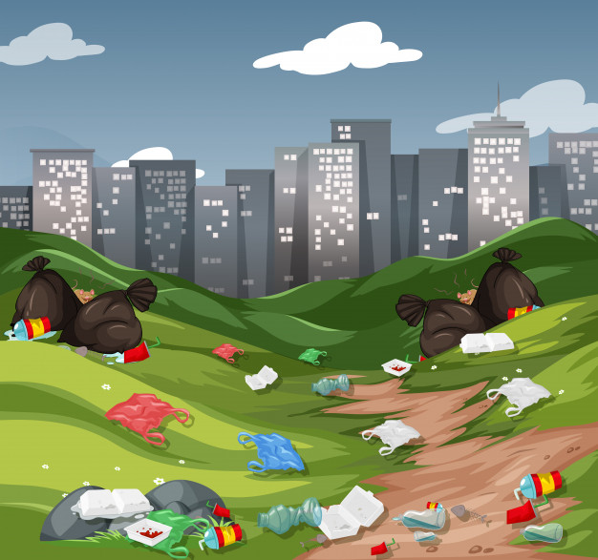
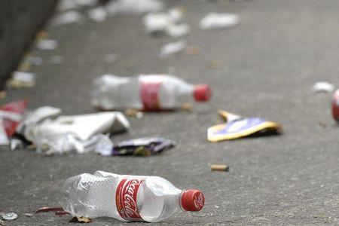
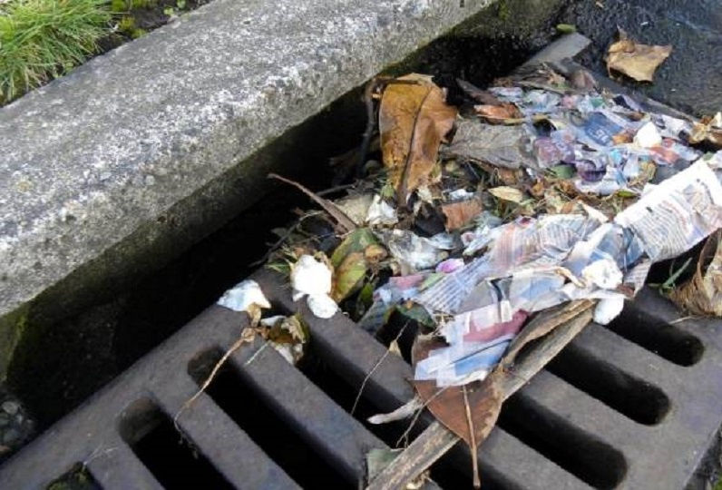
The Big Issue!
Raising awareness of the impact that plastic waste can have on the wider environment if it is not disposed of correctly.
Plastics dropped as litter can end up in our rivers and oceans causing pollution and harm to wildlife.
Contributing to increased flood risk in rivers and brooks due to blockages.
Opportunity to have stenciling of drains in their school grounds for up to 20 schools per academic year.
Help raise awareness and promote sustainable behavior in pupils, teachers, parents and the wider community.
Notes:
20
Raising awareness of the impact that plastic waste can have on the wider environment if it is not disposed of correctly.
Plastics dropped as litter can end up in our rivers and oceans causing pollution and harm to wildlife.
Contributing to increased flood risk in rivers and brooks due to blockages.
Opportunity to have stenciling of drains in their school grounds for up to 20 schools per academic year.
Help raise awareness and promote sustainable behavior in pupils, teachers, parents and the wider community.

Slide 21
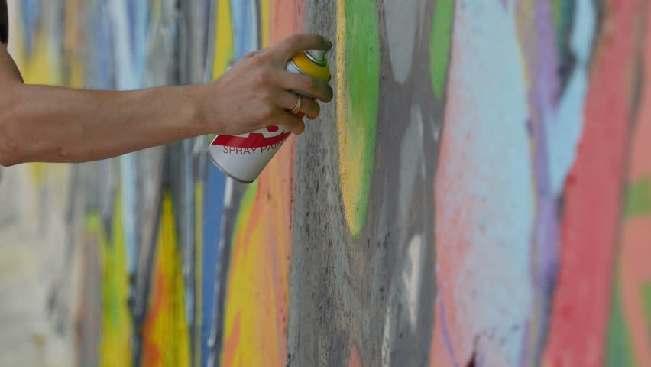
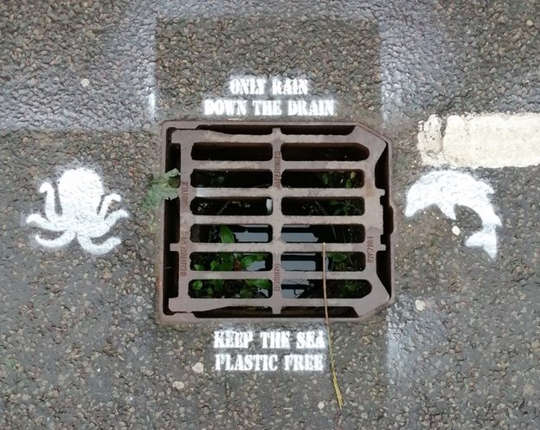
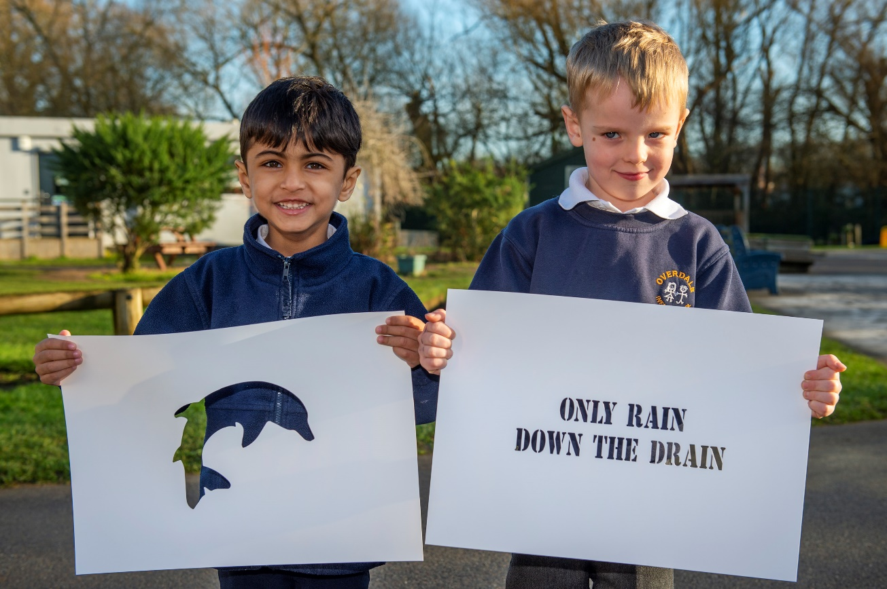
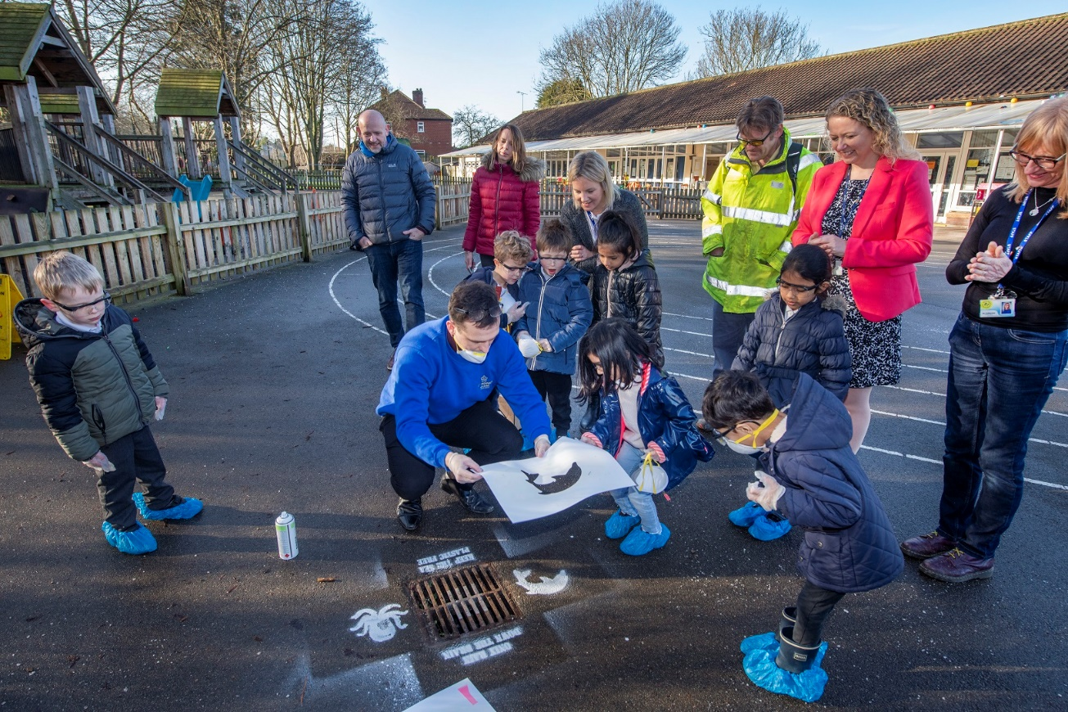
What’s involved?
Notes:
The project is split into two parts:
Part 1 - A welcome assembly to introduce the topic – delivered by a member of Leicester City Council staff – could be me, Lee or Amy.
Part 2 - A stencilling session in and around the school grounds – We’ll have contacted the school beforehand to determine appropriate drains, photo permissions etc.
Whole session lasts between 2 – 3 hours and can be completed as a morning or afternoon session.
Working with groups of 6 – 10 children – usually members from the schools eco-committee/eco-schools group.
Resources (Spray paint, stencils and risk assessment) and protective equipment (safety goggles, gloves, respirator and boot covers are )
All the team members are appropriately DBS checked and these will be brought along with Id Cards to any session.

Slide 22
Which Eco-Schools topics?
Notes:
A Sea Starts Here project in itself won’t satisfy an eco-schools topic. However, it is a great way to introduce the either the water and marine topic to pupils and support the curriculum.
Also, there’s potential for it to be combined with a litter initiative to become a fully fledged project.

Slide 23
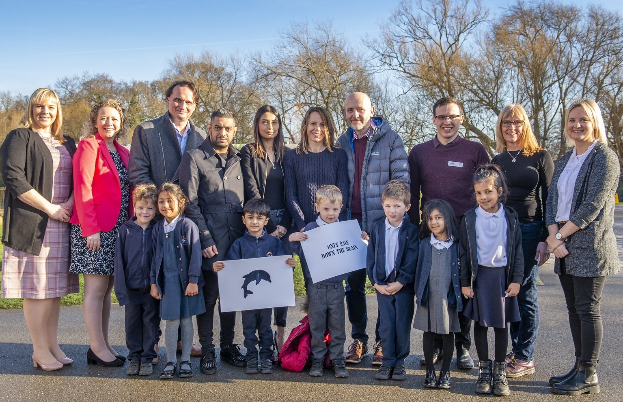
Sea starts here photo
Notes:
Overdale Infants Schools | stencil design winners and first school to take part in the Sea Starts Here project.
Their winning stencils will be used throughout the campaign and Councillor Adam Clarke attended stencilling session along with parents of the winning students – open to parents governors, teachers and staff.
Local Media coverage in the Leicester Mercury.
Due to Coronavirus and the shutdown of schools, we’re looking for schools to start taking part in sea starts here sessions from September onwards (Next academic year). Although we can begin earlier if its convenient for the schools when they reopen.

Slide 24
Yellow Fish Project
Notes:
Builds upon the messages that have been outlined in the Sea Starts Here and does share some similarities as you will see.
It was originally the developed by the Environment Agency – national organisation for managing the environment in the UK - Yellow Fish was an educational campaign, which looked at the water cycle and raising awareness of pollution (in all it’s forms) and the impacts that this has on our water and wider river and marine environments.
Leicester Council have adapted this into an extended 6 – 7 week project, which is suitable to satisfy one or more of the eco-schools topics and work towards green flag certification.

Slide 25
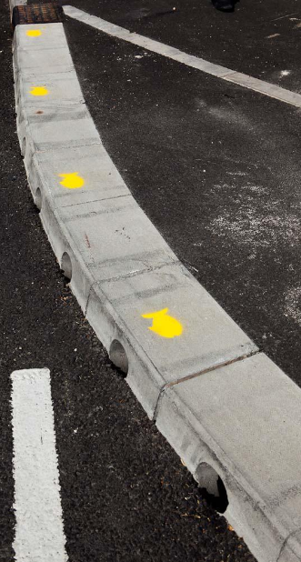
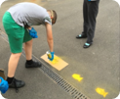
Yellow Fish
Yellow Fish teaches about the local environments, the water cycle and the role of drains and sewers.
Increases awareness on the effects and impacts of pollution on watercourses.
Focus on informing the wider community as part of the project.
It has cross-curricular appeal and can be applied at all Key Stages.
The delivery of the project can be adapted to suit students between year 3 – year 9.
The nature of the activities undertaken also makes Yellow Fish fantastic for developing Personal Learning, Thinking Skills and citizenship awareness.
Notes:
Extended project – with focus on riverine and marine environments
Yellow Fish teaches about the local environments, the water cycle and the role of drains and sewers.
Increases awareness on the effects and impacts of pollution on watercourses.
Focus on informing the wider community as part of the project.
It has cross-curricular appeal and can be applied at all Key Stages.
The delivery of the project can be adapted to suit students between year 3 – year 9.
The nature of the activities undertaken also makes Yellow Fish fantastic for developing Personal Learning, Thinking Skills and citizenship awareness.

Slide 26
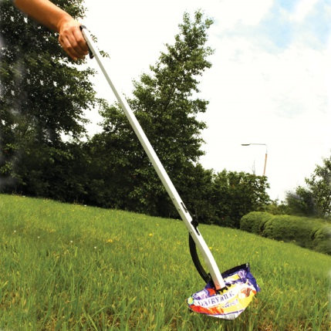
What’s Involved? 2
Week 1 - Project planning and Eco-Board preparation
Week 2 - Eco-committee announce the project
Week 3 - Pre Project Litter Pick
Week 4 - Putting up of Yellow Fish Posters around the school
Week 5 - Yellow Fish Stencil Design Session
Week 6 - Paint the Yellow Fish in and around the school grounds
Week 7 - Post-project Litter Pick
Notes:
7 Steps of a yellow fish project:
Project planning and Eco-Board preparation – done at eco-committee meeting led by the teachers – to determine dates for future activates, where the yellow fish can be sprayed, where posters should be placed and assign eco-committee member roles for the project
Eco-committee announce the project – either in an assemble or the eco committees. This can be led by teachers or students.
Pre Project Litter Pick – in and around the schools ground. All collected waste is then measured either as amount of bags collected or weighed.
Putting up of Yellow Fish Posters around the school – the posters that have been created in todays session are placed around the school to inform other students of the impacts of littering and to remind them to pick up litter.
Yellow Fish Stencil Design Session – 30/60 minute session where the stencils are created by students and then
Paint the Yellow Fish in and around the school grounds – at the places defined previously the yellow fish are sprayed using the stencils created. (semi permanent spray paint – 6-8weeks)
Post-project Litter Pick – to determine the impact of the project

Slide 27
Which Eco-Schools topics? 2
Notes:
Yellow Fish counts towards the water and marine topics.
Worked with Land of learning last year to undertake a Yellow Fish project.
Involvement of the local community faith group etc.

Slide 28
Bincentives – A cool seas campaign
“A Cool Seas Campaign”
Notes:
Bincentives is an Eco-Schools projects that aims to increase awareness of littering and the impacts that this can have on our wider environment, with particular focus on the river and marine environments. Promoting sustainable behaviour in students with regards to litter management by incentivising and rewarding students who practices dispose of and manage litter correctly.
The campaign is based on an idea by the Marine Conservation Society in collaboration with the British Plastics Federation and Plastics Europe.
It forms one of the four Cool Seas Campaigns projects. I do advise teachers to take a look at these and links to further information will be provided as part of the presentation.
By running this campaign we want to raise awareness of the problem of litter and help to reduce the issue in school as well as in our local area. And reward those students who help reduce the litter and spread the message.

Slide 29
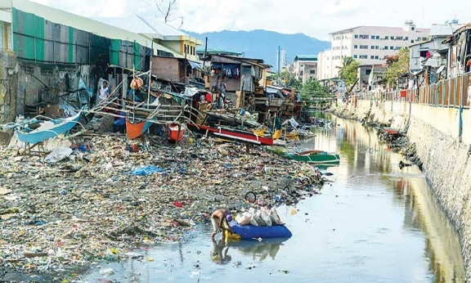
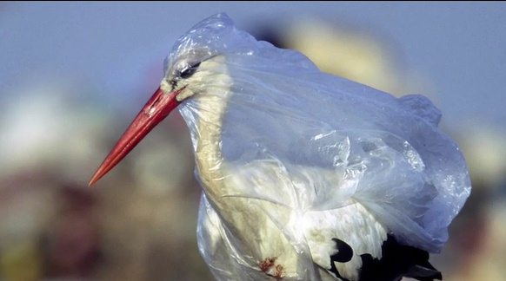
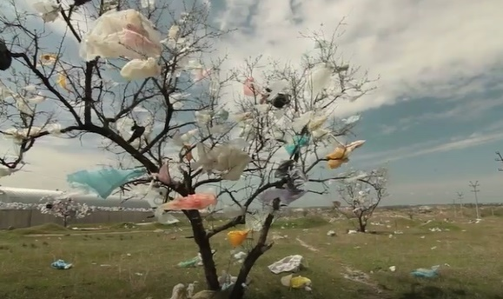
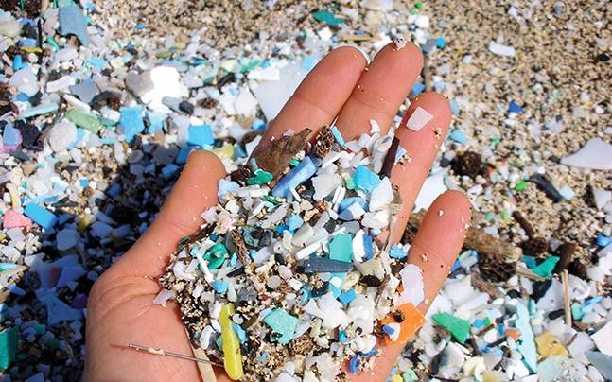
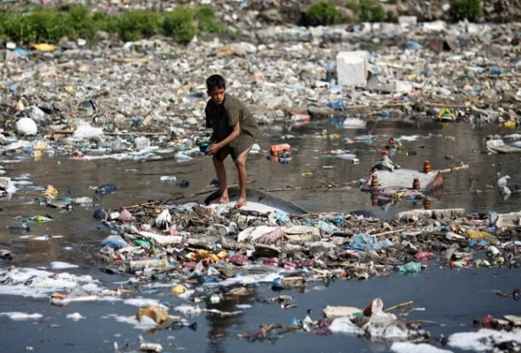
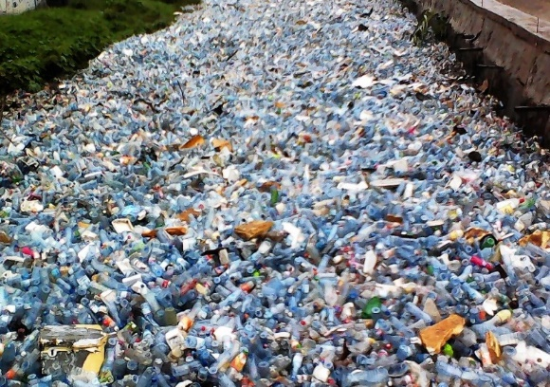
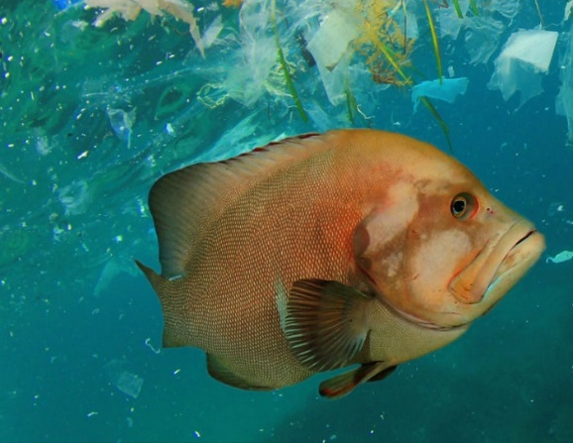
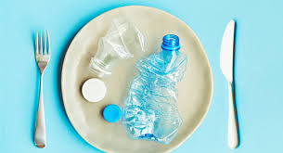
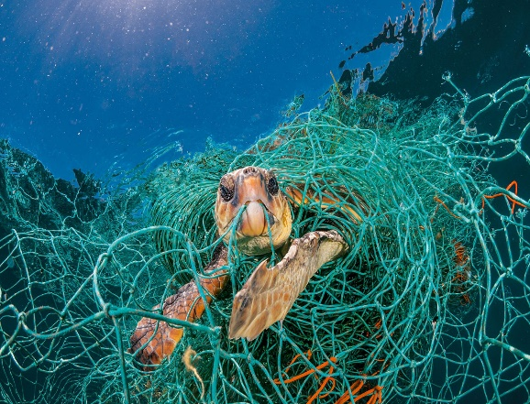
Bincentives
Bincentives teaches pupils about the importance of sustainable litter and waste management.
Increases awareness on the effects and impacts of litter in our urban environments and subsequently our marine environments.
Supports and builds on other litter and waste initiatives the school’s already undertaking. Recycling, crisp packet collections etc.
Promotes and rewards sustainable behavior in students.
Works towards multiple eco –schools topics.
Notes:
29
Environment
Animals & Plants
Flood Risk
Microplastics
Impacts on food and drinking water
Human Health
=
Overall impacts to people

Slide 30
What’s Involved? 3
Bincentives as a Eco-Schools Project
Earn House Points
Notes:
Doing Bincentives as an Eco-Schools Project:
The project is run over an entire term | 6-7 weeks – although it can be run indefinitely once started if considered desirable.
During one or two workshop sessions we’ll create a token reward scheme: where that students can earn tokens by putting litter in the bin, picking up litter on the floor and putting it in the bin, recycling etc. Teachers and the Eco Committee will be handing these tokens out.
Where recycling is not available, we’ll work towards implementing a recycling scheme (quite uncommon as most schools recycle)
The tokens then get handed into your form tutors and you can receive prizes such as: Discounts on events/trips, additional break times, counts towards school awards, house points, sweets and treats etc. - The incentives are created in collaboration with the teacher so that they are realistic and deliverable.
Awareness posters will be displayed around the school and on the Eco-Board
Project is formally announced in an assembly by the eco committee
Data is collected via a pre and post project litter pic or calculation of correctly recycled waste – this is adaptable

Slide 31
Which Eco-Schools topics? 3
Notes:
Bincentives works towards either the Waste minimisation, Litter and Marine topics.

Slide 32
Do you know your flood risk?
This project provides students:
An understanding of what flooding is and the different types of flooding
What is flood risk in Leicester
How to be "flood aware" and "flood prepared"
Interactive activities such as preparing a school flood plan and students recording their own radio/video clip
Notes:
The fourth project we offer is called "Do you know your flood risk". Flooding is likely to occur more frequently and have greater impacts as a result of climate change.
As part of the project, we introduce the topic of flooding and talk about different types of flooding. We outline why it is important to Leicester, as the city is in the top 10 cities at risk from surface water flooding. Then we do some activities to become more prepared for flooding.

Slide 33
Project structure
Week 1 - Introduction to flood risk and being flood aware
Week 2 - students find out about flood risk in Leicester and the area around the school
Week 3 - Potential site visit to a local park/nearby watercourse
Week 4 - Students create a flood plan for the school
Week 5 - Write a radio clip of a potential flood event
Week 6 - Students write up and reflect on project
Notes:
This is the structure of the project and it would be run over approximately 6 weeks.
In week 1, we introduce the topic of flooding, the different types of flooding and how to be flood aware
In week 2, the students would do an activity looking at flood risk in their local area
In week 3, we could do a site visit to learn about watercourses/parks and green spaces in the city
In week 4, the students will create a flood plan for the school
In week 5, we would do an exercise where the students write/record a radio clip from a potential flood event
Week 6 – reflection on what the students have learnt

Slide 34
Which Eco-Schools topics? 4
Notes:
"Do you know your flood risk" counts towards the marine topic, as the project aims to increase the understanding of the rivers and steams in our environment.

Slide 35
Previous work
Previous work on the project
Workshops carried out at 3 primary schools and 2 secondary schools in Leicester in 2019
Presented at the Eco-Schools Roadshow 2019
Notes:
We have run the introductory session of this project (ie. Week 1) at 5 schools in the city
Also the introductory session has been presented at last years Eco-Schools roadshow.

Slide 36
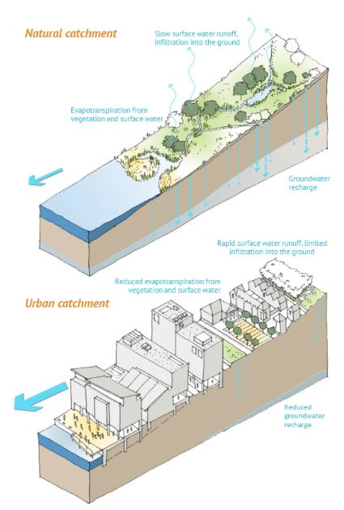
Sustainable Drainage Systems (SuDS)
Manage rainwater
Reduces flooding
Reduces pollution
Biodiversity and Amenity
Notes:
SuDS are the rainwater management systems that are built to manage the rain from where it falls. They mimic the natural drainage by using soft engineered solutions. They also help to reduce pollution, reduce flooding at the downstream of a catchment and also increase biodiversity and amenity.
To give some context, the next figure shows the normal catchment and urban catchment. When it rains, the rain water will seep through the natural ground allowing ground water recharge. But, I case of urban catchment, the rain water will not be able to seeps through the ground as usual due to the pavements and concrete buildings. Therefore, we need to manage our rain water more sustainably and this is done using the SuDS.
Reference: Susdrain (https://www.susdrain.org/delivering-suds/using-suds/background/sustainable-drainage.html)

Slide 37
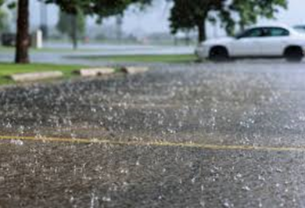
Introduction
Rain
Enters
Drain
Notes:
When the rain hits the ground, it will seeps through if it is a natural ground. But, in case of roads and pavements the rain will fall to the nearest drain.
If the drain s blocked, or if there are no spce for the wain water to go, flooding occurs.
The SuDS techniques helps to reduce flooding in urban areas and manage the rainwater more naturally.

Slide 38
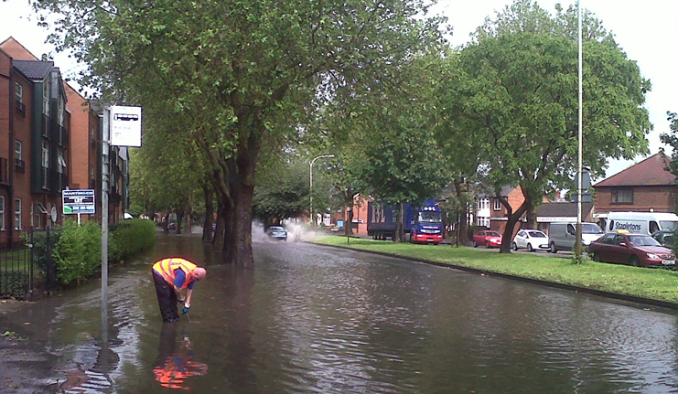
Image of flood

Slide 39
SuDS types
Water Butt
Tree Pit
Rain garden
Permeable Paving
Swales
Ponds
Notes:
There a number of SuDS types: some of them are mentioned here.
Water butts: Used to store water at individual houses. This water can be used for gardening and car washing
Tree Pits: Used mainly in urban areas like city centre, to control water flow and reduces air pollution and provides amenity
Rain garden: Shallow landscaped depressions that can reduce runoff, store water, provide habitat and biodiversity
Permeable Paving: Allow rainwater to infiltrate through underlying structural layers. Either stored or controlled discharge to downstream. Mainly seen at car parks and drive ways.
Swales: Shallow vegetated depressions, flow of water from one section to another. It allows to treat and attenuate surface runoff
Ponds: Permanent pool of water that provide treatment and attenuation, Provide amenity and biodiversity

Slide 40
7-week course: Design and Build a Rain Garden
Week 1: Introduction to staff and students (LCC staff)
Week 2: Exercise - Students and teachers research on the project
Week 3: Field visit - Find permeable paving and water butts near school
Week 4: Exercise - Find the materials to build a raingarden (LCC Staff)
Week 5: Build your own raingarden (LCC staff and Parks Volunteers)
Week 6-7: Project write up
Notes:
This is a 7 week project to Design and Build a Rain Garden.
Week 1: Introduction to staff and students about SuDS and the project
Week 2: students and teachers are are expected to do some research on the SuDS topic. Also discuss the field visit next week
Week 3: The field visit to near by streets to spott permeable pavings and water butts. Use map of the area to select the streets (maximum 5-7 streets)
Week 4: Exercise to find the material for rain garden, location of rain garden and what type of rain garen they would like to build (flowers or begetables)
Week 5: Building of rain garden with the help of LCC staff and Parks Volunteers
Week 6-7: Write project report and monitor the rain garden

Slide 41
Eco-School topics covered
Notes:
SuDS not only reduces flooding and pollution it also increases biodiversity and amenity in the area.
Hence, this projects include the following eco-school topics. Water, Biodiversity

Slide 42
Useful resources
Cool Seas Campaign
Zero Waste Scotland
The Plastic Tide
Bincentives
Recyclenow
Water Community
5 Gyres Institute
Keep Britain Tidy
Eco-Schools
Savewatersavemoney
Floods Video
Flood Toolkit
SuDS for schools
Designing Rain Gardens
10000 Rain Gardens for Scotland
Notes:
To be added at the end of all 5 project slides.

Slide 43
How to get involved
How to get involved with any of these projects? Please contact:
Sea Starts Here, Yellow Fish and Bincentives: Alex Cameron | 0116 454 6834 | alex.cameron@leicester.gov.uk Lee Jowett | 0116 454 2271 | lee.jowett@leicester.gov.uk Flood Risk Daniel Coles | 0116 454 6880 | Daniel.coles@leicester.gov.uk SuDS (Sustainable Drainage Systems): Roshni Jose | 0116 454 4236 | Roshni.Jose@leiceter.gov.uk
Notes:
To be added at the end of all 5 project slides.

Slide 44
Leicester Environmental Volunteers (LEV)
Nicola Holt – Environmental Engagement Manager

Slide 45
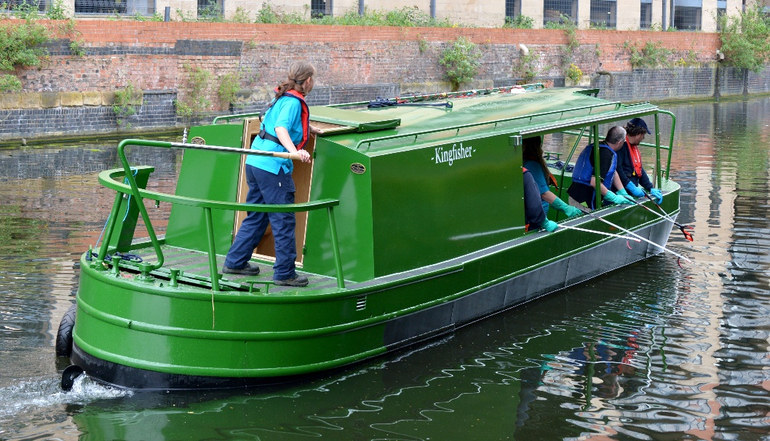
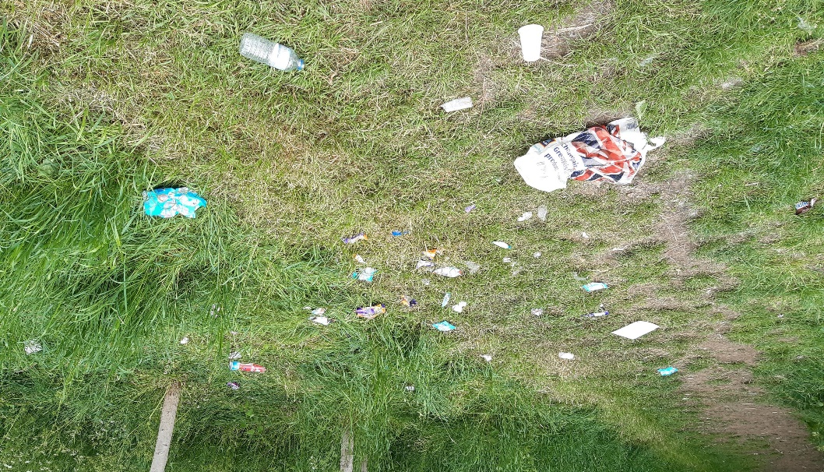
Leicester Environmental Volunteer Sessions
Experience the impact of litter in the marine environment by having a session on the Kingfisher with our trained and experienced Environmental Rangers.
Learn about the river corridor
Litter pick and protect wildlife
Visit our webpage for more information or email us:
www.leicester.gov.uk/parks-volunteering
LEV@Leicester.gov.uk

Slide 46
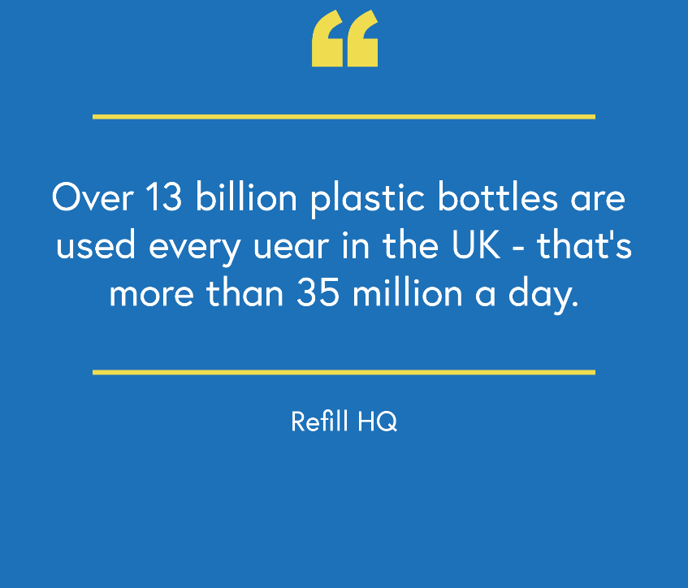
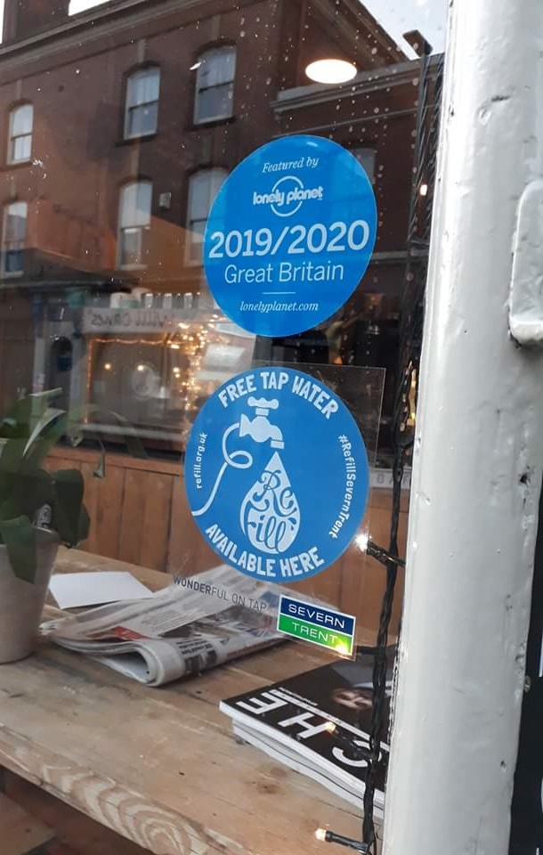
Refill Leicester
Reducing plastic pollution at source by providing access to free tap water.
Up to 12 million tonnes of plastic is entering our oceans every year!
One way to reduce plastic pollution, is to reduce single-use plastics and switch to reusables.
Refill is a scheme in which local businesses sign up as ‘Refill Stations’ to enable the public to refill their reusable bottle with tap water for free and without being a customer.
Use the free Refill app to look for Refill Stations, or look for the Refill sticker in the window.
Email - nicola.refill.leicester@gmail.com
Follow us on Twitter and Facebook - @LeicesterRefill

Slide 47
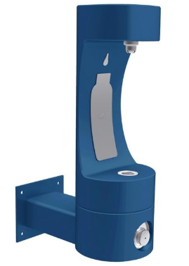
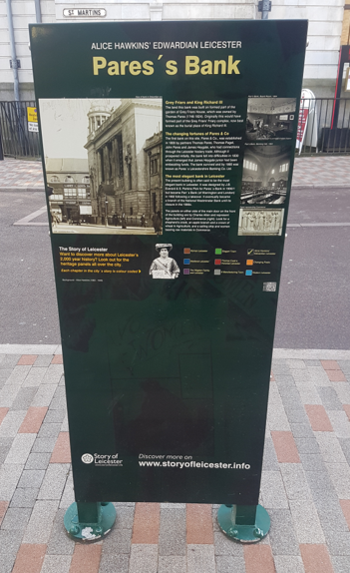
Water Fountain Design Competition
Design Brief
All information needs to be within the bottle outline
It can contain a slogan or phrase
There is no limit to how many colours
Deadline for entries: 5pm on Friday 3 July 2020
Scanned or photographed entries can be emailed to: eco-schools@leicester.gov.uk
Schools or individual parents/guardians can submit entries for this competition

Slide 48
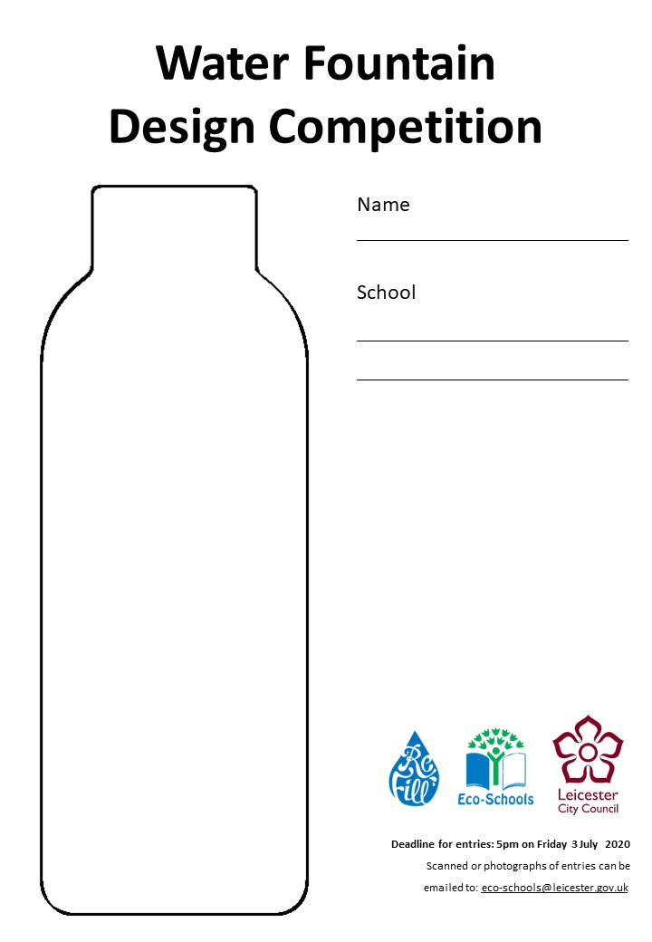
Water Fountain Design
schools.leicester.gov.uk/services/environment-health-and-well-being/environmental-education/competitions

Slide 49
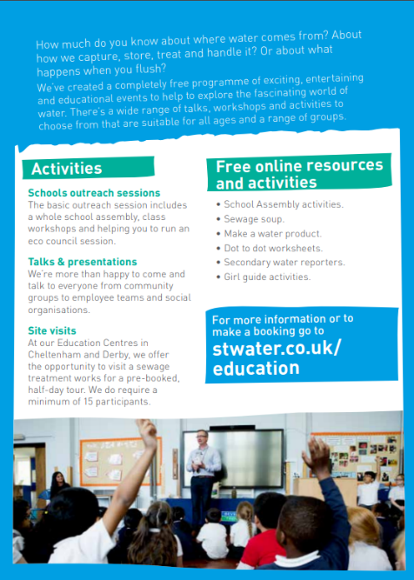
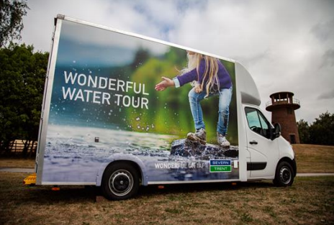
Severn Trent opportunities
Severn Trent offer free online resources and school visits including:
Hands-on workshops
Assemblies
Two interactive buses:
The Digibus - provides an immersive digital experience where you can track a raindrop from the sky, through the water treatment process, to the home, back through the sewers and the waste treatment process to the river.
The Experibus - imagine yourself as a scientist, an engineer, a call centre operative and much more to learn what it’s like to work in the water industry .
Wonderful water tour video
For more information visit: www.stwater.co.uk/about-us/education-zone/workshops-and-visits

Slide 50
World Water Day
Held on the 22 March every year since 1993.
Annual UN Observerance focusing on the importance of fresh water.
Ahead of the day, UN-Water launches a global public campaign via: www.worldwaterday.org

Slide 51
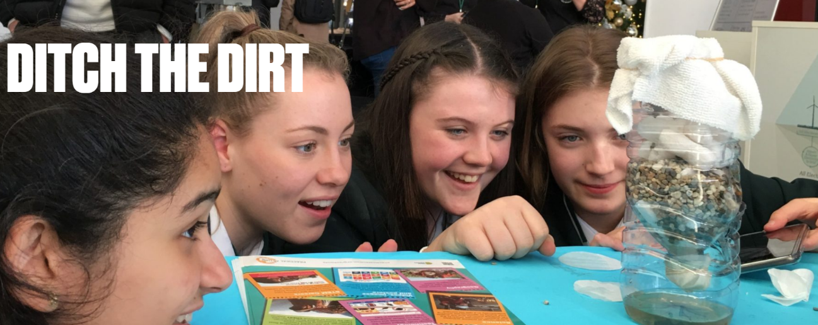
Practical Action
An international development charity whose education team support teachers, parents and carers with education material and training courses.
Many of Practical Action’s resources can be used to support the Eco-Schools topics.
Teacher notes, presentations, activity sheets, posters and certificates which can be downloaded:
Beat the Flood
Regreening the desert
Ditch the dirt
For more information:
practicalaction.org/schools/eco-schools

Slide 52
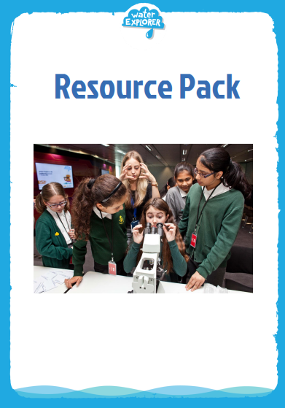
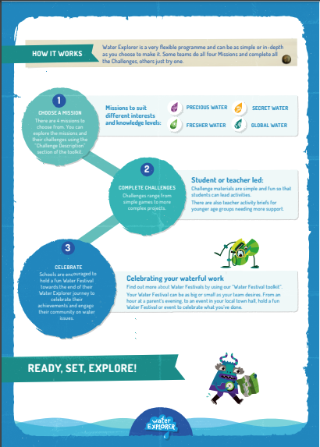
Water Explorer – water projects
Water Explorer inspires and equips students aged 8-14 all over the world to take bold and powerful action to save our precious water through fun water saving Missions.
A downloadable pack for schools and youth groups is availiable in the website. In the pack you will be able to find:
The Challenge toolkit which introduces you to Water Explorer, how the programme works and what it involves.
Resource pack which includes all the challenges, lesson plans and supporting resources.
Water Festival toolkit which aims to inspire and equip you with activities to run your very own water awareness event.
For more information visit: https://www.waterexplorer.org/

Slide 53
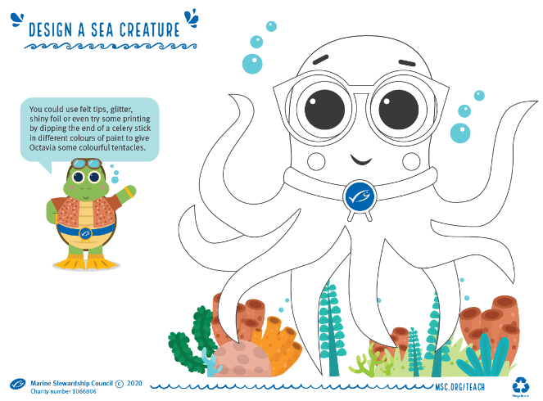
Marine Steward Council (MSC)
Check if fish served in your school is MSC certified
Resources, activities and lesson plans on the oceans and seas Year 1 – Year 13
www.msc.org/for-teachers/teach-learn-about-ocean-sustainability

Slide 54
Plastic Free Schools
Plastic free schools is a pupil led education programme to reduce plastic in and around school.
Created to hit key curriculum targets from KS1 – KS3, their five ‘objectives’ guide students through the plastic free schools process in an easy to understand, purposeful and fun way!
There are five lesson plans each for KS2 and KS3 which explore how and why we use plastic, what happens to it once we’re done and how it’s affecting our coastlines.
www.sas.org.uk/plastic-free-schools

Slide 55
Plastic Free Schools 2

Slide 56
Balloon releases

Slide 57
Riverbank Party at Highfields
Schools from Highfields and Spinney Hills area of the city have been learning all about the impact of inappropriate feeding of our river wildlife and the tremendous impact it has on their growth and development.
The performance focused on educating our future generation on the growing issue of inappropriate food and associated offerings being thrown into our watercourses, by highlighting the consequences of human activity on aquatic wildlife
Over 1500 primary and junior aged children attended the theatre production in a week long run.

Slide 58
Litter Innovation Fund
As part of the Litter Innovation Fund, funded by DEFRA and managed by Wrap UK, Leicester City Council are conducting a media campaign involving local schools to highlight the issue of litter in Leicester and beyond.
The campaign comprises of a series of short, hard-hitting clips to be used in digital media across the city.
Three key themes which will be addressed;
Litter down drains
Fly-tipping
How litter impacts wildlife

Slide 59
Litter Innovation Fund 2
The clips have been filmed by a professional film crew and star children from six Leicester Schools
All clips have been subtitled in English and subtitled in the 10 most spoken languages in Leicester: Gujarati, Urdu, Punjabi, Bengali, Somali, Arabic, Farsi, Polish, Slovak and Chinese
We will be conducting litter surveys, both before and after the campaign, in areas local to schools in order to assess the impact the campaign has
schools.leicester.gov.uk/litter

Slide 60
Marine pollution 2

Slide 61
Marine pollution 1

Slide 62
Declaring a Climate Emergency in School
On 1 February 2019 Leicester City Council declared a Climate Emergency. The declaration is an acknowledgement that:
Climate change is happening, and threatens the wellbeing of everyone in Leicester and worldwide
The speed and scale of global and local action to tackle the problem needs to be dramatically increased.
In its declaration, the Council committed to developing a new action plan to address the emergency through our own services and projects .
What action you can do:
Discuss your plans with students and staff .
Select actions which you plan to achieve, make them manageable but also remember we are in a Climate Emergency.
Make sure your actions have a duration, responsibilities and an evaluation.
Take your action plan to the Governing Body or Trustees to ensure that you have their support.
You can submit your action plan to the City Council which we will publicise as part of our wider action plan.
Start your action plan!
Review regularly to check and maintain your progress .
schools.leicester.gov.uk/climate-emergency

Slide 63
Climate Emergency Documents
Templates and document available at schools.leicester.gov.uk/climate-emergency

Slide 64
Other opportunities coming up
UN Climate Change Learn Online
Climate Change: From Learning to Action (8 hours)
Children and Climate Change (6 hours)
Cities and Climate Change (2 hours)
Human Health and Climate Change (2 hours)
Module 1 of Open Online Course on Gender and Environment (6 hours)
Off School website - a free website full of ideas for home learning and fun activities. Head to the Activity Zone for 100s of films, created by teachers, across loads of great topics and themes!

Slide 65
Grant opportunities
eTeach link
Grants 4 Schools

Slide 66
Questions and Answers

Slide 67
Future Webinars
1 July | Topic: How to submit your Green Flag application

Slide 68
Keeping in Touch
EcoSchoolsLCC
EnvEducationLeicester
EcoSchoolsLCC
EcoSchoolsLCC
schools.leicester.gov.uk/eco-schools
Eco-Schools@leicester.gov.uk
(sign up for newsletter and eBulletins)

