Slide 1

#EcoTeach Webinar
Global Citizenship and Fairtrade
The webinar will start here soon…

Slide 2
#EcoTeach Webinar
Global Citizenship and Fairtrade
Hannah Boydon, Deputy Headteacher, Mayflower Primary School
Ruth Sinhal, School Linking project Leicester
Lee Jowett, Environmental Education Coordinator
Amy Peace, Graduate Project Officer

Slide 3

#EcoTeachMeet Webinar Series
Overview of #EcoTeach format and dates/times of webinars
What Environmental Education Leicester is
Eco-Schools – and how it fits into the big picture
Global Citizenship and Fairtrade Projects
Q & As
Other opportunities coming up

Slide 4
Overview of #EcoTeach Webinar format and dates/times of webinars
Weekly at 10am during term time – lasting up to an hour, Leicester focused but suitable for everyone.
Recording and PowerPoint with links available afterwards at schools.leicester.gov.uk/eco-schools
During the presentation, ask questions in the chat box.
Questions and answers at the end – either directly ask or in chat box depending how many people are attending.

Slide 5

What is Environmental Education Leicester?
Provide free support to all Leicester School.
Communications with schools – social media (Twitter, Facebook, Instagram, YouTube), monthly eBulletins and quarterly newsletter.
TeachMeets, Eco-Schools Roadshow, Eco-Schools & Food for Life Celebration, Sustainable Schools Celebration bi-annual.
Focus on the Eco-Schools Award.
Delivery of energy and litter focused projects.
Project support and partnership working with internal and external organisation.

Slide 6
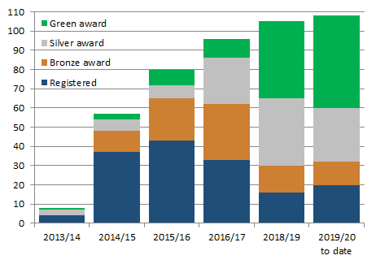

Eco-Schools – Our Work in Leicester
Promoted Eco-Schools as an award since September 2014 (114 schools)
109 registered on the programme
of those, 91 have achieved bronze
of those, 78 have achieved silver
of those 48 have achieved Green Flag

Slide 7
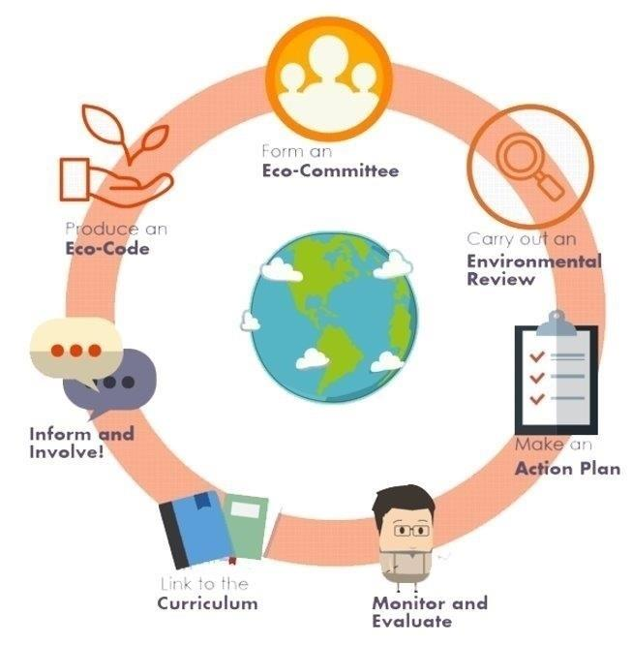

Eco-Schools Programme
7 step model

Slide 8

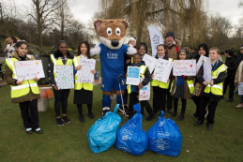
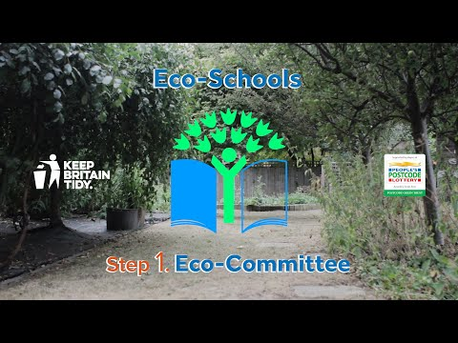
Step 1
Eco-Schools model - 7 steps 1
EYFS resources
Primary resources
Secondary resources
Step 1 – Eco-Committee, the heart of an Eco-Schools action and learning
  At least one pupil form each year group
  Meet at least once per half term
  Share responsibility for running meetings
  Records of minutes are kept
  Minutes displayed on the Eco-board
  Representative from parents, governors or senior leaders

Slide 9
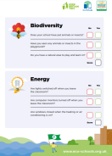
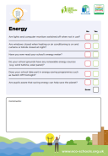


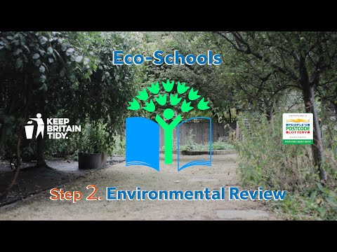
Step 2
Eco-Schools model - 7 steps 1
EYFS resources
Primary resources
Secondary resources
Step 2
EYFS
Primary
Secondary
Step 2 – Environmental Review – investigating the school's environmental performance
  Covers all 10 Eco-Schools topics
  A copy is displayed on the notice board
  It is updated/reviewed at least every 2 years (best practice is annually)

Slide 10
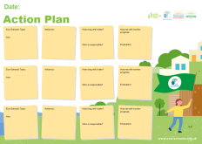
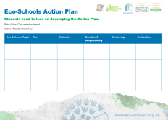
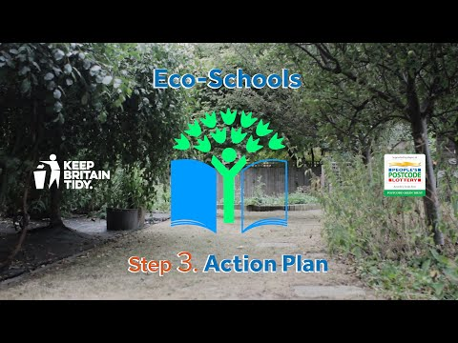
Step 3
Eco-Schools model - 7 steps
EYFS resources
Primary resources
Secondary resources
Step 3
Step 3 – Action Plan – Decide on topic actions, based on the result of the Environmental Review
  The action plan is influenced by the review
  Pupils take responsibility for learning on the topics
    3 for the first green flag
    5 for the renewal (changing 2 with each subsequent application)
  Contains timescale, who is responsible and how it will be monitored
  Shared with the whole school
  A copy is displayed on the noticeboard

Slide 11
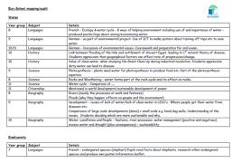


Step 4
Step 4
Eco-Schools model - 7 steps
EYFS resources
Primary resources
Secondary resources
Step 4 – Curriculum Links – making links between the school's environmental activity and the curriculum
  Environmental issues are covered in at least three areas in your school curriculum, evident in schemes of work, pupils work and/or lesson plans (for first green flag this can be the same year group)
  They do not need to be the same topics as your Action plan

Slide 12
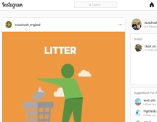
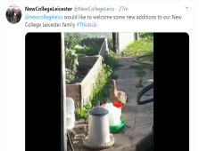
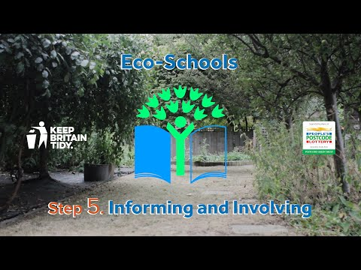
Step 5
Eco-Schools model - 7 steps
EYFS resources
Primary resources
Secondary resources
Step 5
Step 5 – Informing and involving – Let the whole school and wider community know what the Eco-Committee is doing
  A prominent noticeboard in school
    Covering the 7 steps and 3/5 topics
    Members of the committee
    Environmental review
    Environmental action
    Examples of monitoring and evaluation
    Eco-code
  Variety of mediums to communicate
  The whole school and wider community is informed

Slide 13
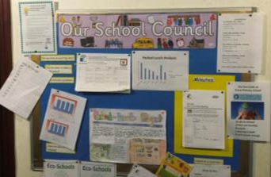

Step 6
Eco-Schools model - 7 steps
EYFS resources
Primary resources
Secondary resources
Step6
Step 6 – Monitoring and Evaluation – Measuring change and finding out what works and what doesn't
  The committee monitors the effectiveness of the topics via data collections, surveys, before and after photographs
  It is communicated with the whole school
  Data has been analysed to help pupils develop further topic actions
  Data has been used in the curriculum e.g. graphs and charts in math

Slide 14

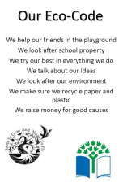
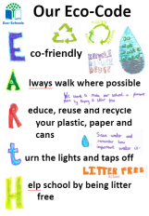
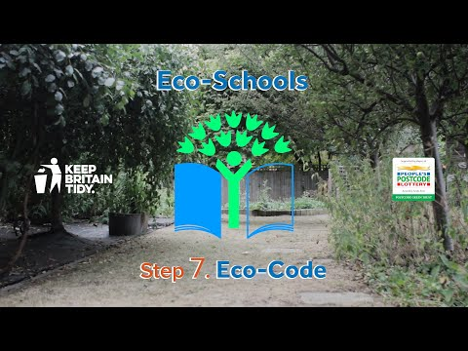
Eco model - 7 steps
EYFS resources
Primary resources
Secondary resources
Step 7
Step 7 – Eco-Code – Creating a call to action that the whole school can get behind
  There is an agreement statement for your school drawn up by pupils
  It reflects the topic actions you are working on
  It is displayed around school e.g. classrooms, hall and the office
  The majority of pupils and students understand is

Slide 15


Eco-Schools model 10 topics

Slide 16

Key things to think about in topics
Whole school opportunities
Informing everyone about the work
Links to curriculum areas
Monitor impact of actions –photos before and after projects & surveys, changes in opinions
Reflected in your Eco-code

Slide 17

Global Citizenship Projects
British Council
Connecting Classrooms
eTwinning
Global Learning
Leicester Schools Linking
#EcoSchoolsAtHome
(Re) Love Our Gadgets
Send a Cow
World's Largest Lesson
Fairtrade Fortnight
Fairtrade Award
90kg rice challenge
Stride Magazine
Oxfam Education
Practical Action
Carbon Literacy

Slide 18


Slide 1
Schools have ALWAYS taught about the global dimension in many different ways across many different curriculum areas …

Slide 19
Since 2013 …
53 mobilities
30 staff members
(17 Teachers
13 TAs)
eTwinning
Comenius Project
Erasmus Plus Key Action 1 Project (x2)
International Schools Award
China Bridge
Global Learning Programme
Erasmus Plus Key Action 2 Project
Connecting Classrooms

Slide 20
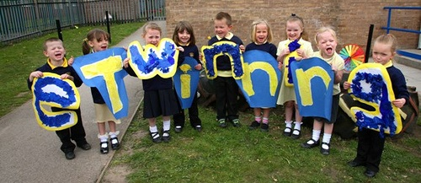

What is eTwinning?
eTwinning is the community for schools in Europe.
It was founded in 2005 and offers a platform for staff working in a school in one of the European countries involved, to communicate, collaborate, develop projects, share and, in short, feel and be part of the most exciting learning community in Europe.
It is funded in the UK by the European Commission and BIS and the British Council is the National Support Service (NSS) for eTwinning in the UK.

Slide 21
Aims of eTwinning
Facilitate collaboration between teachers in different countries in Europe
Allow teachers and pupils to work together online using various tools
Provide a multilingual platform for online work in 25 languages
Make it easy to use ICT in education
Notes:
21

Slide 22
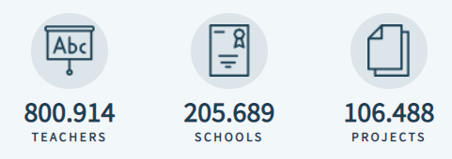
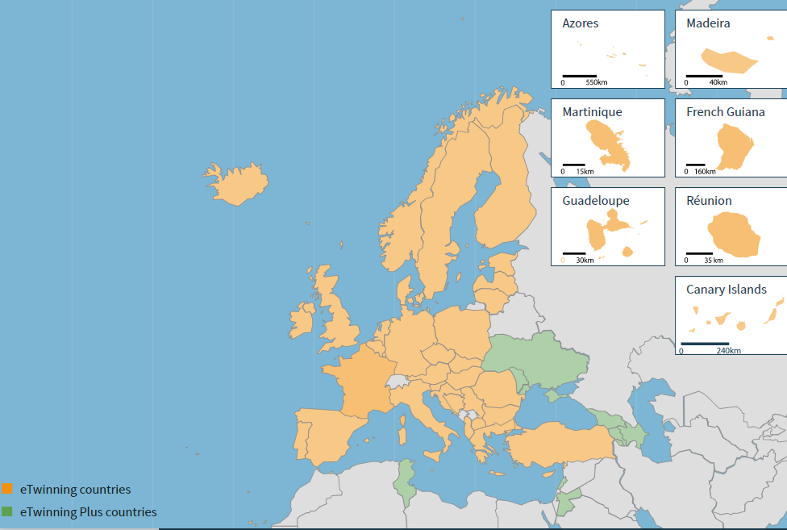
eTwinning Map
Notes:
A total of 43 eTwinning countries
33 European Countries:
All EU member states can participate
Plus Norway, Iceland, Turkey, Switzerland & FYR Macedonia.
From 2013 with the introduction of Etwinning plus 6 neighbouring countries can now participate: Armenai, Azerbaijan, Georgia, Moldova, Tunisia and Ukraine
From September 2014 - Albania, Bosnia and Herzegovina, Serbia, Liechtenstein can now participate
25 Languages
eTwinning website available in 25 languages to make it easier for all teachers across Europe to use eTwinning, not just those who are fluent in English.
You can change the display language of the website on the home page at www.etwinning.net.
There is a support team for every European country
Teachers
Teacher numbers are constantly changing but you can see the most up to date figures on the home page
For example, how many teachers are registered and who joined most recently.
Projects
eTwinning project numbers are constantly changing as teachers join eTwinning & start/finish collaborative projects at any time
Over 750 Yorkshire schools registered
Over 1200 Yorkshire teacher registered
22

Slide 23
Why use eTwinning?
Why use eTwinning?
Free resources
Safe online environment
No application form or lengthy admin process
Could be your 1st step to find a partner or could enhance an existing link
Real context for the children’s learning
Project space to work collaboratively
Support
Awards
Professional development opportunities
Notes:
Resources: Hundreds of categorised project ideas publically available for working with students aged 3-18 across various subject areas e.g. ‘Statistics and You’, Maths and Sciences, Age group 3-13
Safe environment: Online community of over 160, 000 teachers from 42 countries
Partner-finding tool: Once registered you can search online for partner schools and create joint projects
Project space: Once you’ve registered a project your project will be given it’s own virtual classroom where you can upload files, photos, videos, blogs, and wikis etc and use the live chat facility
Support: There is a complete package of free online resources available to support partnerships
Awards: Schools can apply for a Quality Label for their project and can use this work as part of their application for the International Schools Award
Professional Development opportunities As well as online networking with other teachers online, there are online learning opportunities and webinars

Slide 24
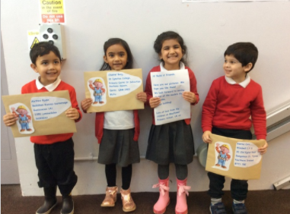
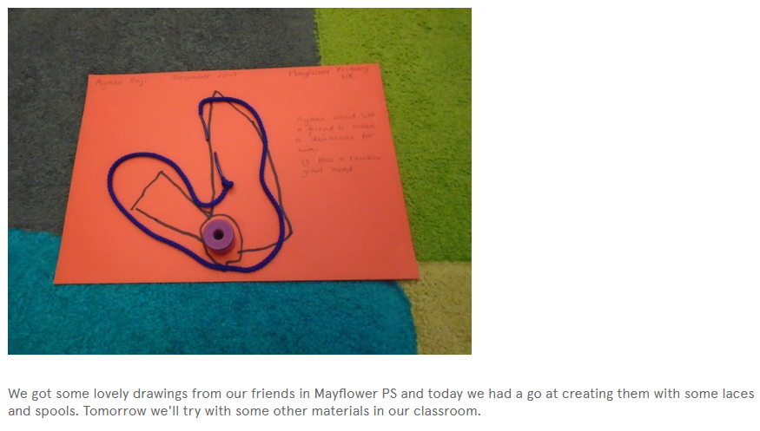
Build It

Slide 25
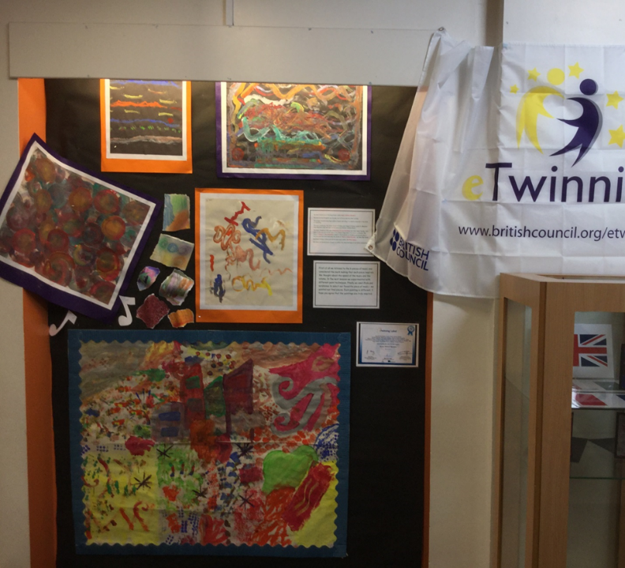
Music Without Borders

Slide 26

Schoolovision
Schoolovision is a unique eTwinning project which brings together children from countries right across Europe and beyond.
In 2018 year we are celebrating the 10th anniversary of our fun-filled partnership in the biggest and long-standing eTwinning project of all time.

Slide 27

eTwinning Schools
Congratulations on the success of your school obtaining the award of the eTwinning School Label 2018- 2019
It is a great achievement by all the eTwinning team in your school and an example to all schools in the eTwinning Community

Slide 28

Short Inspection of Mayflower Primary School 12th September 2017
Many aspects of the curriculum are exceptional
Staff and pupils are rightly proud of the school’s international links, environmental activities, sporting achievements, involvement in local heritage projects and anti-bullying work
The school has won more awards than can be listed here
However, perhaps the unique experience of being a pupil at Mayflower can be illustrated by noting that it is ‘officially’ the funniest school in Leicester (Leicester Comedy Festival Loving Laughter Award) and is England’s regular representative in the annual [eTwinning] Eurovision for Schools competition - (Schoolovision)
To sum up, your pupils, from 26 different ethnic groups, enjoy a fabulous curriculum that gives them a deep understanding of their own locality and of
the wider world

Slide 29

International School Award
We were so proud of all the international work we were doing so we decided to apply for…
The International School Award

Slide 30

British Council Awards

Slide 31

Erasmus Slide 1
Erasmus +
Key Action 1
Key Actions (also referred to as Actions) is the collective name for activities and projects that can be funded under Erasmus+.

Slide 32
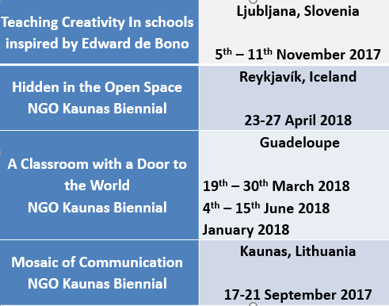
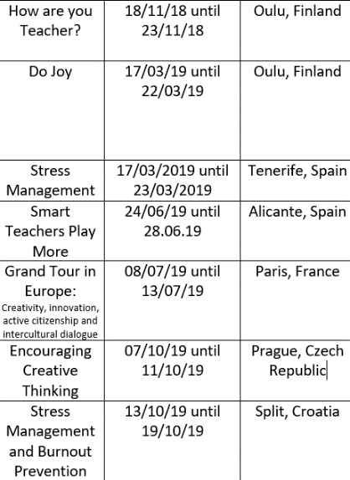

Erasmus Action Plan
Erasmus Plus Key Action 1
2017 – 2019 and 2018 - 2020

Slide 33
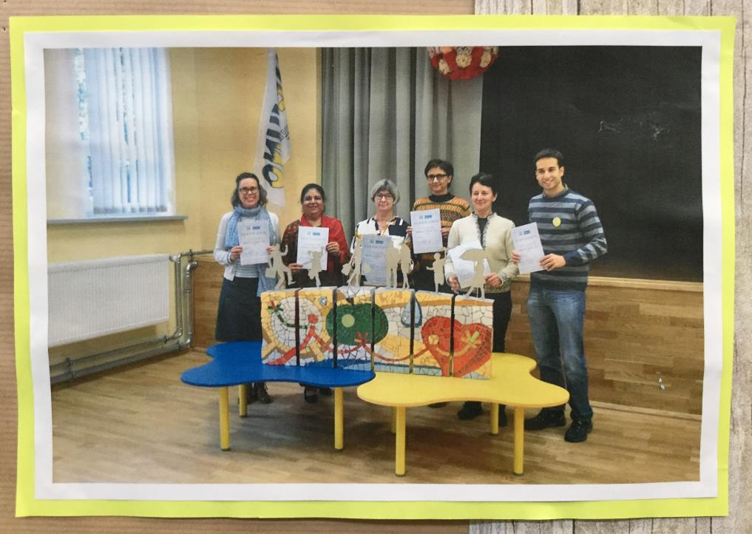
Erasmus slide 3

Slide 34
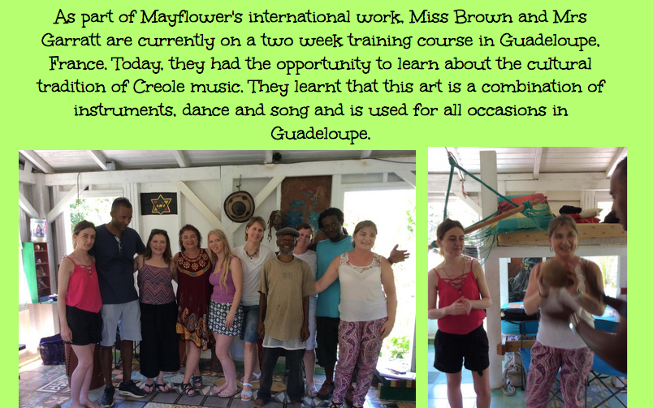
Erasmus slide 4

Slide 35


Erasmus Key Action 2
Erasmus +
Key Action 2
Key Actions (also referred to as Actions) is the collective name for activities and projects that can be funded under Erasmus+.

Slide 36
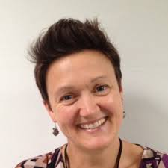

How did we get involved?
How did we get involved?
eTwinning!
Partner finding contact seminar in Lille January 2011
We met Laurent who had the idea for the ‘Move Your Buddy’ project!
Partnership was formed ☺

Slide 37

Our project idea
Our Project Idea -
Move Your Buddy
MYB (Move Your Buddy) was aimed at using sports as a means of increasing the (virtual and physical) mobility of pupils.
We wanted to increase pupils’ motivation to learn and use both ICT and foreign languages.
Through sports, they were encouraged to communicate in a foreign language.

Slide 38
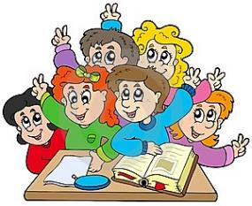
Our Partners
Our Partners
France - Laurent Lentrebecq
Ecole Albert Camus
221 rue Robert Schuman, Tourcoing
France – Jean-Michel Poppe
Ecole Jean Macé
62 rue du Flocon, Tourcoing
Malta – Anna Buttigieg
St Albert the Great College
Old Bakery Street, 160, VLT 1457, Valletta
Italy – Carlo Testi / Monica Di Salvatore
Instituto Comprensivo “Gandhi”
Via Golubovich 4, 50145, Florence
Belgium – Ann Vancoulle
Freinetschool De Vier Tuinen, Oudenaarde, Belgium (Greet)

Slide 39
Thinking allowed
Thinking Allowed
2017 - 2020

Slide 40
Erasmus Plus Key Action 2
Erasmus Plus Key Action 2
2017 – 2020
Thinking Allowed
Year 1 – Getting ready to think
Year 2 – Learning new thinking skills
Year 3 – Applying our new thinking skills to global citizenship issues

Slide 41
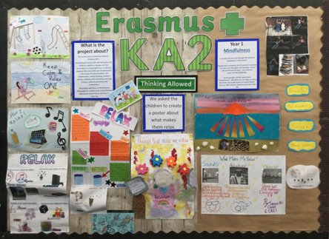
Year 1 Mindfulness
Year 1: Mindfulness

Slide 42
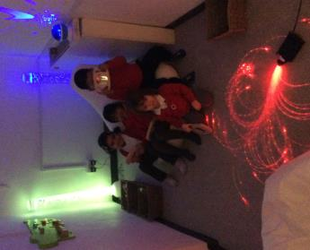
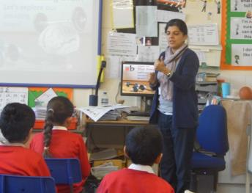
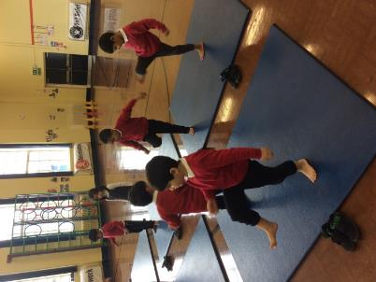

Mindfulness in the woods
A few things that have been happening this year to teach Mindfulness at Mayflower…
Sensory Room
Mindfulness lessons for both the children and parents.
Yoga lessons
Mindfulness in the Woods

Slide 43
Year 2: Thinking skills
Year 2: Thinking Skills
Philosophy for Children
Critical Thinking
Creative Thinking

Slide 44
Year 3: global learning
Year 3: Global Learning
UN Goals for Sustainable Development
Gender Equality
Life on Land
Life Under the Sea

Slide 45
Connecting Classrooms
Supporting global learning in your school

Slide 46
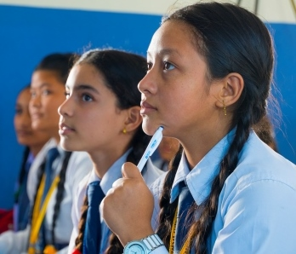
What is CCGL?
Connecting Classrooms through Global Learning
      International programme helping children to explore the Global Goals and make a difference to their world
      Work with an international partner school, attend training and access free resources
      For primary and secondary schools
      No cost to school
        Funded by the British Council and the Department for International Development (DFID)
Image © copyright

Slide 47

Global Learning
What is global learning?
    “Education that aims to inform learners about global issues, such as poverty, climate change and the rationale for UK Aid, and to equip them with the knowledge, skills and attitudes they need to live and work in a globalised economy and take action on poverty.”
    Department for International Development 2018
Image © copyright

Slide 48
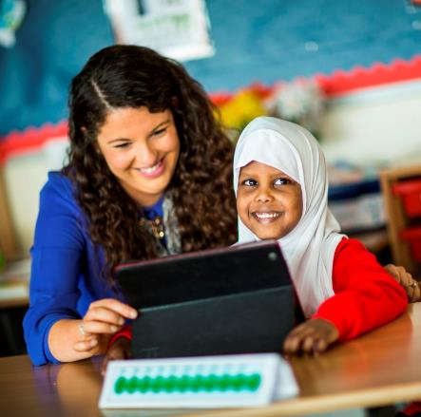
What do I get?
Support for your school
      Find a partner school in another country and get ideas for working together
      Free teaching resources on the Sustainable Development Goals
      Fully-funded professional development for your teachers
      Funding of up to £35,000 for clusters of UK schools with international partners, to support global learning activity
Image © copyright

Slide 49

Sustainable Development Goals

Slide 50
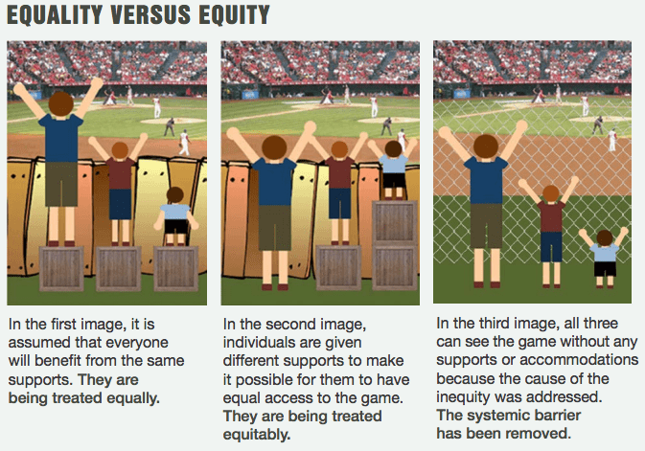
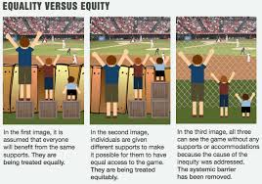
Equality versus Equity
Notes:
A charitable mentality is often a natural starting point and response to learning about development, but to what extent doe the learning progress to the development of an understanding of social justice and equity?

Slide 51
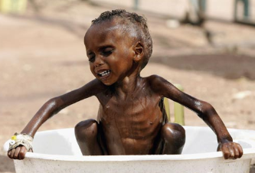
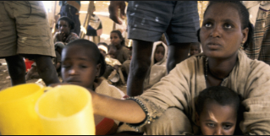
From charity to global mindset
Moving away from a charity mindset to a global justice mindset
Notes:
A moral concern for the poor may be the starting point for many teachers and young people learning about development; and whilst this moral positioning could be criticised as being patronising and benevolent, the educational approach should not be to condemn or criticise. Rathar it should show that a moral concern for the poor by itself will not necessarily lead to change, and could result in reinforcing existing dependency relations

Slide 52
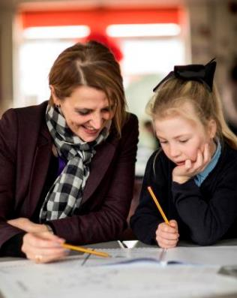
Professional development
      Fully-funded CPD for teachers
      Choose to book a trainer for an INSET or twilight, or attend a scheduled course
      Range of courses to help your teachers develop their practice and embed global learning in the curriculum
      Providers include Lyfta, CODEC, the Geographical Association and the Global Learning Association
      Training can include support with implementation and evaluation
Image © copyright

Slide 53
British Council Connecting Classrooms
Training
Critical Thinking and Problem Solving
Global Learning: Education for a Fair and Sustainable World
Connecting to the World: Successful School Linking
Global Pathways to Excellent Education
Teach Sustainable Development Goals, Skills and Values (Lyfta)

Slide 54
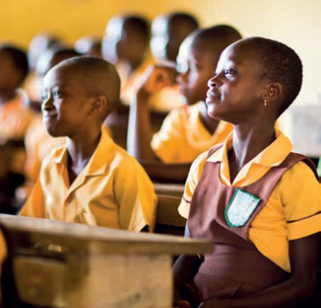
School partnerships
Work with an international partner school
      Free partner matching service from the British Council
      Guidance on how to start working together
      Resources to help you collaborate and explore the Global Goals together
      Work with a partner school from one of our programme countries in Africa, the Middle East, or South Asia
Image © copyright

Slide 55
Which countries are eligible?
MENA - Middle East and North Africa Egypt, Iraq, Jordan, Lebanon, Morocco, Occupied Palestinian Territories, Tunisia and Yemen
SAARC - South Asian Association for Regional Cooperation South Asia: Afghanistan, Bangladesh, Nepal and Pakistan (not included – Bhutan, India, Maldives, Sri Lanka)
SSA - Sub Saharan Africa: Ethiopia, Ghana, Kenya, Lesotho, Malawi, Mozambique, Nigeria, Rwanda, Sierra Leone, South Africa, South Sudan, Sudan, Tanzania, Uganda, Zambia and Zimbabwe
United Kingdom

Slide 56
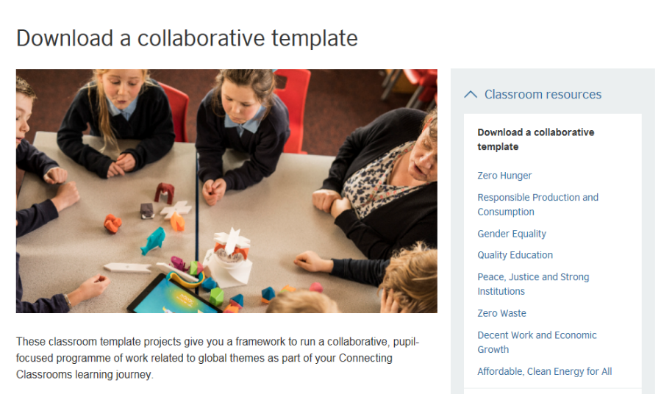
Free resources
Image © copyright
Notes:
8 Classroom Resources
Themed on the SDGs
To use with a partner school or individually
Sitting on the CC website

Slide 57

British Council Connecting Classrooms Project - #2 Zero Hunger 2018

Slide 58
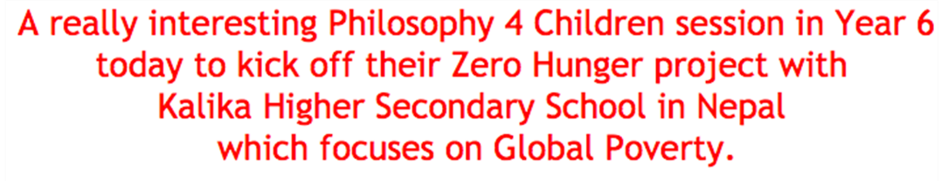
Philosophy 4 Children

Slide 59

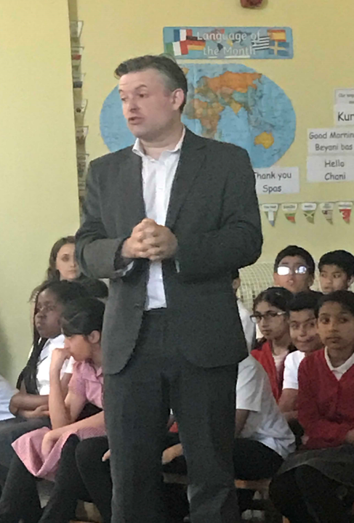
MP backs bid by pupils to cut poverty

Slide 60

Funding
Cluster grants
      Cluster means two or more UK schools working together
      With at least two international partner schools
      Experienced cluster co-ordinator
      Up to £35,000 available per cluster
      Funding for international travel, supply cover for the
      co-ordinator, training for teachers in the cluster, pupil
      projects etc
      Free support from a local advisor, before and after applying

Slide 61
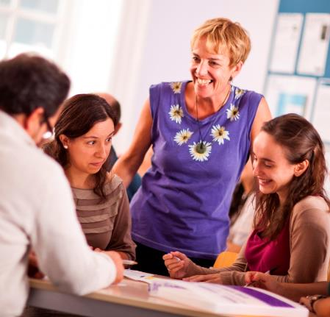
Role of the Cluster Co-ordinator
Cluster co-ordinator
A teacher at the “lead school”
Experienced in global learning
Completes the grant application
Co-ordinates funding and cluster activities
Trains teachers in the cluster and supports less experienced schools
Eligible for funding for supply cover and grants for training and support

Slide 62


Involved schools

Slide 63
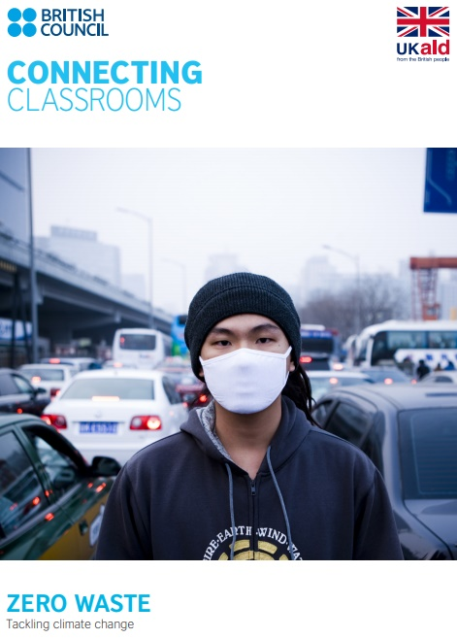
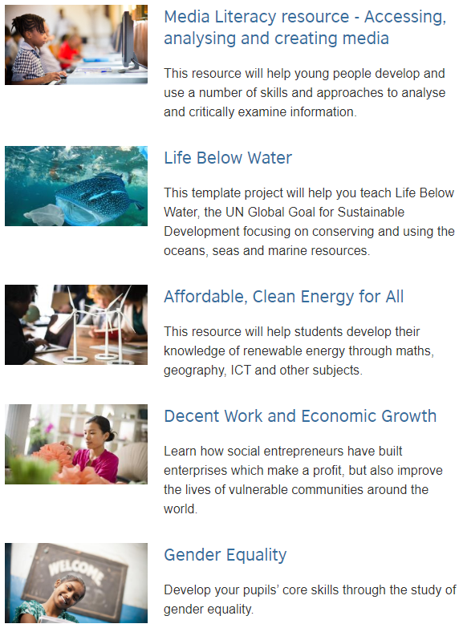
Connecting classrooms website

Slide 64


Practical Action Plastics challenge

Slide 65

Leicester’s litter less campaign

Slide 66
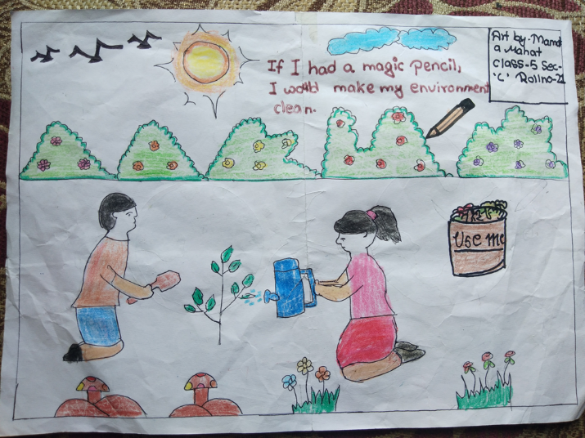
Project Work - Malala’s Magic Pencil

Slide 67

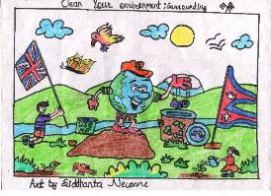




Logo Competition – Zero Waste

Slide 68

eTwinning Live Website

Slide 69
Activities to date:
Global Goals Thinking Day
Cards to Nepalese penpal
Duffy’s Lucky Escape
The Sea Starts Here stencil competition
Logo Competition
Malala’s Magic Pencil
Learning Log – Local-Global
Visit of Head Teachers from Nepal – presentation
Eco bricks
Journey of a plastic bottle
Sorting plastics
Kicking Plastic at Abbey Park
Litter picking in school
Litter picking in the local community

Slide 70
Why take part?
Why do it?
      Broadens horizons and encourages a global outlook
      Enriches the curriculum through exploring real global challenges such as climate change, hunger or gender equality
      Boosts engagement through providing an authentic context and through sharing work with a real audience of international peers
      Develops pupils as responsible global citizens, and empowers them to put learning into action to improve their world
      Contributes to SMSC and British values
Image © copyright

Slide 71

What UK teachers say…
      “All of the activities… helped the children to recognise their role in addressing the issues of human and environmental sustainability and work towards a fairer world in a spirit of mutual respect.”
      “Through this project, we are encouraging the students to see refugees not just as numbers in need of aid but rather as the people that they are. We are providing our children with tools to take action and not just to admire a problem.”
Image © copyright
“It has helped me become enthusiastic about teaching again. It has been successful in helping the pupils talk and think and reason about issues as well as becoming more aware of world issues and broadening their horizons.”

Slide 72





Leicester Schools Linking
Supporting our children to explore identity, celebrate diversity, champion equality and promote community.

Slide 73
The aims….
To link demographically different schools within Leicester/Leicestershire
To improve cohesion between communities and challenge stereotypes
To create a sense of shared identity for all of Leicester’s children and young people
To learn together and appreciate diversity is a strength

Slide 74
Leicester Schools Linking involves…
Working with a partner class to explore four key themes:
Who am I? – exploring identity
Who are we? – celebrating diversity
Where do we live? – promoting community
How do we all live together? – championing equality

Slide 75
What do we do?
Exchange thoughts, work and self reflection with our link class
Remotely meet our link class
Take part in shared virtual experiences with our link class
Communicate digitally with our link class
This is a programme
rooted in the curriculum and
designed around our school’s situation
CPD
Reflection
Exchange Information
Reflection
Meet/Communicate
Work in Class

Slide 76
Structure and Supporters
Begun in 2018 with 18 classes/11 schools
Grew in 2019 to 34 classes/ 15 schools
Recruiting for 2020-21 – our 3rd year will look different due to Covid-19
St Philips Centre
The Linking Network thelinkingnetwork.org.uk
LCFC in The Community- since 2019
Leicester Museums – since 2019
ArtReach – new for 2020

Slide 77
New look for 2020
At least 10 new lesson plans for digital/remote linking activities
Extensive resources for use both at school and for Home Learning
New shared virtual experiences such as virtual tour of King Power, Museum tours and 3 amazing art experiences which can be used towards Arts Awards
Involvement in Social Action projects together
Inter-generational linking

Slide 78
Benefits for the class?
Gives pupils a purpose for speaking and listening because the linking events get children talking, sharing, laughing and learning about each other. Reflection times in the classroom after linking activities offer further opportunities.
Gives pupils a purpose for reading and writing because children write for a real audience. They write about subjects which matter to them and they read post from the class they are linked with.
Supports pupils to develop their self knowledge, confidence and self-esteem as they discuss their own identity and contribute positively to lives of their link class.
Offers pupils powerful learning experiences, that they will probably never forget.
Gives pupils the chance to explore identity, diversity and community with depth and sensitivity in a well-structured curriculum.

Slide 79
Benefits for the wider school?
Helps evidence that we are contributing to the SMSC (spiritual, moral, social and cultural) development of all pupils as set out by OFSTED.
Provides evidence that the curriculum is broad, balanced and relevant and promotes personal development as set out by OFSTED.
Extends our school community to embrace other children and families.
Has been endorsed by the Ministry for Housing Community and Local Government (MHCLG) and the Department for Education (DfE) because it is nationally recognised as offering a positive, age appropriate curriculum contribution to spiritual, moral, social and cultural development of pupils, British values and well being.

Slide 80
Want to know more?
Email
school.linking@stphilipscentre.co.uk
Twitter @LinkingSchool
Or nationally @Linking_Network

Slide 81



#EcoSchoolsAtHome
Every Tuesday Eco-Schools England has been publishing a new Eco-Schools Topic handout that will including 5 different topic related tasks that can be undertaken both at home and in school.
The topic actions have been designed so that they can be carried out by nursery children and college students alike.
School Grounds
Biodiversity work
Marine work
Litter work
Energy work
Global Citizenship Work
Healthy Living Work
Transport
Waste
Water

Slide 82




(Re)Love Our Gadgets
In the age of rapidly developing technology and increased e-waste our new Global Citizenship call to action will show schools how to (re)love their electronic gadgets in a way that benefits isolated members of their local community.
(Re)Love Our Gadgets has been designed to put students in control of reducing social isolation and E-waste by:
Raising awareness of issues surrounding E-waste and promoting the rescue of electrical gadgets
Collecting unwanted (working) gadgets
Creating links with your local community
Donating electronic gadgets to your local community
Providing support and advice to your local community on how to use the donated gadgets.
www.eco-schools.org.uk/wp-content/uploads/2019/03/ReLove-Our-Gadgets.pdf

Slide 83



Send a Cow
These resources will support you and your children at home to learn about Africa, food, sanitation and how to be a global citizen.
We’d love to see a photo of you using our learning resources at home! Please send them in to info@sendacow.org or tag us on social media @SendaCow
For more information
www.sendacow.org/get-involved/organisation/schools

Slide 84


World's Largest Lesson
HOW TO GET STARTED?
We know that introducing the Global Goals to children may appear overwhelming at the beginning – that’s why we have created a handy 5 step guide and resources below.
1. Take Our Free Online Course
2. Watch Our Part 1 Animation with your class
3. Use Our Introductory Lesson Plan
4. Ask your class What World Do You Want in 2030? with this lesson plan
5. Encourage your class to Take An Action!
After that – explore our resources, choose a goal to focus on based on your plans and what’s relevant where you live. Then facilitate student learning and action for the Goals.
END EXTREME POVERTY.​
FIGHT INEQUALITY AND INJUSTICE.​
TACKLE CLIMATE CHANGE.​
Introduce the Sustainable Development Goals to children and young people everywhere and unite them in action.
worldslargestlesson.globalgoals.org

Slide 85


Fairtrade Fortnight
For two weeks each year at the end of February and start of March, thousands of individuals, companies and groups across the UK come together to share the stories of the people who grow our food and drinks and who grow the cotton in our clothes, people who are often exploited and underpaid.
During Fairtrade Fortnight 2020 their campaign focused on raising awareness of the struggles of cocoa farming and to demand living incomes for cocoa farmers.
How to get involved
1. Sign up to emails to stay in touch and receive updates from Fairtrade
2. Follow on social media and to shar the campaign content and raise awareness.
Facebook / Twitter / Instagram / YouTube
3. Get your community involved, read this guide to find out how: Download Campaigner Resources
4. Share the animation from their website
Fairtrade Fortnight website

Slide 86




Fairtrade Award
Becoming a Fairtrade School means joining a worldwide movement – a movement where young people learn that, whatever their age, they have the power to make a difference in the world.
It offers a great opportunity to look at global issues such as where our food comes from and how we are connected to people around the world. Students can also learn a range of skills, from teamwork and co-operation to persuasive writing to running a stall or tuck shop.
There are three levels of award:
FairAware
FairActive
FairAchiever
www.schools.fairtrade.org.uk/fairtrade-schools-awards/

Slide 87

FairAware Award
www.schools.fairtrade.org.uk/fairtrade-schools-awards/
FairAware is the first Fairtrade Schools Award and is about finding out where your school is in terms of understanding Fairtrade and using Fairtrade products.
The award lasts for two years giving you plenty of time to renew or think about moving on to the FairActive Award. It is self-assessed with no evidence to be submitted.
Register
Carry out a product audit of what is used in school
Complete a teaching audit to see what is being taught
Carry out a learner audit to gauge current knowledge
Carry out a learning challenge, which may focus on:
  Where our food comes from and the people producing it
  Examining the concept of fairness and what it means to be fair
  Why there’s a need for Fairtrade
There are lesson kits, films and Fairtrade activities to help you plan your lesson.

Slide 88

FairActive Award
After learning about Fairtrade for your first award, you can move onto FairActive and start taking action for Fairtrade!
The award is self-assessed with no evidence to be submitted.
Set up a Fairtrade group to lead on projects
Hold an assembly inform the whole school
Hold an event, at school on in the local community
Take a Fairtrade challenge, such as:
  Making a Fairtrade switch
  Fundraising for Fairtrade
  School visit related to Fairtrade
www.schools.fairtrade.org.uk/fairtrade-schools-awards/

Slide 89

FairAchiever Award
The final step in the Fairtrade Schools Award is FairAchiever.
At this point the school has fully embedded Fairtrade into their daily life and work to raise awareness of Fairtrade in their local community.
You will need to submit evidence to become a FairAchiever School which will be assessed by an independent assessor.
Adopt a Fairtrade policy, a commitment to Fairtrade
Repeat learner audit, to monitor change in attitudes and highlight areas where more work needs to be carried out
Embed learning
Use Fairtrade products in school
Take two Fairtrade challenges
www.schools.fairtrade.org.uk/fairtrade-schools-awards/

Slide 90



90kg Rice Challenge
This is an easy way to engage participants, educate
and inspire them on the good that fair trade does in
our world.
90kg is the amount of rice a farmer in Malawi has to sell to enable him to send a child to secondary school for a year
It is a very visual and easy to understand concept which people can easily grasp and feel part of.
Another added bonus is that the Challenge counts towards your Fairtrade school and Fairtrade church awards.
www.jts.co.uk/90kg-rice-challenge

Slide 91




Stride Magazine
Stride aims to be a source of inspiration and support for teachers delivering education for Global Citizenship in Scotland.
Our vision is of an education which develops the knowledge, skills, values and attitudes that learners need to participate in a globalised society and to secure a more just and sustainable world for all.
Activities and resources can be found here.
www.stridemagazine.org.uk/

Slide 92




Oxfam Education
www.oxfam.org.uk/education
Oxfam believe young people are critical to building a just world without poverty. They have the power to be active global citizens, and create a fairer, more secure future for everyone.
Through work in schools and beyond, they support them every step of the way giving young people the space to think about their values, and the opportunity to develop their skills and knowledge so they can make change happen.
Oxfam Education offers a huge bank of learning and activity resources to bring the issues Oxfam works on to life, both in the classroom and the wider community. Allof the resources support Education for Global Citizenship – education that helps pupils understand their world and make a positive difference in it.
They also provide school speakers, teacher training opportunities and so much more.

Slide 93




Practical Action
An international development charity whose education team support teachers, parents and carers with education material and training courses.
Many of Practical Action’s resources can be used to support the Eco-Schools topics.
Teacher notes, presentations, activity sheets, posters and certificates which can be downloaded :
  Wind Power Challenge
  Solar Challenge
For more information:
practicalaction.org/schools/eco-schools

Slide 94




Carbon Literacy
https://carbonliteracy.com
'An awareness of the carbon costs and impacts of everyday activities and the ability and motivation to reduce emissions, on an individual, community and organisational basis.'
  Carbon Literacy is a term used to describe an awareness of climate change, and the climate impacts of mankind’s everyday actions.
  Enables students to become carbon aware.
  Gives students a better understanding of how climate change will affect them and others.
  Provides knowledge and skills to develop their own responses to lowering their carbon footprint, and the carbon footprint of others.
  The project is aimed at Year 5 and Year 8, but other year groups can be considered
To register your interest email: amy.peace@leicester.gov.uk

Slide 95

Declaring a Climate Emergency in School
On 1 February 2019 Leicester City Council declared a Climate Emergency. The declaration is an acknowledgement that:
  Climate change is happening, and threatens the wellbeing of everyone in Leicester and worldwide
  The speed and scale of global and local action to tackle the problem needs to be dramatically increased.
In its declaration, the Council committed to developing a new action plan to address the emergency through our own services and projects .
What action you can do:
Discuss your plans with students and staff .
Select actions which you plan to achieve, make them manageable but also remember we are in a Climate Emergency.
Make sure your actions have a duration, responsibilities and an evaluation.
Take your action plan to the Governing Body or Trustees to ensure that you have their support.
You can submit your action plan to the City Council which we will publicise as part of our wider action plan.
Start your action plan!
Review regularly to check and maintain your progress .
schools.leicester.gov.uk/climate-emergency

Slide 96


Climate Emergency Documents
Templates and document available at schools.leicester.gov.uk/climate-emergency

Slide 97


BESS
Energy
schools.leicester.gov.uk/BESS-Energy

Slide 98


Leicester Water Fountain Competition

Slide 99
Other opportunities coming up
UN Climate Change Learn Online
  Climate Change: From Learning to Action (8 hours)
  Children and Climate Change (6 hours)
  Cities and Climate Change (2 hours)
  Human Health and Climate Change (2 hours)
  Module 1 of Open Online Course on Gender and Environment (6 hours)
Off School website - a free website full of ideas for home learning and fun activities. Head to the Activity Zone for 100s of films, created by teachers, across loads of great topics and themes!

Slide 100
Funding and other opportunities
British Council funding
eTeach link
Grants 4 Schools

Slide 101

Questions and Answers

Slide 102

Future Webinars
17 June | Topic: Healthy Living | Lisa Didier - Food for Life Sam Woods - TCV, Daxa Ralhan, Leicester City Council
24 June | Topic: Marine | Daniel Coles, Alex Cameron, Roshni Jose - Leicester City Council Nicola Holt, Environment Engagement, Leicester City Council (and also Refill Leicester)
1 July | Topic: How to submit your Green Flag application

Slide 103






Keeping in Touch
EcoSchoolsLCC
EnvEducationLeicester
EcoSchoolsLCC
EcoSchoolsLCC
schools.leicester.gov.uk/eco-schools
Eco-Schools@leicester.gov.uk
(sign up for newsletter and eBulletins)

