Slide 1
#EcoTeach Webinar Biodiversity
The webinar will start here soon….

Slide 2
#EcoTeach Webinar Biodiversity
Lee Jowett, Environmental Education Coordinator
Amy Peace, Graduate Project Officer
Martha Rose, Leicestershire & Rutland Wildlife Trust

Slide 3
#EcoTeachMeet Webinar Series
Overview of #EcoTeach format and dates/times of webinars
What Environmental Education Leicester is
Eco-Schools – and how it fits into the big picture
Biodiversity projects
Q & As
Other opportunities coming up

Slide 4
Overview of #EcoTeach Webinar format and dates/times of webinars
Weekly at 10am during term time – lasting up to an hour, Leicester focused but suitable for everyone.
Recording and PowerPoint with links available afterwards at schools.leicester.gov.uk/eco-schools
During the presentation, ask questions in the chat box.
Questions and answers at the end – either directly ask or in chat box depending how many people are attending.

Slide 5
What is Environmental Education Leicester?
Provide free support to all Leicester School.
Communications with schools – social media (Twitter, Facebook, Instagram, YouTube), monthly eBulletins and quarterly newsletter.
TeachMeets, Eco-Schools Roadshow, Eco-Schools & Food for Life Celebration, Sustainable Schools Celebration bi-annual.
Focus on the Eco-Schools Award.
Delivery of energy and litter focused projects.
Project support and partnership working with internal and external organisation.

Slide 6
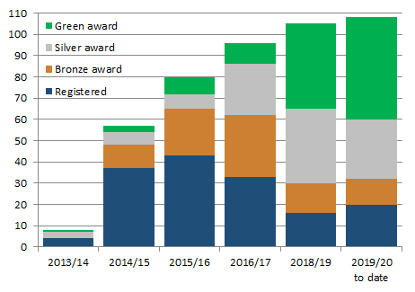
Eco-Schools – Our Work in Leicester
Promoted Eco-Schools as an award since September 2014 (114 schools)
109 registered on the programme
of those, 91 have achieved bronze
of those, 78 have achieved silver
of those 49 have achieved Green Flag

Slide 7
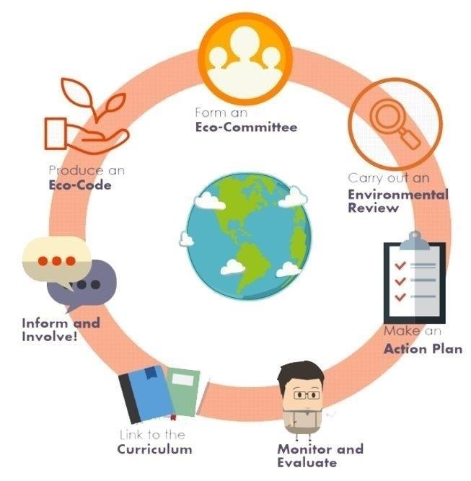
Eco-Schools Programme 7 step model

Slide 8
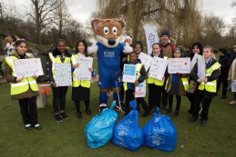
Step 1
Eco-Schools model - 7 steps 1
EYFS resources
Primary resources
Secondary resources
Step 1 – Eco-Committee, the heart of an Eco-Schools action and learning
At least one pupil form each year group
Meet at least once per half term
Share responsibility for running meetings
Records of minutes are kept
Minutes displayed on the Eco-board
Representative from parents, governors or senior leaders

Slide 9
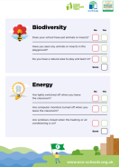
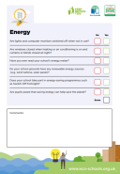
Step 2
Eco-Schools model - 7 steps 1
EYFS resources
Primary resources
Secondary resources
Step 2
EYFS
Primary
Secondary
Step 2 – Environmental Review – investigating the school's environmental performance
Covers all 10 Eco-Schools topics
A copy is displayed on the notice board
It is updated/reviewed at least every 2 years (best practice is annually)

Slide 10
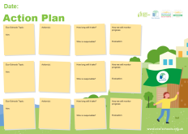
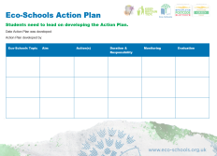
Step 3
Eco-Schools model - 7 steps
EYFS resources
Primary resources
Secondary resources
Step 3
Step 3 – Action Plan – Decide on topic actions, based on the result of the Environmental Review
The action plan is influenced by the review
Pupils take responsibility for learning on the topics
3 for the first green flag
5 for the renewal (changing 2 with each subsequent application)
Contains timescale, who is responsible and how it will be monitored
Shared with the whole school
A copy is displayed on the noticeboard

Slide 11
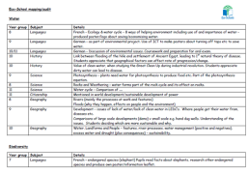
Step 4
Step 4
Eco-Schools model - 7 steps
EYFS resources
Primary resources
Secondary resources
Step 4 – Curriculum Links – making links between the school's environmental activity and the curriculum
Environmental issues are covered in at least three areas in your school curriculum, evident in schemes of work, pupils work and/or lesson plans (for first green flag this can be the same year group)
They do not need to be the same topics as your Action plan

Slide 12
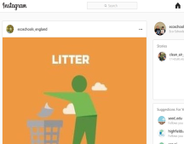
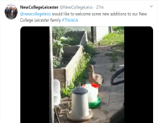
Step 5
Eco-Schools model - 7 steps
EYFS resources
Primary resources
Secondary resources
Step 5
Step 5 – Informing and involving – Let the whole school and wider community know what the Eco-Committee is doing
A prominent noticeboard in school
Covering the 7 steps and 3/5 topics
Members of the committee
Environmental review
Environmental action
Examples of monitoring and evaluation
Eco-code
Variety of mediums to communicate
The whole school and wider community is informed

Slide 13
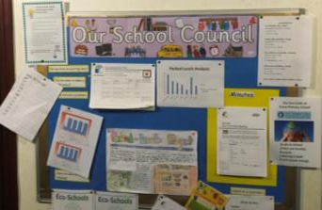
Step 6
Eco-Schools model - 7 steps
EYFS resources
Primary resources
Secondary resources
Step6
Step 6 – Monitoring and Evaluation – Measuring change and finding out what works and what doesn't
The committee monitors the effectiveness of the topics via data collections, surveys, before and after photographs
It is communicated with the whole school
Data has been analysed to help pupils develop further topic actions
Data has been used in the curriculum e.g. graphs and charts in math

Slide 14
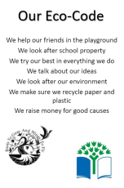
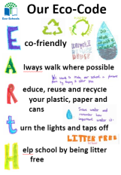
Eco-Schools model - 7 steps
EYFS resources
Primary resources
Secondary resources
Step 7
Step 7 – Eco-Code – Creating a call to action that the whole school can get behind
There is an agreement statement for your school drawn up by pupils
It reflects the topic actions you are working on
It is displayed around school e.g. classrooms, hall and the office
The majority of pupils and students understand is

Slide 15
Eco-Schools model 10 topics

Slide 16
Key things to think about in topics
Whole school opportunities
Informing everyone about the work
Links to curriculum areas e.g. science, English (persuasive writing) and maths (data handling)
Monitor impact of your actions – surveys and monitoring – however photos before and after projects
Reflected in your Eco-code

Slide 17
Biodiversity Projects
Leicestershire and Rutland Wildlife Trust
Woodland Trust Trees
NatureHood
Wildflower Seed
Polli:Nation
City Nature Challenge
iNature App
Buglife
BioBlitz Leicester
RSPB’s Big Schools Bird Watch
RSPB's Wild Challenge
Big Butterfly Count
Learning Through Landscapes – Grants
BLUE Campaign
Working with Leicester City Council
Curriculum Links

Slide 18
Increasing biodiversity in school grounds
To protect and enhance the wildlife and wild places of Leicestershire and Rutland and to engage people with nature
How and what to survey
Wildlife-friendly features

Slide 19
Biodiversity audit trail and mapping
Survey for wildlife features:
Log pile, log discs
Stone pile / rockery, paving slabs
Leaf pile
Compost heap
Wild edges
Bee hotel / nest box
Wildflower / herb planters for pollinators
Mini pond
Bird feeders and nest boxes
Hedgehog homes and holes
Bat box
Trees, hedges and shrubs
Green roofs and walls

Slide 20
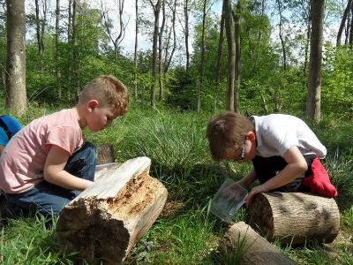
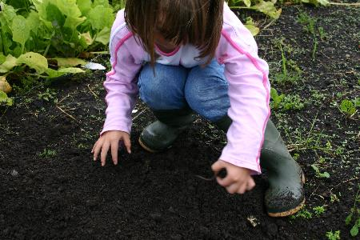
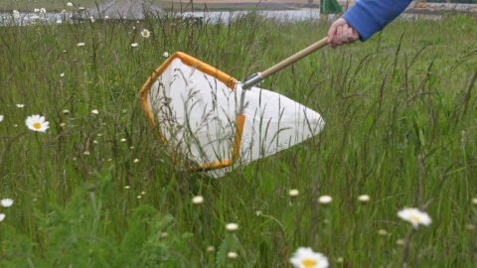
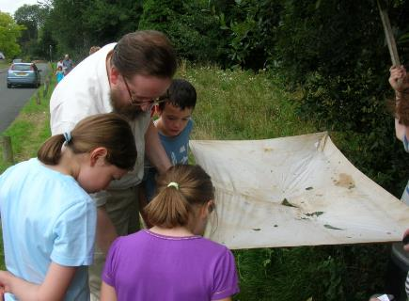
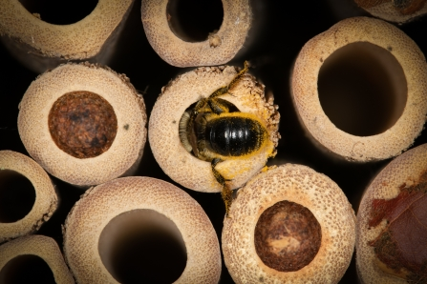
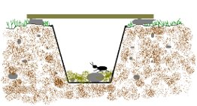
Survey for wildlife - invertebrates
Lift and look | Dig for worms | Sweep netting
Branch shaking or beating | Bee nest box monitoring | Pit fall or tumble trap

Slide 21
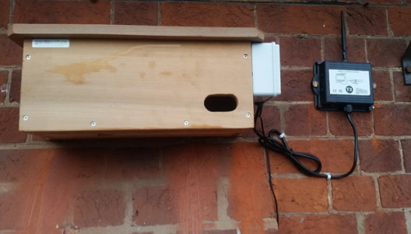
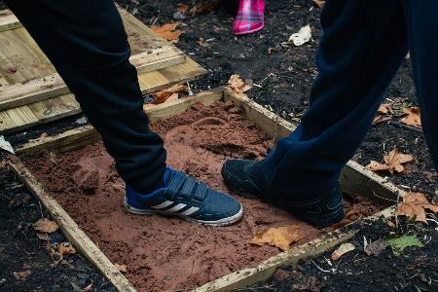
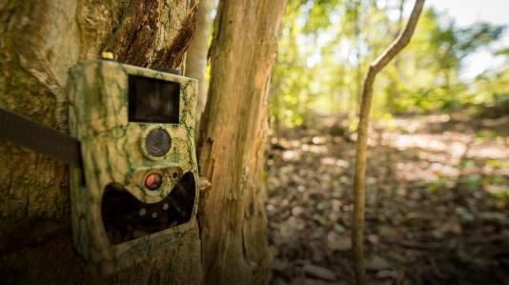
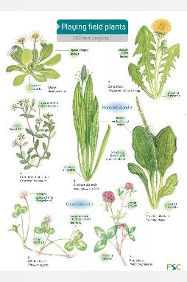
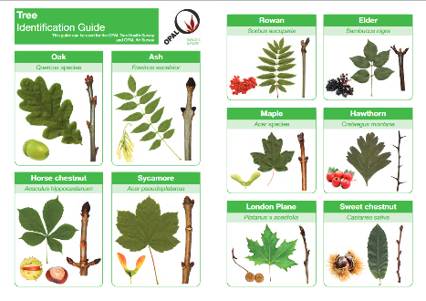
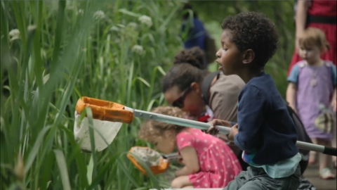
Other wildlife to survey
Birds | Hedgehogs, foxes and badgers
Trees | Playing field plants | Pond dipping

Slide 22
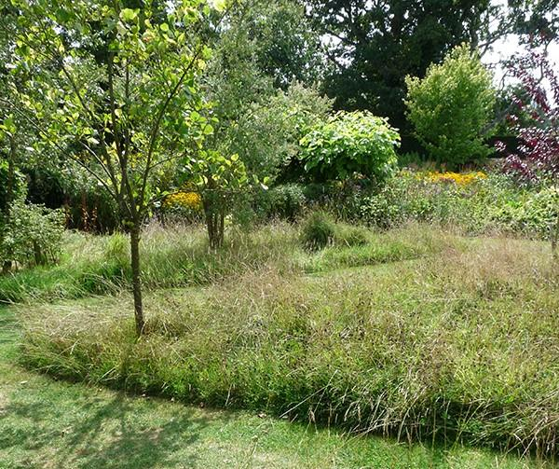
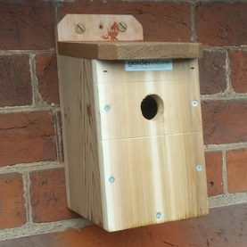
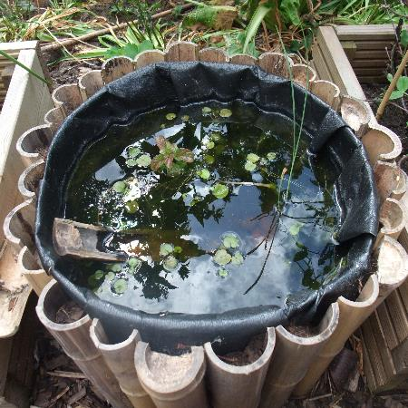
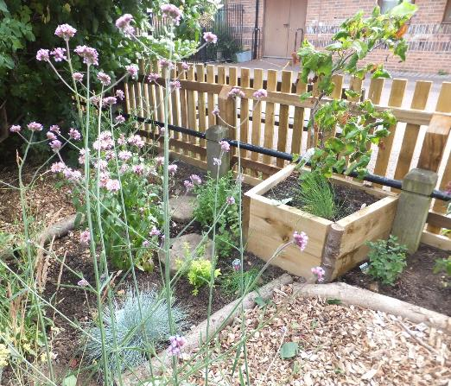
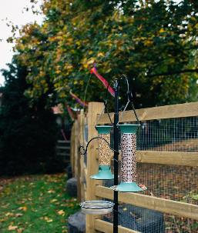
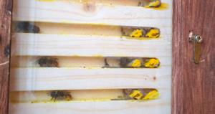
Wildlife friendly features to add
Solitary bee nest box
Mini pond
Wildflower and herb planting
Wild patch – unmown playing field borders
Bird feeders

Slide 23
Grow Wild
Grow Wild supports schools or community group to make the most of their outdoor spaces for you and for wildlife.
Our team of experienced gardeners can work with you to:
Design a wildlife, sensory or mindfulness garden, a Forest School area, a barefoot or minibeast trail or a wildlife-friendly vegetable plot
Create a garden from scratch - there's something possible for everyone from window boxes to wildflower meadows and ponds.
Renovate existing gardens that have fallen by the wayside
www.lrwt.org.uk/grow-wild

Slide 24
Go Wild at Home videos
www.lrwt.org.uk click on the YouTube icon
Four treasure hunt ideas
How to make a:
Stick butterfly
Wormery
Natural loom
Birds nest
Water filter
Stick rattle
Magic potion
Leaf tile

Slide 25
Wild Activity ideas
www.wildforestschool.org.uk/wild-activities
Forest School inspired activities:
Sticks
Mud
Colour and texture
Trees
Water
Treasure hunts, trails and games
Magic

Slide 26
30 Days Wild
Do one wild thing a day in June for your health, wellbeing and for the planet
30 simple, fun and exciting Random Acts of Wildness
Schools and family packs available:
www.lrwt.org.uk/30dayswild

Slide 27
Osprey Home School
These spectacular birds of prey are an excellent way of engaging young people with a love of wildlife and inspire them using creative, social, and scientific areas of education
World Osprey Week Home School: Fun activities for each day of the week to learn everything there is to know about Ospreys
Plus lots more activities to learn about Ospreys
Free primary and secondary resources
www.lrwt.org.uk/wildlife/rutland-ospreys/osprey-education/osprey-education-home

Slide 28
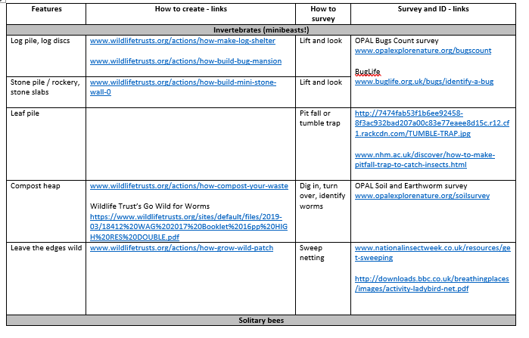
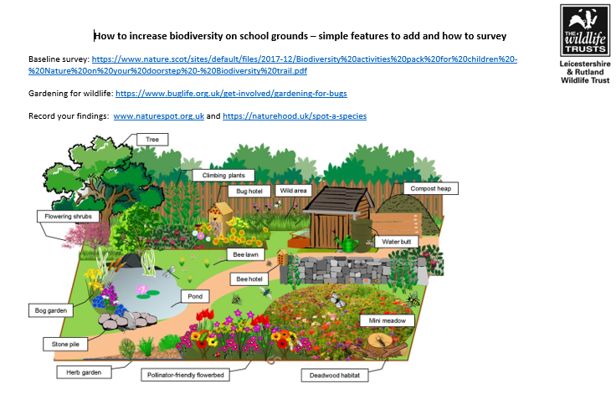
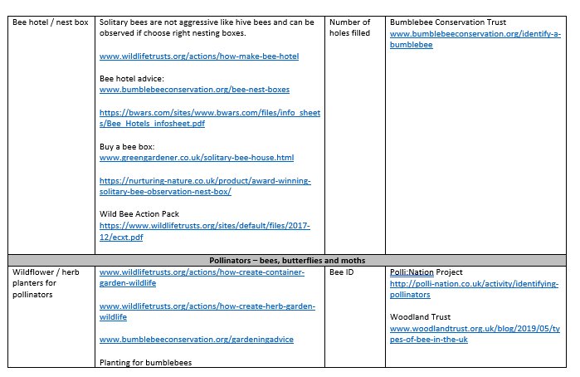
Additional Resources
Available to download from
schools.leicester.gov.uk/services/environment-health-and-well-being/environmental-education/upcoming-events-training

Slide 29
Questions and Answers – Part 1

Slide 30
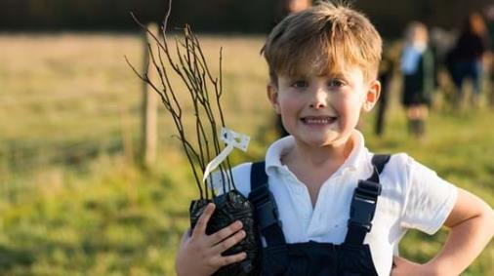
Woodland Trust Trees for Schools
Free trees for schools and communities.
Two delivery periods per year (March and November). Currently taking applications for trees to be delivered in November 2020.
You can buy packs in the shop all year round.
Open to schools across the UK, plus nurseries, colleges, universities and outdoor learning centres.
If you’re applying as a school your trees should be planted on either the school grounds, land the school has arranged regular access to or in an area that is publicly accessible.
The trees can be planted as copses, groves, avenues, shelter belts, hedgerows and many other ways.
You can request up to four separate tree packs as long as the total does not exceed 420 trees in each application cycle.
All the trees they supply are sourced and grown in the UK and Ireland.
www.woodlandtrust.org.uk/plant-trees/schools-and-communities

Slide 31
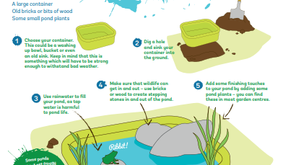
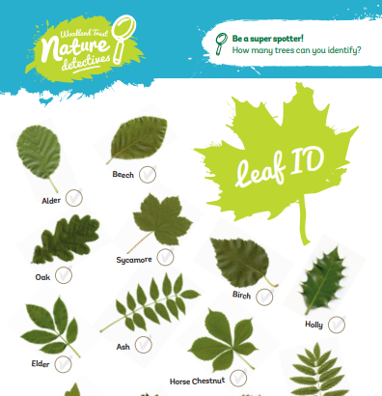
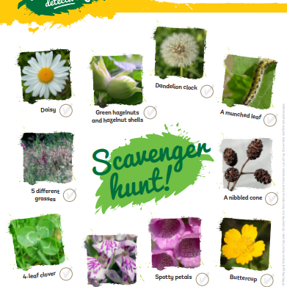
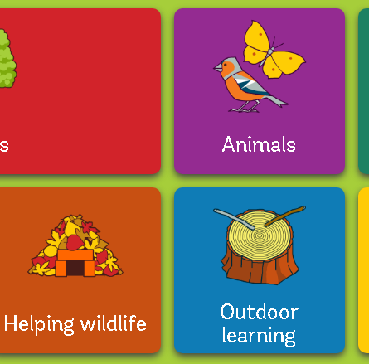
Woodland Trust Resources
treetoolsforschools.org.uk/categorymenu

Slide 32
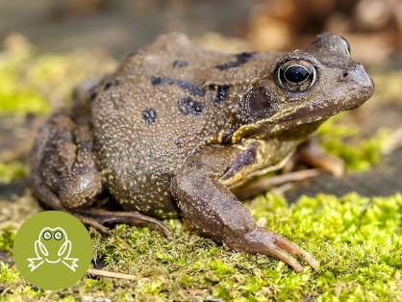
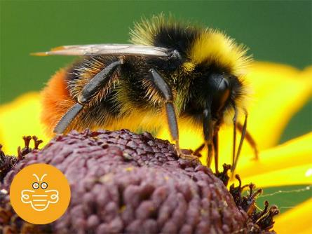
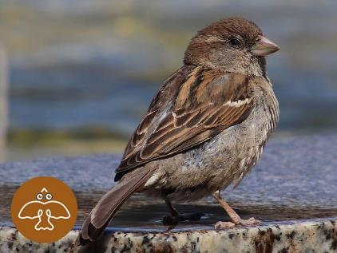
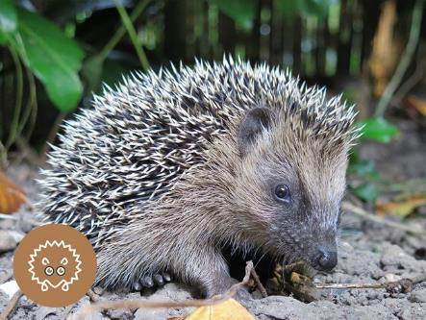
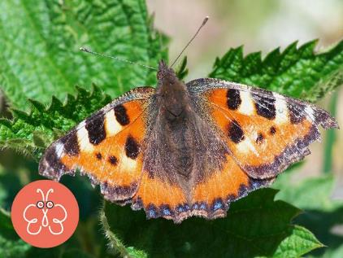
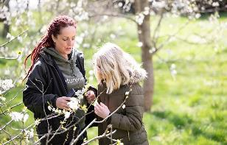
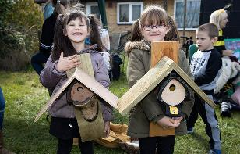
NatureHood
Naturehood is a community project from Earthwatch Europe working to reverse wildlife decline by connecting people and empowering you to take positive action.
The project aims to bring communities together to act positively for wildlife.
Wildlife surveys & spotter’s guides
Actions to increase biodiversity and habitats
School and teacher resources
Can link the activities to an Eco-School campaign
www.naturehood.uk

Slide 33
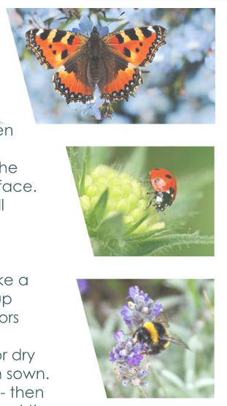
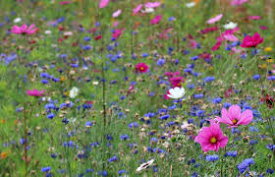
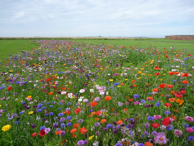
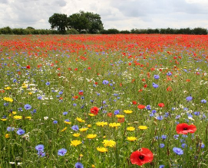
Wildflower Seed
Leicester City Council can provide wildflower seed packs for schools to plant in your grounds.
Plant the wildflower seed in September-October for flowers next spring
Wildflowers provide lots of things that insects need: food, shelter and places to breed. The insects themselves are eaten by a lot of wildlife
Wildflowers help to keep soil healthy and stabilise the surrounding soil.
For your pack contact:
Donna Oxborough
Nature Conservation Officer Donna.Oxborough@Leicester.gov.uk

Slide 34
Polli:Nation
The project ran from 2015-2019 but lots or resources are still available on the website: www.polli-nation.co.uk
UK wide initiative supporting pupils from 260 schools to turn their school grounds and other local walk-to spaces into pollinator friendly habitats by:
Surveying their patch using the OPAL Polli:Nation survey
Making improvements for pollinators on their patch
Assessing impact.
In Leicester we had 3 cluster groups – 12 schools that were success and participated. The aim of the project was to engage and enthuse children and young people to protect pollinating insect species in the UK.

Slide 35
City Nature Challenge
Education tool kit
Started in 2016 for the first-ever Citizen Science Day, the citizen science teams at Natural History Museum of Los Angeles County and California Academy of Sciences launched City Nature Challenge
The first City Nature Challenge was an eight-day competition between Los Angeles and San Francisco, engaging residents and visitors in documenting nature to better understand urban biodiversity.
In 2017 the City Nature Challenge went national, and in 2018, it became an international event!
In 2019 Leicester took part with over 4000 observations and 800 species identified
The City Nature Challenge uses an app called iNaturalist to log species which can used all year round
www.citynaturechallenge.org

Slide 36
iNaturalist App
www.iNaturalist.org
Take a photo of the plant or animal (wild, not a zoo animal)
Upload on the app, it will attempt to identity the species (and pretty accurate!)
It will then be professionally identified where possible

Slide 37
Buglife
Buglife is the only organisation in Europe devoted to the conservation of all invertebrates. They actively working to save Britain’s rarest little animals, everything from bees to beetles, worms to woodlice and jumping spiders to jellyfish
The B-Lines project is creating a network of wildflower meadows across the UK to help link existing wildlife areas together
Buglife previously had an officer based in Leicester that worked with some schools on buzzing hotspots
www.buglife.org.uk
www.buglife.org.uk/get-involved/children-and-schools

Slide 38
BioBlitz
A BioBlitz is a chance to find what wildlife is living in Leicester and to take part in helping us find and record as many species as possible – all within 24 hours
Helped by experts and naturalists the public are invited to take part and learn about the wildlife that live here and where to find them during that time.
The event included a range of guided walks covering bats, birds, bugs and plants along with cameras and traps to see the different mammals that share these special places with us.
The last BioBlitz involved students from Overdale Junior School split into groups and encouraged to take part in 4 tasks: building insect hotels, bug hunts in the woodland, tree identification in the parkland and searching for aquatic invertebrates in the brook.
More information from Nature.Conservation@leicester.gov.uk
The BioBlitz usually takes place in June each year in a different park

Slide 39
RSPB Big Schools' Birdwatch
Last year over 2300 schools all over the UK took part in the Big Schools’ Birdwatch. During a fortnight in January, schools participate in a bird watch in the school grounds or local park
Resources provided by Big Schools’ Birdwatch including examples such as, counting sheets using tens frames and bird cake instructions.
www.rspb.org.uk/fun-and-learning/for-teachers/schools-birdwatch/resources

Slide 40
RSPB's Wild Challenge
Wild Challenge is a free award scheme that anyone can take part in, that prompts children to connect with, and learn about, nature through a series of fun and engaging activities
The activities are divided into two sections - Help nature and Experience nature. You must complete 3 activities from each
Bronze award: you need to complete 6 activities, 3 from Help Nature and 3 from Experience Nature.
Silver award: you need to complete 6 further activities, another 3 from Help Nature and another 3 from Experience Nature (making a total of 12 activities completed).
Gold award: you need to complete another 6 activities, again 3 more from Help Nature and 3 more from Experience Nature (making a total of 18 activities completed).
www.rspb.org.uk/profile/wild-challenge

Slide 41
Big Butterfly Count
The big butterfly count, launched in 2010 is a nationwide survey aimed at helping to assess the health of our environment
Over 113,500 people took part in 2019, submitting 116,009 counts of butterflies and day-flying moths from across the UK
Why count butterflies? Butterflies react very quickly to change in their environment which makes them excellent biodiversity indicators. The count will identify trends in species that will help plan how to protect butterflies from extinction
How to take part Simply count butterflies for 15 minutes during bright (preferably sunny) weather during the big butterfly count. Records are welcome from anywhere: from parks, school grounds and gardens, to fields and forests
Runs from Friday 17 July to Sunday 9 August 2020
www.bigbutterflycount.org

Slide 42
Learning through Landscapes
They help children and young people to connect with nature, become more active, learn outdoors and have fun. Lots of free Resources on their website
Local school grants of £500
Catalogue of equipment (£30 all the way up to full £500)
Training course run in school (2 hours)
Need to involve the students in selecting equipment and course
www.ltl.org.uk

Slide 43
BLUE Campaign
A campaign to rewild schools and gardens using blue hearts

Slide 44
Working with Leicester City Council
Reducing the use herbicides
Increasing wildlife flower and uncut grass edges on fields

Slide 45
Additional Links
Great Plant Hunt - http://www.greatplanthunt.org/gphweek
Birdsong ID App - https://www.rspb.org.uk/birds-and-wildlife/bird-songs/what-bird-is-that/
Pond Building and Dipping -http://primary.cleapss.org.uk/Resource/P060-Pond-safety-in-primary-schools.aspx

Slide 46
Curriculum Links
The World Around Us
Science – growing and caring for plants, investigating the variety of insects and birds associated with different plants
Technology – recording changes with a digital camera, setting up a web camera
Geography – drawing a map of the school grounds, monitoring temperature and wind conditions in different areas of the grounds
History – creating a log of how the grounds have developed over the project, exploring local plant names and their uses
Language and Literacy
Writing – reports and articles, creating poems and stories
Talking – poetry and storytelling
Reading – finding out about some of the living things they find by gathering articles, searching the web etc.
Listening – noting bird song etc. following instructions on practical working days etc.

Slide 47
Curriculum Links 2
Mathematics and Numeracy
Undertaking bird counts, plant transects etc.
Applying findings through graphs, diagrams, charts etc.
Concluding findings and presenting idea
Personal Development
Understanding health and safety on site.
Taking care of others.
Expressing views.
Applying findings to the wider community.
Developing care for their local environment.
Physical Education
Preparing for outdoor work.
Taking part in physical tasks.
Playing nature games.
Religious Education
Exploring the importance of plants and animals to human spirituality and well-being.
Care for other living things.

Slide 48
Declaring a Climate Emergency in School
On 1 February 2019 Leicester City Council declared a Climate Emergency. The declaration is an acknowledgement that:
Climate change is happening, and threatens the wellbeing of everyone in Leicester and worldwide
The speed and scale of global and local action to tackle the problem needs to be dramatically increased.
In its declaration, the Council committed to developing a new action plan to address the emergency through our own services and projects .
What action you can do:
Discuss your plans with students and staff .
Select actions which you plan to achieve, make them manageable but also remember we are in a Climate Emergency.
Make sure your actions have a duration, responsibilities and an evaluation.
Take your action plan to the Governing Body or Trustees to ensure that you have their support.
You can submit your action plan to the City Council which we will publicise as part of our wider action plan.
Start your action plan!
Review regularly to check and maintain your progress .
schools.leicester.gov.uk/climate-emergency

Slide 49
Climate Emergency Documents
Templates and document available at schools.leicester.gov.uk/climate-emergency

Slide 50
Other opportunities coming up
UN Climate Change Learn Online
Climate Change: From Learning to Action (8 hours)
Children and Climate Change (6 hours)
Cities and Climate Change (2 hours)
Human Health and Climate Change (2 hours)
Module 1 of Open Online Course on Gender and Environment (6 hours)
Off School website - a free website full of ideas for home learning and fun activities. Head to the Activity Zone for 100s of films, created by teachers, across loads of great topics and themes!

Slide 51
Grant opportunities
Nature Grants – Learning through Landscapes
eTeach link
Grants 4 Schools

Slide 52
Questions and Answers – Part 2

Slide 53
Future Webinars
10 June | Topic: Global Citizenship & Fairtrade | Hannah Boydon, Mayflower Primary School
17 June | Topic: Healthy Living | Lisa Didier - Food for Life Sam Woods - TCV, Daxa Ralhan, Leicester City Council
24 June | Topic: Marine | Daniel Coles, Alex Cameron, Roshni Jose - Leicester City Council Nicola Holt, Environment Engagement, Leicester City Council (and also Refill Leicester)
1 July | Topic: How to submit your Green Flag application

Slide 54
Keeping in Touch
EcoSchoolsLCC
EnvEducationLeicester
EcoSchoolsLCC
EcoSchoolsLCC
schools.leicester.gov.uk/eco-schools
Eco-Schools@leicester.gov.uk
(sign up for newsletter and eBulletins)

