Slide 1

#EcoTeach Webinar
Transport Holding screen
The webinar will start here soon…

Slide 2
#EcoTeach Webinar
Transport
Lee Jowett, Environmental Education Coordinator, Leicester City Council
Amy Peace, Graduate Project Officer, Leicester City Council
Sally Slade, Cycling and Walk Team Leader, Leicester City Council
Jessie Davidson, Living Streets, School Coordinator
Chris Dee, Schools Cycling Officer, Sustrans
Danni Kennell, Education Officer (Air Quality), Leicester City Council

Slide 3

#EcoTeachMeet Webinar Series
Overview of #EcoTeach format and dates/times of webinars
What Environmental Education Leicester is
Eco-Schools – and how it fits into the big picture
Travel and transport projects
Q & As
Other opportunities coming up

Slide 4
Overview of #EcoTeach Webinar format and dates/times of webinars
Weekly at 10am during term time – lasting up to an hour, Leicester focused but suitable for everyone.
Recording and PowerPoint with links available afterwards at schools.leicester.gov.uk/eco-schools
During the presentation, ask questions in the chat box.
Questions and answers at the end – either directly ask or in chat box depending how many people are attending.

Slide 5

What is Environmental Education Leicester?
Provide free support to all Leicester School.
Communications with schools – social media (Twitter, Facebook, Instagram, YouTube), monthly eBulletins and quarterly newsletter.
TeachMeets, Eco-Schools Roadshow, Eco-Schools & Food for Life Celebration, Sustainable Schools Celebration bi-annual.
Focus on the Eco-Schools Award.
Delivery of energy and litter focused projects.
Project support and partnership working with internal and external organisation.

Slide 6
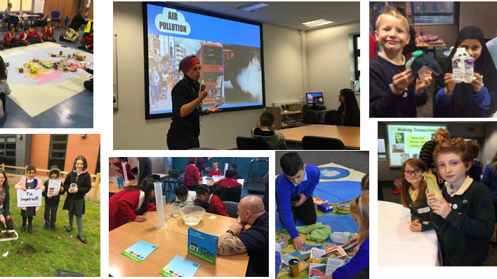
Eco-Schools Roadshow

Slide 7
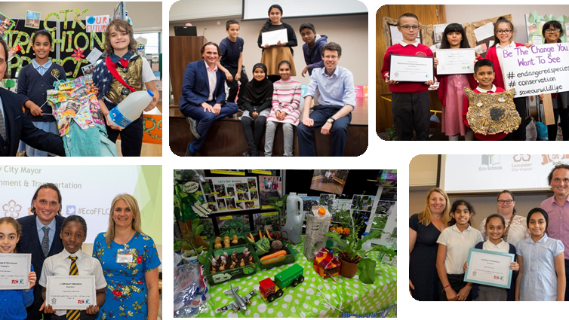
Eco-Schools and Food for Life Celebrations

Slide 8
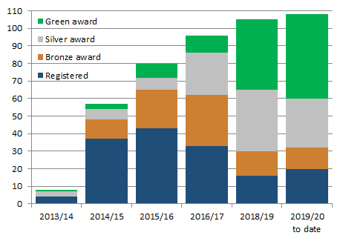

Eco-Schools – Our Work in Leicester
Promoted Eco-Schools as an award since September 2014 (114 schools)
109 registered on the programme
of those, 91 have achieved bronze
of those, 78 have achieved silver
of those 48 have achieved Green Flag

Slide 9
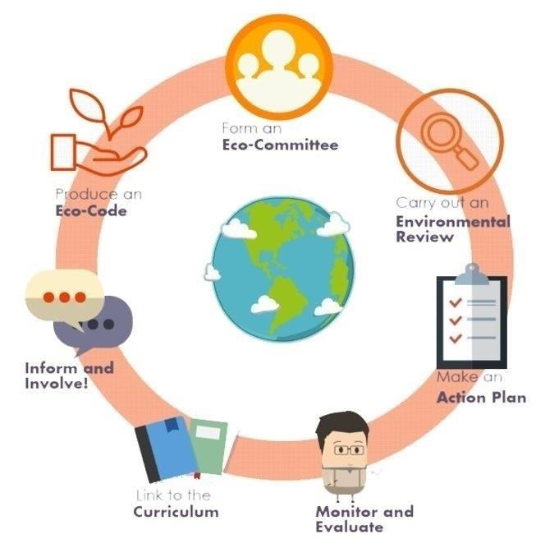

Eco-Schools Programme
7 step model

Slide 10

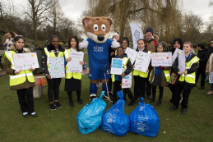
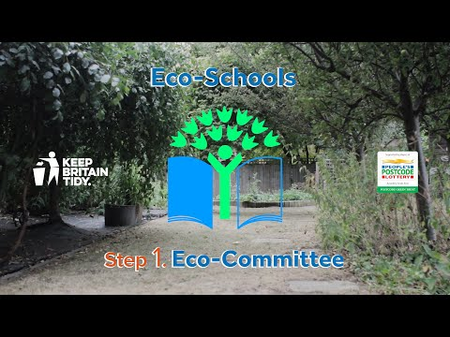
Step 1
Eco-Schools model - 7 steps 1
EYFS resources
Primary resources
Secondary resources
Step 1 – Eco-Committee, the heart of an Eco-Schools action and learning
  At least one pupil form each year group
  Meet at least once per half term
  Share responsibility for running meetings
  Records of minutes are kept
  Minutes displayed on the Eco-board
  Representative from parents, governors or senior leaders

Slide 11
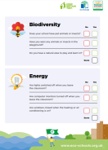



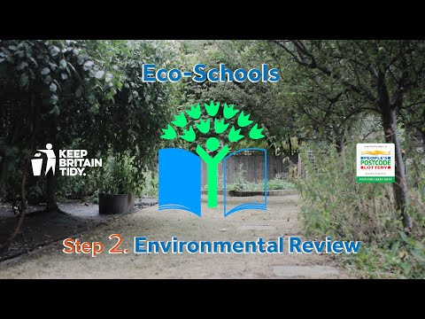
Step 2
Eco-Schools model - 7 steps 1
EYFS resources
Primary resources
Secondary resources
Step 2
EYFS
Primary
Secondary
Step 2 – Environmental Review – investigating the school's environmental performance
  Covers all 10 Eco-Schools topics
  A copy is displayed on the notice board
  It is updated/reviewed at least every 2 years (best practice is annually)

Slide 12
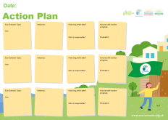

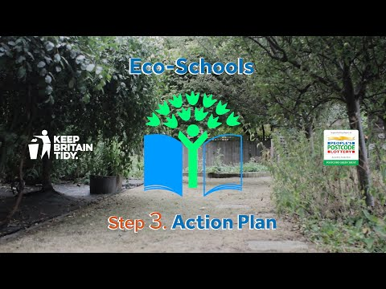
Step 3
Eco-Schools model - 7 steps
EYFS resources
Primary resources
Secondary resources
Step 3
Step 3 – Action Plan – Decide on topic actions, based on the result of the Environmental Review
  The action plan is influenced by the review
  Pupils take responsibility for learning on the topics
    3 for the first green flag
    5 for the renewal (changing 2 with each subsequent application)
  Contains timescale, who is responsible and how it will be monitored
  Shared with the whole school
  A copy is displayed on the noticeboard

Slide 13
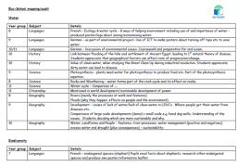


Step 4
Step 4
Eco-Schools model - 7 steps
EYFS resources
Primary resources
Secondary resources
Step 4 – Curriculum Links – making links between the school's environmental activity and the curriculum
  Environmental issues are covered in at least three areas in your school curriculum, evident in schemes of work, pupils work and/or lesson plans (for first green flag this can be the same year group)
  They do not need to be the same topics as your Action plan

Slide 14
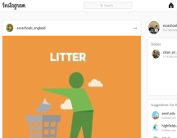
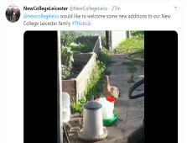
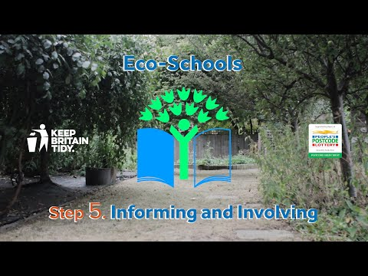
Step 5
Eco-Schools model - 7 steps
EYFS resources
Primary resources
Secondary resources
Step 5
Step 5 – Informing and involving – Let the whole school and wider community know what the Eco-Committee is doing
  A prominent noticeboard in school
    Covering the 7 steps and 3/5 topics
    Members of the committee
    Environmental review
    Environmental action
    Examples of monitoring and evaluation
    Eco-code
  Variety of mediums to communicate
  The whole school and wider community is informed

Slide 15
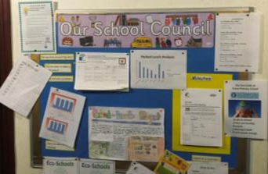

Step 6
Eco-Schools model - 7 steps
EYFS resources
Primary resources
Secondary resources
Step6
Step 6 – Monitoring and Evaluation – Measuring change and finding out what works and what doesn't
  The committee monitors the effectiveness of the topics via data collections, surveys, before and after photographs
  It is communicated with the whole school
  Data has been analysed to help pupils develop further topic actions
  Data has been used in the curriculum e.g. graphs and charts in math

Slide 16


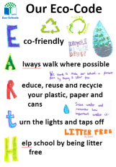
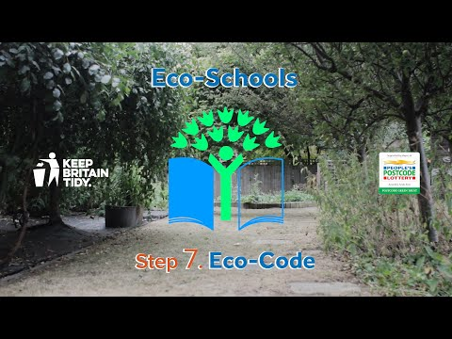
Eco-Schools model - 7 steps
EYFS resources
Primary resources
Secondary resources
Step 7
Step 7 – Eco-Code – Creating a call to action that the whole school can get behind
  There is an agreement statement for your school drawn up by pupils
  It reflects the topic actions you are working on
  It is displayed around school e.g. classrooms, hall and the office
  The majority of pupils and students understand is

Slide 17


Eco-Schools model 10 topics

Slide 18

Key things to think about in topics
Whole school opportunities
Informing everyone about the work
Links to curriculum areas e.g. science (materials), DT (mechanic skills), English (persuasive writing) and maths (data handling)
Monitor impact of actions –counting journeys items – however photos before and after projects & surveys are also suitable
Reflected in your Eco-code

Slide 19

Transport Projects
#EcoSchoolsAtHome
Beat the Street
School Run Parking
British Cycling
National Eco-Schools Winner
Bikeability
School Ride
Play Street Orders
Sustrans
Living Streets
Air Quality Education
Clean Air Day
Switch of your engine campaign
Healthier Air for Leicester Schools Award
Walking Maps

Slide 20

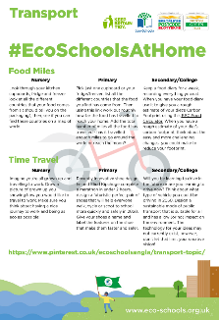
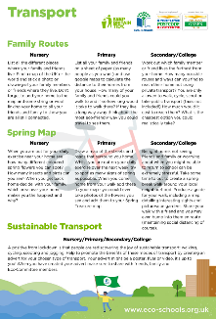
#EcoSchoolsAtHome
Every Tuesday at 8:00pm Eco-Schools England is publishing a new Eco-Schools Topic handout that will include 5 different topic related tasks that can be undertaken both at home and in school.
The topic actions have been designed so that they can be carried out by nursery children and college students alike.
School Grounds
Biodiversity work
Marine work
Litter work
Energy work
Global Citizenship Work
Healthy Living Work
Transport
Waste

Slide 21
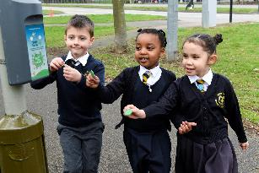
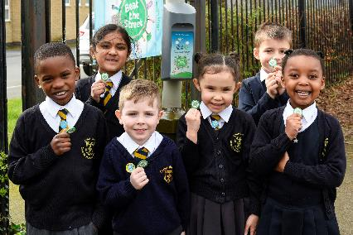

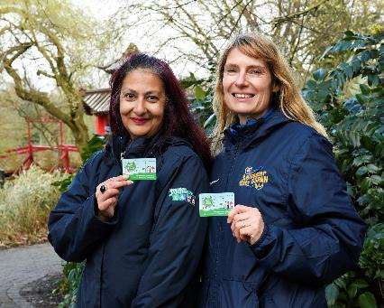
Beat the Street
Beat the Street Leicester is a fun, free game that has seen Leicester transformed into a giant game!
Run over 6 weeks, the game challenges the community to see how far they can walk, cycle or run
There is an element of competition which enables individuals and teams to collect points as they participate to battle it out for the top spots on the leader board and be in with a chance of winning some prizes.
We previously ran with 20 schools and plan to run a further city wide project in the future

Slide 22


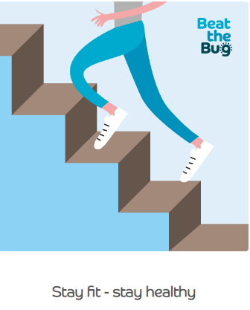
Beat the Bug
Beat the Bug is a health & wellbeing programme designed to help you, and your family stay active and well during the Coronavirus outbreak, protecting the NHS.
Beat the Bug is brought to you by the expert team at Intelligent Health, founded by Dr William Bird MBE, a frontline NHS doctor, global expert in physical fitness and advisor to the World Health Organisation and Public Health England.
Intelligent Health also produce Beat the Street, the global walking and activity game, GP training and education, and patient health testing solutions.
Subscribe to a free weekly newsletter.
www.beatthebug.me/

Slide 23

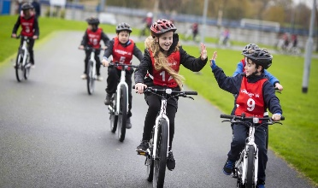
British Cycling
Ready Set Ride - Reception and Year 1
5-week programme in school. All equipment provided.
10 children for roughly 20 – 30 minutes depending on school size.
Developing the children’s balance and coordination and building throughout the weeks to hopefully getting them onto a pedal bike.
Based on the playground but would need indoor space in case bad weather.
Go Ride – Year 5 or 6
5-week programme in schools.
15 children for 45 minutes each.
Either a full day or half a day. Working on skills on the bike, basics to start with and progressing through the weeks. This is brilliant to work towards School Games or just to give the children a chance to ride the bike and learn skills.
This is based on a school field ideally but also a playground.
Tiffany Fletcher
Free cycle coaching in school
Tiffany can provide all the relevant kit including bikes
tiffanyfletcher@britishcycling.org.uk
07384 214096

Slide 24
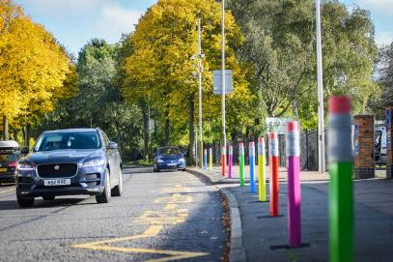
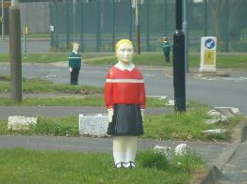
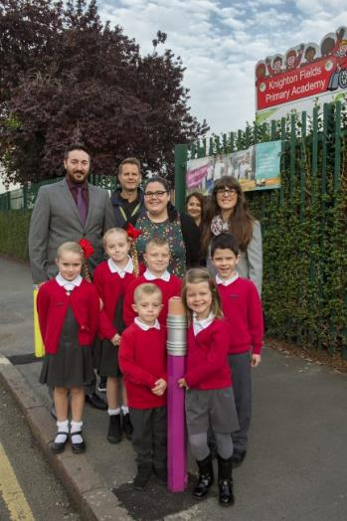
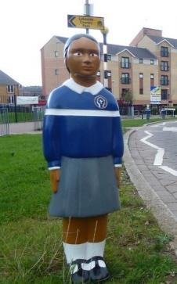
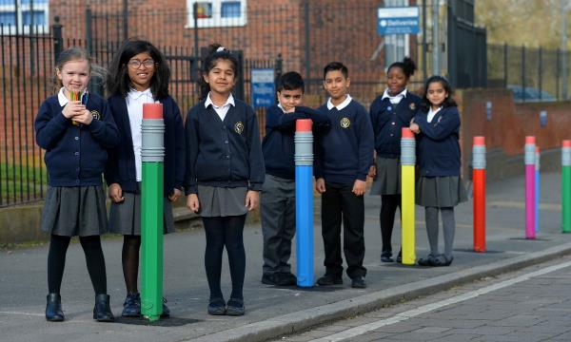
School Run Parking

Slide 25
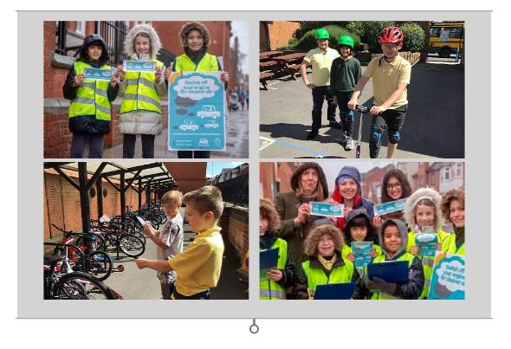

National Eco-Schools Winner
To encourage everyone to travel sustainably to school selected pupils at Avenue have been appointed ‘Walk to School Champions’ and tasked with the responsibility of monitoring how their classmates travel to school.
The Walk to School Champions then provide recognition to those who have walked or cycled to school by awarding badges and class trophies in their monthly assemblies.
In addition to their ongoing work, on 21st May 2019 the whole school participated in Happy Shoes Day, which included a whole school walk (or bike) to school.
On the day they found that in 8 of their classes none of the children had travelled to school by car – in fact, 92% of children in the whole school had walked, biked, scooted or parked and strode.

Slide 26

Bikeability
50 schools
2500 pupils
Level 1 with Year 5/6 - playground
Level 2 with Year 6 - roads around the school
Level 3 - longer journeys
Contact Colin Cheney
Colin.cheney@leicester.gov.uk

Slide 27
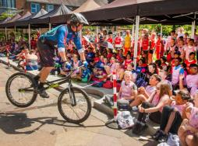
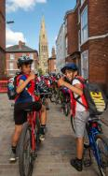

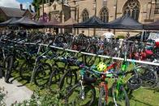
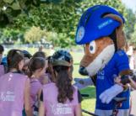
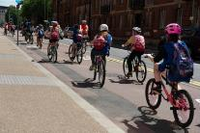
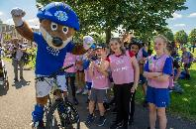
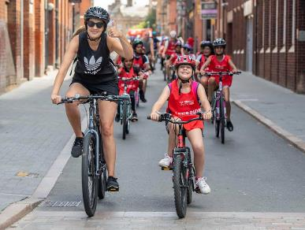
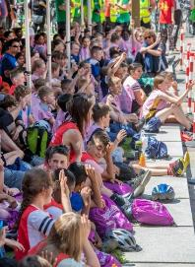
Schools Ride
Around 400 schoolchildren and adults from 11 schools took part in a mass ride into the city on Friday 5 July 2019
Leicester City mascot Filbert Fox lead the young cyclists as part of the annual schools’ bike ride
Year 5 & 6 schoolchildren from across the city and county the chance to put into practice the Bikeability skills
Once there, they watched a demonstration from mountain bike stunt rider Danny Butler
Photos of the day can be found on the Choose How You Move Facebook
www.facebook.com/ChooseHowYouMove

Slide 28
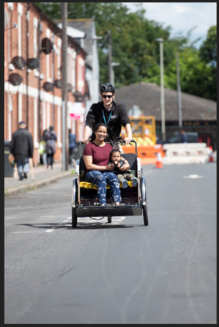
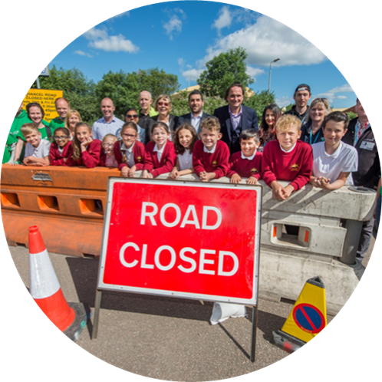
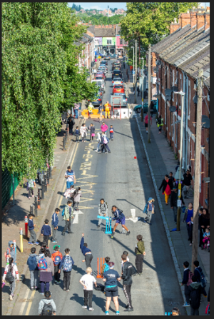
Play Street Orders

Slide 29

Sustrans Schools Cycling Projects

Slide 30
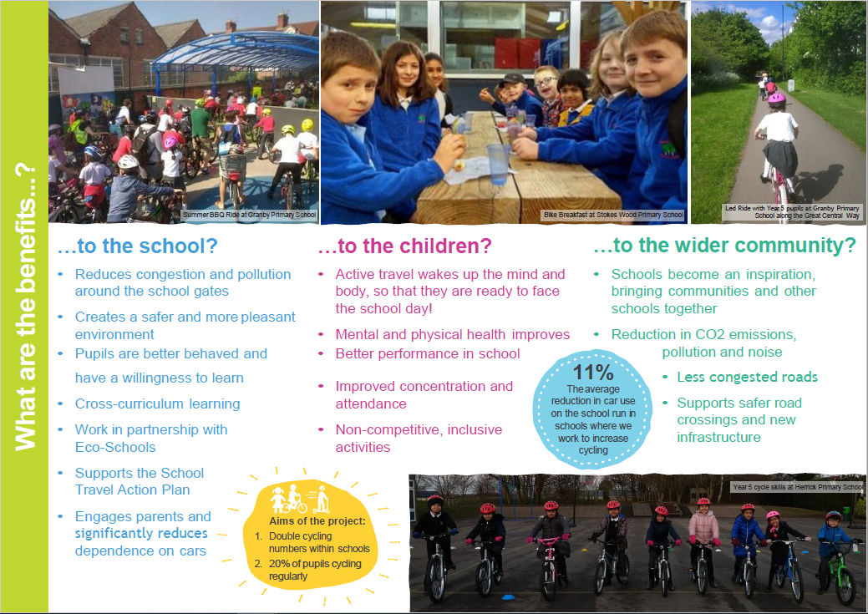
Sustrans Schools Cycling Projects 2

Slide 31
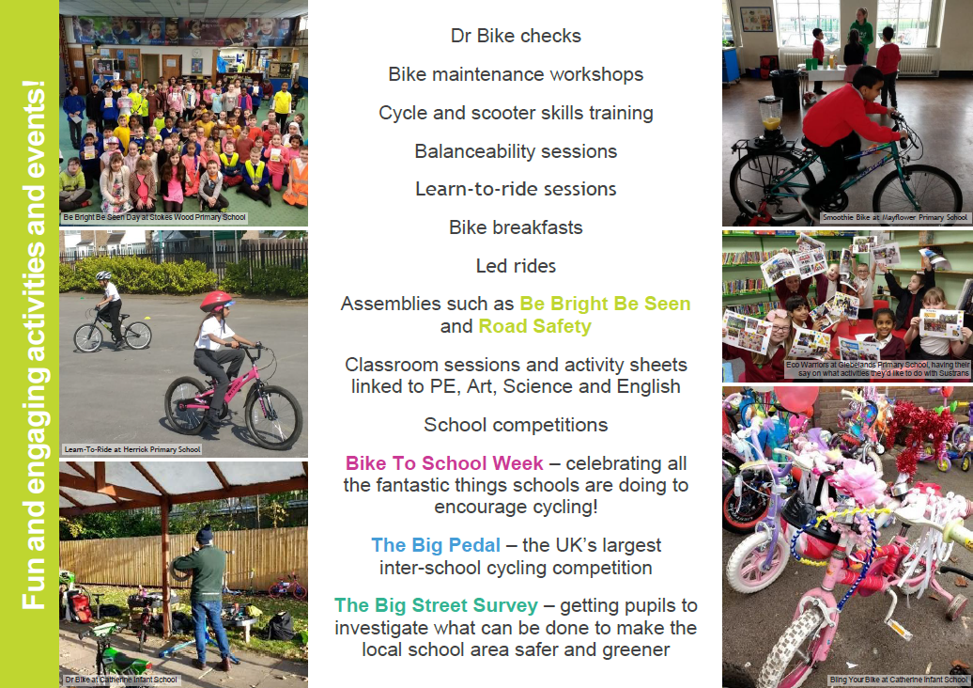
Sustrans Schools Cycling Projects 3

Slide 32
Sustrans Schools Cycling Projects 4

Slide 33

Sustrans Schools Cycling Projects 5

Slide 34
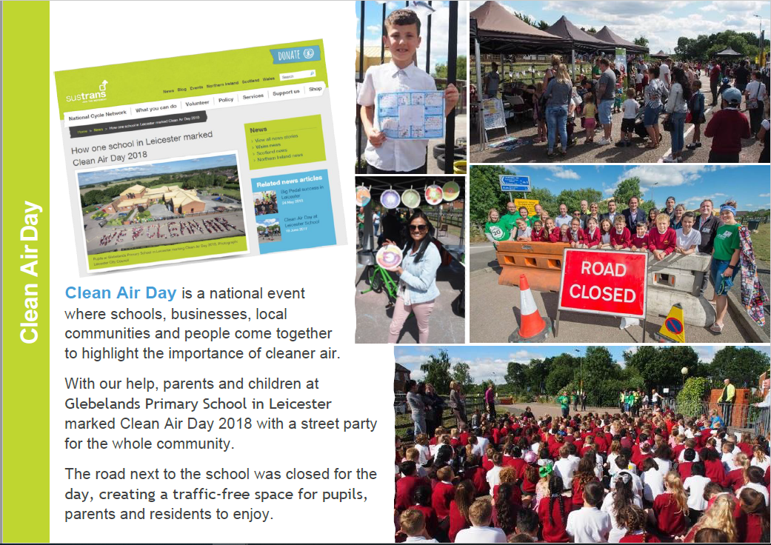
Sustrans Clean Air Day

Slide 35
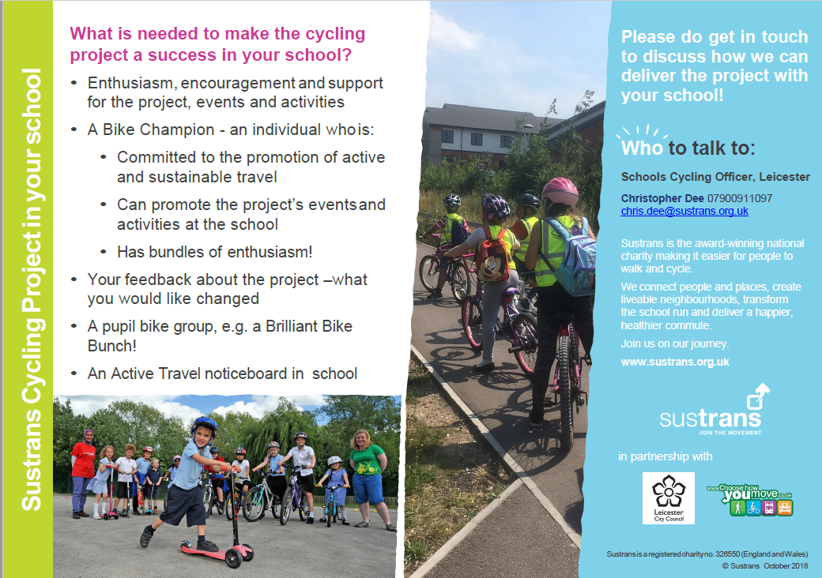
Sustrans School Cycling Projects 6

Slide 36
Sustrans highlights
This academic year
A few highlights
Worked in 71 schools with 27,497 pupils
20 prize giving events
6 Road Safety Assemblies
Helped 150 children learn to ride
9 pupil lead workshops

Slide 37
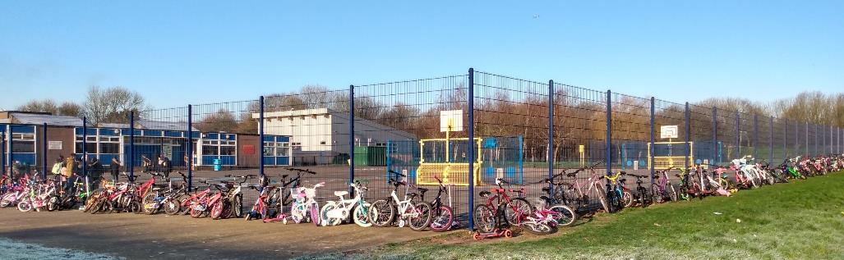
Buswells Lodge
Buswells Lodge
-Two Wheel Thursdays
Start of the academic year:
- No cycle parking
- No pupils cycling
- Lots of parking issues
Start of the 2020:
- Launch of a regular bike to school day that is pupil lead
- 84 pupils cycling
- 60 scooting
- Radio Leicester interviewing pupils, parents and staff

Slide 38
School support during covid 19
Schools support during Covid 19
Resources for those at home and how to travel safely when schools return
Document title | 20 May 2020

Slide 39
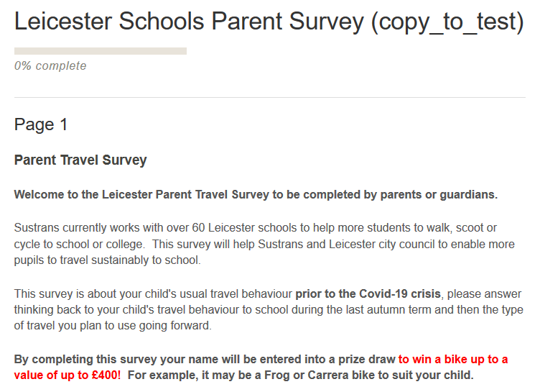
Parents travel survey
Parents Travel Survey

Slide 40
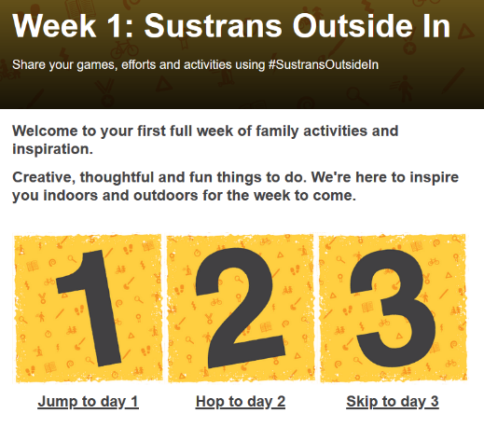
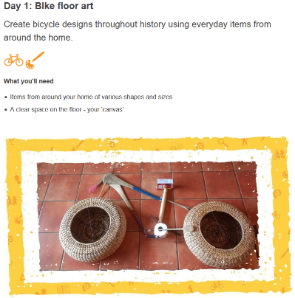
Outside in
Outside In

Slide 41
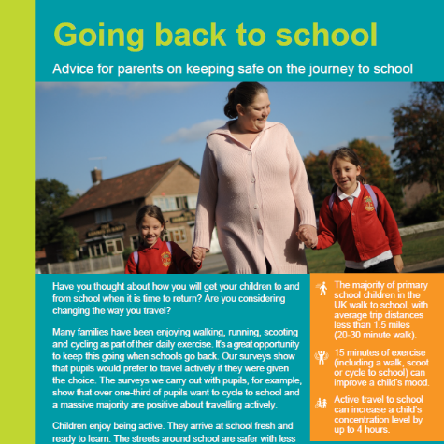
Back to school travel advice
Back to school travel advice

Slide 42


Living streets
Notes:
We are Living Streets, the UK charity for everyday walking.
We want to create a walking nation, free from congested roads and pollution, reducing the risk of preventable illnesses and social isolation and making walking the natural choice. We believe that a walking nation means progress for everyone.
Our ambition is to get people of all generations to enjoy the benefits that this simple act brings and to ensure all our streets are fit for walking.

Slide 43


Living streets 2
Notes:
A SOCIETY THAT DOESN’T WALK IS DISCONNECTED, LESS FRIENDLY, AND LESS EQUAL.
It’s a more dangerous place to live, plagued by pollution, congested roads and the effects of climate change. It’s more sedentary and inefficient, and it’s less healthy.
A society that do
CONGESTED ROADS
POLLUTION LEVELS
UNSAFE STREETS
OBESITY
MENTAL AND PHYSICAL HEALTH COSTS
SOCIAL ISOLATION
INEQUALITY
LOCAL ECONOMIES SUFFERING
doesn’t walk is not somewhere we want to live.

Slide 44






What we campaign for
Walk to school
Improving children’s health & wellbeing
20mph speed limit in urban areas
Creating safer streets and more vibrant communities
Walking Cities
Designed around people not vehicles – accessible for all
#Pavementsforpeople
Uncluttered pavements & being forced into the road
High street walking environment
Making places better for walking & the consumer
Improving air quality
Invest more into walking & cycling as well as developing a new Clean Air Act

Slide 45




Evidence building & resources available at: www.livingstreets.org.uk/policy-and-resources

Slide 46
Living Streets 3
Why encourage walking to school?
Reflection:
Think of two ways that walking might benefit the children you work with

Slide 47


Living streets 4
Why encourage walking to school?
Individual benefits
Quality
family time
Time to learn
and practice road
safety skills

Slide 48




Living streets 5
Why encourage walking to school?
School community benefits

Slide 49
OFSTED & Post Covid-19 Travel
School identity benefits
HMCI Amanda Spielman’s summary of the framework changes focuses on holistic education
Emphasis on rewarding schools with “integrity” and providers who do the best they can “even in challenging circumstances.”
Boris Johnson on travel post lockdown, travel by car or “even better by walking or bicycle.”
References:
1. https://www.gov.uk/government/news/whats-changing-at-ofsted-in-autumn-2019
2. https://www.theguardian.com/world/2020/may/10/uk-coronavirus-lockdown-what-has-boris-johnson-announced
Notes:
To quote some recent statements from key figures:
HMCI Amanda Speilman wants OFSTED’s new framework to focus on holistic education. She wants to reward providers who demonstrate “integrity” and do the best they can in “challenging circumstances.”
Schools settings are free to interpret this guidance, and how their school will demonstrate this, as they will.
On a wider, governmental scale, the Prime Minister has said that he wants the public to start walking or cycling more post Covid-19, as evidenced in his speech from 10.5.2020.

Slide 50
Living Streets in Leicester
Key contacts: Katie France and Annie Russell
WOW (the year round walk to school challenge)
Walk to School Week
Happy Shoesday
Next Steps to Secondary
Next Steps: Changemakers
Next Steps to University
Lockdown walking resources for primary
Lockdown walking resources for secondary
School Streets toolkit
Notes:
Want to get involved? Here are some of the things that we can offer you.
The most popular project we offer in Leicester is the WOW project, which I’ll be going into a little more detail later. This is a walking intiative aimed at primary schools.
WTSW – usually takes place in May, but has been postponed to October this year. This can be engaged with by any primary school through purchasing the WTSW packs.
Happy Shoesday – a sponsored event where children wear their Happy shoes to school, raising funds for Living Streets.
Next Steps to Secondary – a transition programme usually offered through secondary schools to upcoming Year Six pupils (under review for 2020).
Free your Feet – a project aimed at increasing walking in secondary schools, which I’ll discuss later.
Without even signing up for any involvement with Living Streets you can access our free resources online – we’ve produced a lot of material to encourage walking during the pandemic for a variety of ages. Also, the School Streets toolkit is a really useful resource to help school staff consider the environment around their school and what practical steps they can take to change that.

Slide 51

Walk to school
Notes:
What is WOW?
Year round walking challenge
Children are rewarded for walking once a week (or more) every week in a month with a collectible WOW badge
There are eleven badges over the year to collect, all designed by children who take part in the annual WOW badge competition
Last years theme was “Inventions that changed the world,” this year’s theme (2020-21) is Wonders of the World.
Trips are recorded on the Travel Tracker system, very little admin involved with running this as children can take charge of the recording process once the project is up and running.

Slide 52

Travel tracker
Record journeys on the
WOW Travel Tracker - Demo
Notes:
Access via whiteboards, computers, iPads
New batch mode has made this process much quicker – so there may be some people on the call who have had experience of old versions of Travel Tracker, the new version is slicker and may work better.
Depending on numbers – I’ll do a sample of how this might work using our Demo class. So ask “how did XX travel to the shops on their most recent trip?” Share screen to show how this is recorded in individual mode and batch mode.

Slide 53
Travel tracker 2
Record journeys on the
WOW Travel Tracker
Log journeys at a convenient time of school day
Pupils receive instant feedback on progress made towards earning a badge
Class leader boards
Automatic calculation of badges earned
Travel by class shown in circle graphs
Run and export reports
**New** batch process www.traveltracker.org.uk/en-gb/pupils/by-class-date/27252/quick/2020/5/14
Notes:
Things that you can do on Travel Tracker

Slide 54






Achievements
Notes:
Child friendly data reports that can be used in extension tasks for Maths lessons

Slide 55
Support and resources
Support and resources from LS*
Launch and refresher assemblies
Parent letters
WOW Monitor badges and certificates
Curriculum linked learning resources
Park and Stride guidance
Strider mascot visit
Support and advice by phone, email, face-to-face
WOW badge competition (spring term)
Travel Tracker subscription
*subject to national government restrictions and organisation response
Notes:
This is ‘what normal WOW looks like’ obviously these are going to be different for a while (particularly assembly delivery and face to face interactions), but we are working hard to give schools everything they need to promote safe, active travel.

Slide 56

WOW: The stats in Leicester*
54 schools participating
38 schools of these are recording on Travel Tracker
13 new schools for 2019/2020
 | Active Trips | Car Trips
Baseline | 67% | 33%
Year | 84% | 16%
Difference | +17% | -17%
*Taken from Travel Tracker data 2/9/2019 – 31/3/2020
Notes:
The data in Leicester is very good:
More schools are participating than ever before
The difference in active trips from the baseline to across the year is a massive increase
Not only is the percentage bigger, but if you look at the graph at the bottom – from September through you see an immediate increase in Walking trips, even in the winter months children are walking more than they did in September
March we see a drop off – but this is very tied into the pandemic and the actual amount of data recorded more than anything else

Slide 57



NEXT STEPS to Secondary
Transition offer
Delivered to Year Six pupils planning their journeys to Secondary School
Notes:
Normally this would consist of two workshops run by LS staff. One in Summer term, promoting active travel, and another in Autumn with a Walking Challenge. This is in flux at the moment – but we are developing a Covid-19 appropriate transition offer, with online resources being developed to support Secondary Schools keen to promote active travel ( url should be available by 20th).

Slide 58
NEXT STEPS : Changemakers
Consists of a toolkit for LS staff ( or associates) to support time-limited, student-led campaigns for better streets and/or more walking by their peers
Suitable for delivery in Secondary Schools or Further Education settings
Notes:
Changemakers consists of a Living Streets facilitator, available to support a group of students, who lead a project to increase walking and/or improve the walking environment. Examples might be a secondary school which wants to improve congestion, so sets up a Park and Stride through LS support; or a further education college which recognises the need for increased pathfinder signs to their setting.

Slide 59



Leicester Uni promo event
Leicester Uni,
Promo Event and led walk, Sept 2019
Next Steps at University
Notes:
For Next Steps Uni we deliver maps, themed led walks and events, focussing on student mental health and wellbeing. Again - this is what normal looks like - we will do what we can, and have resources online for secondary school, FE and HE students, to support their wellbeing and mental health through walking, on our website .

Slide 60

Get in touch
Get in touch
Jessie Davidson
Living Streets Schools Coordinator
jessie.davidson@livingstreets.org.uk
07711557023
@JessieD78882826 @livingstreets
In Katie’s absence, happy to be contacted with further queries and forward on interest to relevant LS staff member
Katie France
Living Streets Project Coordinator (Leicester)
katie.france@livingstreets.org.uk
07808 6403305
@kt_france
@livingstreets
Usually based at City Hall within Leicester City Council’s Walking and Cycling team

Slide 61







Air Quality Education
FREE
For schools
Suitable
for:
Learn about air quality
Raise awareness throughout the whole school community
Take action, through pupil – led campaigns
Lessons, workshops and assemblies available to download.
Practical activities to help you explore air pollution.

Slide 62






Clean Air Day
SAVE THE DATE
Thursday 8 October 2020
(if Government
Guidance allows)
Tie-in with launch of the LCC School Play Streets, temporary road closure initiative
Currently five schools are on board, £170 application fee - waived for the first 10 schools who apply
You don't need to apply for play streets to get involved – a toolkit of event and activity ideas, is on its way.
Find out more: email danielle.kennell@leicester.gov.uk

Slide 63






Switch off your engine campaign
FREE
for schools
Idling vehicles outside of schools is one of the
biggest contributors to air pollution
around schools.
Campaign developed to discourage vehicles from idling outside of schools
Support to develop pupil-led campaign
Idling monitoring
Free resources: posters, flyers, car stickers
Assemblies available for your school
Suitable
for:
Find out more email: danielle.kennell@leicester.gov.uk

Slide 64


Healthier Air for Leicester Schools Award
FREE
for schools
2020 awards postponed until 2021
Celebrate work undertaken to change school travel behaviours,
alleviate congestion and improve air quality
Participating through achieving three criteria and submit evidence through a short application form
Criteria are linked to school projects and awards you may already be participating in across Eco-Schools, Living Streets, School Run Parking and the Sustrans schools cycling project
You can submit evidence from events and activities from across the past 12 months. Your 2019-20 work, still counts.
Find out more email: danielle.kennell@leicester.gov.uk
Suitable
for:

Slide 65


Walking Maps
Walking maps are currently being developed for schools across the city
Once individual maps have been produced schools will be contacted about arranging an assembly and launch event

Slide 66

Declaring a Climate Emergency in School
On 1 February 2019 Leicester City Council declared a Climate Emergency. The declaration is an acknowledgement that:
  Climate change is happening, and threatens the wellbeing of everyone in Leicester and worldwide
  The speed and scale of global and local action to tackle the problem needs to be dramatically increased.
In its declaration, the Council committed to developing a new action plan to address the emergency through our own services and projects .
What action you can do:
Discuss your plans with students and staff .
Select actions which you plan to achieve, make them manageable but also remember we are in a Climate Emergency.
Make sure your actions have a duration, responsibilities and an evaluation.
Take your action plan to the Governing Body or Trustees to ensure that you have their support.
You can submit your action plan to the City Council which we will publicise as part of our wider action plan.
Start your action plan!
Review regularly to check and maintain your progress .
schools.leicester.gov.uk/climate-emergency

Slide 67


Climate Emergency Documents
Templates and document available at schools.leicester.gov.uk/climate-emergency

Slide 68
Other opportunities coming up
UN Climate Change Learn Online
  Climate Change: From Learning to Action (8 hours)
  Children and Climate Change (6 hours)
  Cities and Climate Change (2 hours)
  Human Health and Climate Change (2 hours)
  Module 1 of Open Online Course on Gender and Environment (6 hours)
Off School website - a free website full of ideas for home learning and fun activities. Head to the Activity Zone for 100s of films, created by teachers, across loads of great topics and themes!

Slide 69
Information and grant opportunities
Travel advice
eTeach link
Grants 4 Schools

Slide 70

Questions and Answers

Slide 71

Future Webinars
3 June | Topic: Biodiversity | Martha Rose, Leicestershire & Rutland Wildlife Trust
10 June | Topic: Global Citizenship & Fairtrade | Hannah Boydon, Mayflower Primary School
17 June | Topic: Healthy Living | Lisa Didier - Food for Life, Sam Woods - TCV, Daxa Ralhan, Leicester City Council
24 June | Topic: Marine | Daniel Coles, Alex Cameron, Roshni Jose - Leicester City Council Nicola Holt, Environment Engagement, Leicester City Council (and also Refill Leicester)
1 July | Topic: How to submit your Green Flag application

Slide 72






Keeping in Touch
EcoSchoolsLCC
EnvEducationLeicester
EcoSchoolsLCC
EcoSchoolsLCC
schools.leicester.gov.uk/eco-schools
Eco-Schools@leicester.gov.uk
(sign up for newsletter and eBulletins)

