Slide 1

#EcoTeach Webinar
Litter
Lee Jowett, Environmental Education Coordinator
Amy Peace, Graduate Project Officer

Slide 2

#EcoTeachMeet Webinar Series
Overview of #EcoTeach format and dates/times of webinars
What Environmental Education Leicester is
Eco-Schools – and how it fits into the big picture
Litter projects
Q & As
Other opportunities coming up

Slide 3
Overview of #EcoTeach Webinar format and dates/times of webinars
Weekly at 10am during term time – lasting up to an hour, Leicester focused but suitable for everyone.
Recording and PowerPoint with links available afterwards at schools.leicester.gov.uk/eco-schools
During the presentation, ask questions in the chat box.
Questions and answers at the end – either directly ask or in chat box depending how many people are attending.

Slide 4

What is Environmental Education Leicester?
Provide free support to all Leicester School.
Communications with schools – social media (Twitter, Facebook, Instagram, YouTube), monthly eBulletins and quarterly newsletter.
TeachMeets, Eco-Schools Roadshow, Eco-Schools & Food for Life Celebration, Sustainable Schools Celebration bi-annual.
Focus on the Eco-Schools Award.
Delivery of energy and litter focused projects.
Project support and partnership working with internal and external organisation.

Slide 5
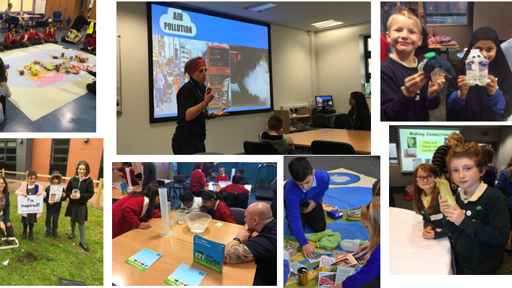
Eco-Schools Roadshow

Slide 6
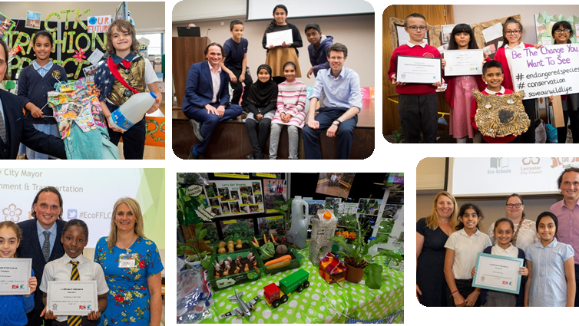
Eco-Schools and Food for Life Celebrations

Slide 7
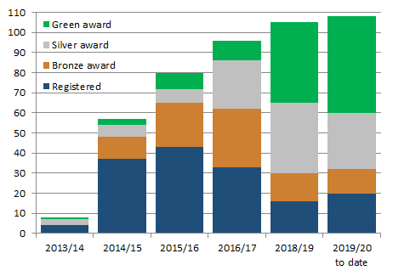

Eco-Schools – Our Work in Leicester
Promoted Eco-Schools as an award since September 2014 (114 schools)
109 registered on the programme
of those, 91 have achieved bronze
of those, 78 have achieved silver
of those 48 have achieved Green Flag

Slide 8
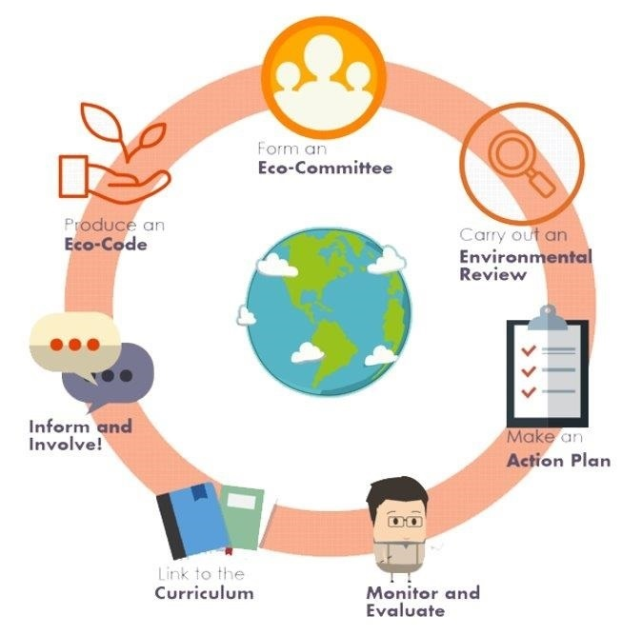

Eco-Schools Programme
7 step model

Slide 9

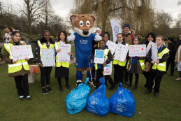
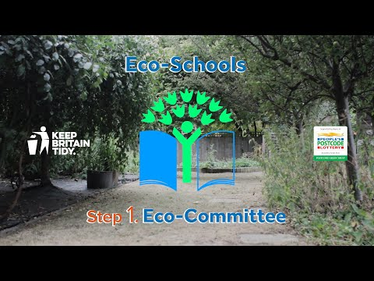
Step 1
Eco-Schools model - 7 steps 1
EYFS resources
Primary resources
Secondary resources
Step 1 – Eco-Committee, the heart of an Eco-Schools action and learning
  At least one pupil form each year group
  Meet at least once per half term
  Share responsibility for running meetings
  Records of minutes are kept
  Minutes displayed on the Eco-board
  Representative from parents, governors or senior leaders

Slide 10
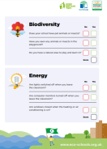
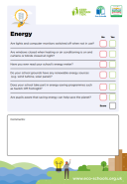


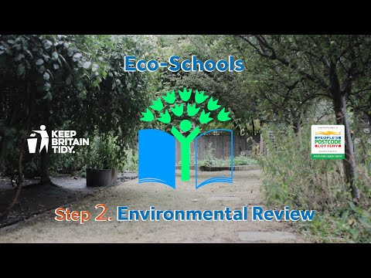
Eco-Schools model - 7 steps 1
EYFS resources
Primary resources
Secondary resources
Step 2
EYFS
Primary
Secondary
Step 2 – Environmental Review – investigating the school's environmental performance
  Covers all 10 Eco-Schools topics
  A copy is displayed on the notice board
  It is updated/reviewed at least every 2 years (best practice is annually)

Slide 11
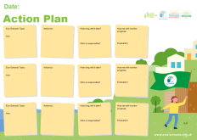

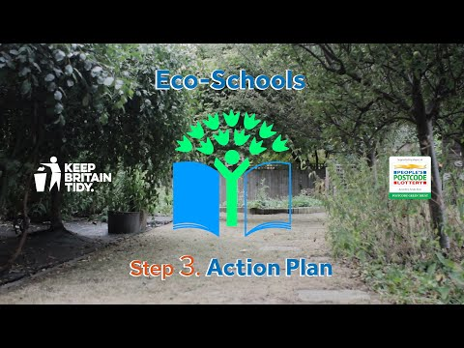
Eco-Schools model - 7 steps
EYFS resources
Primary resources
Secondary resources
Step 3
Step 3 – Action Plan – Decide on topic actions, based on the result of the Environmental Review
  The action plan is influenced by the review
  Pupils take responsibility for learning on the topics
    3 for the first green flag
    5 for the renewal (changing 2 with each subsequent application)
  Contains timescale, who is responsible and how it will be monitored
  Shared with the whole school
  A copy is displayed on the noticeboard

Slide 12
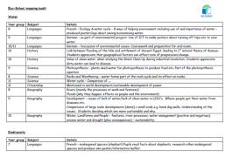


Step 4
Eco-Schools model - 7 steps
EYFS resources
Primary resources
Secondary resources
Step 4 – Curriculum Links – making links between the school's environmental activity and the curriculum
  Environmental issues are covered in at least three areas in your school curriculum, evident in schemes of work, pupils work and/or lesson plans (for first green flag this can be the same year group)
  They do not need to be the same topics as your Action plan

Slide 13
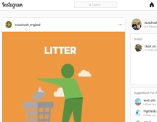
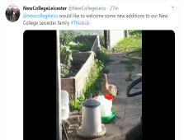
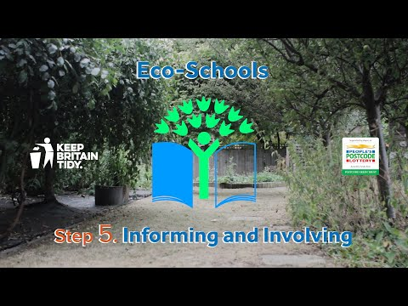
Eco-Schools model - 7 steps
EYFS resources
Primary resources
Secondary resources
Step 5
Step 5 – Informing and involving – Let the whole school and wider community know what the Eco-Committee is doing
  A prominent noticeboard in school
    Covering the 7 steps and 3/5 topics
    Members of the committee
    Environmental review
    Environmental action
    Examples of monitoring and evaluation
    Eco-code
  Variety of mediums to communicate
  The whole school and wider community is informed

Slide 14
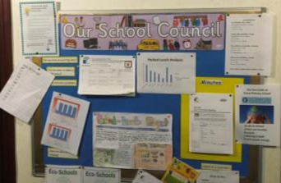

Eco-Schools model - 7 steps
EYFS resources
Primary resources
Secondary resources
Step6
Step 6 – Monitoring and Evaluation – Measuring change and finding out what works and what doesn't
  The committee monitors the effectiveness of the topics via data collections, surveys, before and after photographs
  It is communicated with the whole school
  Data has been analysed to help pupils develop further topic actions
  Data has been used in the curriculum e.g. graphs and charts in math

Slide 15

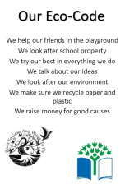
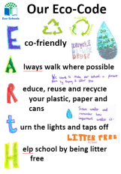
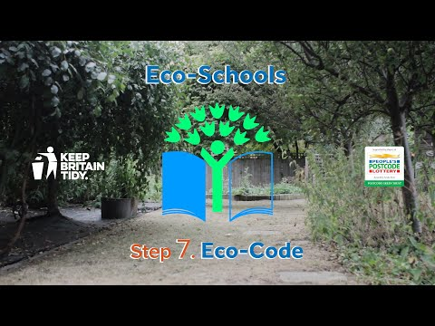
Eco-Schools model - 7 steps
EYFS resources
Primary resources
Secondary resources
Step 7
Step 7 – Eco-Code – Creating a call to action that the whole school can get behind
  There is an agreement statement for your school drawn up by pupils
  It reflects the topic actions you are working on
  It is displayed around school e.g. classrooms, hall and the office
  The majority of pupils and students understand is

Slide 16


Eco-Schools model 10 topics

Slide 17

Key things to think about in topics
Whole school opportunities
Informing everyone about the work
Links to curriculum areas e.g. Science (sorting materials), geography (sustainable development), math (data handling)
Monitor impact of actions – hopefully, reductions in litter (but not always!)
Reflected in your Eco-code

Slide 18

Litter projects
Litter Innovation Fund
Litter Less Leicester
#EcoSchoolsatHome
Great Big School Clean
Bin It
Helping Hands Environmental
Curriculum Links
Notes:
Why focus on litter?
- bad for the environment, can pollute soil, water and air
- looks horrible
- costs money to clear up
- can attract pests

Slide 19


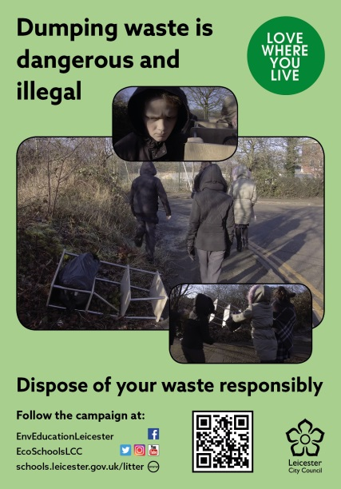

Litter Innovation Fund
As part of the Litter Innovation Fund, funded by DEFRA and managed by Wrap UK, Leicester City Council are conducting a media campaign involving local schools to highlight the issue of litter in Leicester and beyond.
The campaign comprises of a series of short, hard-hitting clips to be used in digital media across the city.
Three key themes which will be addressed;
  Litter down drains
  Fly-tipping
  How litter impacts wildlife

Slide 20



Litter Innovation Fund
The clips have been filmed by a professional film crew and star children from six Leicester Schools
All clips have been subtitled in English and subtitled in the 10 most spoken languages in Leicester: Gujarati, Urdu, Punjabi, Bengali, Somali, Arabic, Farsi, Polish, Slovak and Chinese
We will be conducting litter surveys, both before and after the campaign, in areas local to schools in order to assess the impact the campaign has

Slide 21
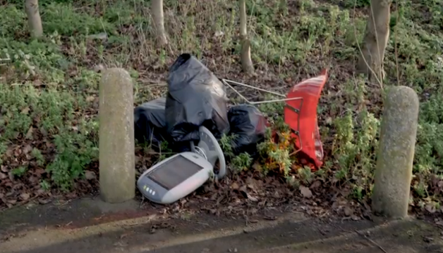
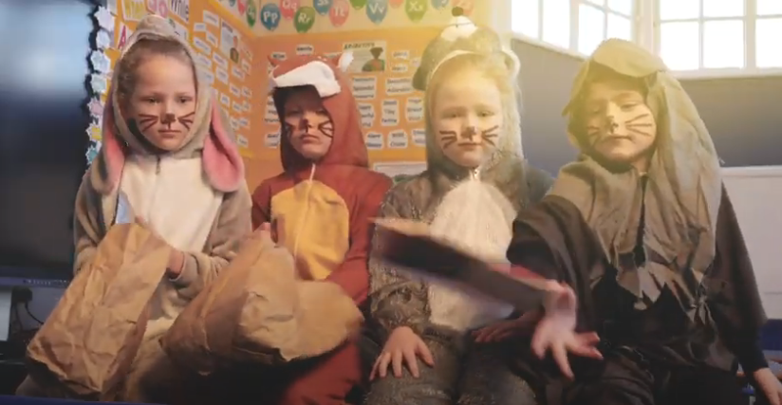
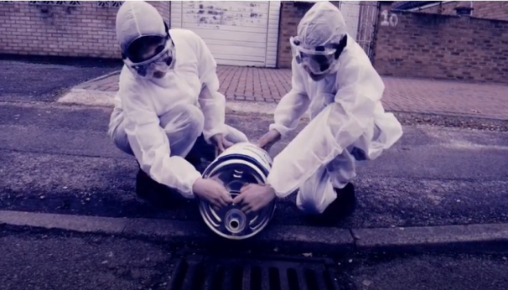
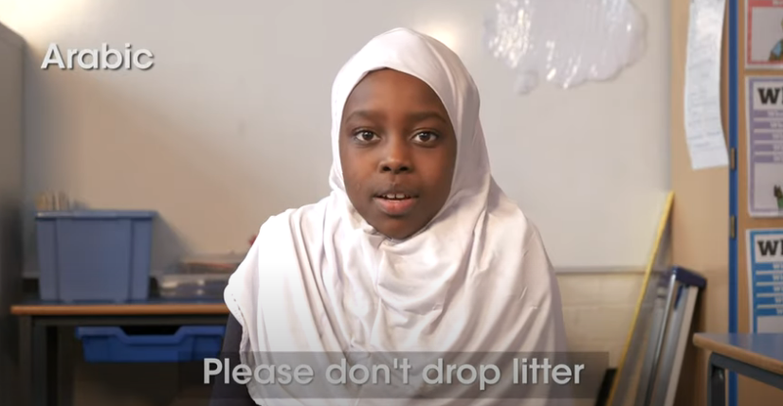
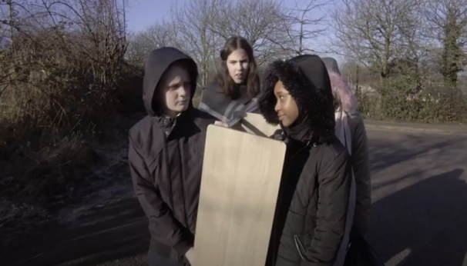
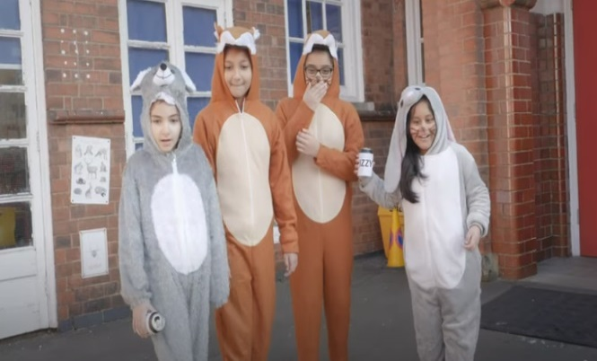
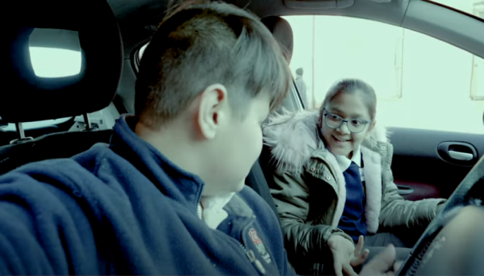

Litter Innovation Fund
King Richard III
Shaftesbury Junior
Rushey Mead Academy
Love where you live
EcoSchoolsLCC
Castle Mead Academy
Rushey Mead Primary
Catherine Juniors

Slide 22
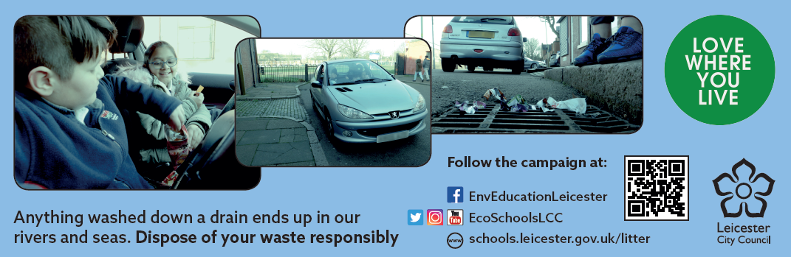
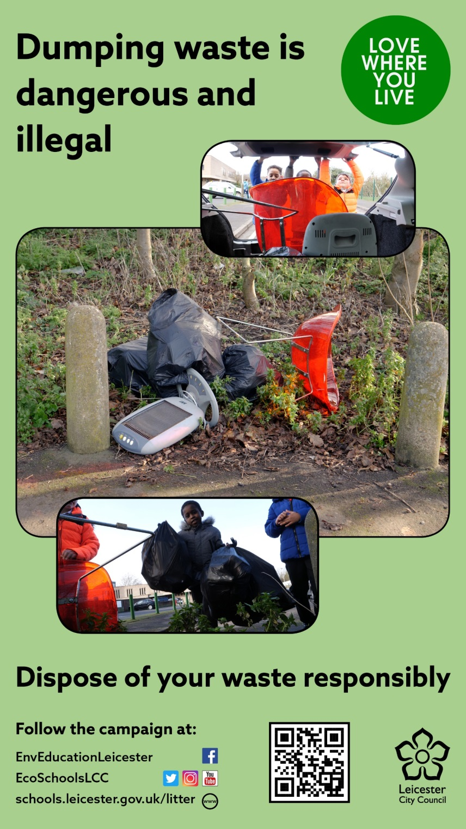

Campaign posters
Email signature and banner size
9:16 poster size
A4 poster size

Slide 23
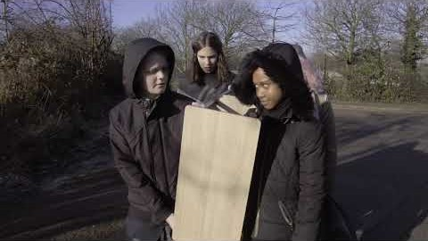
Flytipping 1

Slide 24
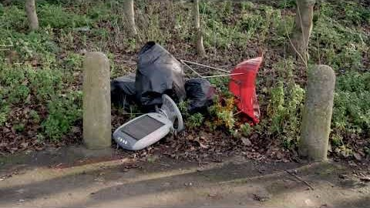
Flytipping 2

Slide 25
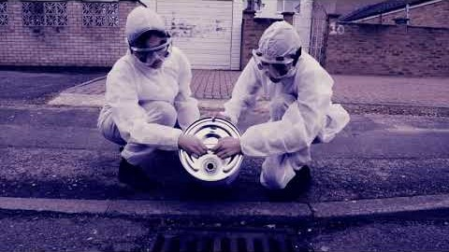
Marine pollution 2

Slide 26
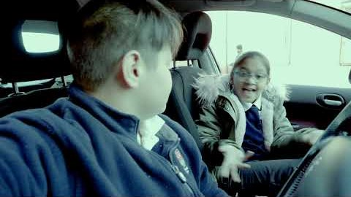
Marine pollution 1

Slide 27
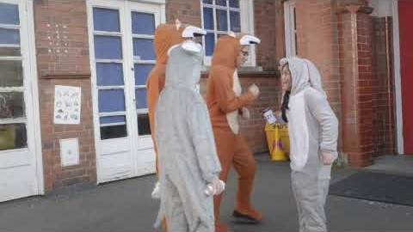
Animals 1

Slide 28
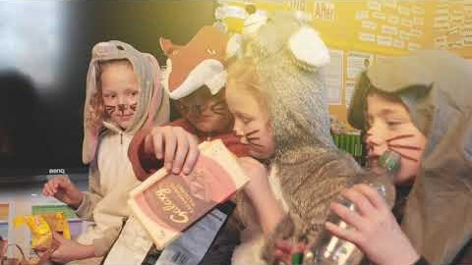
Animals 2

Slide 29
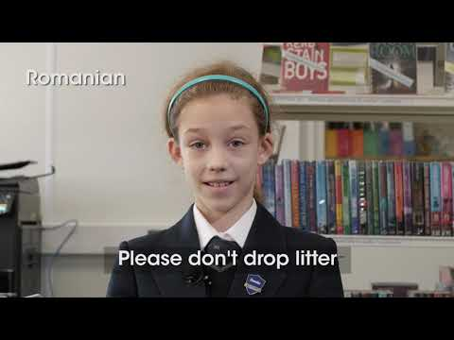
Love where you Live

Slide 30
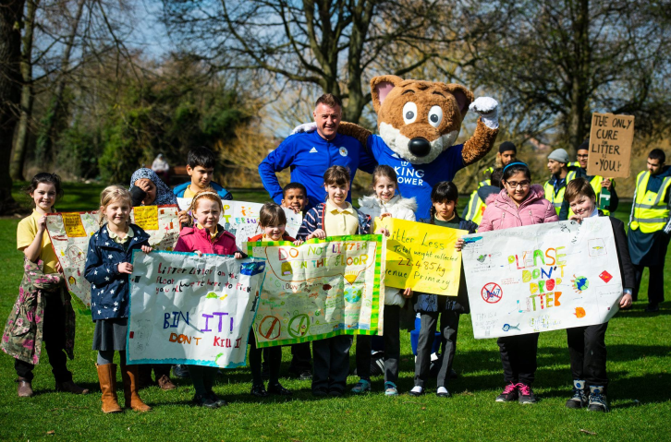

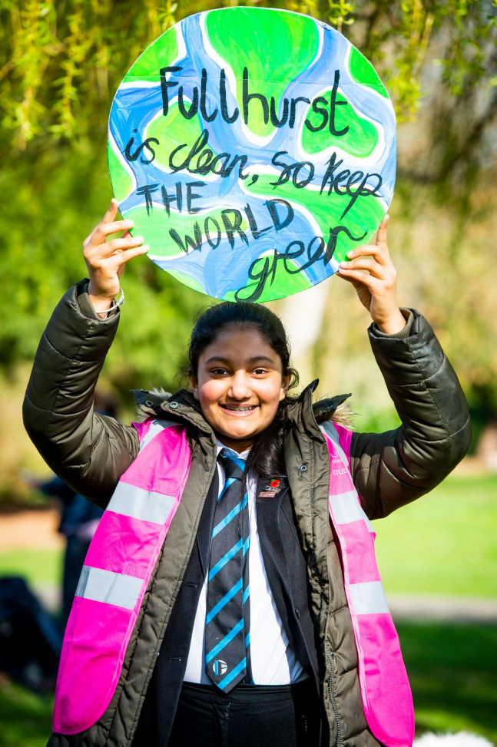
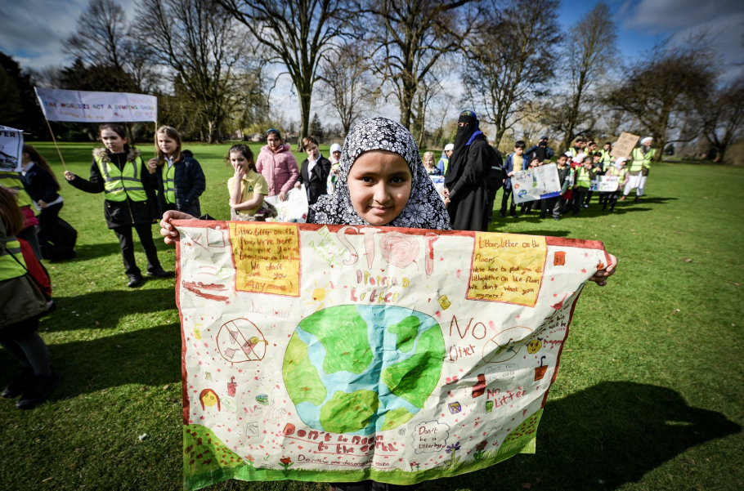
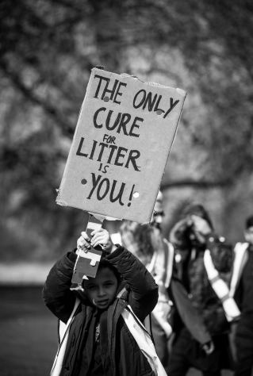
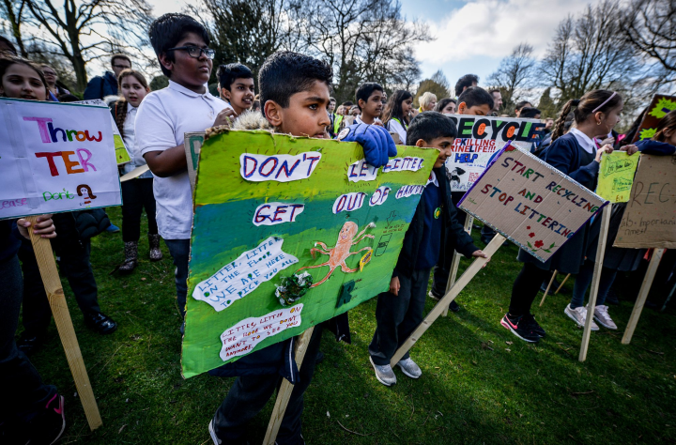
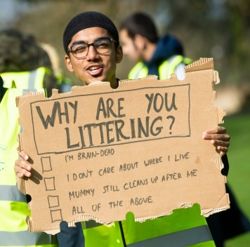
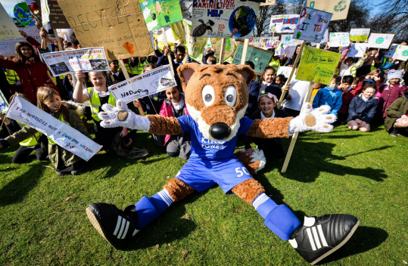

Litter Less Leicester

Slide 31
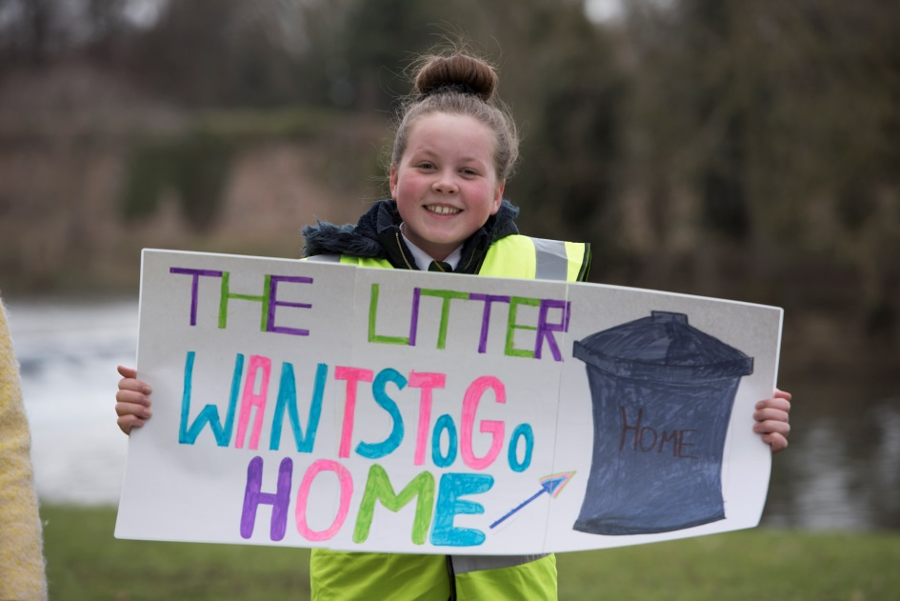

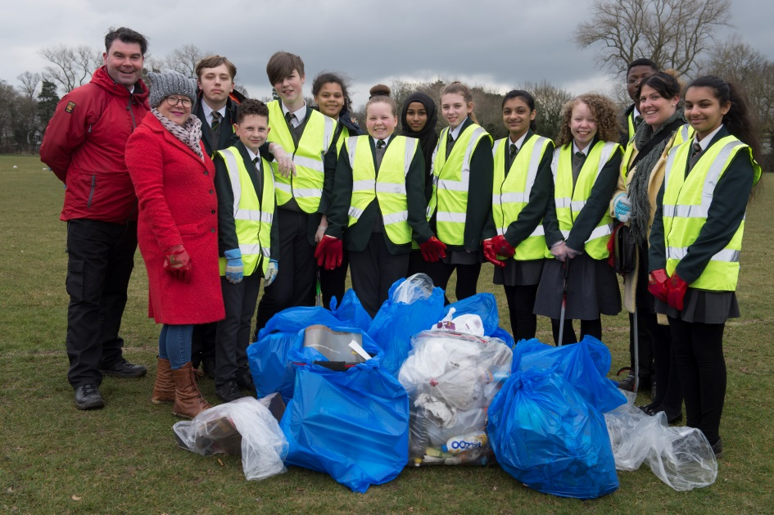
Litter Less Leicester
The Litter Less Campaign, led by Eco-Schools aims to reduce litter and affect long-term behaviour change through implementing a waste management system, which involves the whole school. Leicester is the only place in the UK to run the campaign
Use strategies & activities to engage your staff and students to reduce litter in and around the school grounds
Receive funding to run a campaign and litter pick in and around your school grounds
Develop big community engagement and impact work

Slide 32
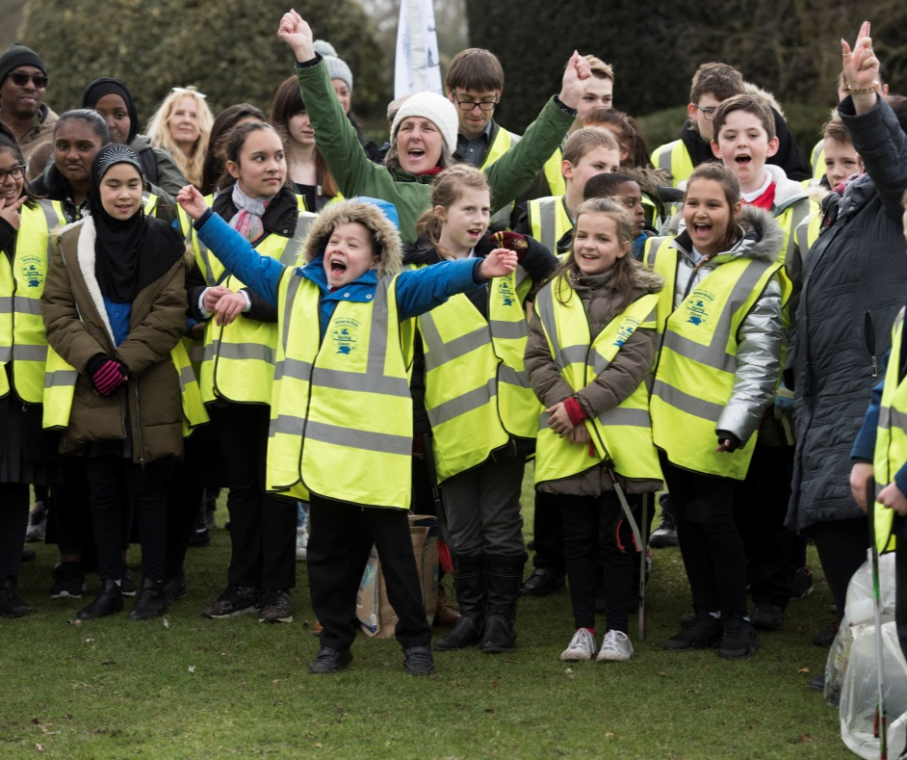
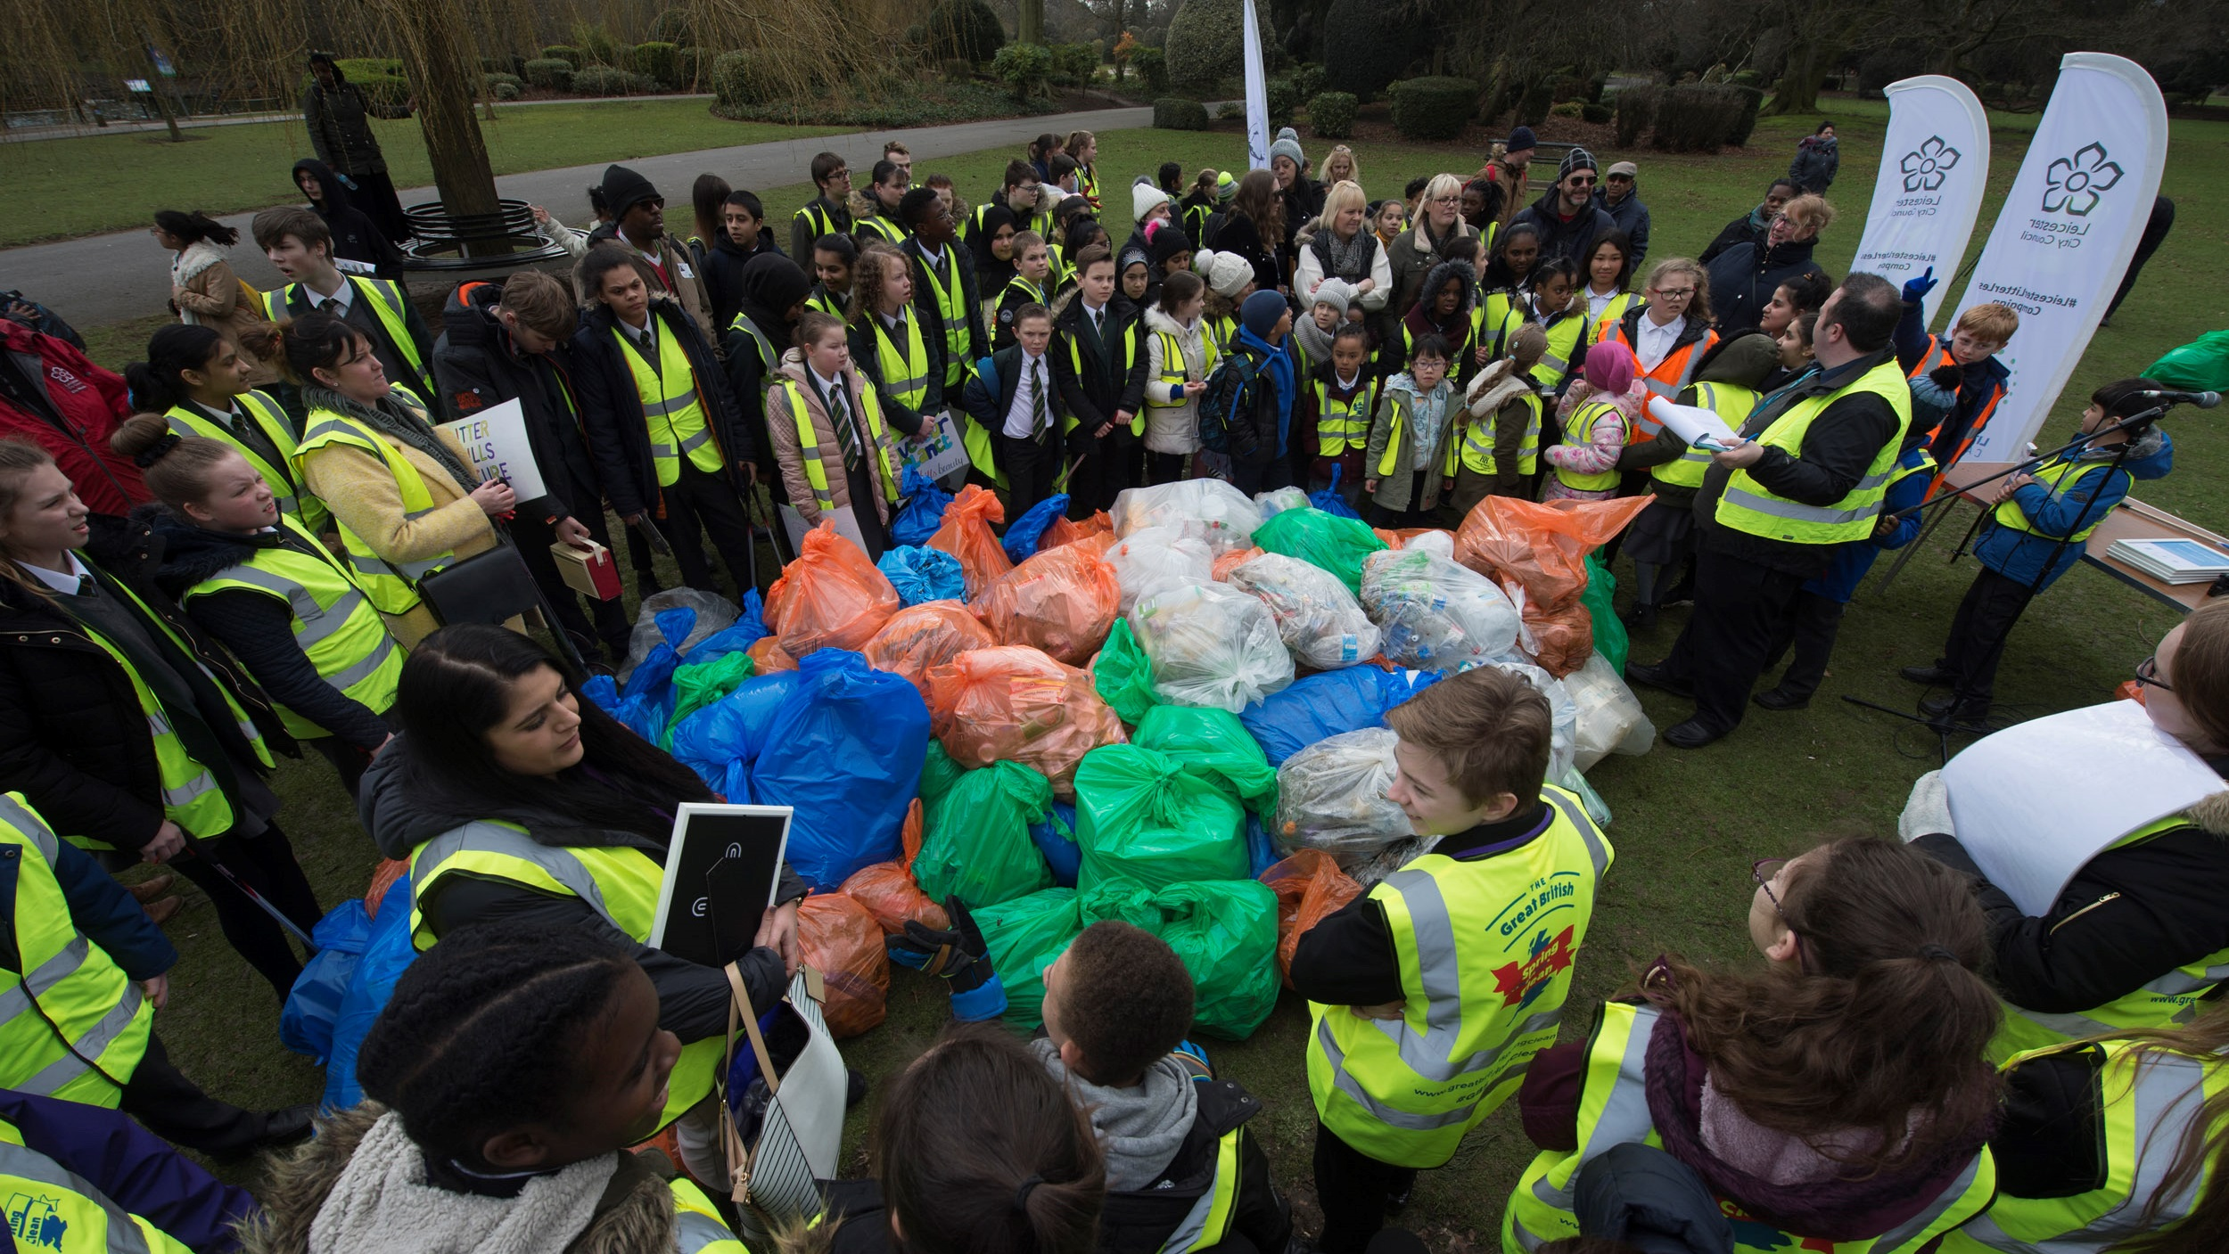
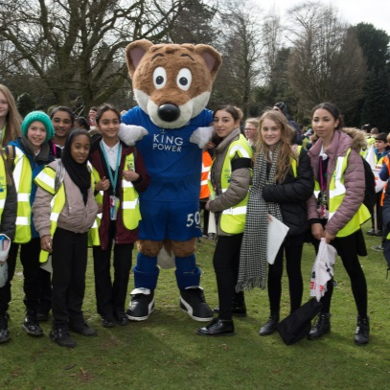
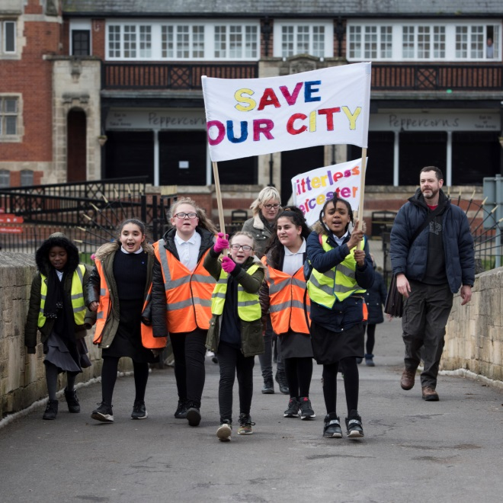
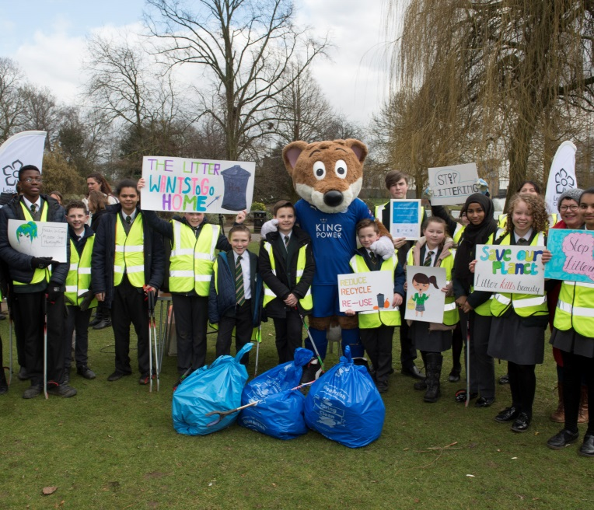

Litterless images

Slide 33


Litter Less Leicester
What do you have to do?
Purchase equipment for litter picking and raising awareness
Bespoke action plan
Carry out 3 different lesson plans linked to litter and waste
Carry out 6 litter picks in and around the school grounds with the last one during the week of the project
Attend the celebration event at Abbey Park with children
Complete a short case study after the event with photos

Slide 34
Litter Less Leicester
What do you have to do?
Purchase equipment for litter picking and raising awareness
Bespoke action plan
Carry out 3 different lesson plans linked to litter and waste
Carry out 6 litter picks in and around the school grounds with the last one during the week of the project
Attend the celebration event at Abbey Park with children
Complete a short case study after the event with photos

Slide 35






Litter Less Leicester 2020

Slide 36

Litter Less on the News

Slide 37



#EcoSchoolsAtHome
Every Tuesday at 8:00pm Eco-Schools England is publishing a new Eco-Schools Topic handout that will include 5 different topic related tasks that can be undertaken both at home and in school.
The topic actions have been designed so that they can be carried out by nursery children and college students alike.
#EcoSchoolsAtHome Nursery Litter resource
#EcoSchoolsAtHome Primary Litter resource
#EcoSchoolsAtHome Secondary Litter resource
Previous:
Biodiversity work
Energy work
Global Citizenship Work
Healthy Living Work

Slide 38


#EcoSchoolsAtHome
#TheWombleEcoSchool Competition
EYFS - Draw a picture of favourite Womble and animal on a litter pick together
Primary - Make short cartoon strip using the template to explain why dropping litter is bad for wildlife
Secondary - 30 second clip about why you are not embarrassed to pick up litter
Deadline for all online competition entries on social media
Friday 29 May 2020 at 16:00
Winners will be announced throughout the day on Friday 5 June 2020 to celebrate World Environment Day

Slide 39


The Great Big School Clean
11-27 September 2020
In 2019 over 175,055 inspiring children and young people took part, compared to 126,000 last year - making it the biggest-ever school clean up!
They were part of a mass-action of over 563,163 volunteer #LitterHeroes who took part in a our Great British Spring Clean
Together, they collected 957,377 bags of litter, equal to 4,308 tonnes, from our country's schools, streets, parks, beaches and waterways - litter that could otherwise have ended up in the ocean.
To sign up: www.surveymonkey.co.uk/r/schoolclean2020

Slide 40





Bin It
Sponsored by Mars Wrigley Confectionery
Resources for students to run anti-litter campaigns
Suitable for age groups:
  5 – 11
  11- 13
  14+
biniteducation.com/resources

Slide 41





Helping Hand Environmental
Recommended by Eco-Schools England
Based in the UK
Range of high-quality, customisable litter picking equipment in a variety of sizes and designs suitable for everyone.
Discounts available to schools.
www.hhenvironmental.co.uk/product-range/environmental-education

Slide 42


Curriculum Links - Language and Literacy
Writing
  Create presentations on a Litter theme such as a plan for tackling a litter issue.
  Write a report or article e.g. on recycling or about the problem of litter at the school.
  Create a Litter poem such as an acrostic. n Phonic work and spellings – high frequency litter topic words.
Talking & Listening
  Discuss video clips related to litter.
  Storytelling and performance poetry relevant to the Litter theme.
  Interview locals about the litter problem in the area.
Reading
  Fiction and non-fiction books on litter and recycling. Put these into a display.
  Follow instructions on products on how to recycle or dispose of them

Slide 43
Curriculum Links - Mathematics and Numeracy
Number
  Undertake counts of litter levels in the school; apply knowledge of percentage calculations to problem solving e.g. percentage reduction or increase in school litter and recycling figures.
  Discuss and be able to assess “value for money” in relation to shopping, e.g. when purchasing waste and recycling bins, buying products with less packaging.
  Use the four operations to solve more complex word problems and puzzles involving numbers and measures related to a litter investigation.
Measures
  Undertake monitoring of litter levels and amount of waste produced by the school.
  Record measurements of “weight” e.g. bin bags and convert from one metric unit of weight to another.
  Read and interpret simple timetables and graphs and apply knowledge to solve related problems e.g. litter levels in school or using national statistics.
Shape & Space
  Discuss the shape of junk models, bins etc.
Handling Data
  Calculate averages related to litter statistics.
  Discuss, plan, collect, organise and represent data in response to a question or statement such as what materials are we recycling? Interpret information and evaluate the effectiveness of the process.

Slide 44
Curriculum Links -The World Around Us
Geography
  Find out how litter affects our seas and oceans.
  Find out about litter levels in other countries.
  Pinpoint local habitats on maps and the human impact on them from dumping litter.
  Draw a map/plan of the school grounds noting waste and recycling points.
History
  Research a local recycling centre/landfill site and how it was and is used etc.
  Create a log of how the grounds have developed over the project regarding waste efficiency.
  How the process of recycling and removal of waste has changed over time with improvements in technology.
  Discover how litter was dealt with in the past.
Science & Technology
  Find out how litter affects animals and plants.
  Investigate how long it takes products to break down.
  Investigate the school’s recycling habits, taking measurements etc.
  Research a priority species of plants or animal and investigating possible threats of inefficient waste management on people, plants and animals.
  Research and investigate problems of landfill.

Slide 45
Curriculum Links – The Arts
Art & Design
  Collect, examine and select recycling materials to use in the development of ideas; re-use items for practical or fun activities. Make planters or bird feeders.
  Look at and talk about the work of artists, who use litter or recycled materials for their art projects.
  Use a range of media, materials, tools and processes such as: drawing, painting, printmaking, malleable materials, textiles and three-dimensional construction.
Music
  Create musical stories, pictures, patterns, conversations etc. based on a litter theme or issue e.g. sounds in the forest.
  Sing and perform a song about the litter topic.
Drama
  Role play situations such as how litter pollution from human activities has a long-term effect on people.
  Explore a range of cultural and human issues in a safe environment by using drama to begin to explore their own and others’ feeling about issues, and by negotiating situations both in and out of role.
  Use the litter topic to develop a range of drama strategies including freeze frame, tableau, hot seating, thought tracking and conscience alley

Slide 46
Curriculum Links
PHSE and Citizenship
  Understanding health and safety on site.
  Actively taking care of self and others.
  Applying findings to the wider community.
  Developing care for their local environment through playing an active and meaningful part in the life of the community
Physical Education
  Preparing for outdoor work.
  Taking part in physical tasks. Such as a litter pick.
  Playing nature games.
Religious Education
  Explore the importance of plants, animals and rivers, which are affected by poor waste management and landfill, to human spirituality and wellbeing.
  Stewardship-care for the planet

Slide 47






Litter Topic Winner, National Eco-Schools Awards
www.eco-schools.org.uk/eco-schools-national-awards-winners-2019/litter-topic-winner

Slide 48

Declaring a Climate Emergency in School
On 1 February 2019 Leicester City Council declared a Climate Emergency. The declaration is an acknowledgement that:
  Climate change is happening, and threatens the wellbeing of everyone in Leicester and worldwide
  The speed and scale of global and local action to tackle the problem needs to be dramatically increased.
In its declaration, the Council committed to developing a new action plan to address the emergency through our own services and projects .
What action you can do:
Discuss your plans with students and staff .
Select actions which you plan to achieve, make them manageable but also remember we are in a Climate Emergency.
Make sure your actions have a duration, responsibilities and an evaluation.
Take your action plan to the Governing Body or Trustees to ensure that you have their support.
You can submit your action plan to the City Council which we will publicise as part of our wider action plan.
Start your action plan!
Review regularly to check and maintain your progress .
schools.leicester.gov.uk/climate-emergency

Slide 49


Climate Emergency Documents
Templates and document available at schools.leicester.gov.uk/climate-emergency

Slide 50
Other opportunities coming up
Education Officer (Eco-Schools) in Leicester – deadline 13 May 2020
  15 hours a week, starting at the end of August 2020 (term time working)
UN Climate Change Learn Online
  Climate Change: From Learning to Action (8 hours)
  Children and Climate Change (6 hours)
  Cities and Climate Change (2 hours)
  Human Health and Climate Change (2 hours)
  Module 1 of Open Online Course on Gender and Environment (6 hours)
Off School website - a free website full of ideas for home learning and fun activities. Head to the Activity Zone for 100s of films, created by teachers, across loads of great topics and themes!

Slide 51
Grant opportunities
Information about Litter Less Leicester
eTeach link
Grants 4 Schools

Slide 52

Questions and Answers

Slide 53

Future Webinars
6 May | Topic: School Grounds | Matthew Herbert, Leicestershire & Rutland Wildlife Trust
13 May | Topic: Waste and recycling
20 May | Topic: Transport | Danni Kennell, Air Quality Education, Living Streets
3 June | Topic: Biodiversity | Martha Rose, Leicestershire & Rutland Wildlife Trust
10 June | Topic: Global Citizenship & Fairtrade | Hannah Boydon, Mayflower Primary School
17 June | Topic: Healthy Living | Lisa Didier - Food for Life, Sam Woods - TCV, Daxa Ralhan, Leicester City Council
24 June | Topic: Marine | Daniel Coles, Alex Cameron, Roshni Jose - Leicester City Council
1 July | Topic: Catch up on all Eco-topics

Slide 54





Keeping in Touch
EcoSchoolsLCC
EnvEducationLeicester
EcoSchoolsLCC
EcoSchoolsLCC
schools.leicester.gov.uk/eco-schools
Eco-Schools@leicester.gov.uk
(sign up for newsletter and eBulletins)

