Slide 1

#EcoTeach Webinar
Energy and Water
Lee Jowett, Environmental Education Coordinator
Amy Peace, Graduate Project Officer

Slide 2

#EcoTeachMeet Webinar Series
Overview of #EcoTeach format and dates/times of webinars
What Environmental Education Leicester is
Eco-Schools – and how it fits into the big picture
Energy projects
Water projects
Q & As
Other opportunities coming up

Slide 3
Overview of #EcoTeach Webinar format and dates/times of webinars
Weekly at 10am during term time – lasting up to an hour, Leicester focused but suitable for everyone.
Recording and PowerPoint with links available afterwards at schools.leicester.gov.uk/eco-schools
During the presentation, ask questions in the chat box.
Questions and answers at the end – either directly ask or in chat box depending how many people are attending.

Slide 4

What is Environmental Education Leicester?
Provide free support to all Leicester School.
Communications with schools – social media (Twitter, Facebook, Instagram, YouTube), monthly eBulletins and quarterly newsletter.
TeachMeets, Eco-Schools Roadshow, Eco-Schools & Food for Life Celebration, Sustainable Schools Celebration bi-annual.
Focus on the Eco-Schools Award.
Delivery of energy and litter focused projects.
Project support and partnership working with internal and external organisation.

Slide 5
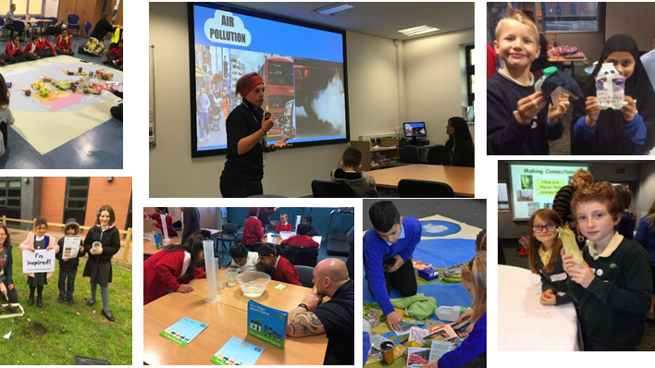
Eco-Schools Roadshow

Slide 6
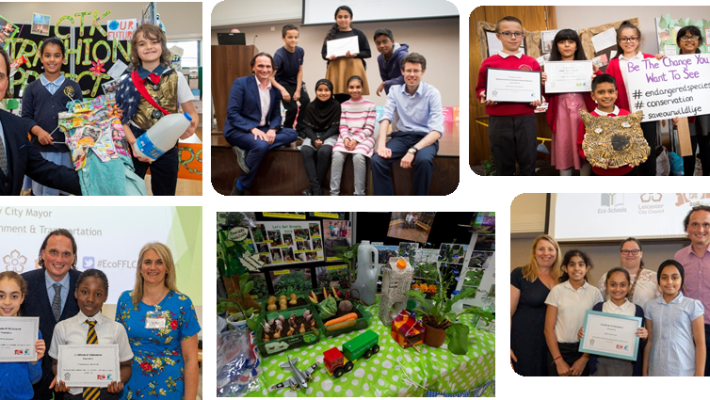
Eco-Schools and Food for Life Celebrations

Slide 7
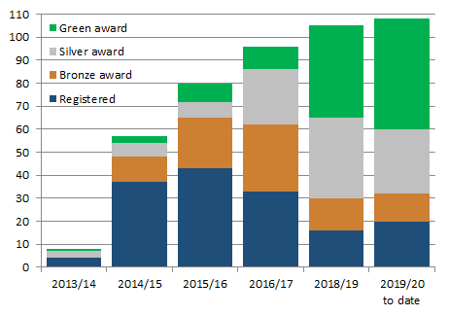

Eco-Schools – Our Work in Leicester
Promoted Eco-Schools as an award since September 2014 (114 schools)
109 registered on the programme
of those, 91 have achieved bronze
of those, 78 have achieved silver
of those 48 have achieved Green Flag

Slide 8
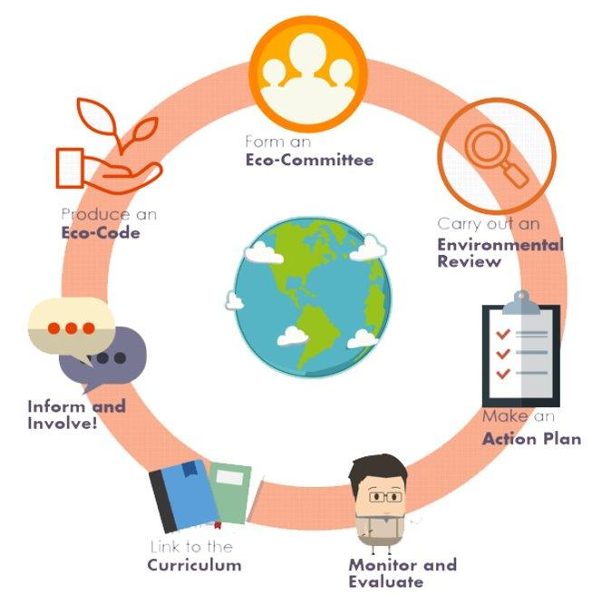

Eco-Schools Programme
7 step model

Slide 9

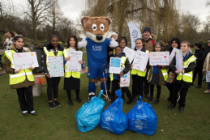
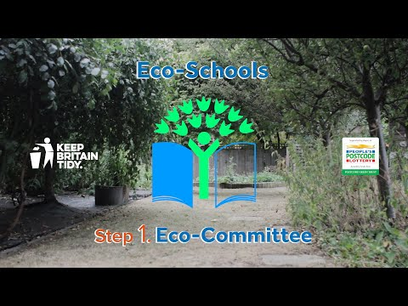
Step 1
Eco-Schools model - 7 steps 1
EYFS resources
Primary resources
Secondary resources
Step 1 – Eco-Committee, the heart of an Eco-Schools action and learning
  At least one pupil form each year group
  Meet at least once per half term
  Share responsibility for running meetings
  Records of minutes are kept
  Minutes displayed on the Eco-board
  Representative from parents, governors or senior leaders

Slide 10
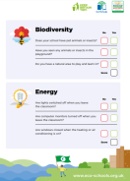
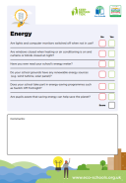


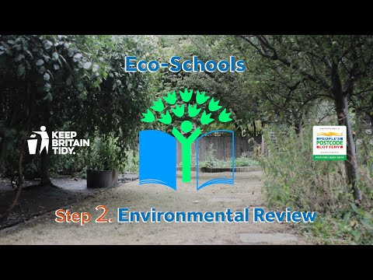
Eco-Schools model - 7 steps 1
EYFS resources
Primary resources
Secondary resources
Step 2
EYFS
Primary
Secondary
Step 2 – Environmental Review – investigating the school's environmental performance
  Covers all 10 Eco-Schools topics
  A copy is displayed on the notice board
  It is updated/reviewed at least every 2 years (best practice is annually)

Slide 11
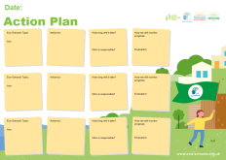
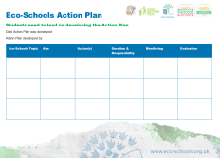
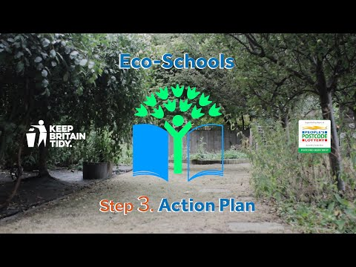
Eco-Schools model - 7 steps
EYFS resources
Primary resources
Secondary resources
Step 3
Step 3 – Action Plan – Decide on topic actions, based on the result of the Environmental Review
  The action plan is influenced by the review
  Pupils take responsibility for learning on the topics
    3 for the first green flag
    5 for the renewal (changing 2 with each subsequent application)
  Contains timescale, who is responsible and how it will be monitored
  Shared with the whole school
  A copy is displayed on the noticeboard

Slide 12
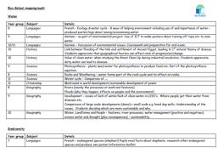


Step 4
Eco-Schools model - 7 steps
EYFS resources
Primary resources
Secondary resources
Step 4 – Curriculum Links – making links between the school's environmental activity and the curriculum
  Environmental issues are covered in at least three areas in your school curriculum, evident in schemes of work, pupils work and/or lesson plans (for first green flag this can be the same year group)
  They do not need to be the same topics as your Action plan

Slide 13
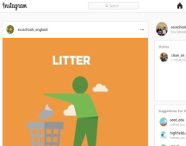
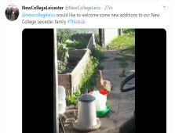
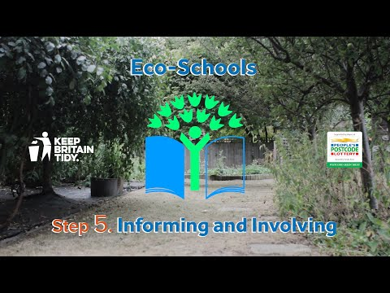
Eco-Schools model - 7 steps
EYFS resources
Primary resources
Secondary resources
Step 5
Step 5 – Informing and involving – Let the whole school and wider community know what the Eco-Committee is doing
  A prominent noticeboard in school
    Covering the 7 steps and 3/5 topics
    Members of the committee
    Environmental review
    Environmental action
    Examples of monitoring and evaluation
    Eco-code
  Variety of mediums to communicate
  The whole school and wider community is informed

Slide 14
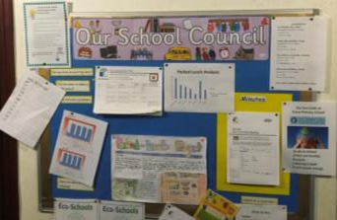

Eco-Schools model - 7 steps
EYFS resources
Primary resources
Secondary resources
Step6
Step 6 – Monitoring and Evaluation – Measuring change and finding out what works and what doesn't
  The committee monitors the effectiveness of the topics via data collections, surveys, before and after photographs
  It is communicated with the whole school
  Data has been analysed to help pupils develop further topic actions
  Data has been used in the curriculum e.g. graphs and charts in math

Slide 15

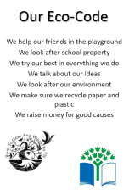
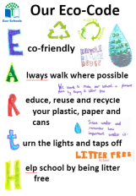
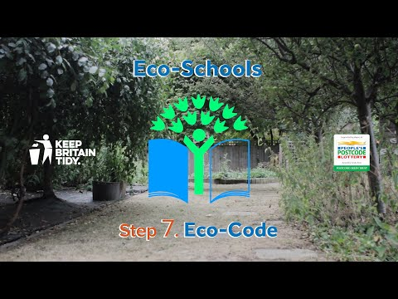
Eco-Schools model - 7 steps
EYFS resources
Primary resources
Secondary resources
Step 7
Step 7 – Eco-Code – Creating a call to action that the whole school can get behind
  There is an agreement statement for your school drawn up by pupils
  It reflects the topic actions you are working on
  It is displayed around school e.g. classrooms, hall and the office
  The majority of pupils and students understand is

Slide 16


Eco-Schools model 10 topics

Slide 17


Key things to think about in topics
Whole school opportunities
Informing everyone about the work
Links to curriculum areas e.g. Science (energy/renewable), geography (sustainable development), math (data handling)
Monitor impact of actions – hopefully, energy and water savings (but not always!)
Reflected in your Eco-code

Slide 18

Energy projects
BESS Energy
Carbon Literacy
Energy champions – job descriptions and spot checking
Energy monitoring – DynamatLite access
Ashden LESS CO2
Schools Climate Emergency Fund
Renewable Energy project – solar panels
Salix Finance
Practical Action
#EcoSchoolsatHome
Earth hour
Climate Emergency Declaration

Slide 19
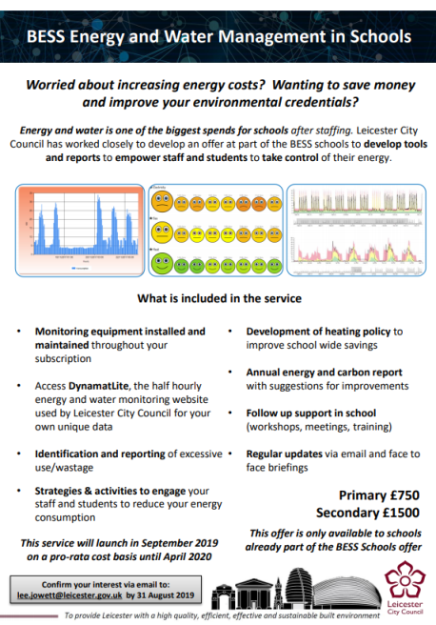
Built Environment School Service (BESS) Energy
Energy and water is one of the biggest spends for schools after staffing
Annual service provided to Leicester City Schools (currently subscribing to the main BESS offer)
  Online monitoring (half hourly – gas, water, electricity and district heat)
  Bureau service for leakage and excess use
  Annual energy and carbon report
  Training and individual online support
  One to one support delivered in school including education offer delivered by qualified teacher

Slide 20
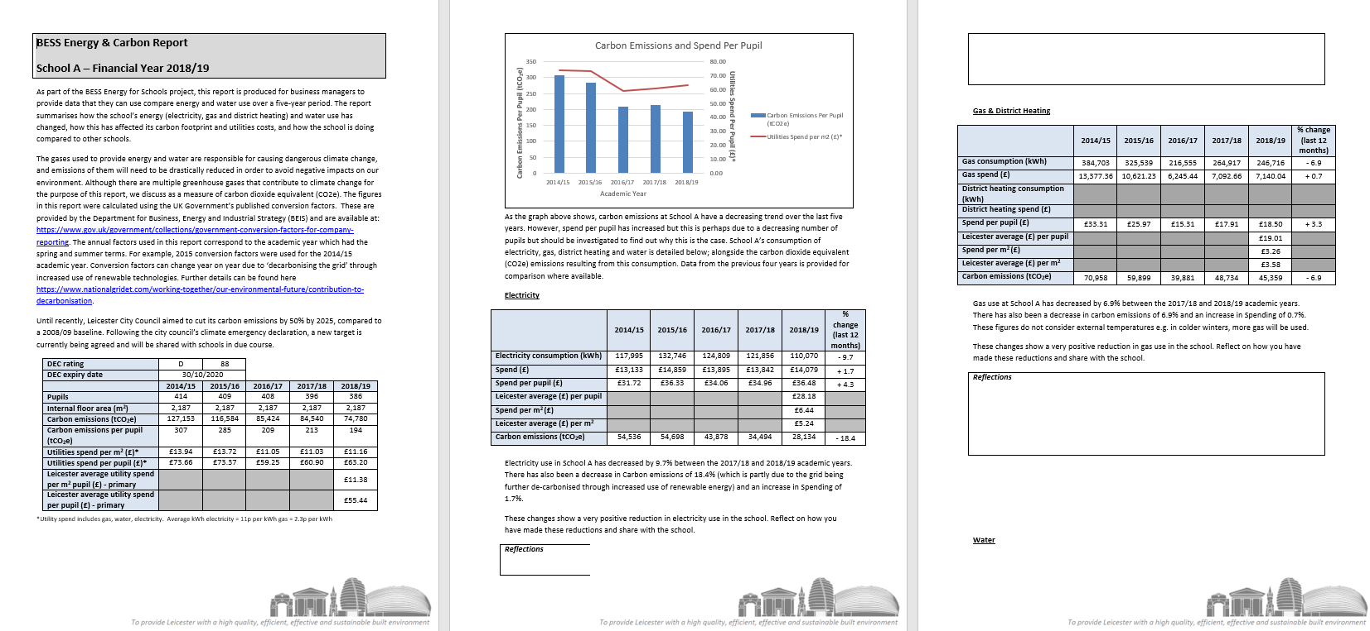
Carbon Reports for Schools

Slide 21
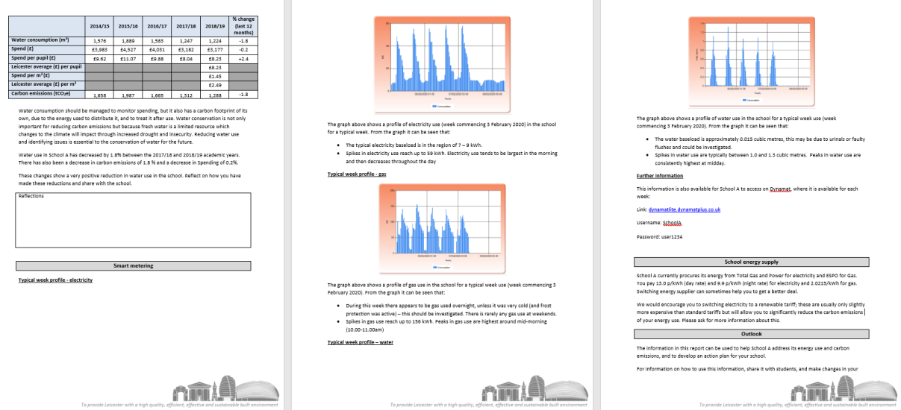
Carbon reports for schools 2

Slide 22

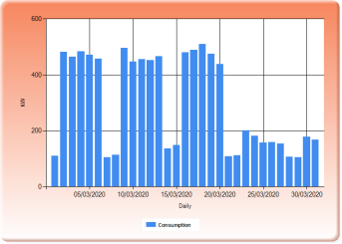
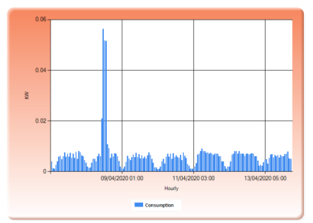
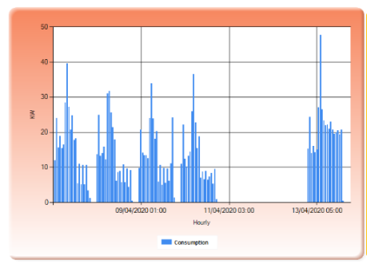
Energy monitoring – DynamatLite
Electricity
​
​Weekend​s
​
Easter holidays
DynamatLite is on online web interface which provides individual site information
Monitors gas, electricity, district heat and water consumption and cost
Can be viewed in hourly, daily, weekly, monthly and annually graphs (and downloaded)
Heating
Weekend
Overnight
Water use during
half term
System flush
Excess use or urinals flushing

Slide 23

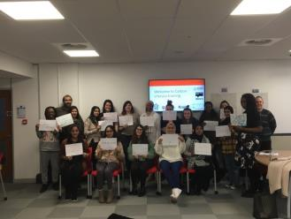

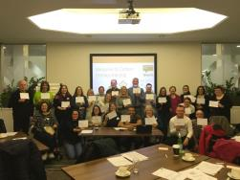
Carbon Literacy
https://carbonliteracy.com
'An awareness of the carbon costs and impacts of everyday activities and the ability and motivation to reduce emissions, on an individual, community and organisational basis.'
Carbon Literacy is a term used to describe an awareness of climate change, and the climate impacts of mankind’s everyday actions.
Enables students to become carbon aware
Gives students a better understanding of how climate change will affect them and others
Provides knowledge and skills to develop their own responses to lowering their carbon footprint, and the carbon footprint of others
The project is aimed at Year 5 and Year 8, but other year groups can be considered
To register your interest email: amy.peace@leicester.gov.uk

Slide 24
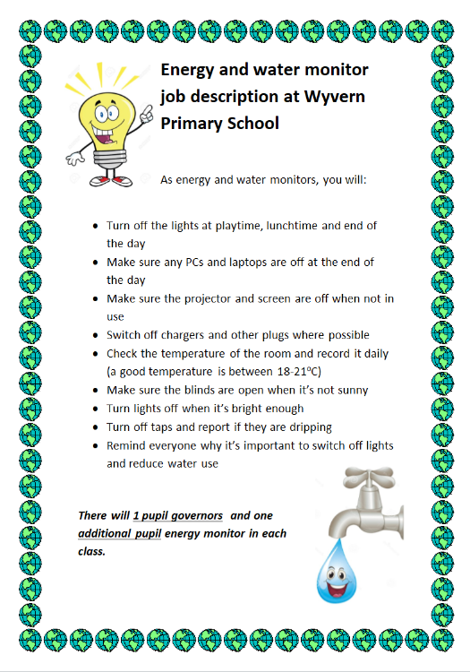
Developing Energy champions in school
Empowers students to take responsibility and hold others accountable for school energy use
Can make it into a competition between classes awarding house points or even a trophy:
  4 points per class
    Lights off
    Projector or screen off
    Windows open in summer/closed in winter
    Door open in summer/closed in winter

Slide 25

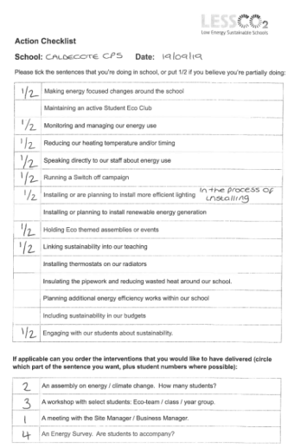
Ashden LESS CO₂
Schools who have completed the LESS CO₂ programme, over one year, saved an average of 10 tonnes of CO2 and £2,650 on their energy bills.
A free programme supporting schools across the UK to reduce their energy use, engage with their staff and students about energy, and teach about sustainability.
Run by Ashden, a charity that champions and supports leaders in sustainable energy to accelerate the transition to a low-carbon world.
Staff from schools taking part in the programme attend 4 half-day workshops spread across a year, each covering a different aspect of energy saving at your school.
In Leicester we have run 4 clusters of Ashden Schools and intend to run more in the future.
Visit the website to find out more and sign up! www.lessco2.org.uk

Slide 26
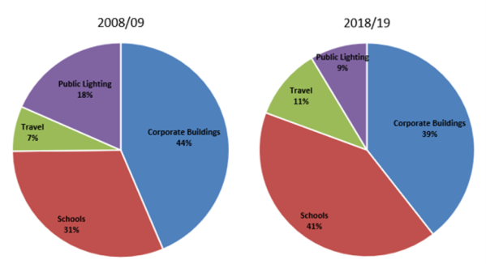
Schools' Climate Emergency Fund
Fund to provide improved energy efficiency and carbon savings in local authority schools.
Energy audits - detailed analysis of how the building is functioning including behaviour change.
Salix style survey covering over 100 technologies.
Support to install technologies including Solar PVs to reduce carbon.
Phase of Education​ | ‘Best practice’ energy spend per pupil​ | ‘Typical’ energy spend per pupil​ | Average energy spend per pupil – Leicester ​ | Average National reduction​
Primary​ | £39​ | £51​ | £55​ | 16%​
Secondary​ | £60​ | £75​ | £77​ | 24%​

Slide 27


Salix Finance
Independent not-for-profit company around since 2004.
Interest-free finance for energy efficiency projects in the public sector.
Operating throughout the UK, funded by the Department for Education.
DfE partnership since 2012, Funding available throughout the year.
Compliance criteria: 8-year payback, cost no more than £222 per tonne of CO2.
No capital outlay for schools .
  Full site survey to identify potential energy saving measures.

Slide 28

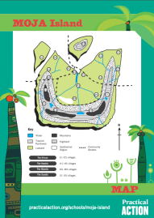
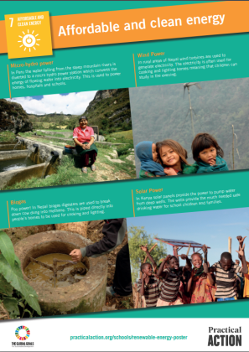

Practical Action
An international development charity whose education team support teachers, parents and carers with education material and training courses.
Many of Practical Action’s resources can be used to support the Eco-Schools topics.
Teacher notes, presentations, activity sheets, posters and certificates which can be downloaded :
  Wind Power Challenge
  Solar Challenge
For more information:
practicalaction.org/schools/eco-schools

Slide 29



#EcoSchoolsAtHome
Every Tueday at 8:00pm Eco-Schools England is publishing a new Eco-Schools Topic handout that will include 5 different topic related tasks that can be undertaken both at home and in school.
The topic actions have been designed so that they can be carried out by nursery children and college students alike.
#EcoSchoolsAtHome Biodiversity work
#EcoSchoolsAtHome Energy work
#EcoSchoolsAtHome Global Citizenship Work
#EcoSchoolsAtHome Healthy Living Work

Slide 30

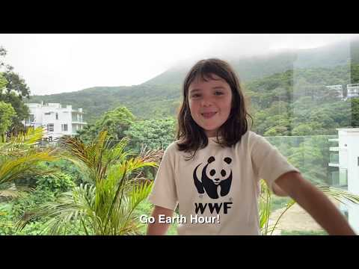
Earth Hour
Earth Hour is now one of the world's largest grassroots movements for the environment. Held every year on the last Saturday of March, Earth Hour engages millions of people in more than 180 countries and territories, switching off their lights to show support for our planet.
For more information: www.earthhour.org/

Slide 31

Declaring a Climate Emergency in School
On 1 February 2019 Leicester City Council declared a Climate Emergency. The declaration is an acknowledgement that:
  Climate change is happening, and threatens the wellbeing of everyone in Leicester and worldwide
  The speed and scale of global and local action to tackle the problem needs to be dramatically increased.
In its declaration, the Council committed to developing a new action plan to address the emergency through our own services and projects .
What action you can do:
Discuss your plans with students and staff .
Select actions which you plan to achieve, make them manageable but also remember we are in a Climate Emergency.
Make sure your actions have a duration, responsibilities and an evaluation.
Take your action plan to the Governing Body or Trustees to ensure that you have their support.
You can submit your action plan to the City Council which we will publicise as part of our wider action plan.
Start your action plan!
Review regularly to check and maintain your progress .
schools.leicester.gov.uk/climate-emergency

Slide 32
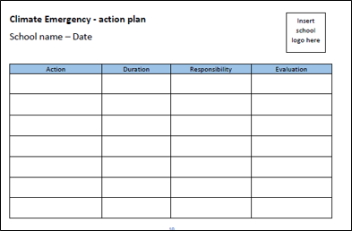
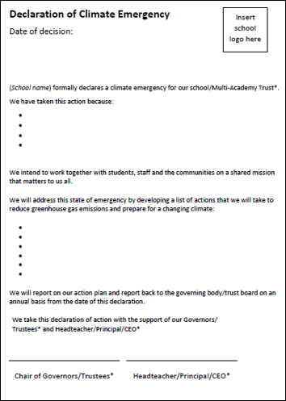
Climate Emergency Documents
Templates and document available at schools.leicester.gov.uk/climate-emergency

Slide 33


Water projects
The Sea Starts here – linked to marine topic
Severn Trent
Yellow Fish – also linked to marine
World Water Day
Practical Action – water projects
Water Explorers – water projects

Slide 34
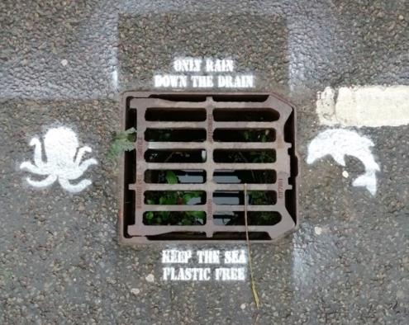
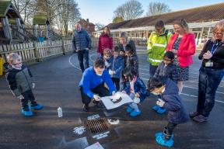
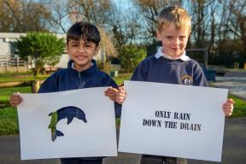
The Sea Starts Here
Raising awareness of the impact that plastic waste can have on the wider environment if it is not disposed of correctly.
Plastics dropped as litter can end up in our rivers and oceans causing pollution and harm to wildlife, as well as contributing to increased flood risk in rivers and brooks.
Opportunity to have stencilling of drains in their school grounds for up to 20 schools per academic year.
To get involved contact:
Alex Cameron | Lee Jowett
Email: alex.cameron@leicester.gov.uk | Email: lee.jowett@leicester.gov.uk
Phone: 0116 454 6834 | Phone: 0116 454 2271

Slide 35


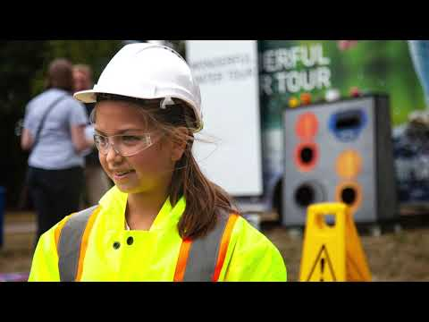

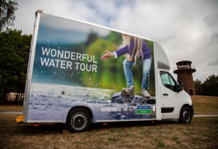
Severn Trent opportunities
Severn Trent offer free online resources and school visits including:
Hands-on workshops
Assemblies
Two interactive buses:
  The Digibus - provides an immersive digital experience where you can track a raindrop from the sky, through the water treatment process, to the home, back through the sewers and the waste treatment process to the river.
  The Experibus - imagine yourself as a scientist, an engineer, a call centre operative and much more to learn what it’s like to work in the water industry .
Wonderful water tour video
For more information visit: www.stwater.co.uk/about-us/education-zone/workshops-and-visits

Slide 36
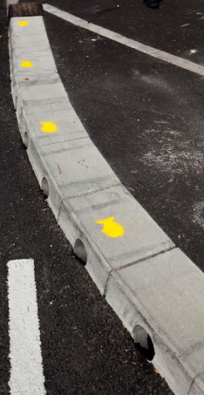



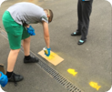
Yellow Fish
Yellow Fish teaches about local environments, the role of drains and the effect of pollution on watercourses.
It has cross-curricular appeal and can be applied atall Key Stages.
The scope of delivery depends entirely on the demands of the institution, being equally suited as the foundation of a whole Key Stage scheme of work or as a standalone activity.
The nature of the activities undertaken also makes Yellow Fish fantastic for developing Personal Learning and Thinking Skills and citizenship awareness.
For more information:
Alex Cameron
alex.cameron@leicester.gov.uk ​
Phone: 0116 454 6834​

Slide 37


World Water Day
Held on the 22 March every year since 1993.
Annual UN Observerance focusing on the importance of fresh water.
Ahead of the day, UN-Water launches a global public campaign via: www.worldwaterday.org

Slide 38
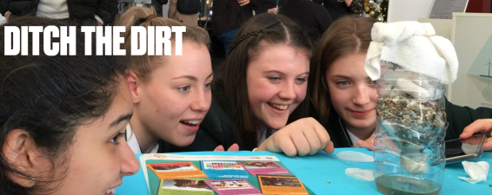
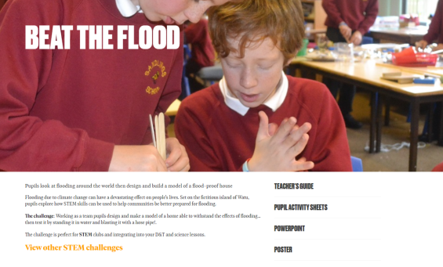
Practical Action
An international development charity whose education team support teachers, parents and carers with education material and training courses.
Many of Practical Action’s resources can be used to support the Eco-Schools topics.
Teacher notes, presentations, activity sheets, posters and certificates which can be downloaded:
  Beat the Flood
  Regreening the desert
  Ditch the dirt
For more information:
practicalaction.org/schools/eco-schools

Slide 39

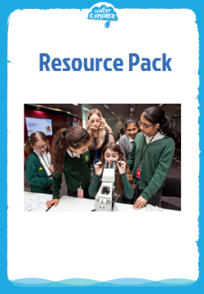
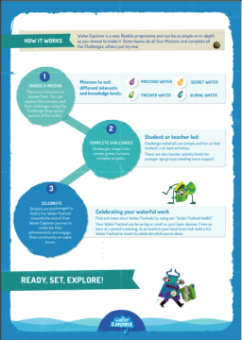
Water Explorer – water projects
Water Explorer inspires and equips students aged 8-14 all over the world to take bold and powerful action to save our precious water through fun water saving Missions.
A downloadable pack for schools and youth groups is availiable in the website. In the pack you will be able to find:
The Challenge toolkit which introduces you to Water Explorer, how the programme works and what it involves.
Resource pack which includes all the challenges, lesson plans and supporting resources.
Water Festival toolkit which aims to inspire and equip you with activities to run your very own water awareness event.
For more information visit: https://www.waterexplorer.org/

Slide 40
Other opportunities coming up
Education Officer (Eco-Schools) in Leicester – deadline 13 May 2020
  15 hours a week, starting at the end of August 2020 (term time working)
UN Climate Change Learn Online
  Climate Change: From Learning to Action (8 hours)
  Children and Climate Change (6 hours)
  Cities and Climate Change (2 hours)
  Human Health and Climate Change (2 hours)
  Module 1 of Open Online Course on Gender and Environment (6 hours)
Off School website - a free website full of ideas for home learning and fun activities. Head to the Activity Zone for 100s of films, created by teachers, across loads of great topics and themes!

Slide 41
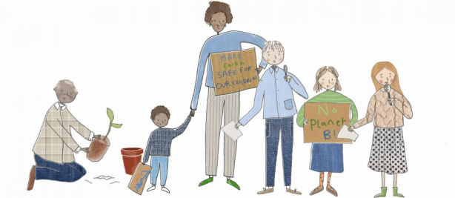
National Youth Climate Summit 2020
Calling all schools, colleges and young activists across the UK: you are invited to join the UK’s first online youth climate conference organised by Robert Ferguson Primary School, in partnership with Transform our World, the national resource hub for teachers to bring environmental action into the classroom.
Livestreaming 22nd April 2020 from 12:00 to 15:00, live streamed via YouTube on their webpage

Slide 42
Grant opportunities
Salix Finance (energy efficiency)
Tap Water Grants
eTeach link
Grants 4 Schools

Slide 43

Questions and Answers

Slide 44

Future Webinars
29 April | Topic: Litter | zoom.us/j/729762258
6 May | Topic: School Grounds | zoom.us/j/868876787
13 May | Topic: Waste and recycling | zoom.us/j/583112963
20 May | Topic: Transport | zoom.us/j/219213760
3 June | Topic: Biodiversity | zoom.us/j/335624673
10 June | Topic: Global Citizenship & Fairtrade | zoom.us/j/921396066
17 June | Topic: Healthy Living | zoom.us/j/880976336
24 June | Topic: Marine | zoom.us/j/514363381
1 July | Topic: Catch up on all Eco-topics | zoom.us/j/366369785

Slide 45






Keeping in Touch
EcoSchoolsLCC
EnvEducationLeicester
EcoSchoolsLCC
EcoSchoolsLCC
schools.leicester.gov.uk/eco-schools
Eco-Schools@leicester.gov.uk
(sign up for newsletter and eBulletins)

