Slide 1



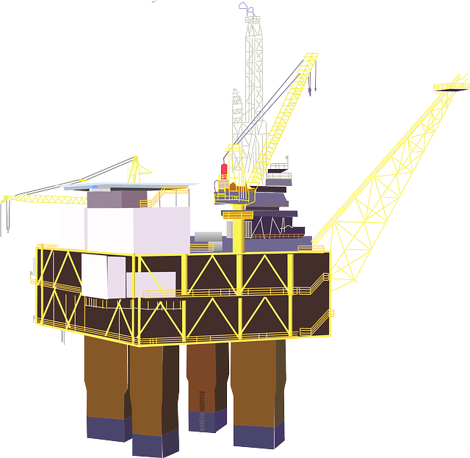



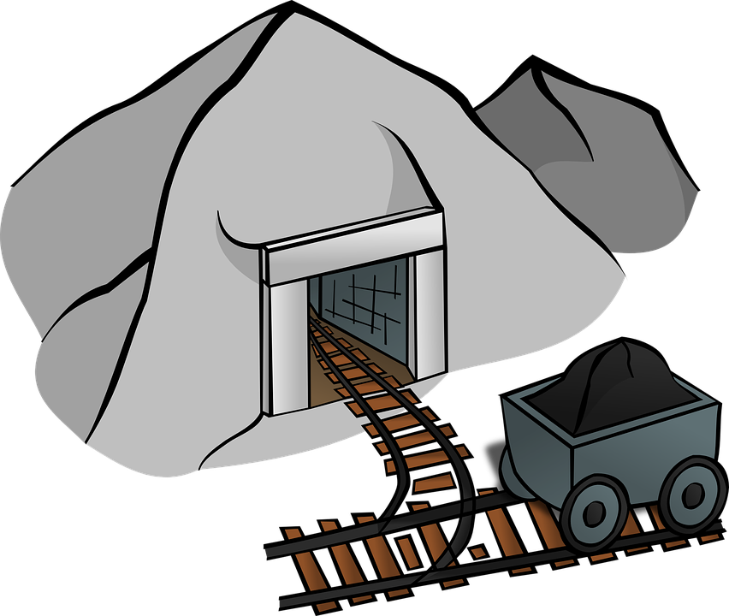


ENERGY EXPLORERS: Fossil Fuels
Notes:
Introduction
In this session pupils will discover what fossil fuels are, where they come from and what they can be used for. Pupils will use knowledge gained to explore where fossil fuels have been used to create or fuel every day objects found around the classroom and will make a poster or table to display these.

Slide 2

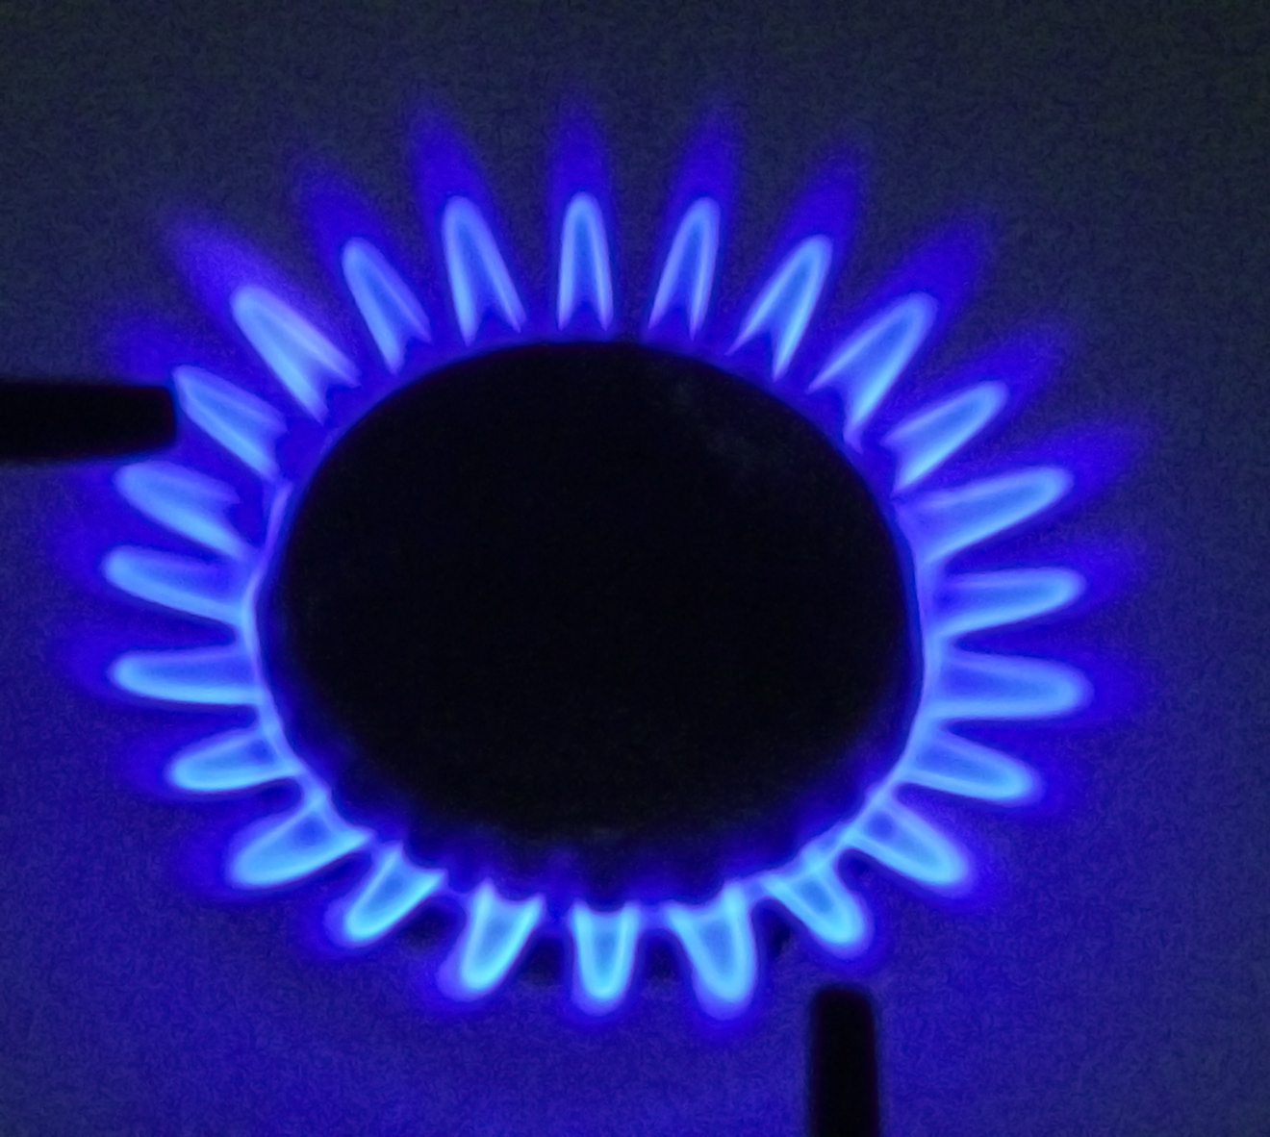
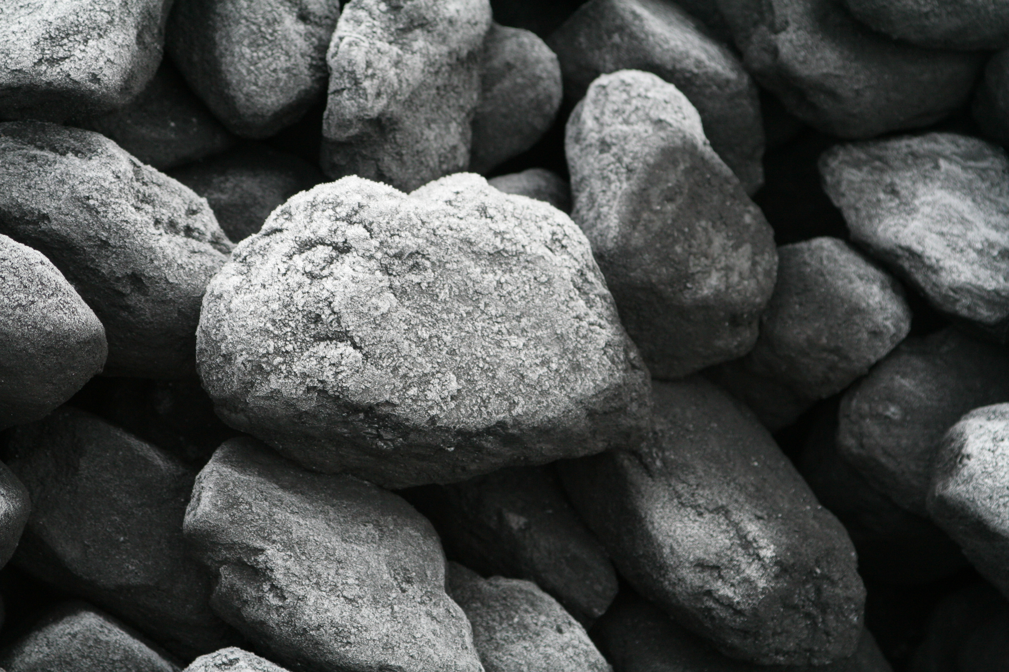
What is a fossil fuel?
Oil
Coal
Gas
Notes:
Ask the children: have you ever heard of a fossil fuel? Any idea what a fossil fuel might be? Where they come from?
Fossil fuels are formed from the remains of plants and animals that died millions of years ago. These remains over time are turned into fossil fuels: coal, oil and gas… which contain lots of energy.
Once burned, this energy is released and can be used to power lots of things. Fossil fuels are also made into lots of products that we use every day too.

Slide 3


Energy Explorer Task 1: Do we need fossil fuels?
1. Make a table on a sheet of paper, with three columns.
2. Label each heading: Coal, Oil and Natural Gas.
Coal
Oil
Natural Gas
3. In each column write as many things as you can that use coal, oil and gas to fuel them.
5 minute challenge
Notes:
Task 1: Do we need fossil fuels?
Full class / activity in pairs / could be completed as a hands up instead.
Aim: To understand the connection between fossil fuels and many every day objects.
Task:
Create table and label with each fossil fuel as column headers.
Underneath each header write a list of objects and items that use that fossil fuel to make them work, or are made from that fossil fuel

Slide 4




WHERE DO FOSSIL FUELS COME FROM?
Fossil fuels are made from the burial of plants, animals and organisms from millions of years ago.
This means that fossil fuels are NON-RENEWABLE.
Notes:
Where do fossil fuels come from? (brief overview)
Does anyone know where fossil fuels come from?
Fossil fuels come from remains of animals, plants and organisms. Over millions of years animals, plants and organisms are buried under sediment and silt, heat (from the earth) and pressure (from the weight or sediments on top) cause them to change their form and become fossil fuel.
Once these fuels have been extracted from below the ground, processed and used, they cannot be used again. We describe them as ‘non-renewable’, as these resources will not be replenished across a human lifetime.

Slide 5
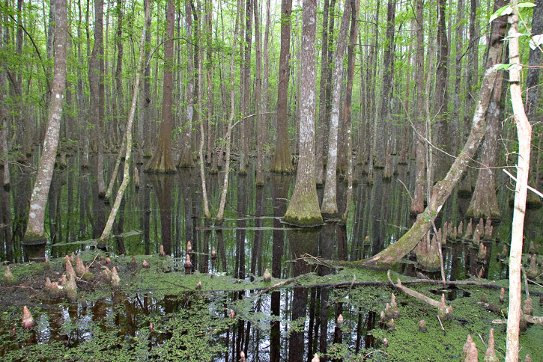
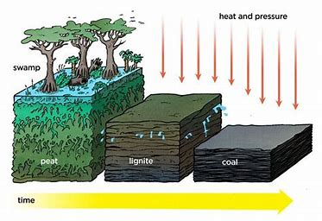
Coal was formed in swampy places, around 300 million years ago!
Notes:
Formation of coal
Around 300 million years ago the earth’s climate was a lot warmer and wetter and much of the earth was covered in swamp-like areas.
Over time organic matter like trees and plants would die and decompose, sinking into the depths of the swamp. This material would then be covered with silt and sand, and more layers of organic matter. These layers and layers of sand, silt and more organic matter were heavy… very heavy…
Over millions of years, the additional weight (pressure) from above squeezed the water out of the material along with intense heat from the earth’s core and added weight above the organic matter changes form and becomes coal.
This process takes millions of years and cannot be repeated within a human lifetime. Making coal non-renewable.

Slide 6

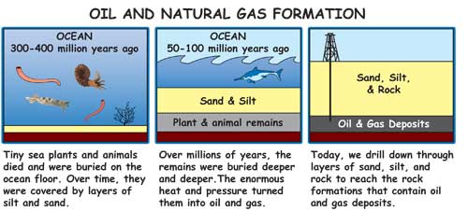
Oil and gas were formed in places like this millions of years ago!
Notes:
Formation of oil and natural gas
Similar to coal, oil and natural gas are made from organic matter… This time however, it is ocean plants and animals from millions of years ago that die and fall to the sea bed. Where they are covered with sand and silt.
Pressure from the extra weight on top and heat from the earth cause the ocean dwelling plants and animals to change into oil and natural gas.

Slide 7







Energy Explorers Task 2: Story board
Task: Make a story board
Example: Coal
Your story board should either show the formation of:
Coal, Oil or Gas
Trees and plants die and decay
Swampy area 300 million years ago
Notes:
Task 2: Storyboard
Pairs / individual working / small groups (no more than three)
Aim: to understand how fossil fuels are formed
Activity: make a story board about how a fossil fuel is formed, you can choose coal, oil or natural gas.
Play the Fossil fuels 101 YouTube video to the class, or ask them to do their own online research. Some additional resources have been suggested in the lesson plan.
Extensions: Can you add a box to show how we get that fossil fuel out of the ground?

Slide 8

HOW DO WE GET FOSSIL FUELS OUT OF THE GROUND?
2 MINUTE DISCUSSION
Notes:
How do we get fossil fuels out of the ground?
Discussion: Can you think of different ways to get fossil fuels out of the ground?
Answers on slide 9

Slide 9
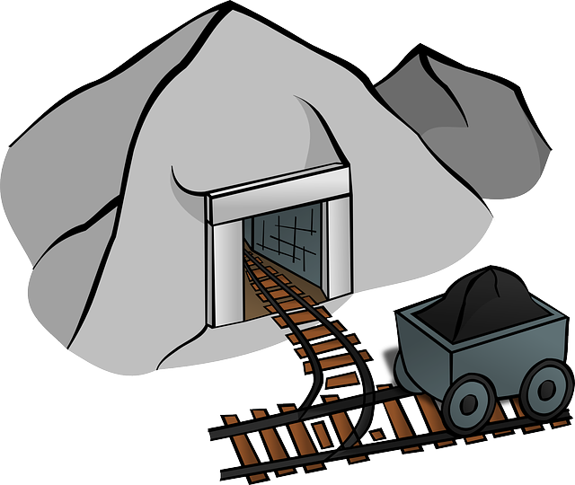


How do we get fossil fuels out of the ground?
mining
off shore oil platform
On-land oil pump (fracking)
Notes:
How do we get fossil fuels out of the ground?
Answers include:
Coal: Mining (underground and open cast (surface mining)
Oil and Gas: Off-shore oil platform (rig) / on-land hydraulic fracking / pumping and drilling rig.

Slide 10

Why do we need fossil fuels?
Click the link
It’s time
for a film!
Notes:
Why do we need fossil fuels?
Discussion: Ask children why they think they think we need fossil fuels? Write down their ideas on the board.
Show: Fossil Fuels video, BP Educational Services (1:05) (click link in slide)

Slide 11
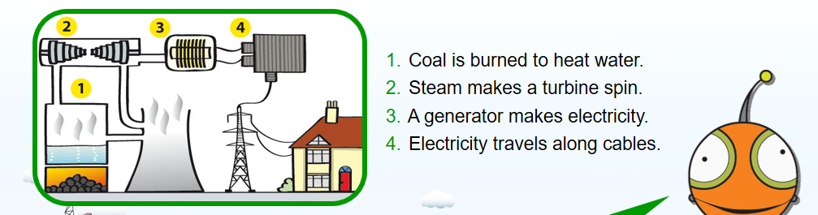
What does coal make?
Medicines
ELECTRICITY
Steel
Plastics
Dyes
Beauty products
Cleaning products
Notes:
What does coal make?
Discussion: Ask children what do we use coal for? Can they name anything we use at home that coal might be used as an ingredient?

Slide 12
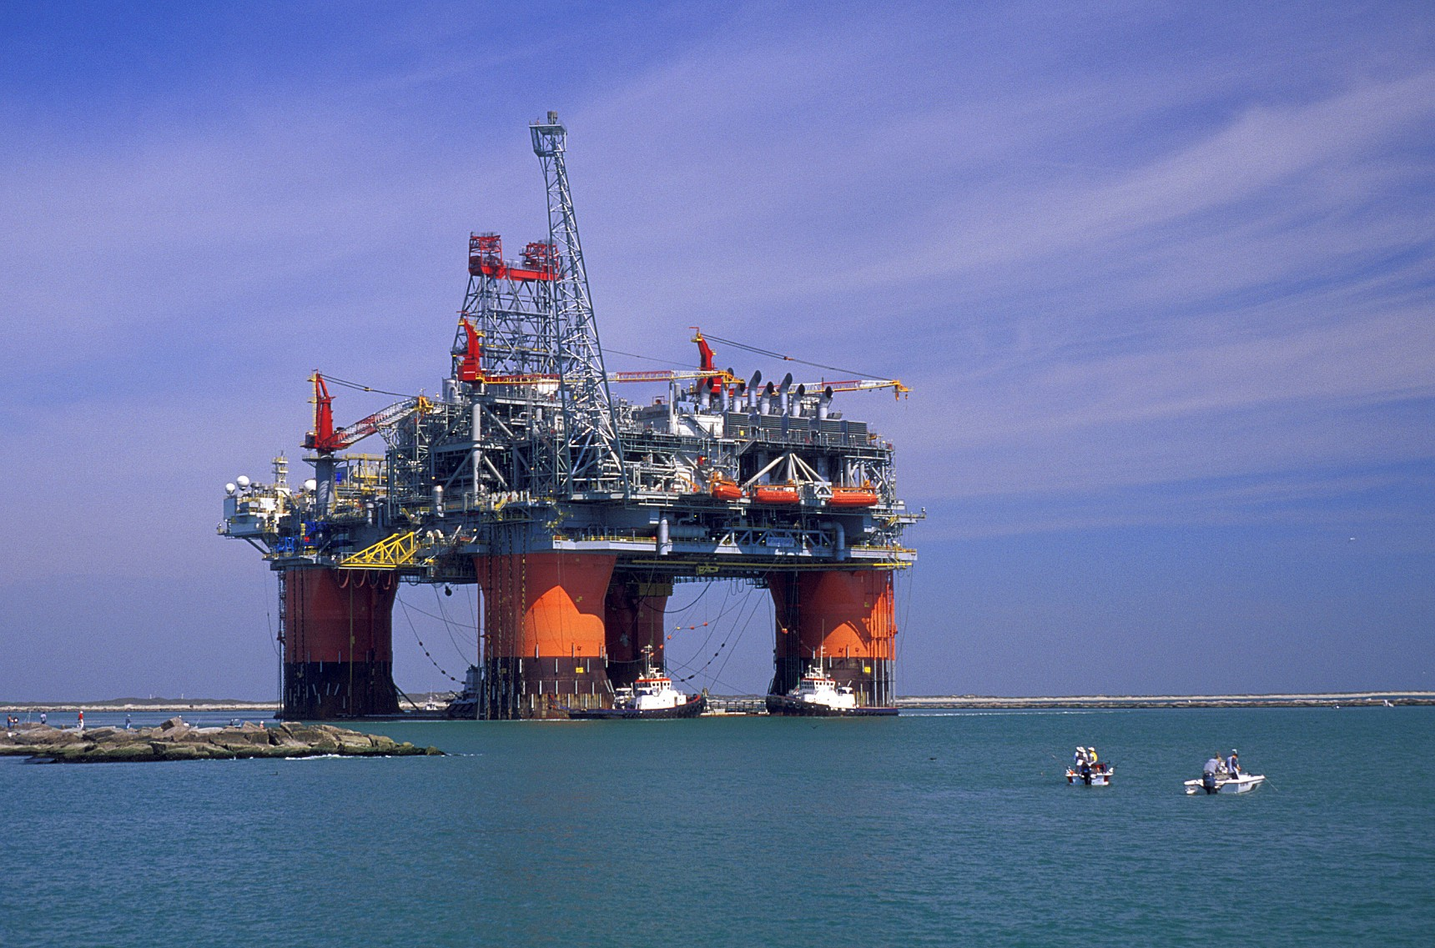

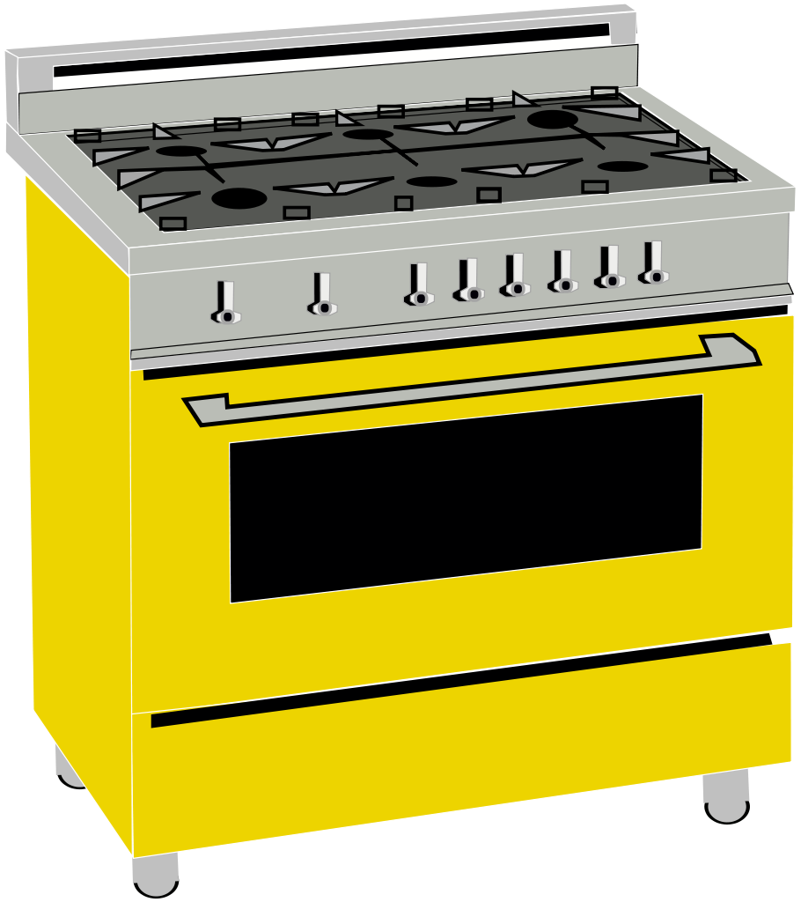



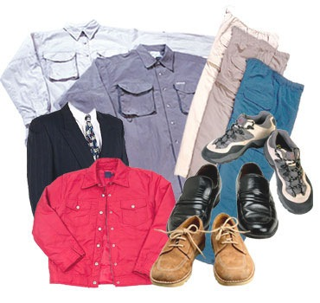

What are oil and gas used for?
Oil and gas are fuels. They give off heat when they are burnt.
Oil can also be made into LOADS of things.
Notes:
What are oil and gas used for?
Discussion: Ask children if they can remember where oil and gas where used during the Fossil Fuel Video? Remind them that the stored energy in oil and gas can be burnt to create heat.

Slide 13
Energy Explorer Task 3: Classroom Exploration
1. Take a tour of the classroom and continue the list of objects and items that use fossil fuels for energy, or to make them.
Coal
Oil
Natural Gas
The lights – use electricity
Oil used to make…
Notes:
Task 3: Classroom Exploration
Full class / pairs
Aim: To identify where fossil fuels are used in objects and items around the classroom.
Activity: In pairs, take a tour of the classroom and continue the table of objects and items from task 1, that use fossil fuels for energy, or to make them.

Slide 14
Do fossil fuels make air pollution?
Notes:
Do fossil fuels make air pollution?
Discussion: In pairs, ask the children to discuss if they think fossil fuels make air pollution or not. After a minute or two, ask them to raise their hands if they agree air pollution can be made from fossil fuels, then ask again, if anyone disagrees.
Explain to the children that air pollution can be made from fossil fuels.

Slide 15
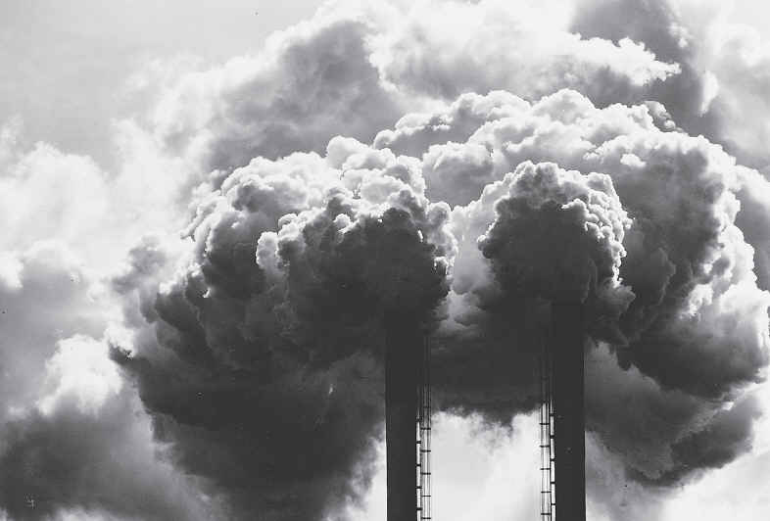
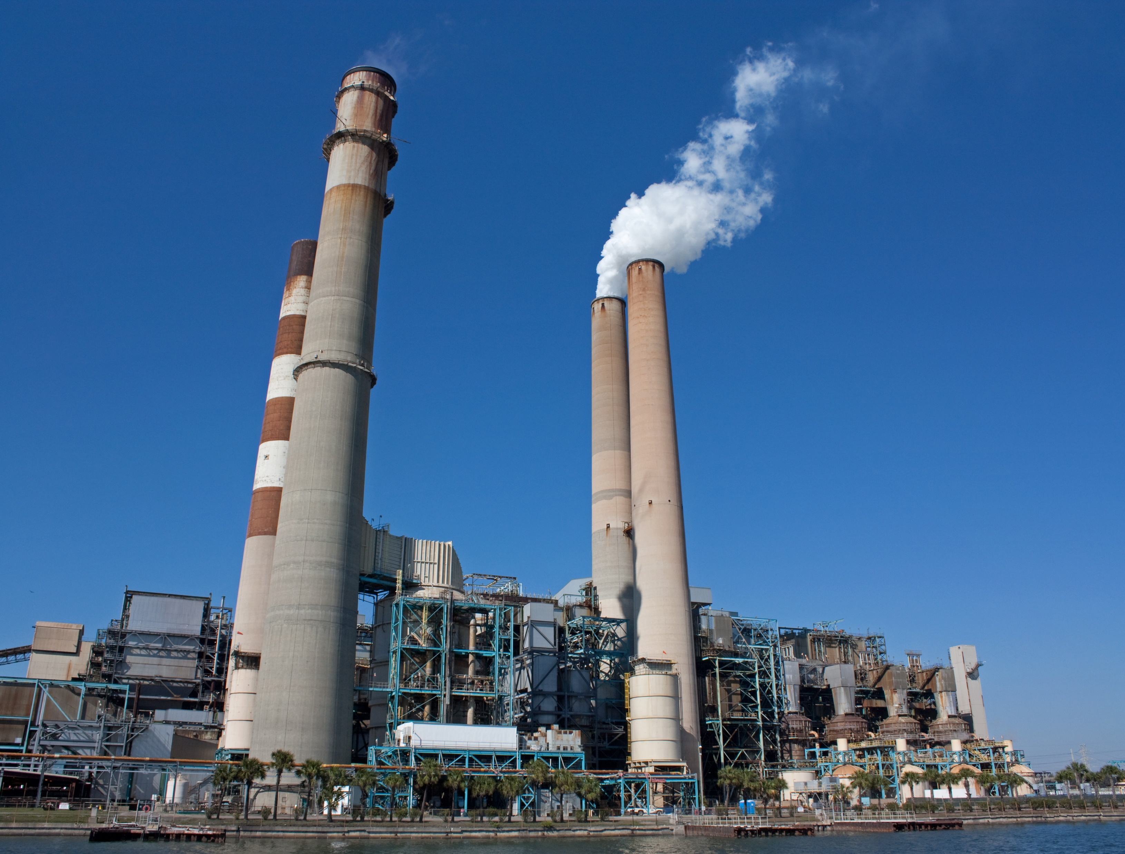
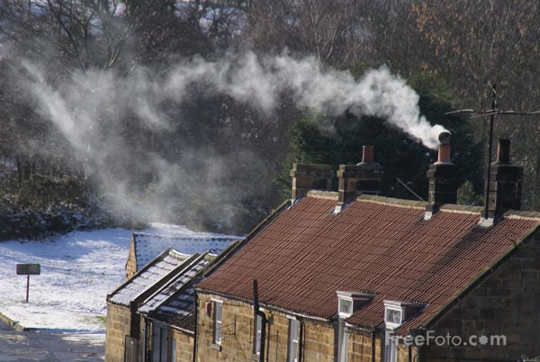
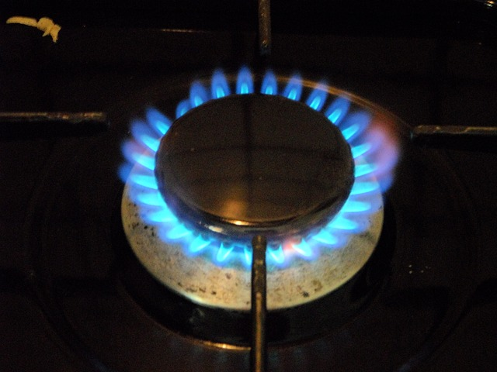
Burning fossil fuels creates air pollution…
Air pollution is caused by harmful pollutants being released into the air we breathe.
Notes:
How do fossil fuels contribute to air pollution?
Burning fossil fuels to make vehicles go, using gas for cooking, burning coal in fireplaces to keep our houses warm and burning coal in power stations to create electricity.
The process of mining also creates large amounts of dust and the transportation of fossil fuels, once extracted, will also cause air pollution.
Plenary
Summarise the lesson and key learning points with the children.
Can the children remember:
The name of each fossil fuel?
Where fossil fuels come from?
Some things that use each fossil fuel?

