Slide 1


AIR POLLUTION: living things and the environment

Slide 2
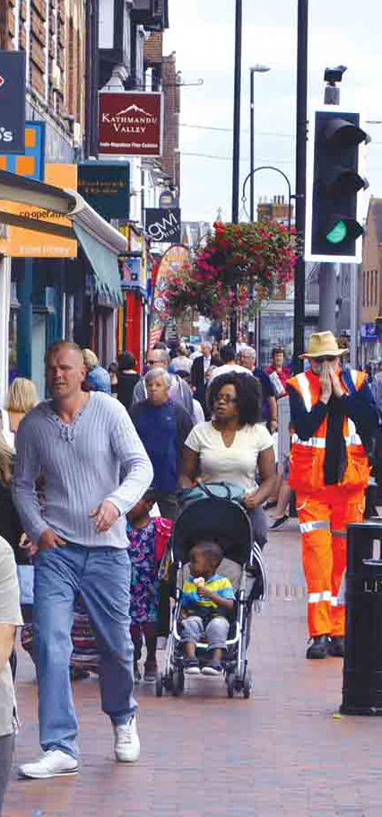
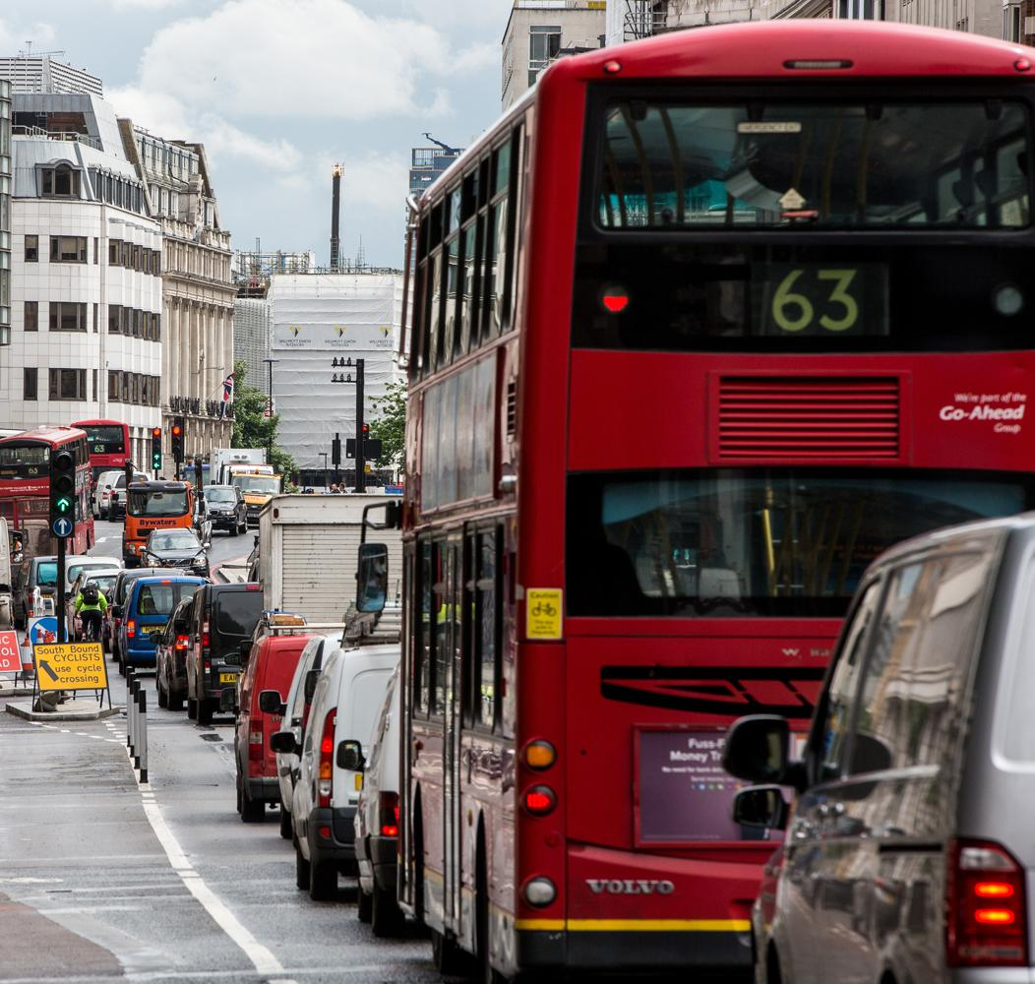
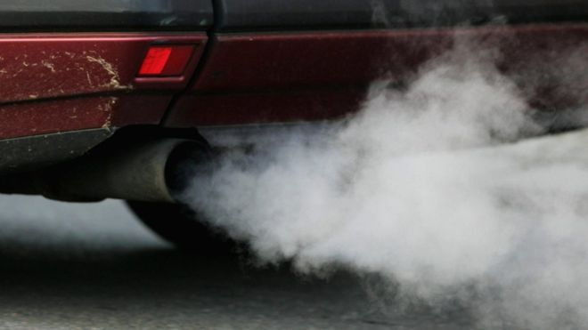
Where is the air pollution coming from?

Slide 3













Where is air pollution coming from?
5 MINUTE CHALLENGE
LABEL EACH CAUSE CARD
DUST STORMS

Slide 4

MAKE A POSTER SHOWING THE CAUSES OF AIR POLLUTION
Sort them into two columns – are they ‘man made’ or ‘natural’?
MAN MADE
NATURAL
5 MINUTE CHALLENGE

Slide 5
What are the effects of air pollution?
Health
Environment

Slide 6
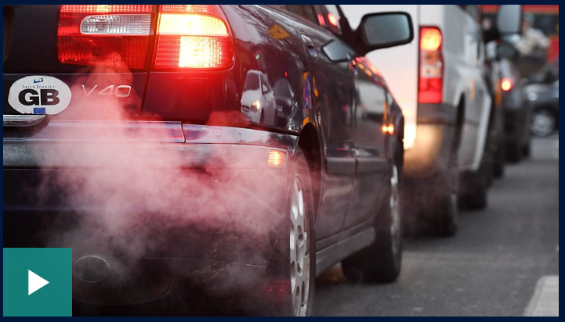
Impact on health
Time for a film!
London kids on air pollution: 'Our eyes sting'
Students at a school in the heart of London tell us what it's like living in a place where the pollution levels are so bad...
https://www.bbc.co.uk/newsround/38789471

Slide 7
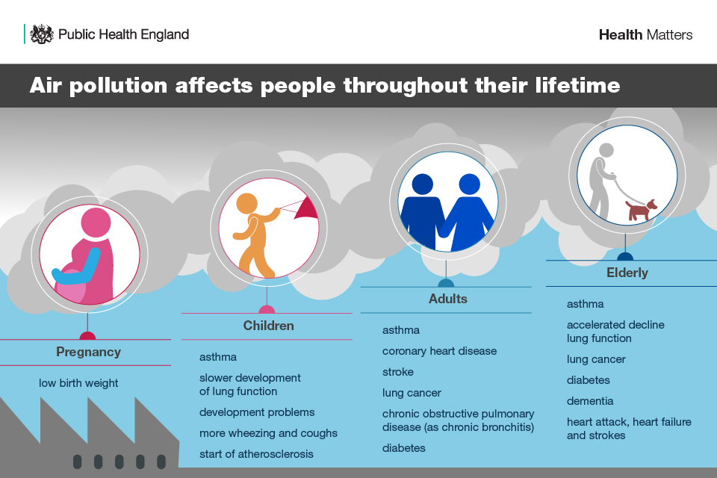
Air pollution affects people throughout their lifetime

Slide 8
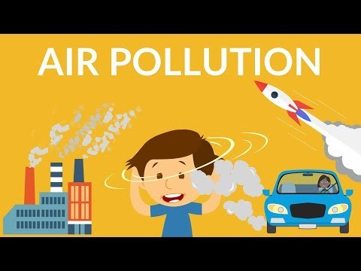
The impact of air pollution – a short film
https://www.youtube.com/watch?v=t7Q7y_xjR5E

Slide 9
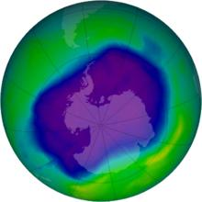


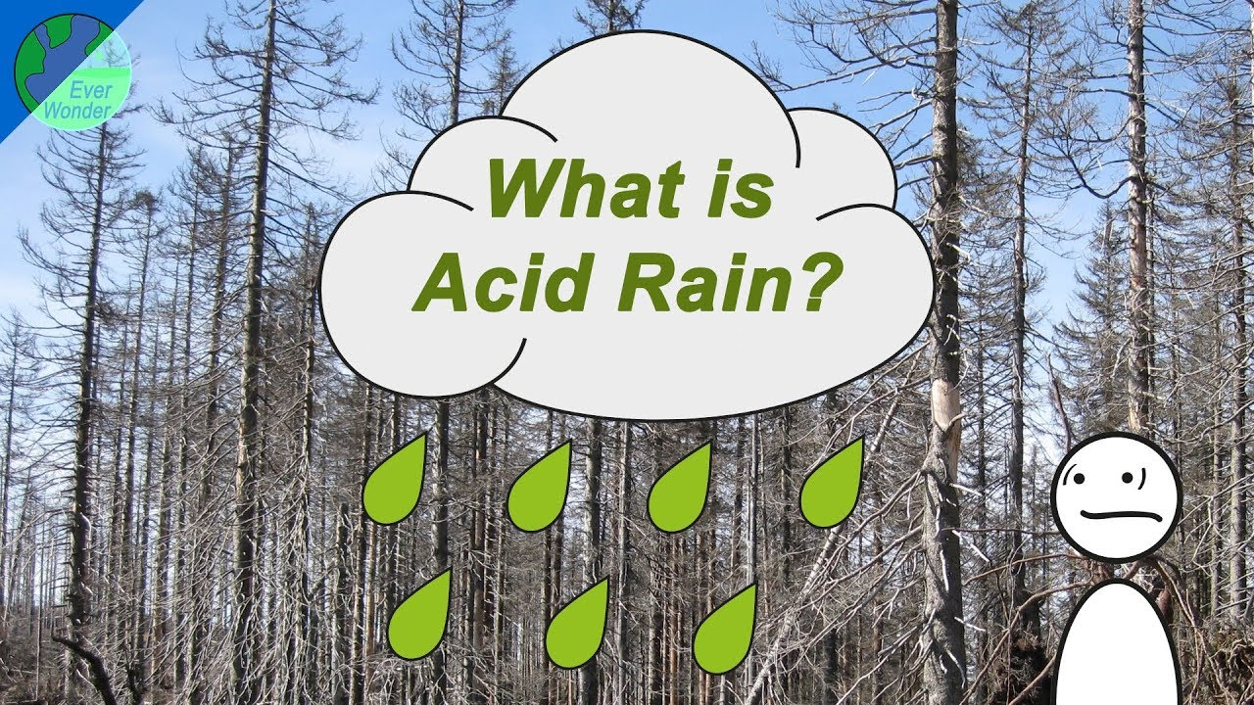
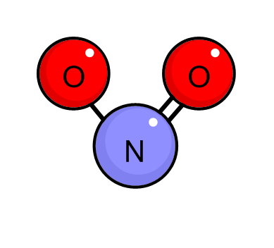





Environmental
Impact
Global Warming
Nitrogen Dioxide
NO2
Sulphur Dioxide
SO₂

Slide 10




How can we improve air quality?
60 second challenge
In pairs – think of three things that we could do, that will improve air quality.
Write each idea on a post-it

Slide 11
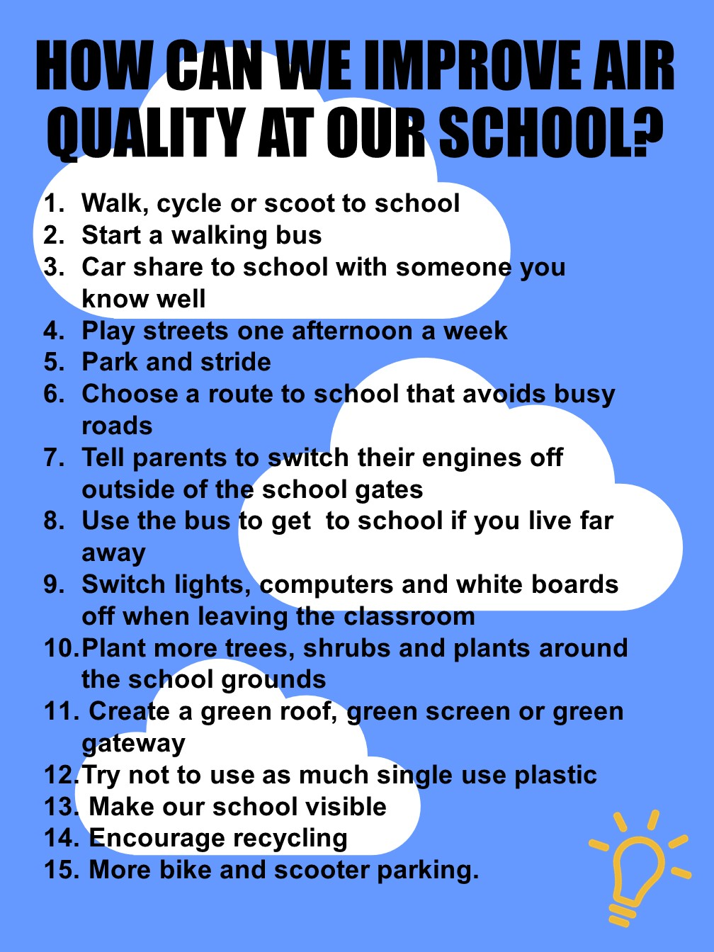

HOW CAN WE IMPROVE AIR QUALITY
AT OUR SCHOOL?
10-15 MINUTE CHALLENGE
Make your own
Clean Air Code
In groups, write a list of five golden rules your school could follow to improve air quality.
What else could we do to improve air quality at school? Look at the list
Notes:
Activity 4: How can we improve air quality at our school?
Children should work in small groups of up to 4 (5 at the most) for this activity. Pairs or threes will also work well.
Explain that the children have learn about the causes of air pollution and identified sources of air pollution around their school. It is now time for them to think like the Mayor of Leicester and decided what they can do in our Air Quality Management Area to improve air quality.
Task: Children should develop their own Clean Air Code – a bit like the Eco-schools code of conduct – a list of golden rules that advise pupils, teachers and parents how they can improve air quality. These rules need to be achievable and realistic (check understanding of these words). Children will need paper and pens for this activity.
If there is time – children can think about other ways we can improve air quality at school. They can look at the ‘How can we improve air quality at our school’ list – would anything work particularly well at our school? Could it be adapted? What would we need to do, to make it happen?

