Slide 1


AIR POLLUTION:
PAST & PRESENT

Slide 2
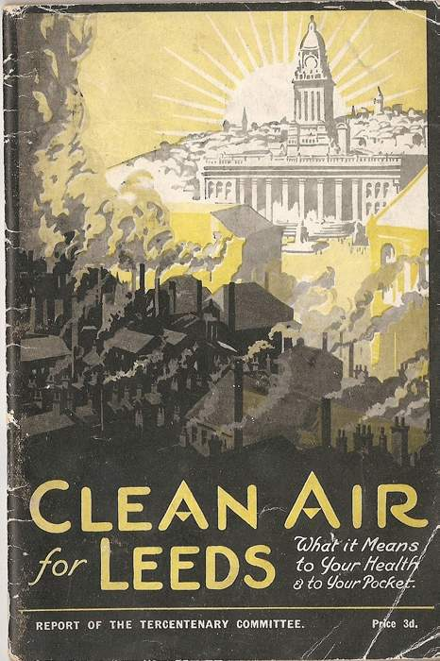
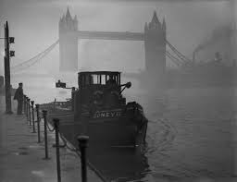



JOB 1. LABEL EACH TIME PERIOD
5 MINUTE CHALLENGE
with a time period and a description
Roman Empire

Slide 3

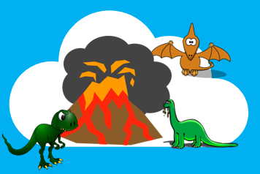

JOB 2. MAKE A TIMELINE POSTER
Order your time cards into historical order from the past to the present
The PAST
The PRESENT
http://www.learnaboutair.com/primary/history.html

Slide 4


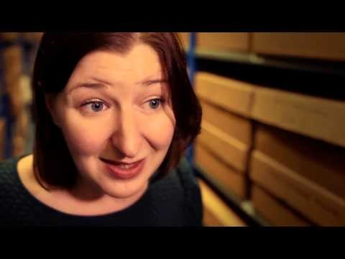
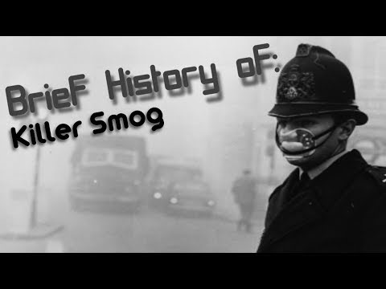
WHAT IS SMOG?
The great smog of London 1952
https://binged.it/2tG41Pk

Slide 5
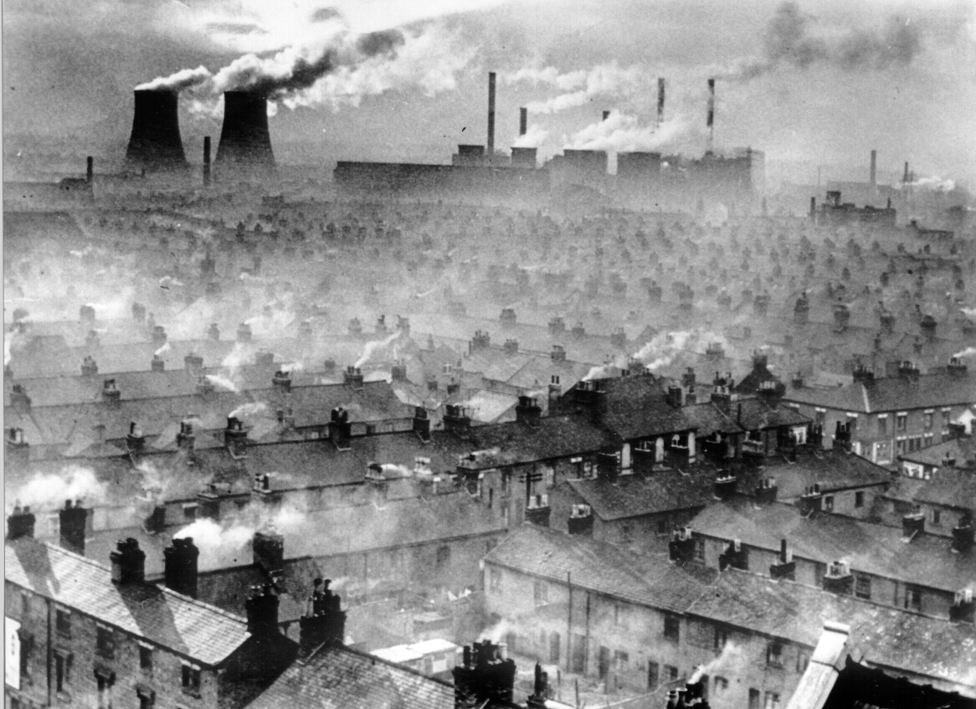
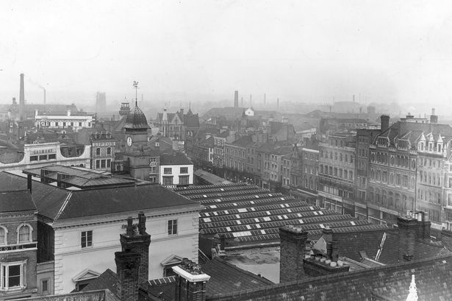
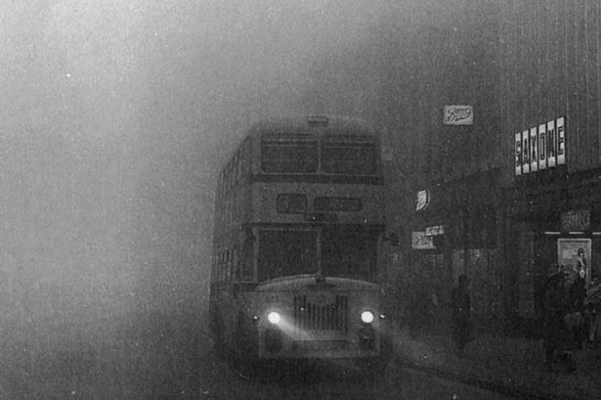
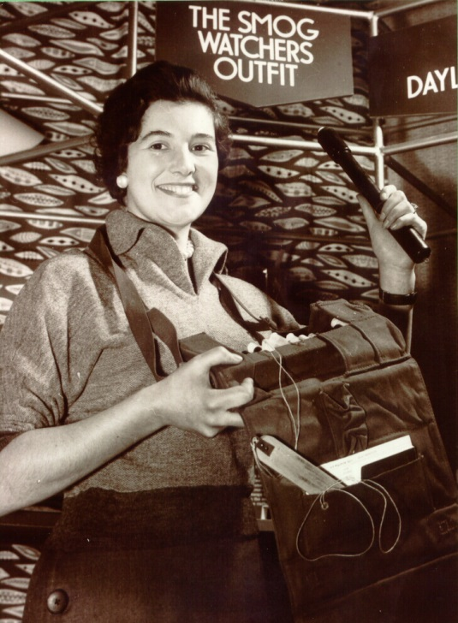

SMOG IN LEICESTER
2.
CLUE!
1.
Where
is this?
CLUE!

Slide 6


LEICESTER TODAY
1.
2.
Where
is this?

Slide 7
AIR POLLUTION: THE PRESENT

Slide 8

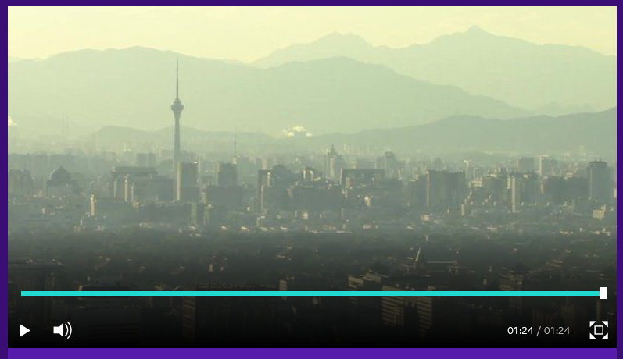
SMOG
today
Red-alert smog warning across parts of China
Parts of china can be covered in smog – all year round. What causes smog? And how do people live in Beijing?
https://www.bbc.co.uk/newsround/38389844

Slide 9


AIR
POLLUTION
CAUSES
5 MINUTE CHALLENGE
Cars
TASK: MAKE A SPIDER DIAGRAM

Slide 10
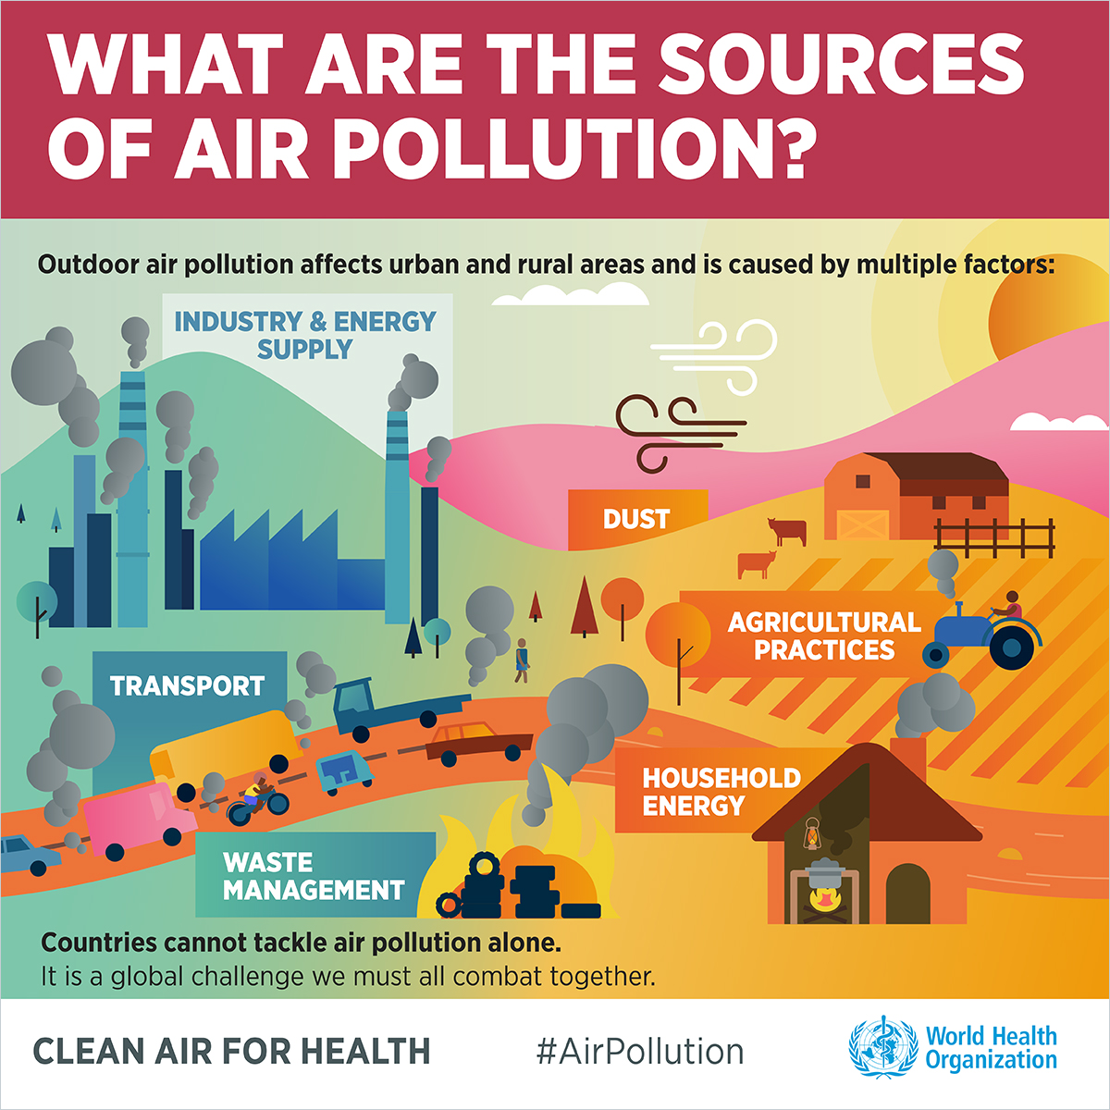
THE ANSWERS
What can we do about it?

Slide 11
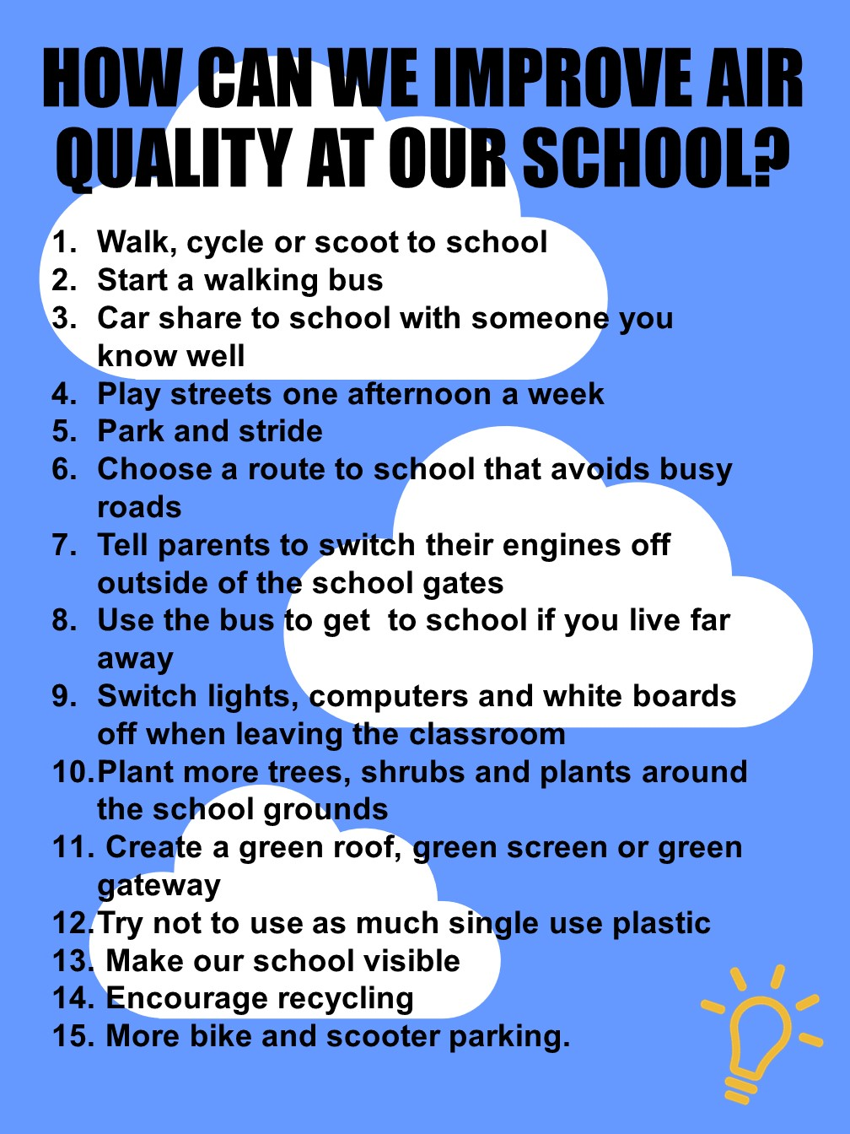


HOW CAN WE IMPROVE AIR QUALITY
AT OUR SCHOOL?
Make your own
Clean Air Code
10-15 MINUTE CHALLENGE
Use the evidence you’ve collected as a class
In groups, write a list of five golden rules your school could follow to improve air quality.
What else could we do to improve air quality at school? Look at the list
Notes:
Activity 4: How can we improve air quality at our school?
Children should work in small groups of up to 4 (5 at the most) for this activity. Pairs or threes will also work well.
Explain that the children have learn about the causes of air pollution and identified sources of air pollution around their school. It is now time for them to think like the Mayor of Leicester and decided what they can do in our Air Quality Management Area to improve air quality.
Task: Children should develop their own Clean Air Code – a bit like the Eco-schools code of conduct – a list of golden rules that advise pupils, teachers and parents how they can improve air quality. These rules need to be achievable and realistic (check understanding of these words). Children will need paper and pens for this activity.
If there is time – children can think about other ways we can improve air quality at school. They can look at the ‘How can we improve air quality at our school’ list – would anything work particularly well at our school? Could it be adapted? What would we need to do, to make it happen?

