Slide 1

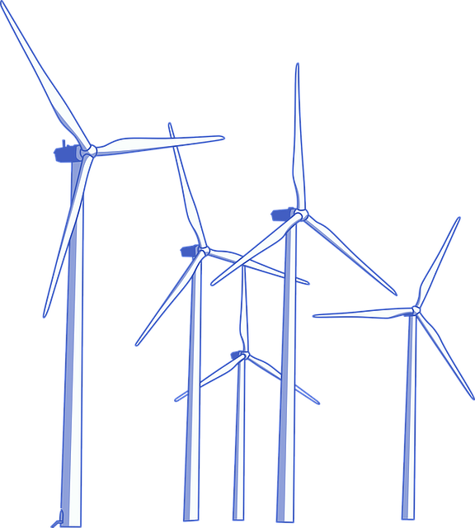

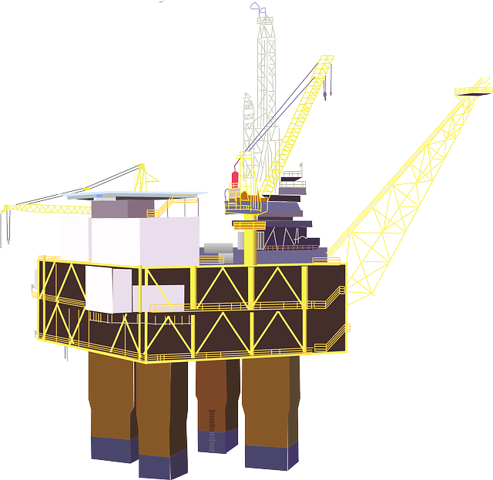






ENERGY EXPLORERS
Notes:
Energy Explorers Recap and intro
Ask children to remember and recap what they did last week:
What is a fossil fuel: coal, oil and natural gas
Where fossil fuels came from and how it was formed
Explored fossil fuel uses: in cars, heating, plastics, to make electricity
Why they are important – what are their big uses
Explored the classroom – what uses fossil fuels to make them work, what fossil fuels were used to make objects
What is the link to air pollution?
Explain to the children that today, we will be looking at a different type of energy – Renewable sources of energy…

Slide 2



What is Renewable energy?
Wind
Biomass
Solar
Wave
Tidal
Geothermal
Notes:
What is renewable energy?
Ask the children what their thoughts are?
Renewable energy is energy that is collected from a source that is naturally replenished within a human timescale and won’t run out within our lifetime.
Can the children name any types of renewable energy?
Some suggestions include:
Solar
Biomass
Tidal
Wave
Biomass
Geothermal
Wind
Ask the children if they can describe what any of these types of energy sources are, or how they might work.

Slide 3



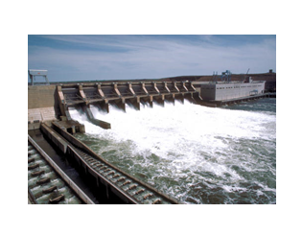
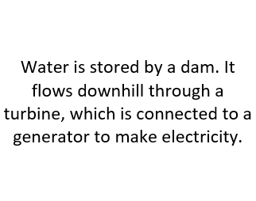


Energy Explorer Task 1: ENERGY MATCH
Working in groups
1. Match the correct energy picture with it’s name and description.
2. Make a poster displaying
each energy source
10 minute challenge
3. Can you label each one as either renewable or non-renewable?
Notes:
Energy Explorer task: Energy Matching Game
Working in groups. 10 minute challenge.
Explain to the children that each table will be given some paper, pens and a set of cards. They need to match up the name of an energy form with it’s correct picture and description.
Once the children are happy they have matched them up correctly they can stick them down, colour them in and label each type of fuels as either Renewable or Non-renewable.
Use the hydro electricity card as an example.

Slide 4

WHY IS RENEWABLE ENERGY SO IMPORTANT?
1. Won’t run out
1 MINUTE DISCUSSION
2. Less air pollution
3. Less harmful to the environment
Notes:
Why is renewable energy so important?
Discussion in pairs. 1 minute challenge.
So now we’ve looked at several different types of renewable energy, can the children suggest what it is so important? Can they tell me three really good things about it?
Give the children a minute or so to discuss in pairs their thoughts. Feedback to the rest of the class.

Slide 5


FOSSIL FUELS vs RENEWABLES
GOOD THINGS
GOOD THINGS
Make lots of really useful things like plastics
Cheap to buy
Produces lots of energy
Widely available
Less pollution
Low maintenance
Will not run out
Not as destructive to the environment
Lower operating costs
BAD THINGS
BAD THINGS
Need lots of fuel to keep up with demand
Accidents happen
Bad for the environment
Fossil fuels are non-renewable
Impact human health
Fossil fuels cause pollution
Rising prices
Not reliable – doesn’t produce the same amount of energy
Weather can affect supply
Expensive to set up
Notes:
Fossil Fuels Vs Renewables
Explain to the children that there are lots of good things and bad things to using fossil fuels or renewable energy. The governments internationally argue about which type of fuel to use all the time.
But, can you think of the good and bad things for both?
Start with Fossil fuels and then go on to Renewables.
Great work… now, if you were in charge… which fuel source would you prefer your country to use?

Slide 6

YOUR CHOICE… which type of energy would you use?
Time to vote!
Notes:
Your choice… which type of energy would you use?
You know the importance fossil fuels and renewable energy sources. But if you ruled a country, which one would you use? Or would you use both? Or is there another way?
Ask the class to vote through a hands up: Raise your hands if you are ‘for’ fossil fuels, raise your hand if you are ‘against’ fossil fuels, raise your hand if we should use both?

Slide 7
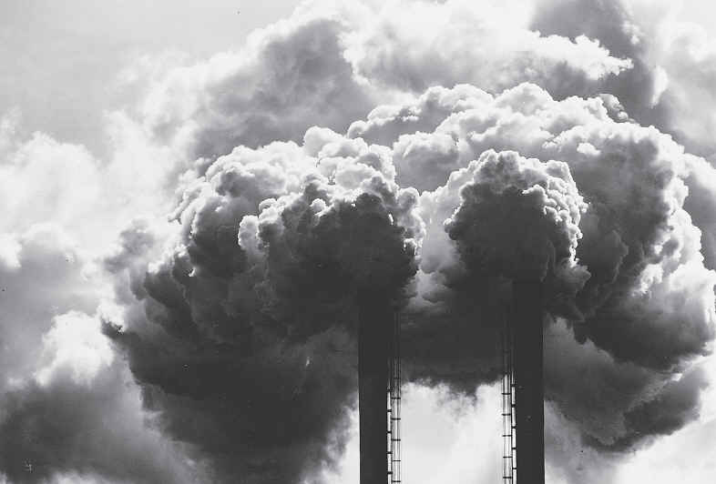


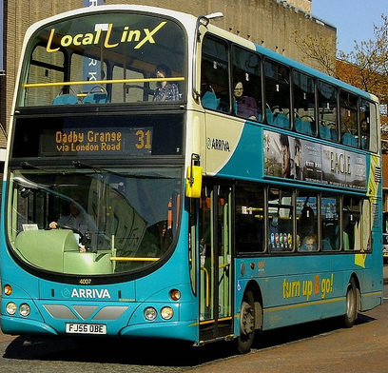




What else can we do?
Try not to use single-use plastic
Encourage recycling
Switch lights off
Switch your engine off – don’t idle!
Park and Stride
Use public transport
Notes:
What else can we do?
We know that there are some serious consequences to using fossil fuels at the rate that we do. Renewable energy is a great alternative to using fossil fuels to make our electricity, but getting everyone on board in this country and around the world to make the change is going to take a long time.
So, in the meantime it’s important to remind ourselves that ‘every little helps’ and there are lots of little things we can all do to help reduce the amount of fossil fuels we use every day.
Come up with three ideas in your table groups. Feedback to the class.

Slide 8










It’s gameshow time!
WHAT CAN YOU REMEMBER?
Notes:
It’s gameshow time!
If there is time at the end of the session explain to the children that we are going to do a class gameshow to see what we can remember from our Energy Explorer lessons.
Firstly, I need two volunteers. Seat the two volunteers at the front of the class, they will each have in front of them a pack of paper statements. These will be facedown in front of them, they should not pick them up or move them around.
Volunteers will be asked to pick them up one at a time from the top of the pile and show them to the rest of the class.
The whole class vote for which statement they think is correct. The class teacher will keep a tally chart of the correct and incorrect answers. If the class is successful at the end of the gameshow they will win a trophy.
Statements:
Solar cells are a source of light
1. The sun is a source of light for solar cells (correct)
2. Wind turbine blades are pushed by the wind (correct)
2. Wind turbine blades are pulled by air resistance
3. Energy is what makes things move or work (correct)
3. Energy is a type of fuel
4. Electricity is a force
4. Electricity is a type of energy (correct)
5. Heat is a kind of energy that can change materials (correct)
5. Heat is caused by temperature
6. Natural gas is a fossil fuel (correct)
6. Solar power is a fossil fuel
7. Global warming caused by burning fossil fuels is causing loss of some animal habitats (correct)
7. Habitats are causing climate change and other damage to the environment
8. Air pollution can be caused by vehicles (correct)
8. Electric cars are pollution free.

