Slide 1
Behind the news headlines: can we work out which are reliable?
Based on rewriting the headlines (Science4Society)

Slide 2
Aim of the session
To evaluate reliability of news stories about air quality
Lesson objectives
To apply questions to reported research in the media
To reflect on reliability of news stories
To compare the reliability of different stories

Slide 3
Looking at how research is reported in the media
What is research and what are researchers?
Discuss in pairs/small groups

Slide 4
Research is…
Asking questions
Finding answers
Researchers
Share their findings

Slide 5
Research in the media
Where do you or your family see, hear or read the news?

Slide 6






Media is…

Slide 7
What is a headline?
What is a ‘headline’? What does it look like?
Discuss in pairs/small groups
BIG AND BOLD, eye catching, short, key points

Slide 8


Question 1
How do you feel when you read this headline?

Slide 9
Question 2
What questions should you ask about this headline?

Slide 10
Question 3
Are your questions about how the research was done - or how it is presented or reported?

Slide 11

Questions about how the research was done
SMURF the researcher says the research must be:
  relevant
  verifiable
  unbiased
Sample
How big is the sample and who is in it?
Measures
What was measured and how?
Unbiased Research
Who did the research and when?
Funding
Who funded the research?

Slide 12
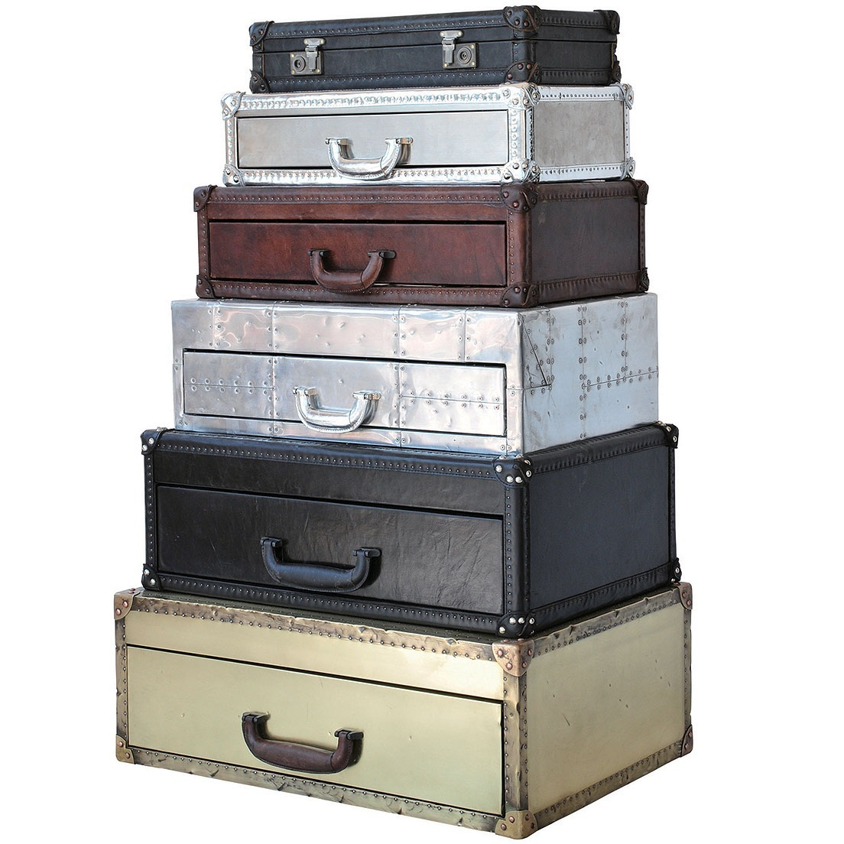
Questions about how the research is reported
The CASES the media are reporting should be:
  accurate
  honest
Contradictory
Is the evidence inconsistent/contradictory?
Accuracy
Is the research reported accurately?
Sources
Are these quoted and are they accessible?
Exaggeration
Is the evidence overstated or embellished?
Selective
Are the examples chosen to support only one side?

Slide 13
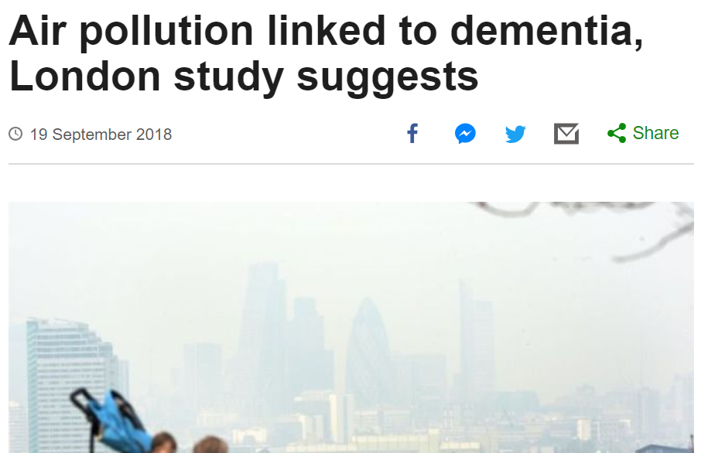
BBC Headline

Slide 14
BBC Headline Question 1
How do you feel about this headline?

Slide 15
BBC Headline Question 2
What questions should you ask about this headline?
About the research (SMURF)
About how it is reported (CASES)
Rewrite the headline

Slide 16
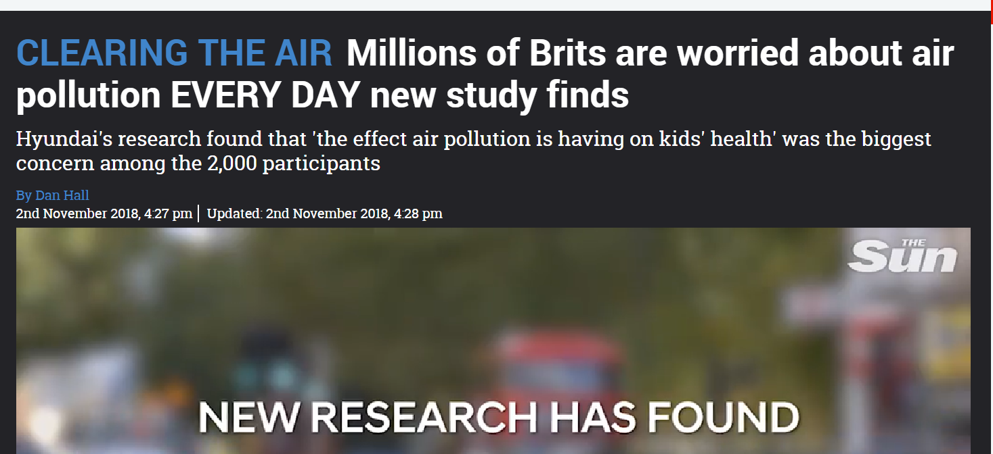
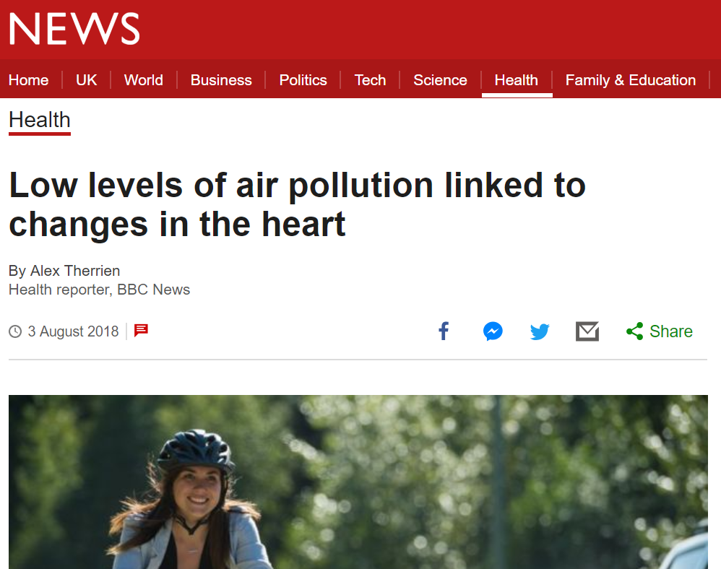
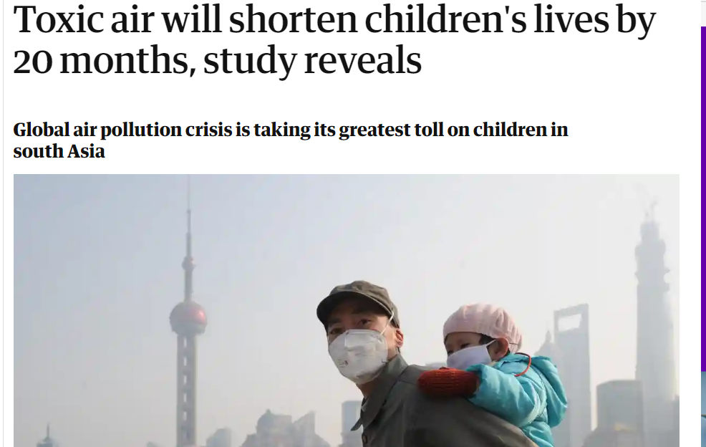
Apply the same method to these headlines

Slide 17
Review
What have you learned about research?
What have you learned about communicating research?

Slide 18
Extension/homework activity
Find an online news story about air quality from the last 12 months
Apply the SMURF and CASE method
Re-write the headline so that it fully reflects the story
Summarise the story in 4 sentences

