Slide 1
Why buy an electric vehicle?

Slide 2
Aim of the session
To understand the benefits and current limitations of electric vehicles
Lesson objectives
Understand what an electric vehicle is
Identify the benefits and potential problems currently associated with electric vehicles
Evaluate vehicle purchases based on differing circumstances

Slide 3
What is an electric vehicle?
A vehicle which uses one or more electric motors for movement.
There are several types of electrical vehicle
  Pure electric vehicle (also known as ultra low emission vehicles)
  Plug-in hybrid electric (also known as PHEVs)
  Range extended electric vehicles
Notes:
Pure electric vehicle – high performance batteries are used to provide power to an electric motor, which in-turn drives the wheels.
Plug-in hybrid (PHEVs) – a highly efficient petrol or diesel engine with an electric motor and batteries.
Range-extended electric vehicle – as pure electric cars, these only ever run on electricity. However, they also have a small petrol engine which tops-up the battery charge

Slide 4
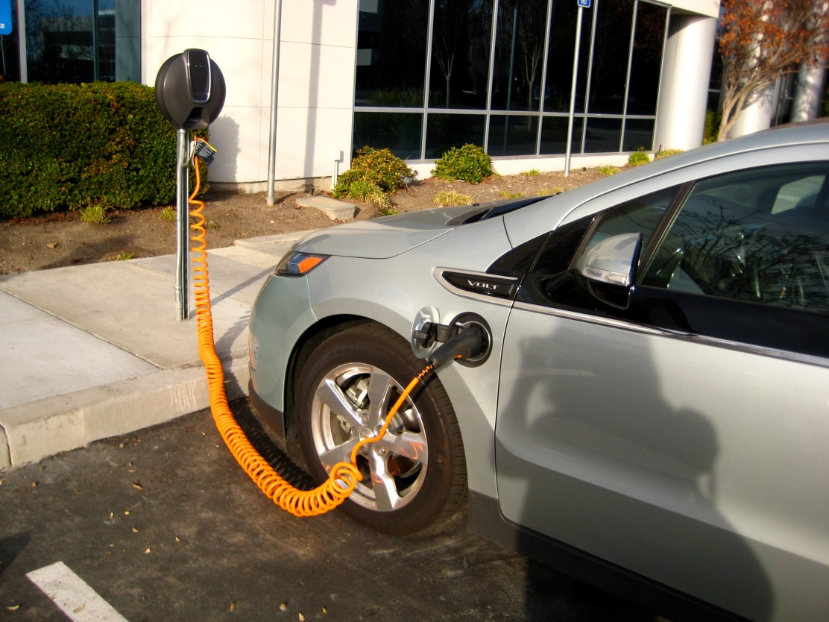
Electric vehicles 1
Zero emission 100% electric - wholly driven by an electric motor
When the vehicle slows down, the motor is put into reverse, which tops up the battery - called regenerative braking
They produce no tailpipe emissions - and typically offer a range of 100 miles (but some many more!)

Slide 5
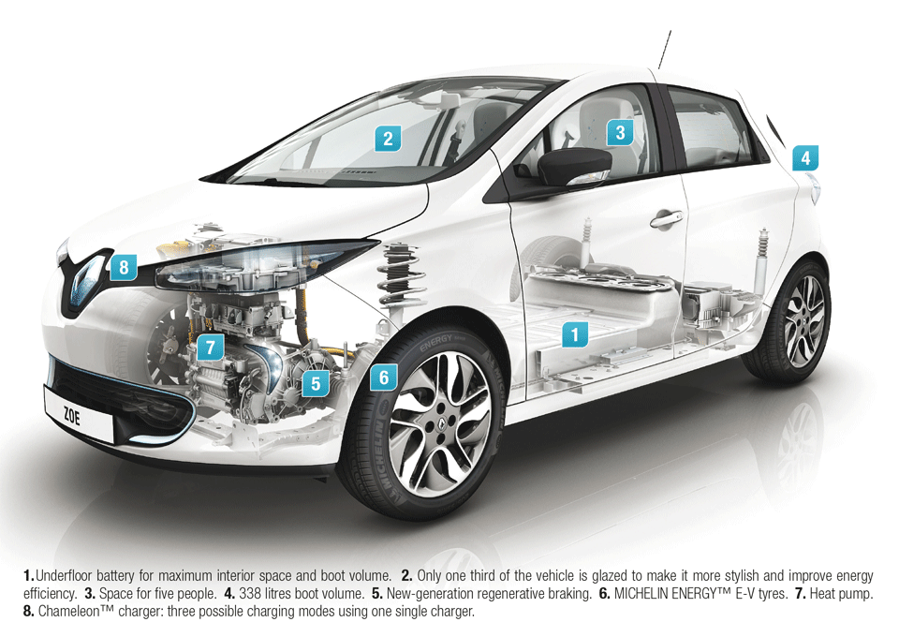
Electric vehicles 2
Electric vehicles have been around for over 100 years
They are very smooth and only need a single gear, they have no engine noise
They can be charged from a normal socket, but to speed up charging there are a host of charging options
Ultra-low emission vehicles (ULEV) emit less than 75g of CO₂ per/km and zero emission for at least 10 miles

Slide 6
Electric vehicles and the environment 1
Transport accounts for a quarter of UK carbon emissions - if renewable energy is used to charge, this further reduces carbon
As more energy is produced from renewables the carbon emissions are reduced (in 2012 the BMW i3 created 81g/CO₂ per km, in 2017 this dropped to 27g/km)

Slide 7
Electric vehicles and the environment 2
Improves air quality - there isn’t a tailpipe producing emissions
This helps to keep the air we breathe clean especially in urban areas like built up cities

Slide 8
Advantages and disadvantages
Organise into advantages and disadvantages
Then rank from biggest advantages/disadvantages to smallest advantages/disadvantages

Slide 9
Advantages
Cheaper to run
Easy to charge at home
Cheaper to maintain
Better for the environment
Quick and quiet
Tax saving

Slide 10
Disadvantages
Limited makes and models
Electricity could still be generated from fossil fuels
More expensive
Silent cars aren’t heard by pedestrians
Charge points not freely available yet
Limited range
Future charging capacity
Battery replacement
Takes longer to charge

Slide 11
Which vehicle and why? Option I
Using the Go Ultra Low website www.goultralow.com, select up to 10 vehicles
(less than 50g/km) that can travel at least 70 miles
Complete the summary table on key factors when selecting a vehicle
From your selection pick a vehicle for these groups:
  Family of 5 – regularly visit family 50 miles away
  Single person – commutes to work, on a budget – typically 10 miles round trip
  A couple – who want a top of the range vehicle (price no object)
  Sales person – can travel over 100 miles a day
Select one vehicle you would choose, justify your choice
Internet access required

Slide 12
Which vehicle and why? Option II
Using the resource cards produced from Go Ultra Low website www.goultralow.com, select up to 10 vehicles
Complete the summary table on key factors when selecting a vehicle.
From your selection pick a vehicle for these groups:
  Family of 5 – regularly visit family 50 miles away
  Single person – commutes to work, on a budget – 10 miles round trip
  Couple – who want top of the range vehicle
  Sales person – can travel over 100 miles a day
Select one vehicle you would choose, justify your choice

Slide 13
Extension/homework activity
Using what you have learned about electric vehicles, design an advertising board highlighting all the benefits of electric
Describe how you would tackle some of the current problems identified with electric vehicles
Write to your local MPs and/or councillors asking them about electric charging points in the city and their plans to encourage more electric vehicle uptake

