Slide 1
Where does air pollution come from?

Slide 2
Aim of the session
To understand there are many air pollutants, which have multiple sources and the impacts
Lesson objectives
To name air pollutants and their sources
To describe how to improve air quality locally
To convince others to help improve air quality

Slide 3
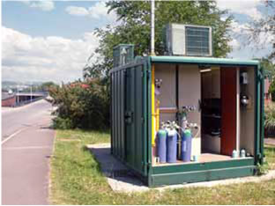
Air pollutants
Pollutants come from many sources: some are made by humans, some are natural
The main pollutants of concern are nitrogen dioxide (NO₂) and particulates (PM₁₀ and PM_{2.5})
Traffic pollutants are generally the biggest problems for cities like Leicester

Slide 4
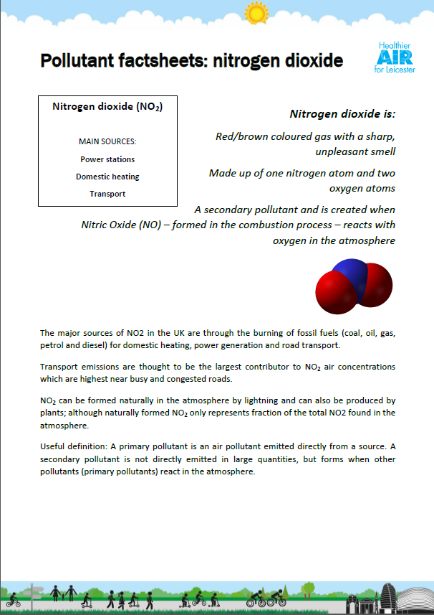
Air pollutants activity
Using the information sheets
Complete the table for the major pollutants

Slide 5
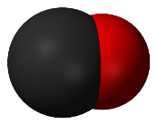
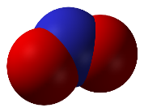

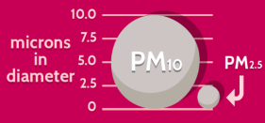
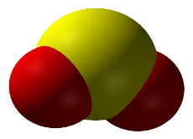
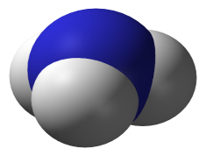
Summary Table
Name (and symbol) | Diagram | Sources | How to reduce | Interesting fact
Carbon dioxide (CO) |  | Road transport Smoking | Good supply of oxygen for burning | Produced instead of carbon dioxide in low oxygen levels
Nitrogen dioxide (NO₂) |  | Burning fossil fuels (heating) Lightening | Using less cars, vans and lorries on the roads | Lightening production makes a very small amount
Ozone (O₃) |  | Industrial sources Nitrogen dioxide in sunlight | Reduce the amount of other pollutants e.g. burning fossil fuels | Found in the atmosphere to reduce UV
Particulates |  | Transport Solid fuel burning and BBQs | Using less cars and vehicles | Can be man-made and natural
Sulphur dioxide (SO₂) |  | Power stations Solid fuel burning | Reducing the amount of fuels being burned | Volcanoes produce large amounts of sulphur dioxide
Ammonia (NH₃) |  | Fertilisers Waste disposal | Reduce the amount of fertiliser and use at the correct time of year | Limited exposure for most people
VOCs | Lots of diagrams | Household products Fuels | Reduce the amount of VOCs being used as solvents | Can last in the air for a long time!

Slide 6
Improving air quality
There isn’t one answer to improving air quality in cities
Leicester has a long term air quality action plan (AQAP) to improve the air quality of Leicester
The plan identifies the types, distribution and sources of air pollution affecting the city

Slide 7
Improving air quality
Select your top 3 things to improve air quality around school
Be prepared to
justify your choices
Encourage recycling
Leave the car at home – walk, cycle or scoot to school
Use public transport
Don’t use single use plastic
Save energy – switch lights off
Hold an anti-idling campaign, switch off your engines when the car isn’t moving
Choose a route to school that avoids busy roads
Park and stride

Slide 8
Planning activity
Choose ONE way that your school can improve air quality
Decide what change/s you want to make
Decide the messages you want to share
Create a poster or plan an activity to share your campaign

Slide 9
Extension/homework
One of the biggest pollution problems is traffic in cities. Imagine if every car that came into Leicester city had to pay £5.
What would you spend this money on?
Explain your strategy
What would be the benefits and problems of your plan?

