Slide 1
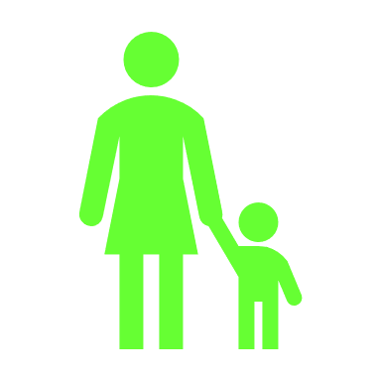

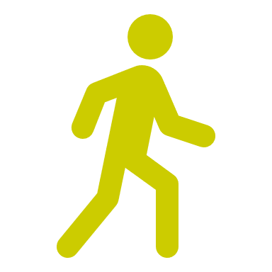

Be Bright Be Seen
Are you walking, cycling and scooting to school in the winter?
Notes:
Be Bright Be Seen – Active travel to school in the winter assembly
Explain to the children that this assembly is all about being safe and seen when travelling actively to school during the winter time.
Ask the children why we need to think about being bright and seen during the winter? Why is this important? Because it’s dark, poor weather, might snow, mist and fog, reduced light, short day light hours
When light is low and visibility is poor due to the dark nights, dark mornings or poor weather – we might not as visible to motorists, as children are also a smaller – and less easy to see from the windscreen of a car.
So being bright and visible is really important to keep us safe.

Slide 2










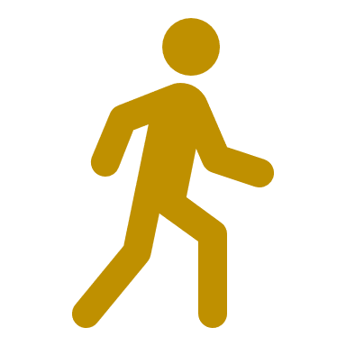
What can you do to be bright and seen?
Notes:
What can we do to be bright and seen?
Ask the children what do they think they can do to make sure that they are seen when they are:
Walking – wear bright colours
Cycling – lights on bike
Scooting – wear something reflective

Slide 3

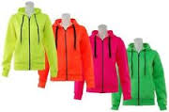
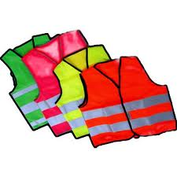
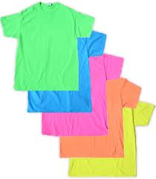
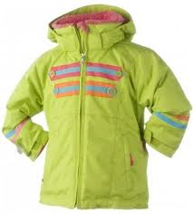
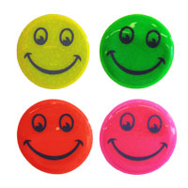
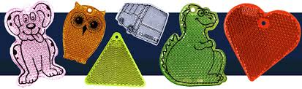
Being colourful is cool and fluorescents are fun
Notes:
Being colourful is cool and fluorescents are fun!
There are loads of ways to brighten up what you wear to school – these are just a few ideas:
brightly coloured hoodies / jumpers, high visibility vests with reflective stripes, brightly coloured and reflective coats, reflective key chains for backpacks and reflective stickers for your bike or scooter!

Slide 4
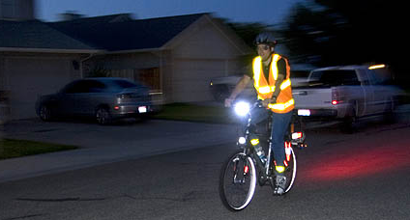
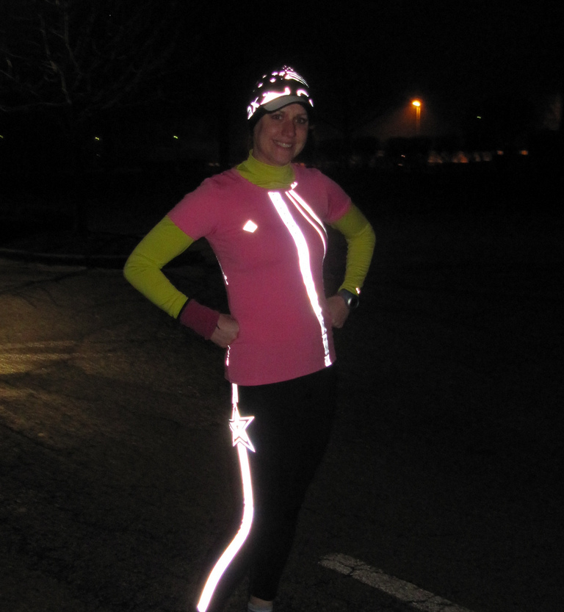
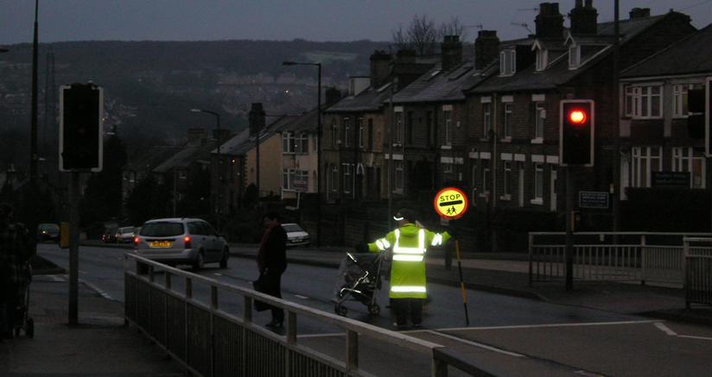
What makes these people noticeable in the dark?
Notes:
Ask the children what makes each one of these people noticeable in the dark?
Man riding bike – lights, high visibility vest, reflective stripes, reflective ankle clips
High visibility coat, fluorescent stop sign, reflective stripes
Brightly coloured clothing and hat – lots of reflective stripes

Slide 5
Make yourself visible when it’s dark
lights
Wear bright
colours
accessories
reflectors
Reflective stripes on clothing
High-vis
Notes:
Bright colours are really fun, and so are lights and reflexives…
Would you notice these people in the dark? How have they dressed themselves to make themselves bright at night?
Optional activity: Suitcase activity (a set of dark and colourful / reflective clothing/accessories is packed in a suitcase the audience need to decide which clothes/accessories should we wear to school on a dark and misty morning…
Ask a child to be a model and explain that if they are happy they can either try on the brightly coloured clothes and accessories, or hold them up for the other boys and girls in the audience to see. Ask members of the audience to come and choose: a jumper , coat, bag, accessories etc to dress our model appropriately for a dark and misty morning

Slide 6




When it’s dark remember…
Being bright isn’t the only way to stay safe on the road
Stop
Look
Listen
Think
Notes:
Finally, always remember, that being bright and visible isn’t the only way to stay safe on the road…
Always follow the Green Cross Code!
Find a safe place to cross the road and STOP
Look right, look left and look right again
Listen – can you hear anything coming?
Think – is it safe to cross?
Ask the children for three top tips when being safe during the winter..

