Slide 2


Why encourage walking to school?
Quality
family time
Time to learn
and practise road
safety skills

Slide 3




Walking to school work as evidence for local/national award schemes

Slide 4


Slide 5
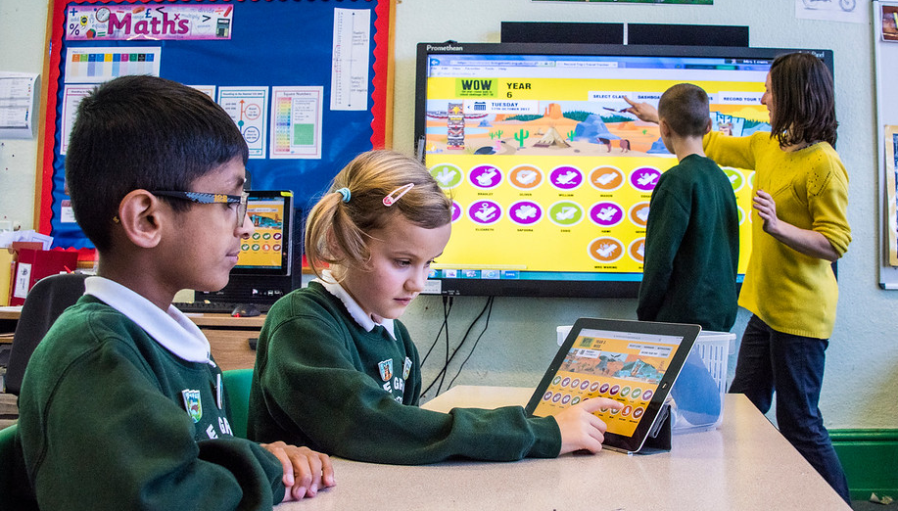
Record journeys on the
WOW Travel Tracker
Notes:
Access via whiteboards, computers, iPads

Slide 6
Record journeys on the
WOW Travel Tracker
Log journeys at a convenient time of school day
Pupils receive instant feedback on progress made towards earning a badge
Class leader boards
Automatic calculation of badges earned
Travel by class shown in circle graphs
Run and export reports

Slide 8
Support and resources
Launch and refresher assemblies
Parent letters
WOW Monitor badges and certificates
Railing banner
Class of the month trophy
Curriculum linked learning resources
Park and stride guidance
Mascot visit
Support and advice by phone, email, face-to-face
WOW badge competition (spring term)
WOW badge app

Slide 9



Notes:
We have a new app which you could ask your parents to download and which brings our badges to life! This September you can see the Canadian moose roaming and there are games to play too.

Slide 10
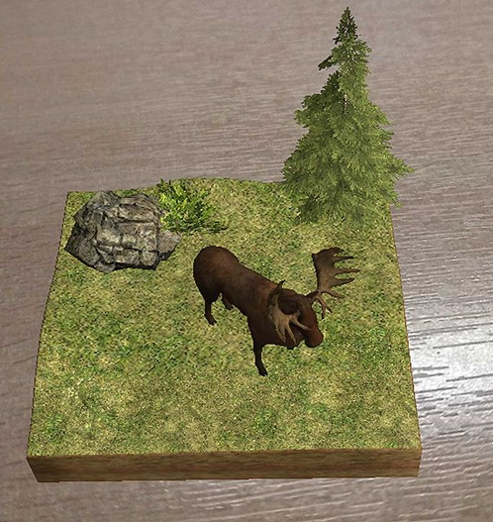


Notes:
We have a new app which you could ask your parents to download and which brings our badges to life! This September you can see the Canadian moose roaming and there are games to play too.

Slide 11

week-long walking challenge

Slide 12
Student-led campaign
It’s entirely up to the students’ creativity what type of walk to school campaign they create.

Slide 13
Set up Walking Stations / Park and Stride / Walking Zones
Create a walking map of safe routes into school
Create and deliver a walking challenge
Create resources/materials to give to students/parents
Promote walking to pupils in feeder schools
Create a presentation or workshop for Year 6 transition days
Notes:
• Welcome to this assembly about Free Your Feet, the week-long walking challenge for secondary schools from the national charity Living Streets.
• Who are Living Streets? A walking charity that’s on a mission to make our streets more walkable and encourage walking.
• Schools all over the country are taking part.
• I’m going to tell you about how walking a bit could make a difference to your life, how the Free your Feet challenge works and how you could win £50.

Slide 14

Get in touch
Katie France
Living Streets Project Coordinator (Leicester)
katie.france@livingstreets.org.uk
07808 6403305
@kt_france @livingstreets
I’m based at City Hall within Leicester City Council’s Walking and Cycling team.

