Slide 1



Slide 2

Introduction
Daxa Ralhan
Programme Officer
Public Health
Tel: 0116 454 4376
Email: Daxa.Ralhan@Leicester.gov.uk
Notes:
My name is Daxa and I work in Public Health
One of my remit is to introduce and implement TDM within our schools in partnership with some of the major sports clubs within Leicester and the Schools Sports Physical Activity Network (SSPAN) which we commission to work within your schools.
Today, I’m going to tell you about The Daily

Slide 3
What is The Daily Mile?
A daily outdoor physical activity which takes 15 minutes
100% inclusive – Boys, Girls, SEN
The children wear their school clothes
Children choose to walk, jog or run
Light touch encouragement to run where appropriate
Slick turn around from desk-to-desk
Non competitive (but some do compete)
Free
Notes:
15 minutes – in this time most children average a mile or more.
100% inclusive – every child, every day. No child is left behind in the classroom.
Able bodied children would be expected to run for most of the way, to ensure they feel the full benefits.
The dynamic between teacher and child – teachers know their students and can encourage them to run where appropriate
Slick 15 minute turn around from desk to desk.
The Daily Mile is (and always will be) free – all resources on our website are free to download.
Spread and scale
28 countries
Over 3000 registered schools
= half a million children every day

Slide 4
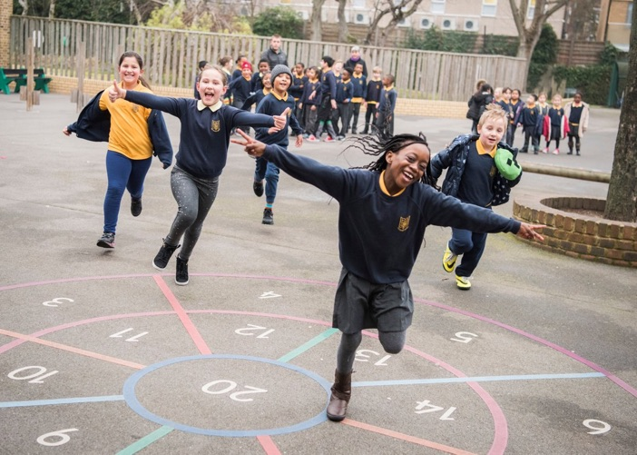
Notes:
The Daily Mile is inherently a social activity.
This is a great example of what The Daily Mile looks like in a school setting.
This photo was taken in an urban school in Hackney – it’s a clear demonstration that the children are happy and having fun.
They are running in their playground – no track required.
The main reason The Daily Mile is successful is because the children love it.

Slide 5
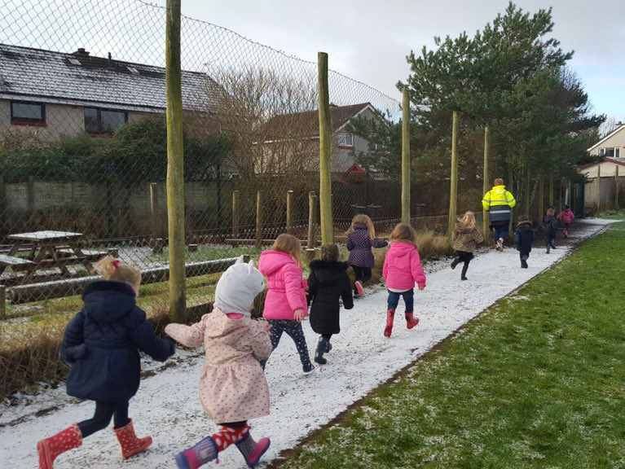
Notes:
The weather is not a barrier.
Not necessarily great weather, having fun together
This photo is from a Nursery in Scotland
Some Nursery schools in Wigan have taken to doing “The Daily Toddle” for 2 and 3 year olds

Slide 6








Excess weight* and Physical Activity
in Leicester
Significantly
better than
England
Significantly
worse than
England
Similar to
England
In Reception
…by Year 6
by adulthood it is
estimated that…
1 in 5
children have
excess weight
2 in 5
3 in 5
have excess weight
have excess weight
Only
In a week…
1 in 5
35% of children did no
vigorous exercise
4 in 5
Children participated in physical activity on seven days of the week
45% did vigorous exercise for less than 3 days
children enjoy P.E.
at school:
boys more so than girls
20% did vigorous exercise for more than 3 days
Source: NCMP 2015/2016, Leicester Children and Young People’s Health and Wellbeing Survey 2016 and Active Lives Survey 2015/2016. *overweight or obese
Notes:
These figures were taken from the Health & Wellbeing survey conducted in 2016 of >>>>>>>>>
So within Leicester we have

Slide 7
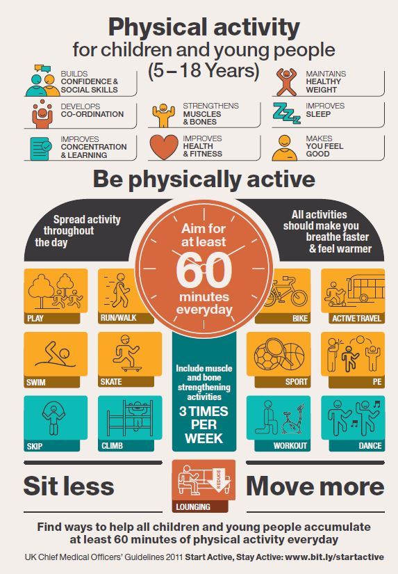
Notes:
In the UK, the Chief Medical Officer’s guidelines state that children should be active for at least 1 hour a day, with an expectation that half of this physical activity time will be provided in-school.
The Daily Mile is a quick, simple, and free way to provide 15 of your 30 active minutes for the children every day.
(It’s good for staff too!)

Slide 8
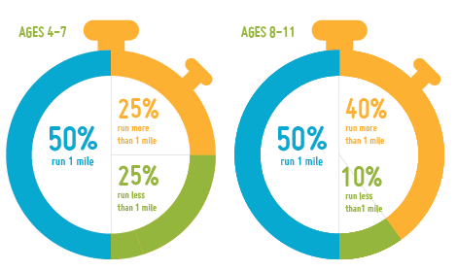
No child has to run a mile…
In 15 minutes this is how far they run
Notes:
75% of the younger children complete 1 mile or more
90% of the older children complete 1 mile or more
Scotland’s Chief Medical Officer has declared The Daily Mile appropriate physical activity for children aged 2 and up.
Children aged 2-12 regularly participate.

Slide 9
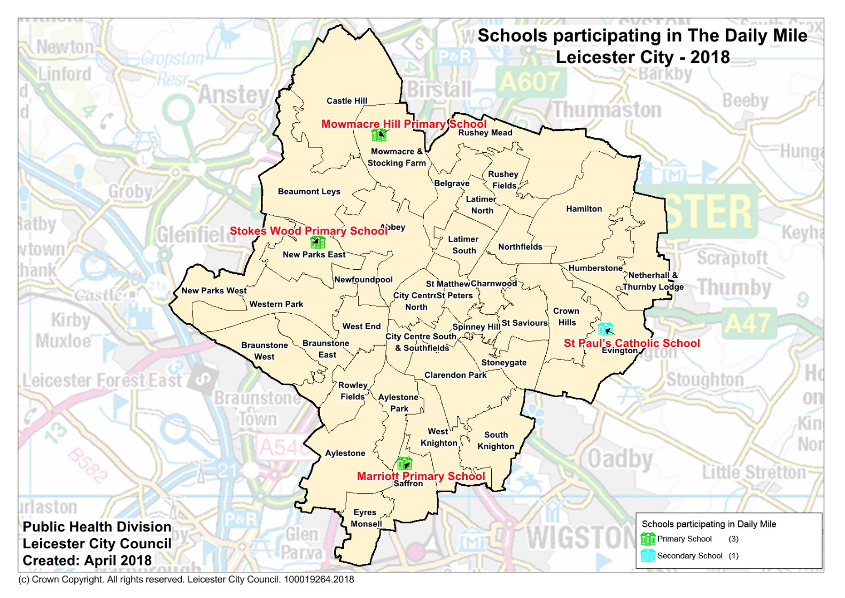

Participation so far
Notes:
When I started on this project at the beginning of this year we had only 3 schools involved
We currently have >>>>>
But I want to get more schools involved as it’s a free, quick, and simple initiative with huge benefits.

Slide 10
The benefits for children
Clear improvement in their health and wellbeing
All children are fit
Obesity and sedentary behaviour is tackled
Self esteem is raised
Improves body composition for life
They ‘own’ a healthy body and they know it
Reduces stress and anxiety
Builds resilience and determination
Notes:
Health and wellbeing improvements – physical, social, mental and emotional
All children succeed - All children’s fitness improved in 4-6 weeks
Obesity and sedentary behaviour is tackled – regular running becomes normal
Helps to improve relationships (social cohesion and class cohesion)
Some benefits of daily physical activity: good for children’s development, attainment, health and wellbeing, attention, mood, memory, cognition and personal self-efficacy.
There are health and wellbeing improvements for staff, too!

Slide 11
The Daily Mile in the curriculum
Health and Wellbeing – Social, Physical, Emotional and Mental
Improves access to PE and Sport
Improves focus, concentration and behaviour
Daily physical activity raises attainment levels
A bonus, not a burden for Teachers – no extra workload
Coppermile Report
BBC’s Terrific Scientific
Notes:
It’s not sport or PE but is physical activity in a social setting
It’s health and wellbeing, and causes improved focus.
When the children return from TDM, they’re ready for learning – benefit of improved cognition that comes directly after exercise
Slick 15 minute transition from desk-to-desk
No special training required for teachers – no extra workload, no data handling, no spreadsheets and no measurements. Unless the teachers and children want to do some child-pleasing measuring of their own.
For those interested in research and results of TDM in schools – The Coppermile Report [University of Essex / Fitmedia Fitness and London Playing Fields Association] and BBC’s Terrific Scientific [Universities of Stirling and Edinburgh] are freely available to view on our website

Slide 12
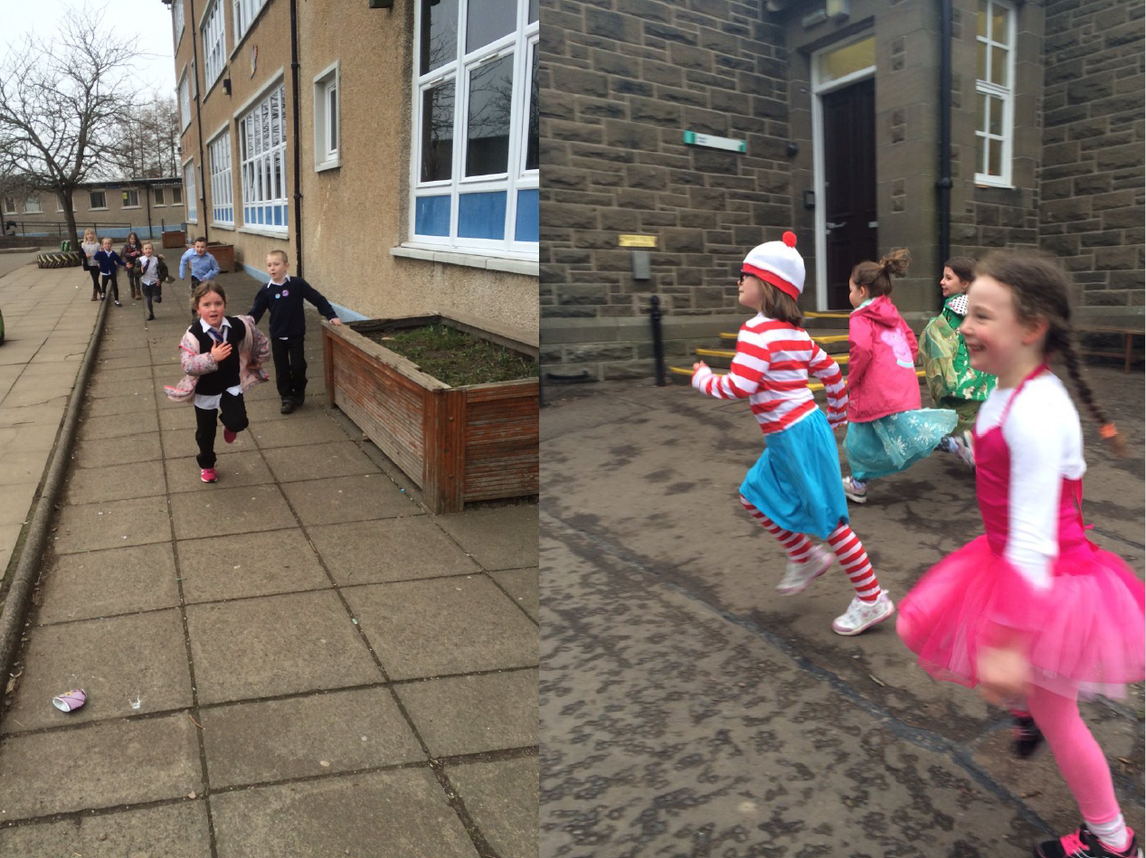
Notes:
The children run The Daily Mile in whatever they’re wearing
On the right, you can see if was World Book Day at the time this photo was taken
We’ve also received some photographs recently of schools completing “Laps to Lapland” for their Daily Mile, in Christmas attire

Slide 13
Removing Barriers to Physical Activity
No equipment, no set up and no tidy up
Weather is a benefit, not a barrier
No staff training needed
Risk assessment straightforward
No kit needed, therefore:
  No cool / uncool kit
  No forgetting or losing kit
  No time spent changing
  No body issues or revealing your body
Notes:
Weather as a benefit, not a barrier – children enjoy being outside in nature and connecting with the seasons

Slide 14
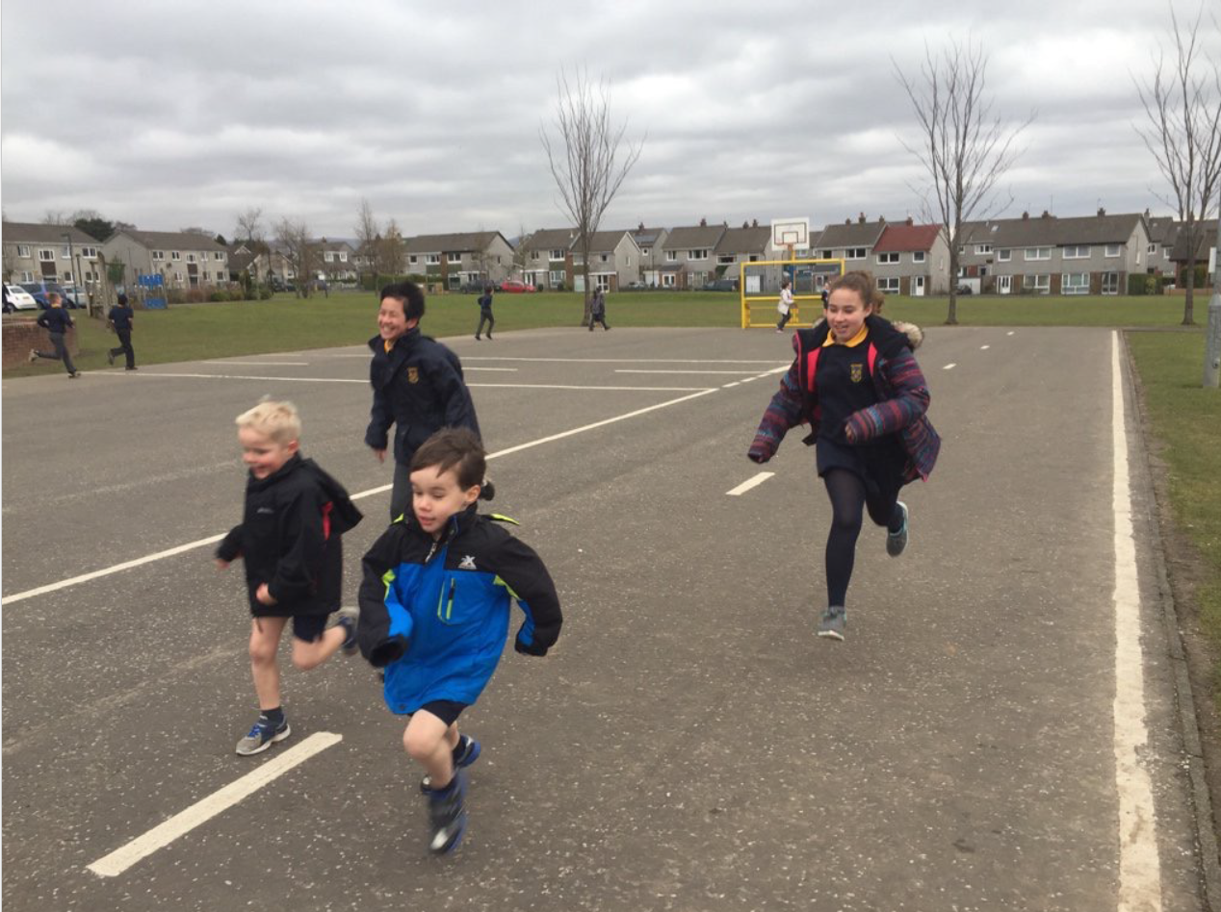
Notes:
In this photograph you can see children of different ages running together – they may be buddies
This can bring a school together – allows children of different ages to get together and develop friendships
Children run in whatever space they have available to them:
Around school grounds, playgrounds, local parks / green spaces, or around the school buildings in small schools.

Slide 15
Why does The Daily Mile work?
It happens where the children are every day
It’s not complicated – for children or staff
It works for all - keen on sport or not keen on sport
It’s sustainable over years – running is normal
Helps towards a healthy weight
A practical health and wellbeing solution
It meets the needs of childhood:
Fun, Friends, Freedom, Fresh Air
... In 15 golden minutes of childhood
Notes:
It’s sustainable over years – running is normal!
Simple to implement
The founding school, St Ninians in Scotland has been doing The Daily Mile for 6 years in February
It helps towards a healthy weight and create good, daily habits for our younger generation
It’s free – for schools, children, parents, etc.
It meets the needs of childhood – fun, friends, freedom and fresh air …. fitness simply comes with the territory

Slide 16
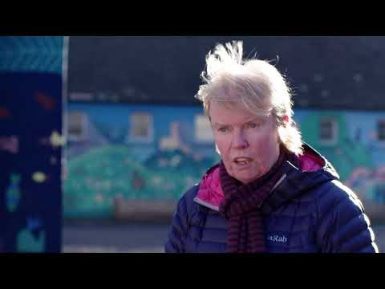
The Daily Mile by Elaine Wyllie

Slide 17
Questions?
For further information visit:
Website: www.thedailymile.co.uk
Facebook: TheDailyMile.UK
Notes:
If you would like to sign up to this initiative come and see me afterwards
I also have leaflets at my stall

