Slide 1





Healthy Schools Network

Slide 2

Healthy Schools Network
Now in its third year, the Healthy Schools Network was set up in 2016 as a response to demand expressed in the April 2016 survey of schools. As you may be aware, central government funding for a National Healthy Schools’ Programme was withdrawn in 2011 and Leicester City Council funding ceased in 2014. Therefore, new arrangements surrounding healthy schools, in Leicester, are now school-funded. The Healthy Schools Network is designed to offer school-to-school support for this vital aspect of the wider curriculum.
2016/17 Healthy Schools Network
2017/18 A Network to Share good Practice
2018/19 A Network to Support a Whole School Approach
“Raise attainment and achievement by meeting the health and wellbeing needs of children and young people”

Slide 3
2017/18 Programme
The 2017-18 programme encouraged schools to share good practice through:
Designating a Health and Wellbeing Champion
^{Introductory Network Meeting}
^{Networking meetings}
Sharing Good Practice Marketplace
Network meetings allowed schools to come together to discuss four key areas:
Anti-Bullying/Cyberbullying
  Leicestershire Police
  Warning Zone
  Leicester City Psychology Service
  Babington Academy
  Uplands Junior LEAD Academy
Healthy Eating and Physical Activity
  Crown Hills Community College
  Food for Life
  Aim Strong Sport
RSE (Relationships and Sex Education) and PSHE (Personal, Social, Health Education)
  NSPCC
Emotional Health and Wellbeing
  Stokes Wood Primary School
  Wellbeing Education/Route to Resilience
  Place2Be
  Centre for BME Health

Slide 4
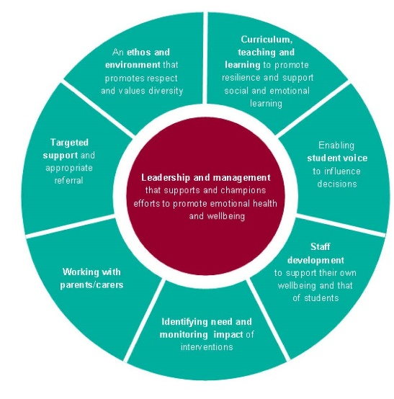
Health and Wellbeing Champion
The designated Health and Wellbeing Champion attends all events.
Role
  Work as the key link between the work of the Healthy Schools Network and its impact on the wider curriculum.
  Share information with relevant colleagues
  Signpost colleagues to relevant organisations/services
  Consider the Eight Principles in a Whole School Approach
  Promote awareness days in school where possible

Slide 5





2018/19 Programme
The 2018-19 programme will encourage a whole school approach to Health and Wellbeing through:
Designating a Health and Wellbeing Champion
Health and Wellbeing Champions Conferences
^{Networking meetings}
Training and Development programme
^{Online resources}
Network meetings will allow schools to come together to
^{discuss four key areas:}
PSHE (Personal, Social & Health Education)
^{Physical Activity}
SEMH (Social, Emotional & Mental Health)
^{Healthy Eating}

Slide 6

Healthy Schools network Team
Rebecca Partington - rebecca.partington@sdsa.net
Sophie Mellor - sophie.mellor@sdsa.net
Emma Sheasby - emma.sheasby@sdsa.net
www.healthyschoolsnetwork.co.uk

