Slide 1
Walk Leicester Project
Sara Coy
Active Travel Training Coordinator (Walking)

Slide 2
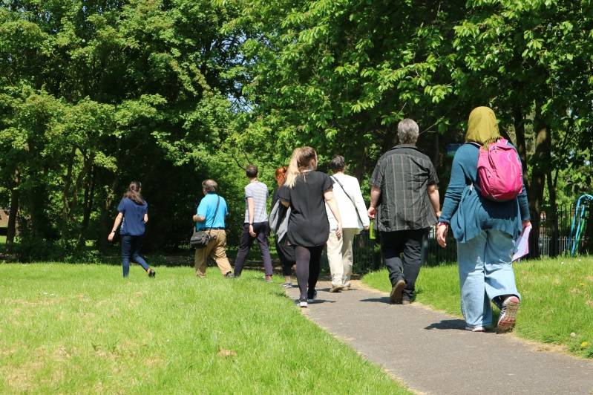
Walk Leicester Project
DfT funded until March 2020
Group walks in Leicester (public & community)
Encourage people to be more active
Free pedometer (aim for 10,000 steps /day)
Familiarise with local walking routes
Sustainable travel
encourage more short
journeys on foot

Slide 3
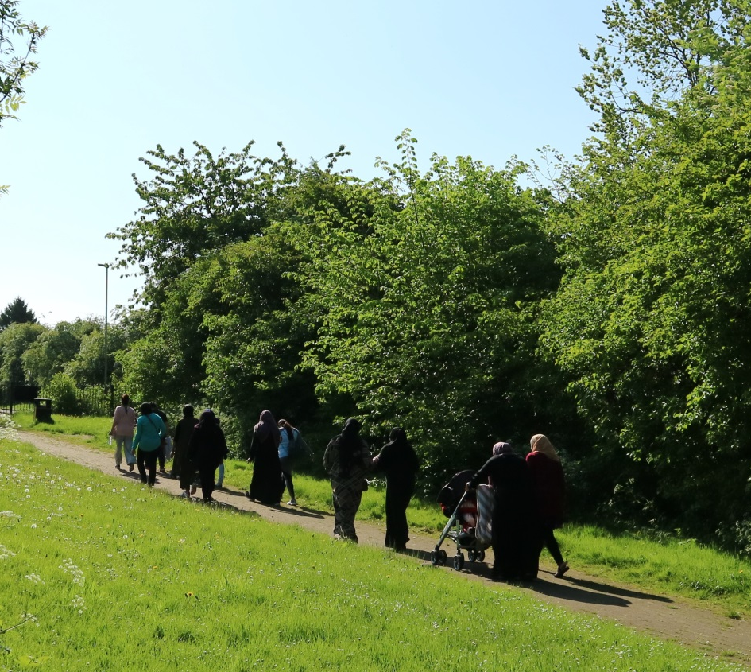
Starting parents’ walking groups from schools
Motivate parents to walk more
Improve confidence to walk 1.5 miles.
Encourage parents to work towards their recommended 10,000 steps / day (free pedometer)
Monitor parents at 6 months after start of programme – has their travel behaviour changed?

Slide 4
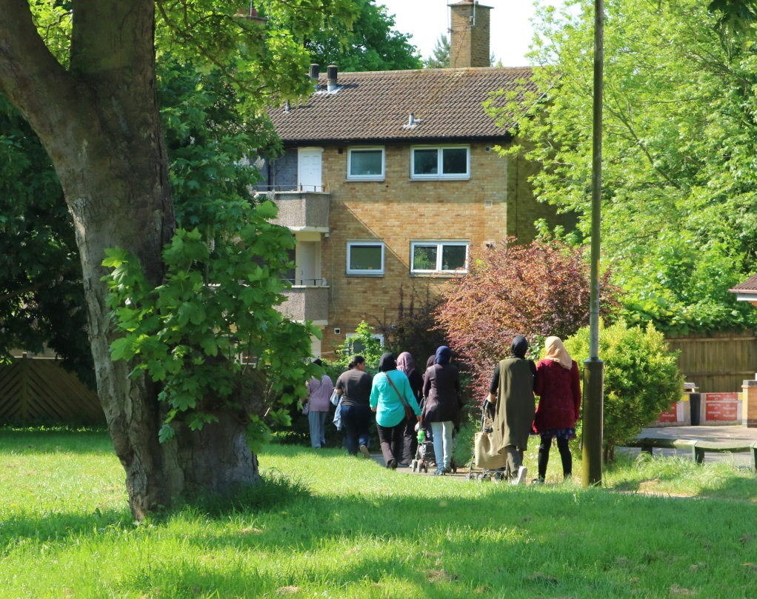
Our offer
‘Buy-in’ from parents prior to setting up the walks programme
We lead a group walk once/week for 4 weeks.
Volunteer walk leader mini-training session (2.5 hours, classroom)
Parents walk as a self-led friendship group thereafter

Slide 5
Pilot – Whitehall Primary School
Parent’s walking group
Timeline
November 2017
January 2018
February 2018
May 2018
Safe Happy Families event
Started group walks for parents
  Weekly group walks for 4 weeks
  9.15am for 45 minutes (1.5 miles), steady pace.
  Starting and finishing at school.
  Walks led by myself / trained volunteers
  Local routes, city and green space
Volunteer Walk Leader mini training session for parents
Walks still continue, led by parents

Slide 6
Feedback
I hardly walk, so this has got me and my family to become more active during the weekends.
..without the group I would not go for walk… good to chat with other parents too and hit my 10,000 steps!
..
This is a proper walk and I feel as if I have had a workout. I was always at the back of the group… I have now moved up a place.
I made loads of new friends who have helped support me when I have struggled and it has got me of of the house.
This group is amazing, I love it… first I was really slow but [I’ve] now built so much confidence in myself.

Slide 7
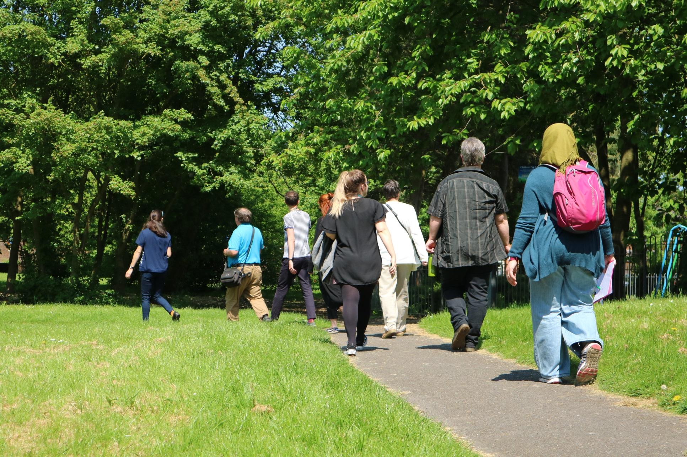
Thank you

