Slide 1
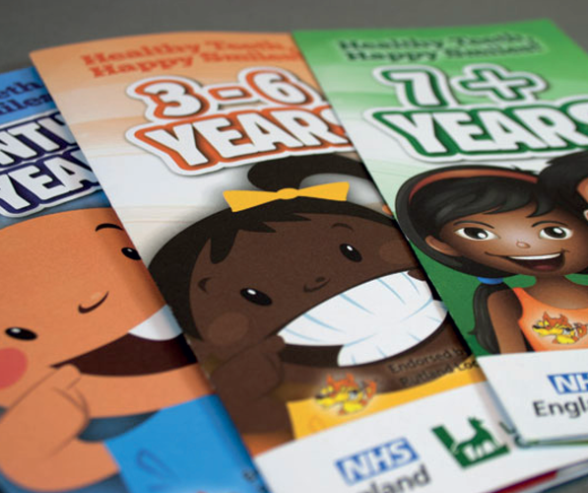

Healthy Teeth, Happy Smiles!

Slide 2

What we do
Healthy Teeth, Happy Smiles! is an evidence-based early intervention programme starting from birth. It is a shared initiative of Leicester City Council and NHS England.
Supervised tooth brushing
FREE support and resources for early years settings to carry out tooth brushing with children on a daily basis
Oral Health Resources
Educational resource packs
Resource catalogue
Leaflets and activities
Accreditation schemes
Early years settings
Dental Practices
Campaigns and partnership working
National Smile Month
Mouth Cancer Action Month
Notes:
HTHS is an evidence based intervention programme starting from birth. We’re here because for oral health in 5 years olds we were the worst in the country, but we are now improving.

Slide 3
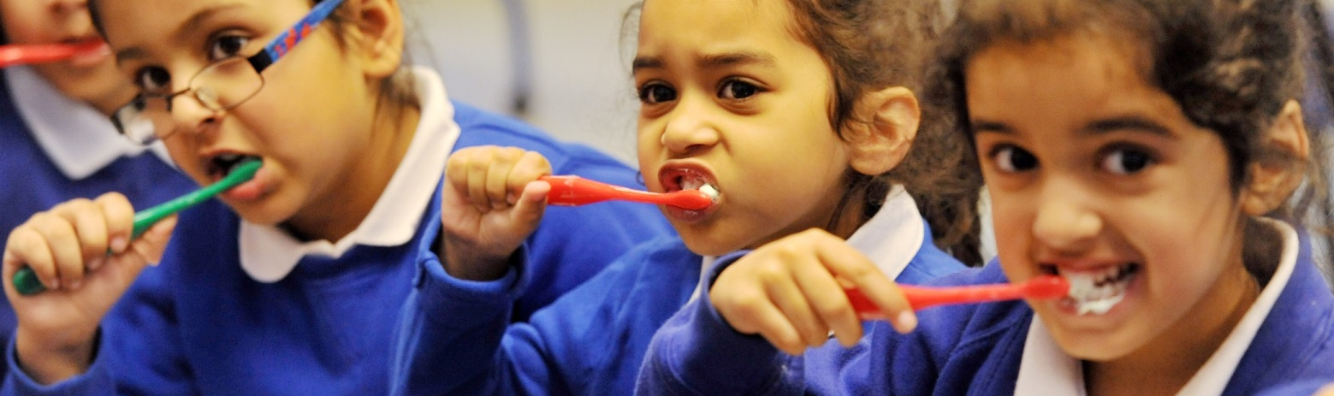
Supervised Toothbrushing
Video file link
5-10 minute activity with the children that takes place every day under the supervision of staff
Oral Health Promoter (OHP) visits and trains school/nursery
Toothbrushes and toothpaste provided by Leicester City Council
School/nursery fill in termly ‘Quality Assurance Check’ (QAC) and is visited on an annual basis by an OHP

Slide 4
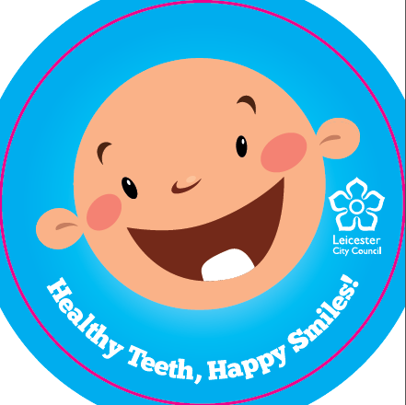
THANK YOU FOR
LISTENING

