Slide 1



Slide 2
Why LESS CO₂?
1 | Energy use in buildings and infrastructure. | Save CO₂ emissions and spending on energy bills.
2 | Behaviour change for staff and students. | Increase energy awareness and develop a ‘whole school’ culture of sustainable energy use.
3 | Teaching about sustainability. | Integrate energy into lesson plans and curriculum.

Slide 3
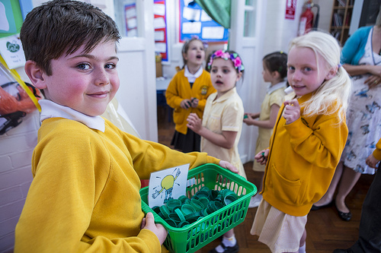
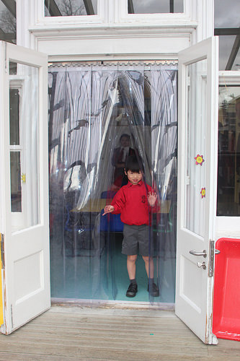

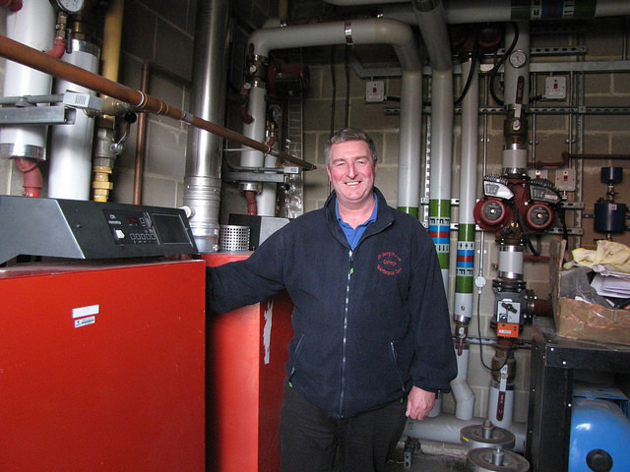
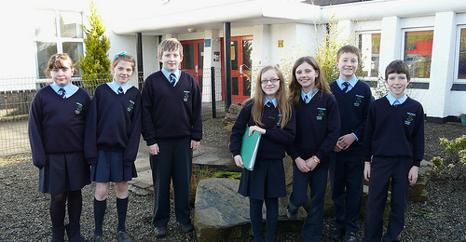
Quick wins… and easy measures!

Slide 4
