Slide 1
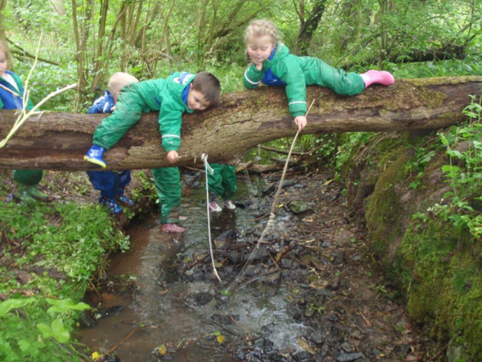
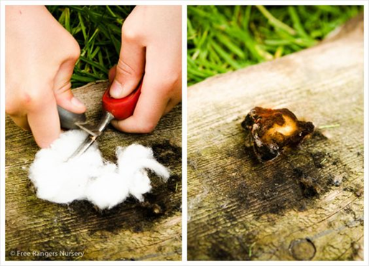
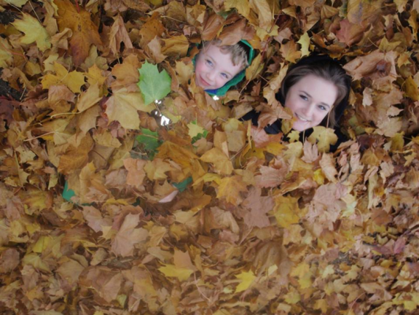
Forest school at Holmsdale manor
2007- 2018

Slide 2

Holmsdale manor nursery- forest school
Started in 2007- the first Early Years setting accessing Forest School in Leicestershire
Now have a L4 trainer, 10 Level 3 staff plus others with Level 1 and 2.
Just awarded the highest quality mark for Forest School- ‘Leadership Centre’.

Slide 3
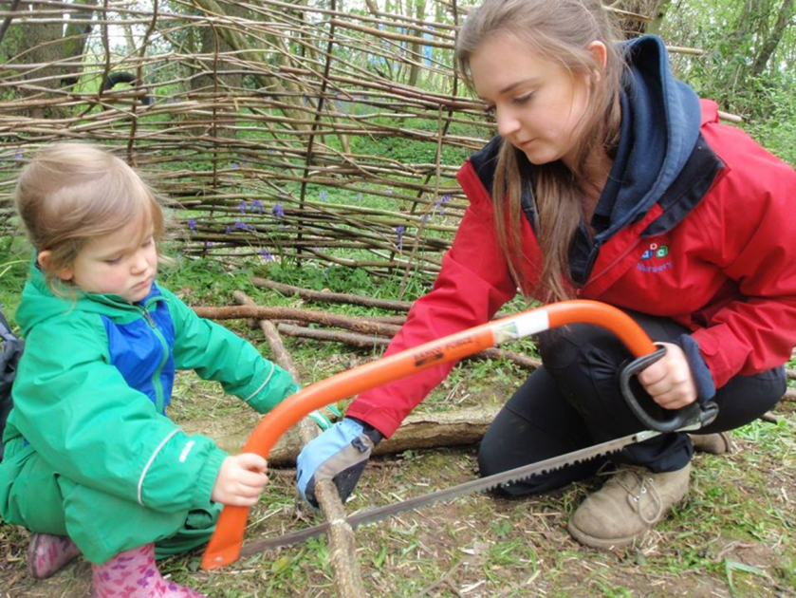
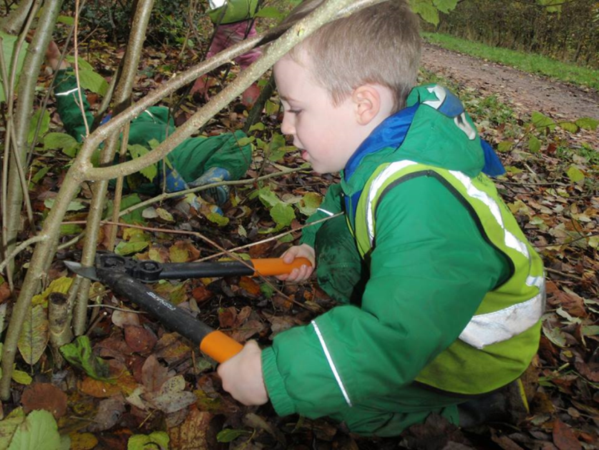
Forest school photos
The last thing we should use is plastic toys of any kind when we can teach much more effectively with the real thing.
Plastic tools simply do not work as well as real tools and leave little room for children to do anything substantial, meaningful, or realistic.

Slide 4
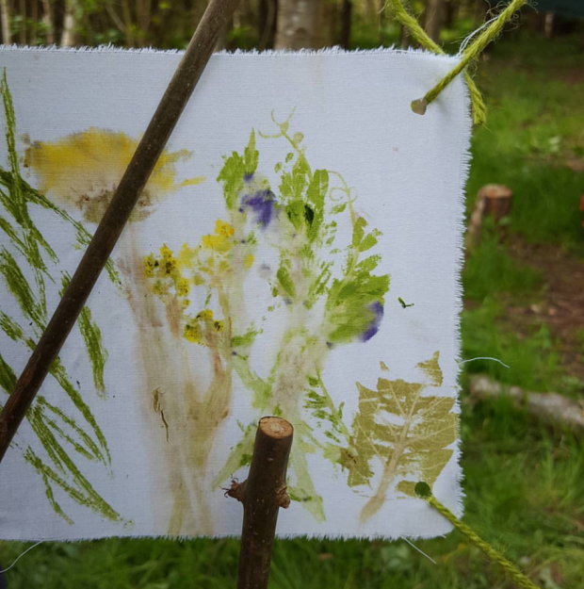
Forest school training
6 courses per year – Leicestershire.
Level 2s / 3s can attend together.
Qualified trainer- 10+ years experience, 5+ years training. Background in teaching (Birmingham) PGCE, M.Ed. and EYP status, LTL accredited.
Training options:
term time / holiday / weekend / 1 day a week

Slide 5
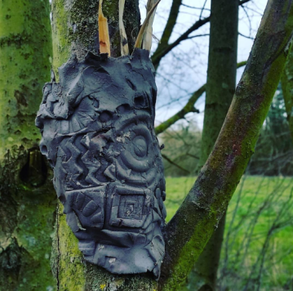
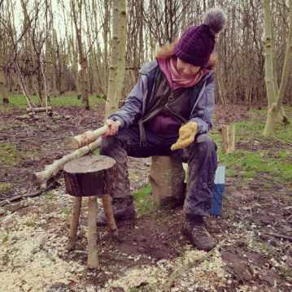
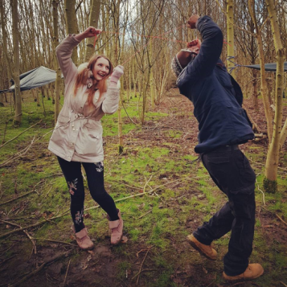
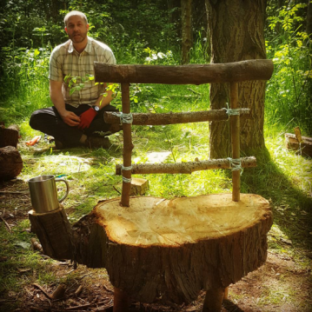
Forest school training
Level 2 – 5 days (high quality content, more taught hours than most L2 courses, this can easily be topped up to Level 3).
Level 3 course – 9 days (split into 5 days followed by 4 more days).
CPD – Forest school tasters, outdoor literacy, outdoor maths, outdoor / large-scale / transient art. Inset days, workshops, twilight sessions and weekends.
Skills development days for Forest School trained practitioners.

Slide 6
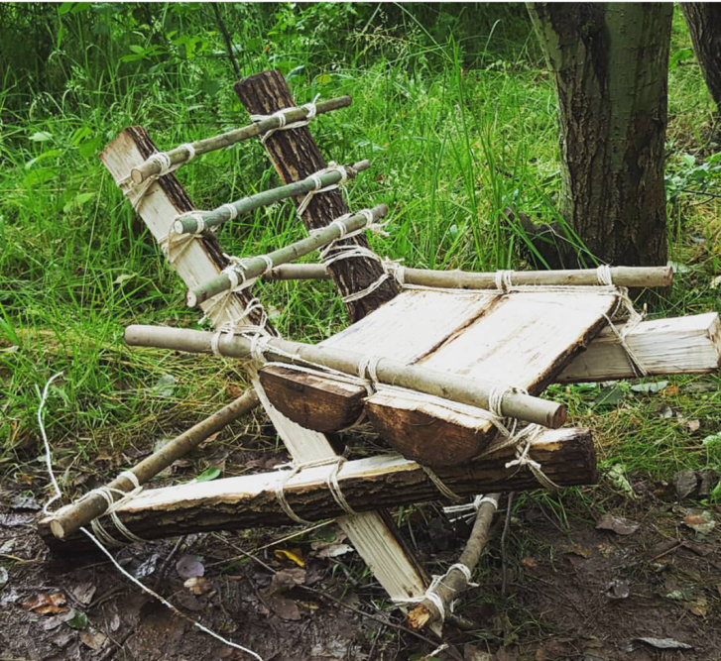
Holmsdale manor
Forest school training
Trained staff from 50+ local schools- some training one Level 3, others training up to 8 staff- teachers, TAs, groundsmen, deputy heads and heads.
Trainees from Ireland, Scotland, Egypt, Switzerland, Germany, Israel, and more!

Slide 7
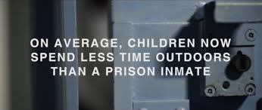
Holmsdale manor Forest school training
The popularity of Forest School has been rising consistently over the past decade- we are passionate about keeping the standard high and maximising the benefits to children, particularly in the context of declining skills on school entry, ‘screen time’ and lack of freely spent time outdoors.
¾ of UK children- 2016 survey.
A fifth don’t play outside at all
“Our children should be climbing trees, not the walls.” Liz Truss – Environment Secretary

Slide 8
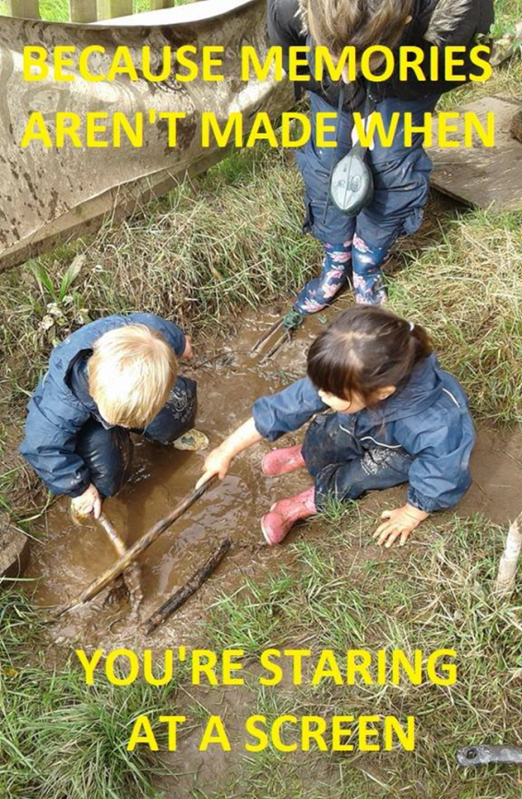
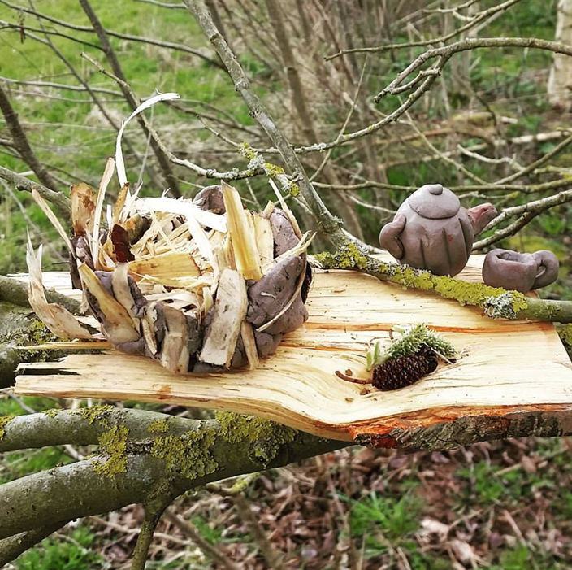

Slide 9
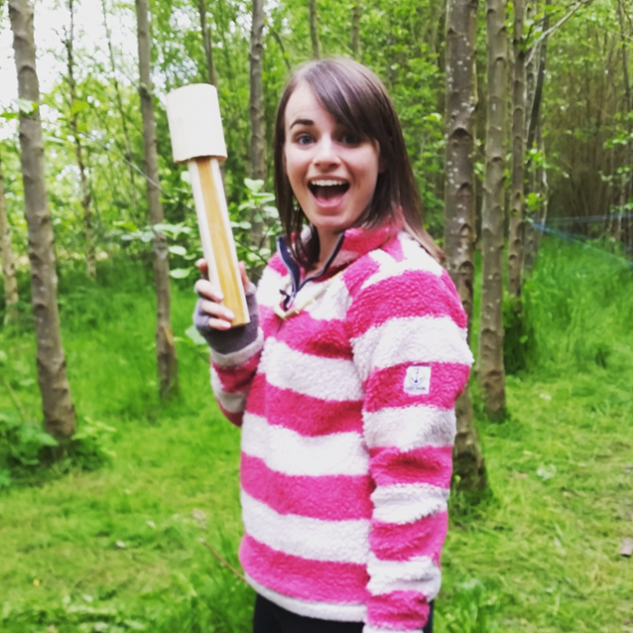
Training dates
June 4-8 (4 spaces left)
June 13/20/27 and July 4/11 (1 space left)
July 30- August 3
September 14/21/28 and October 5/12
October 15-19
“When other heads ask me how we can afford the time to do this,
I ask them how we can afford not to?”

Slide 10
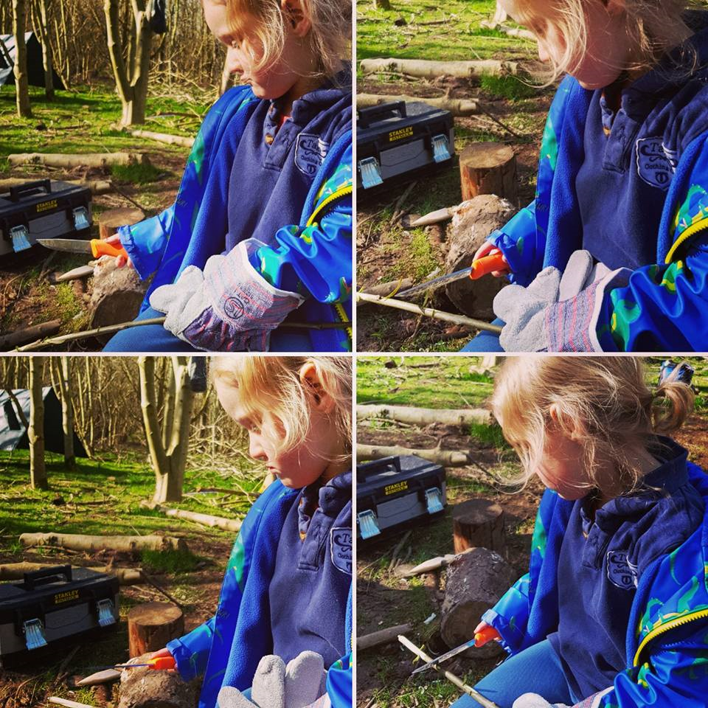
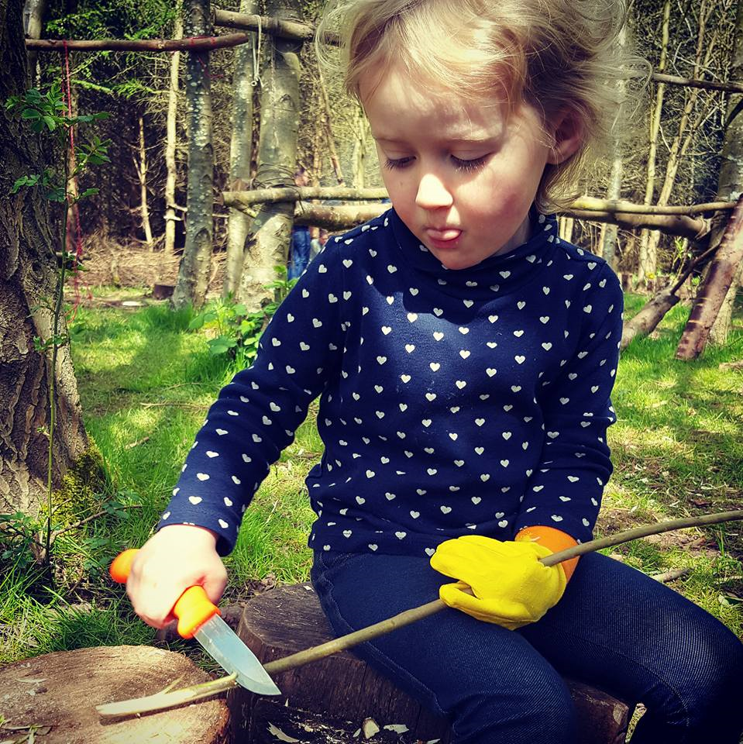

Slide 11



Slide 12

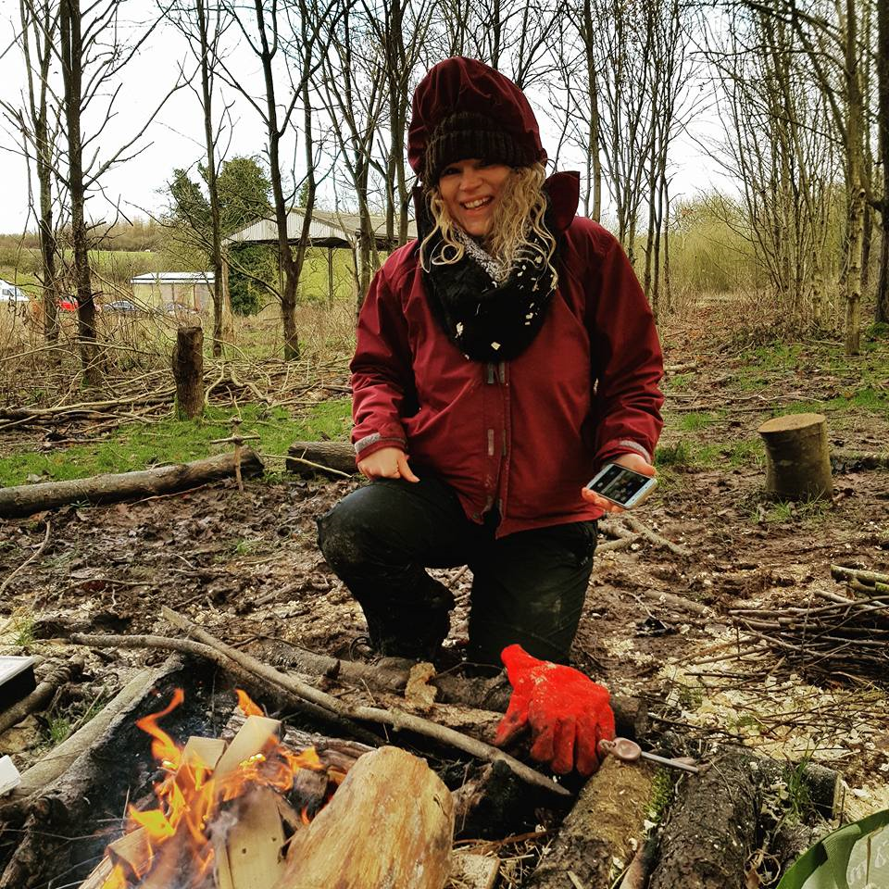

Slide 13
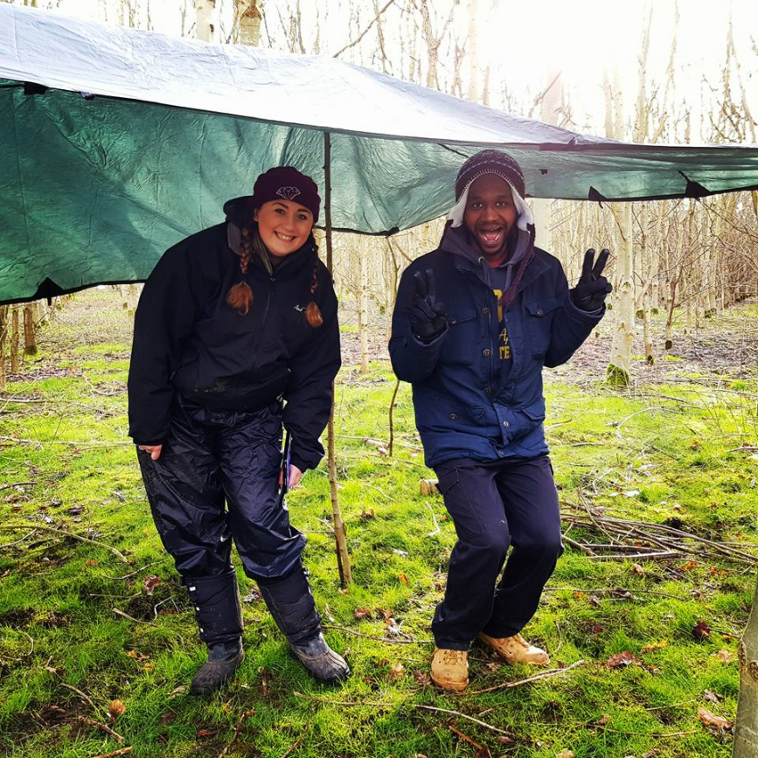
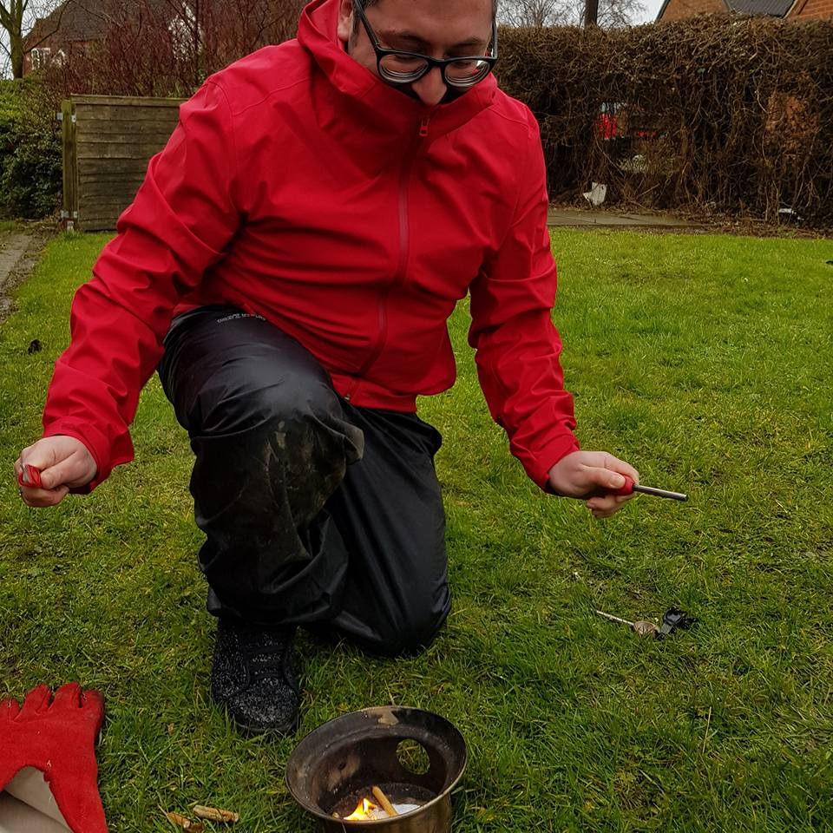

Slide 14
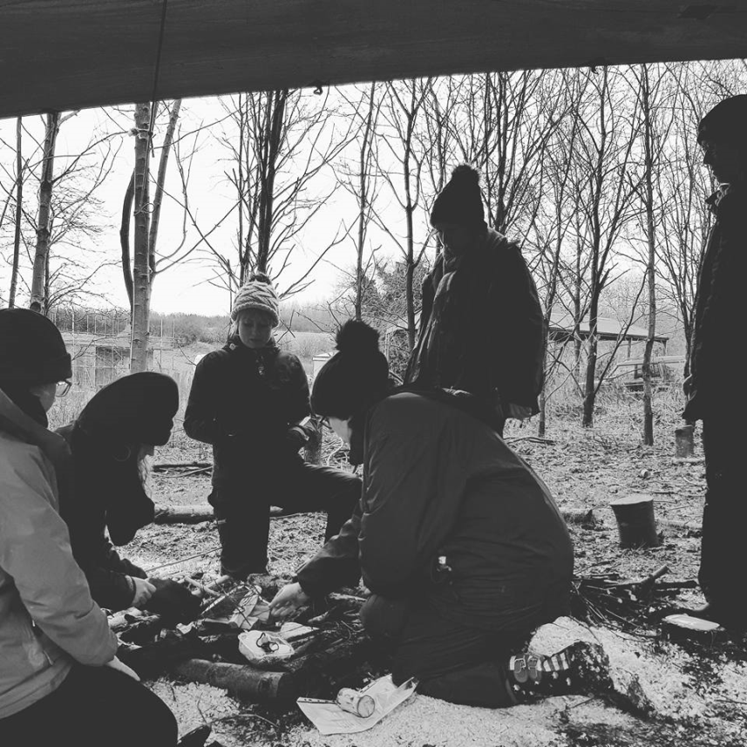
Any
questions?

