Slide 1

RUTLAND WATER
EDUCATION TEAM
DALE MARTIN AND LUKE RUSSELL

Slide 2
Set in 4200 acres of open countryside Rutland Water Park offers many options for great Education experiences
Delivers a range of education and activity sessions utilising the whole of the reservoir.
Covers a wide variety of topics from nature conservation to tourism.
All days can be tailored to suit your learning objectives

Slide 3
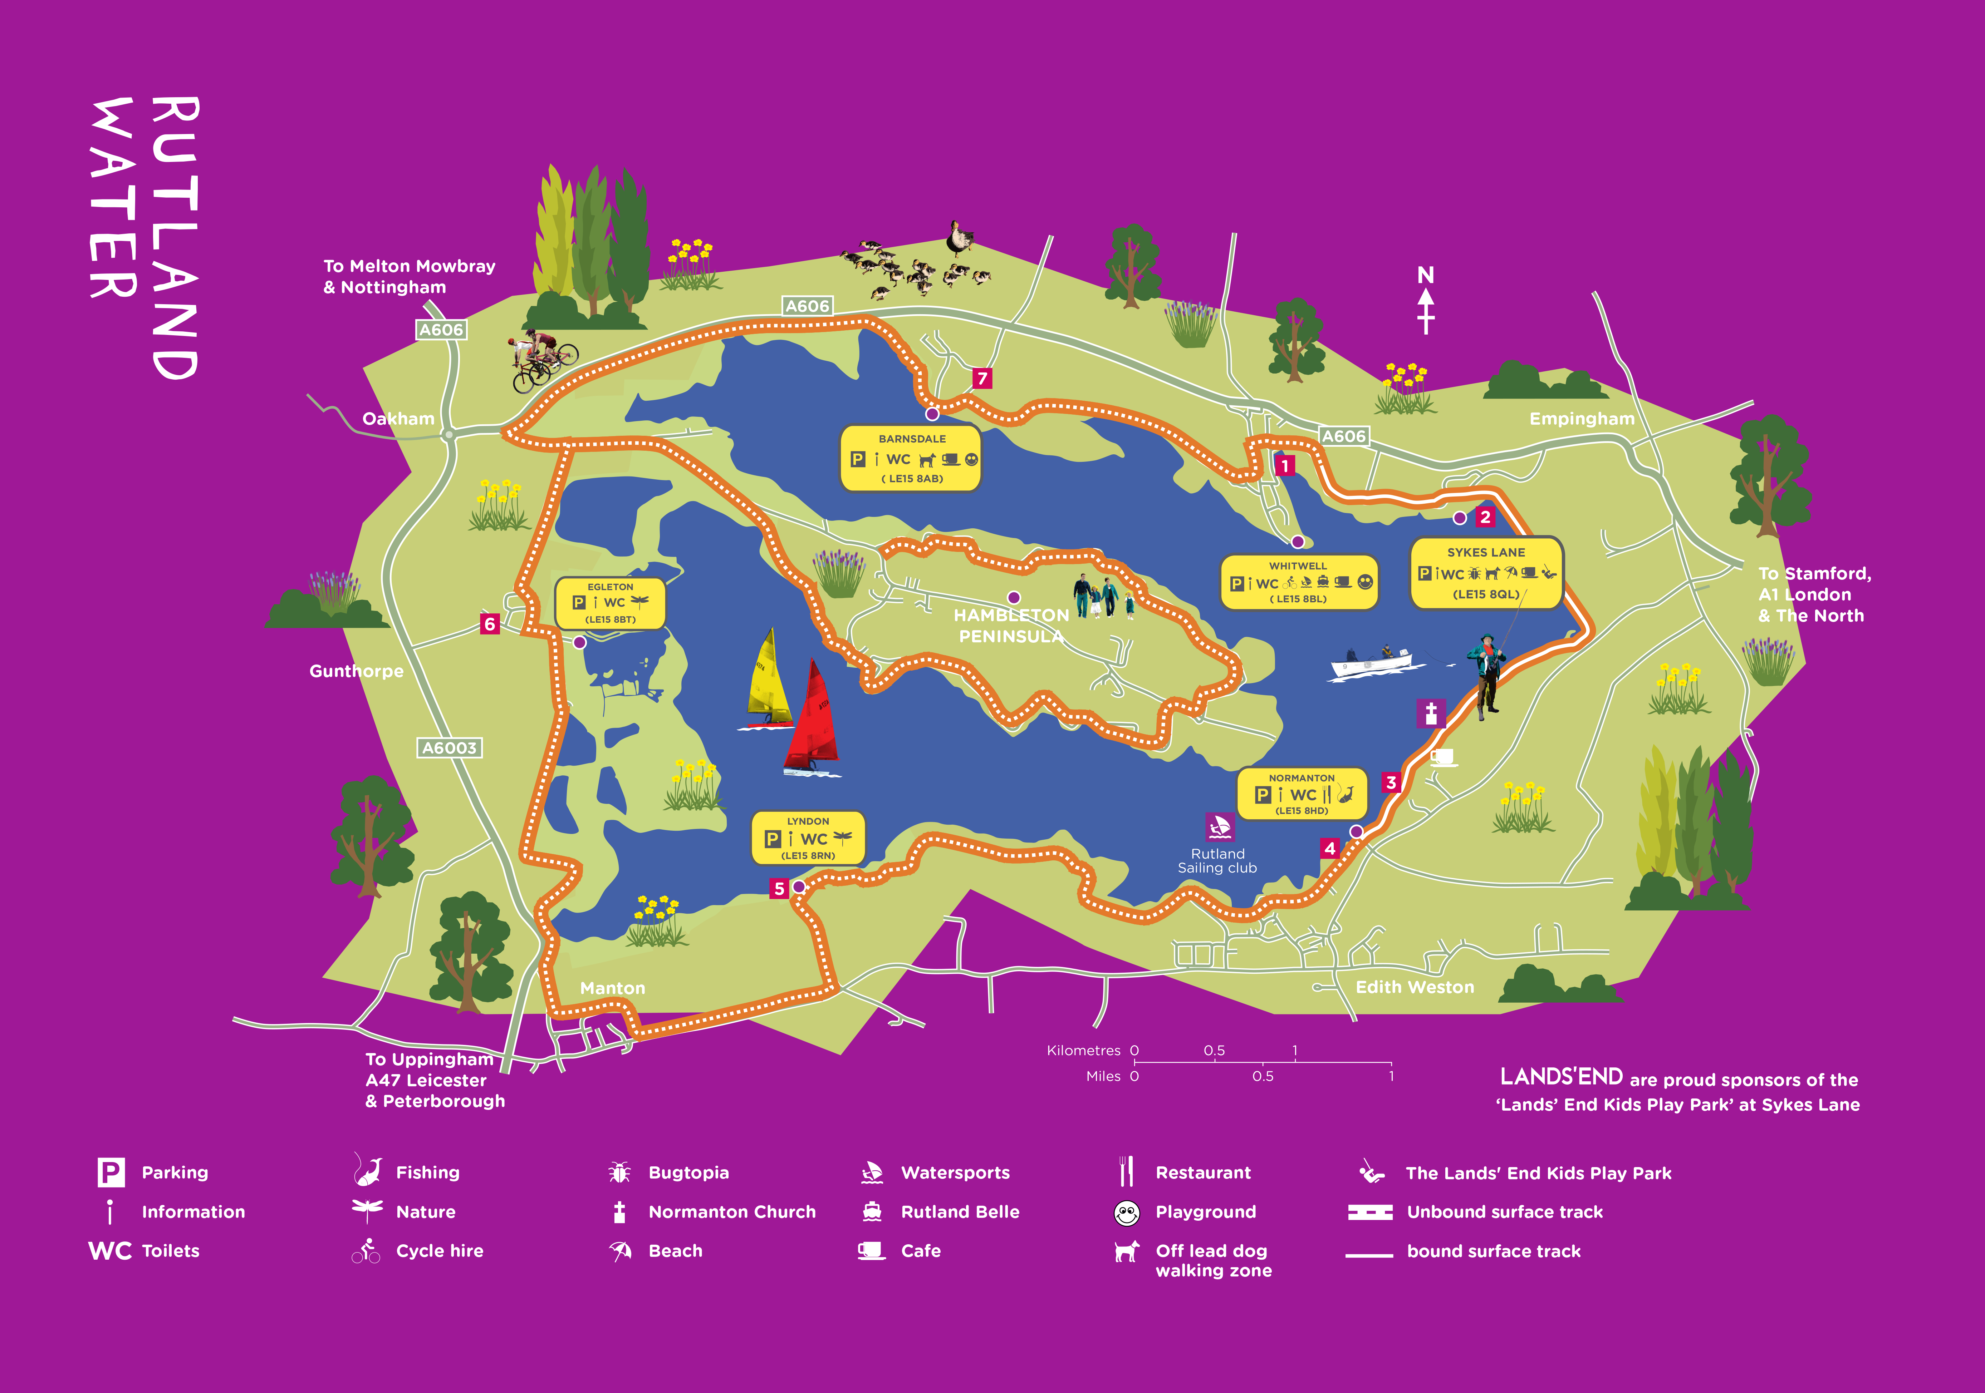

Slide 4
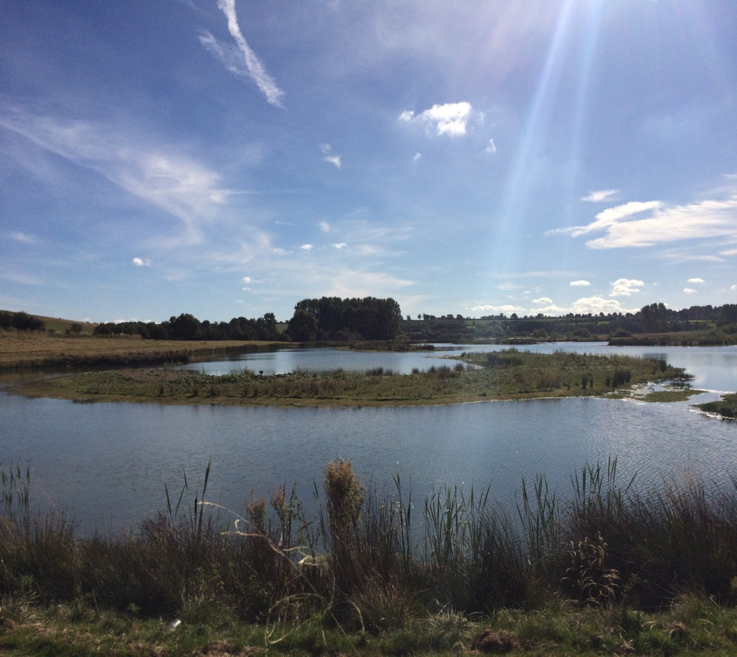
Rutland Water Nature Reserve
Rutland Environmental Education Centre is based on the Western shore. At the internationally renowned wetland nature reserve.
Offers environmental education to people of all ages.
Indoor classroom and education areas within the centre.

Slide 5
What Sessions Do We Run?
Education Days
Activity Days
Water Days
Reservoir Days
Habitat Days
Seasons Days
Beach Golf and Games
Bushcraft
Practical Nature Conservation

Slide 6
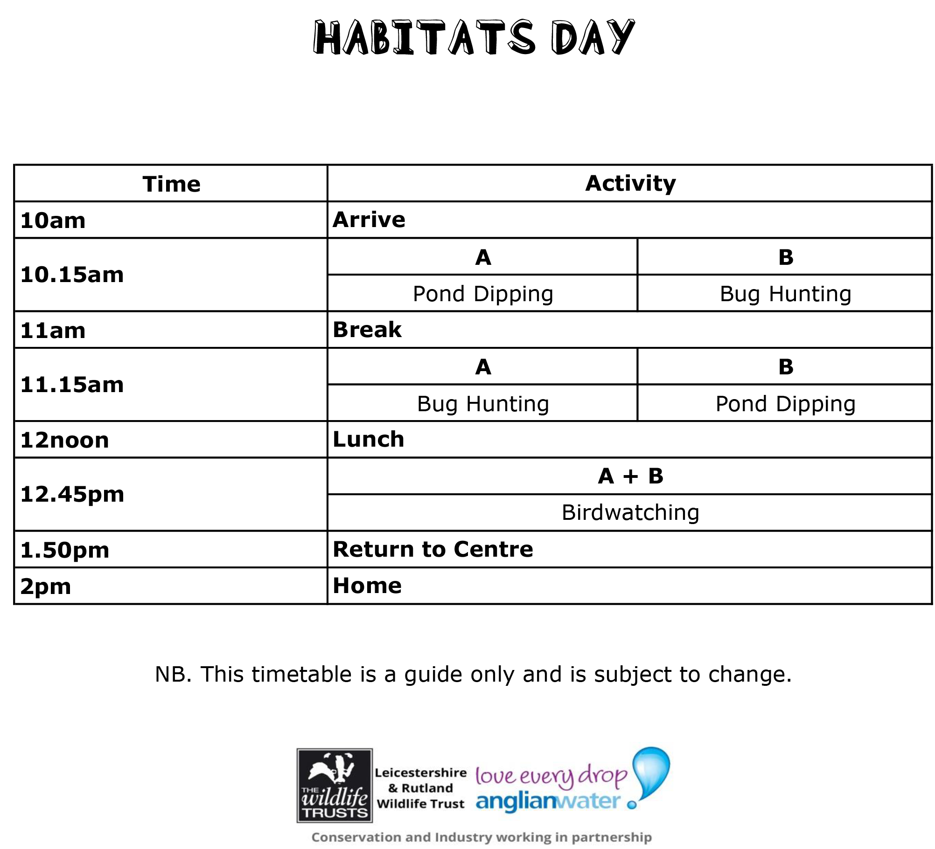

Slide 7
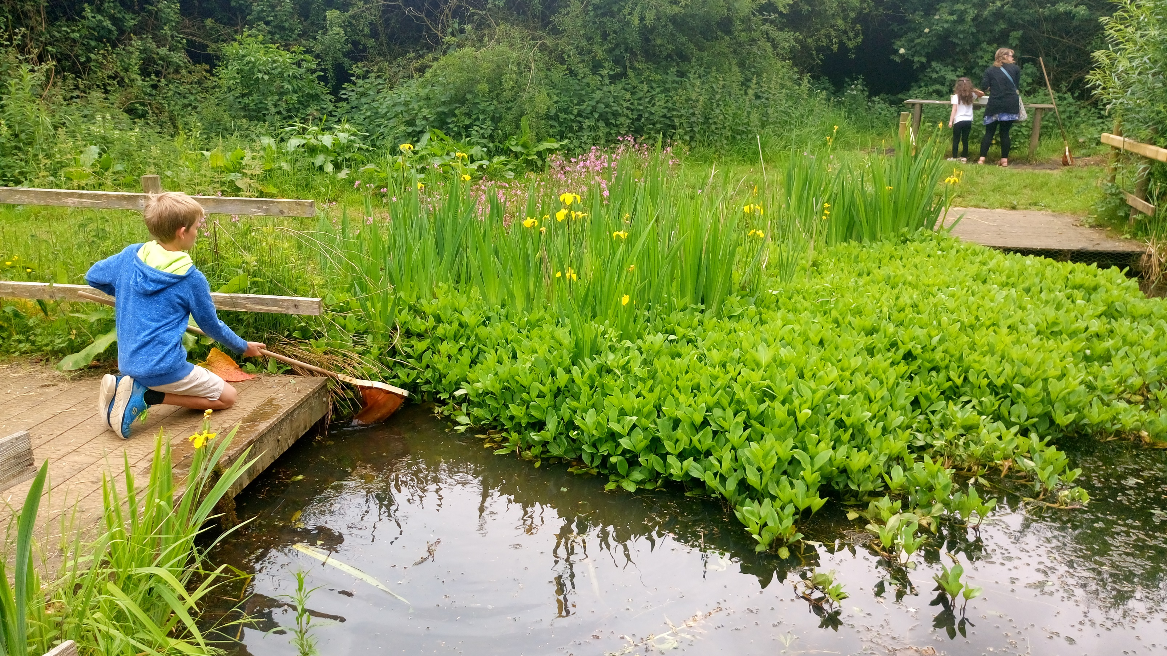

Slide 8
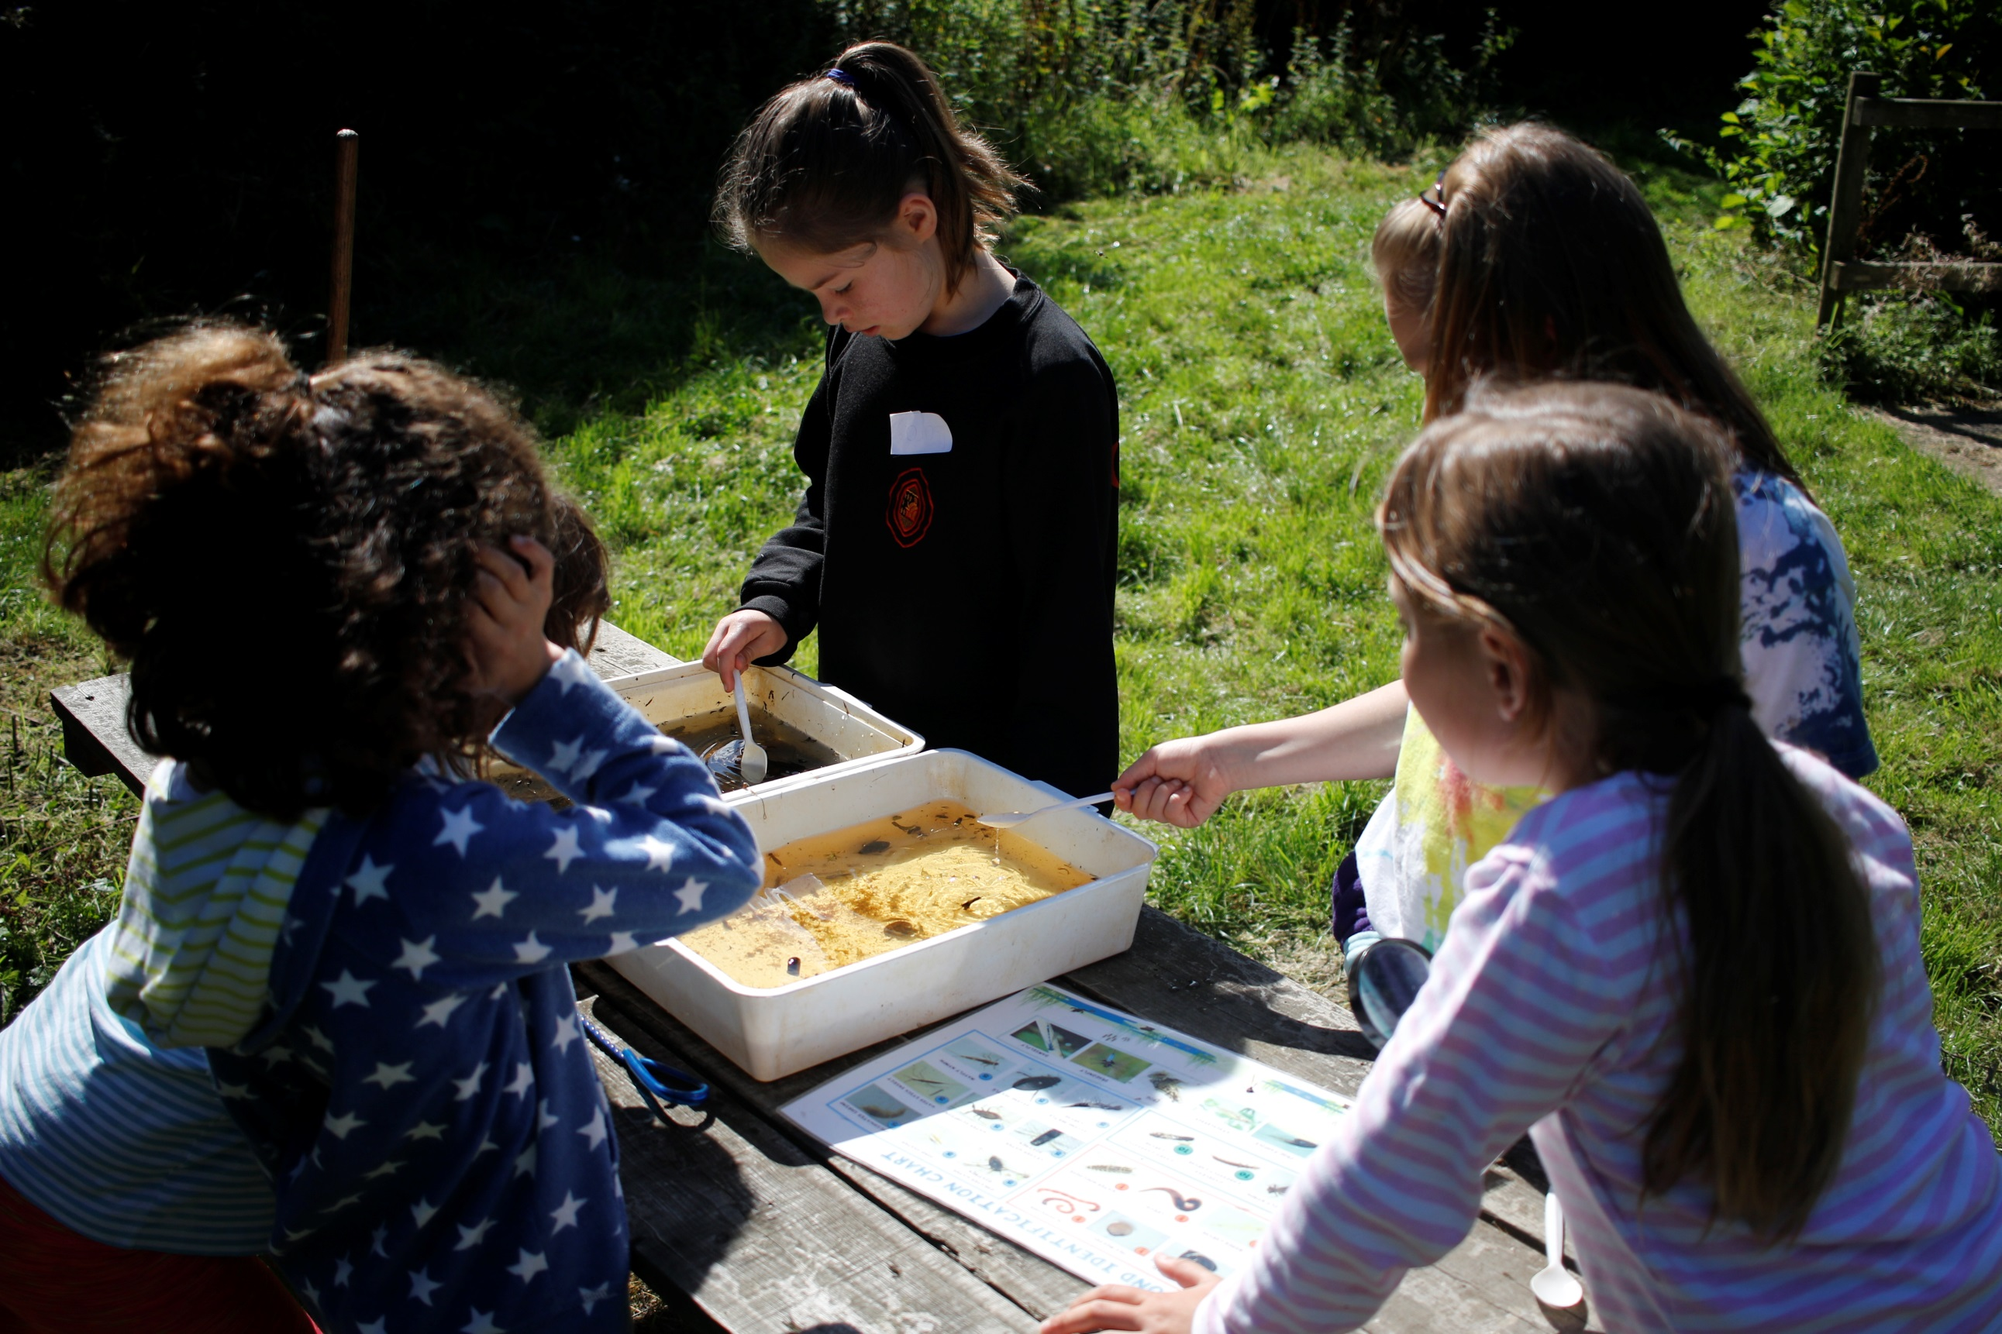
Education day picture

Slide 9
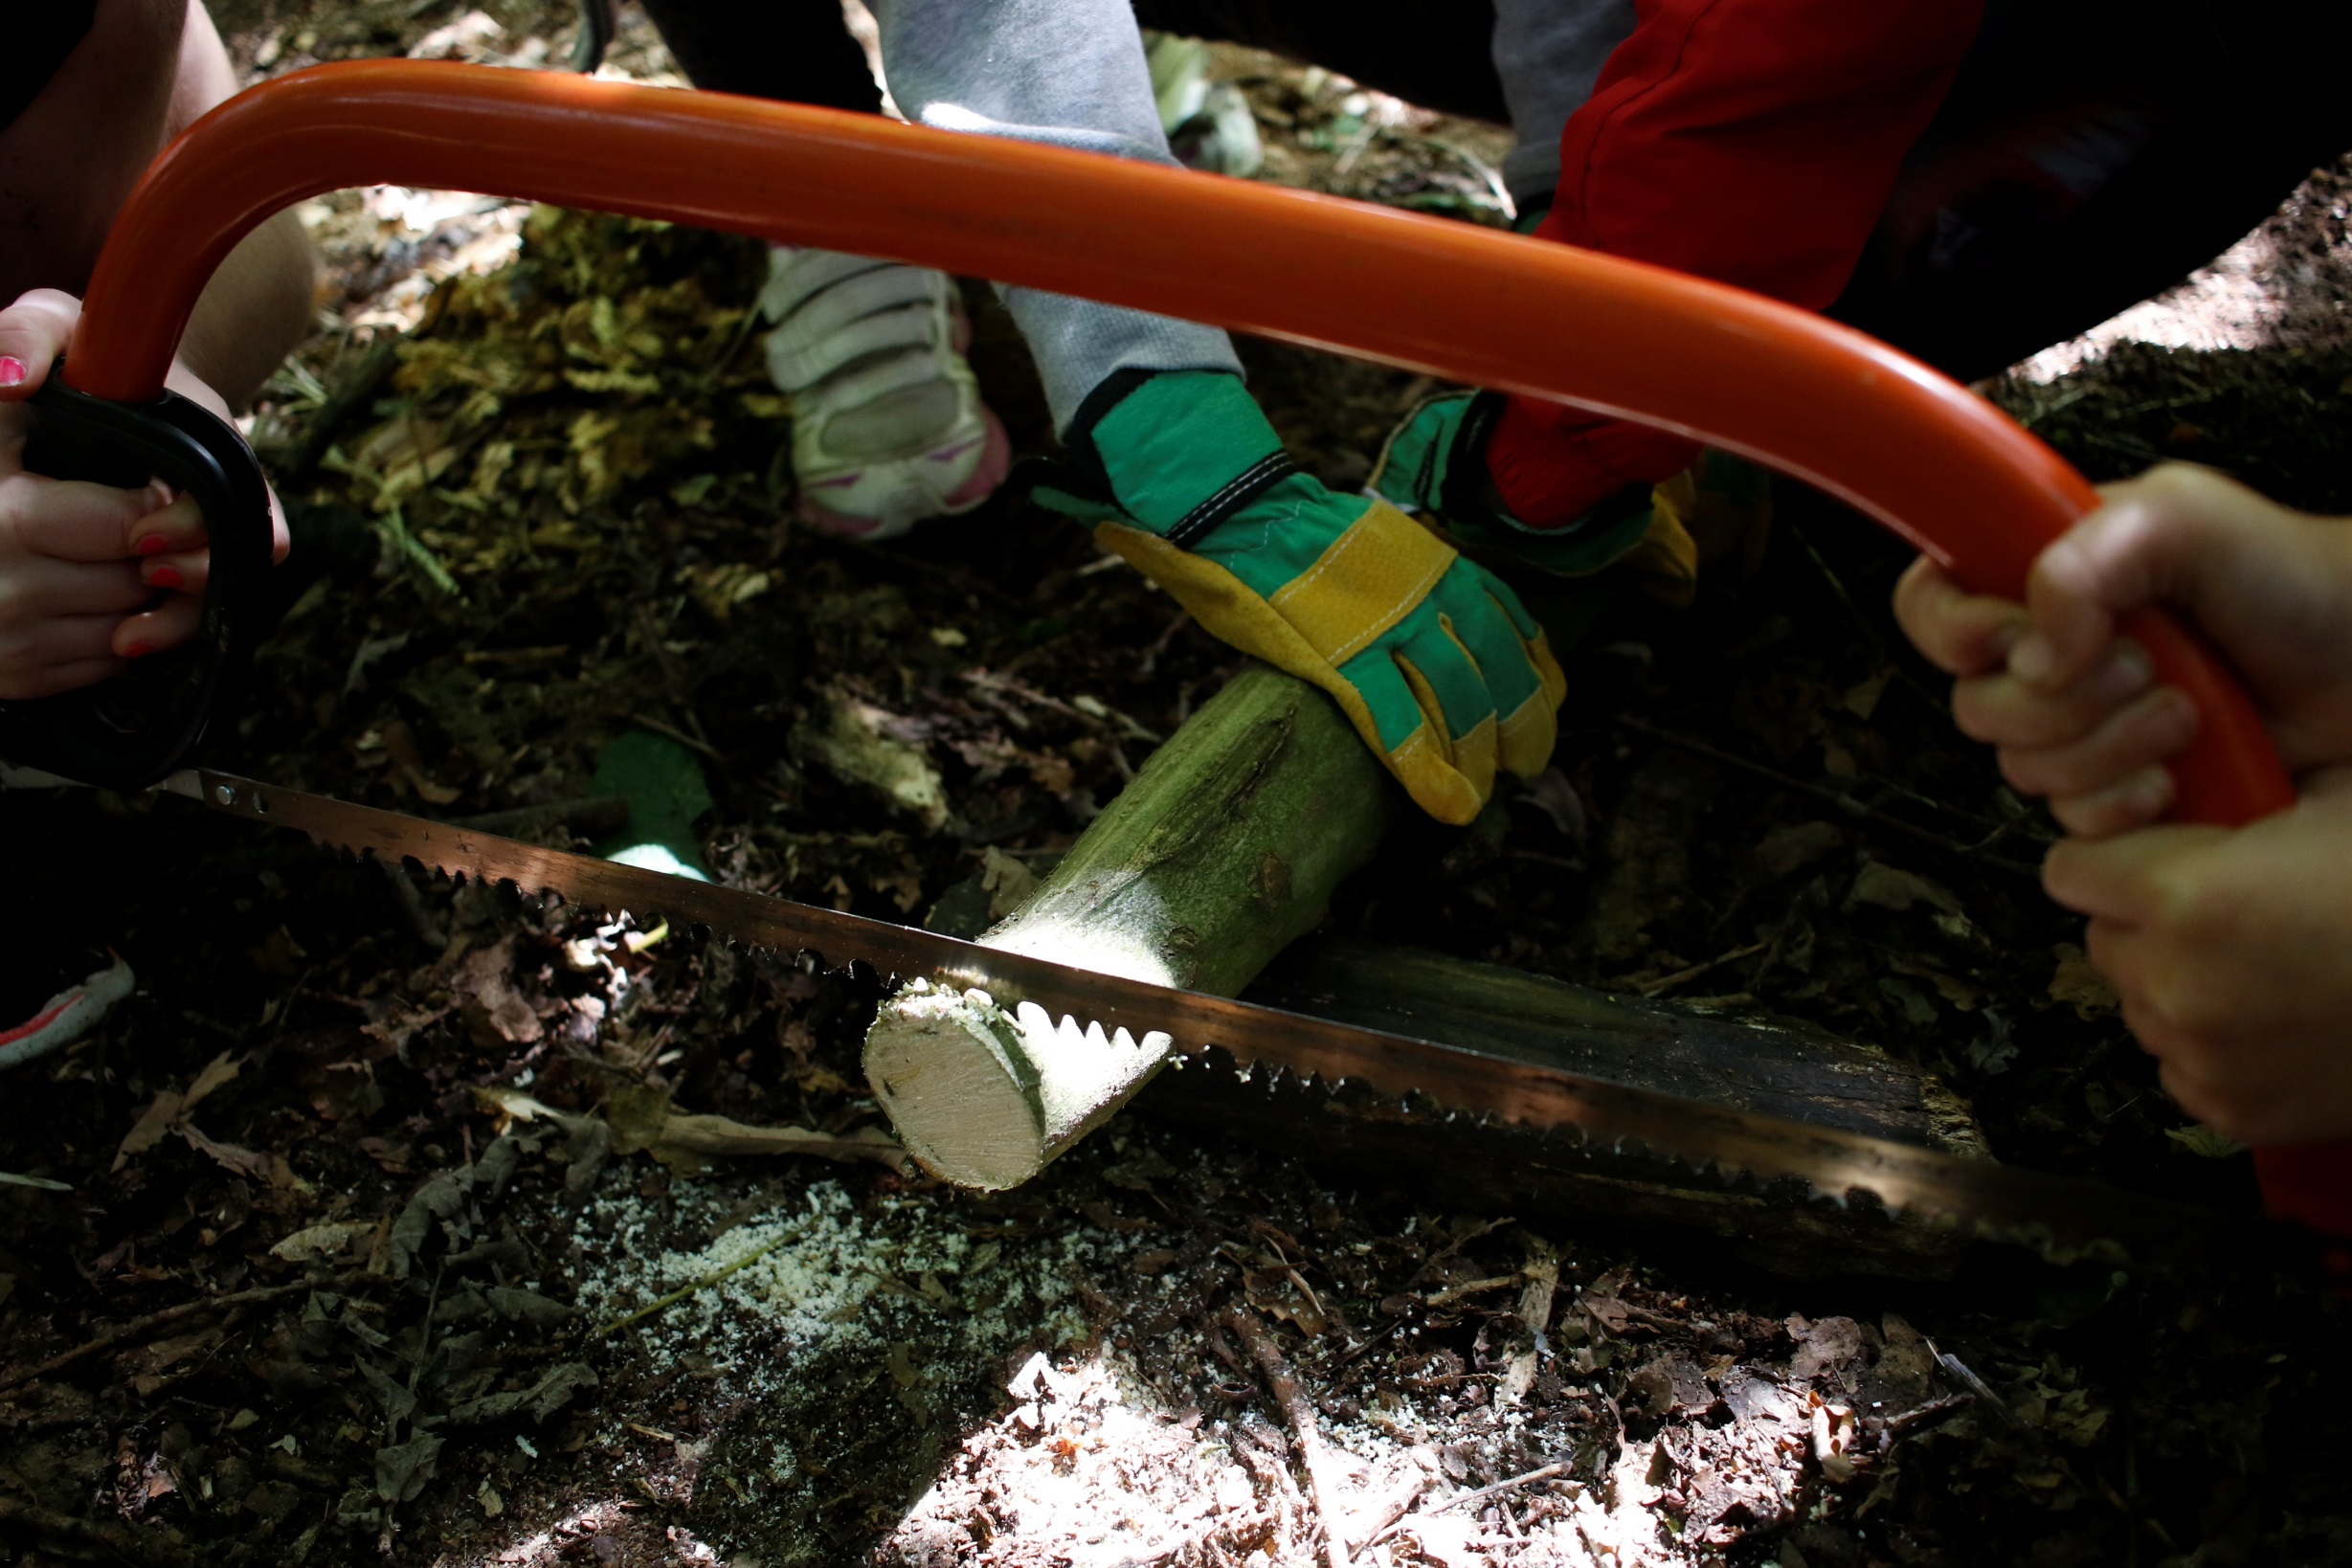
Activity day picture

Slide 10
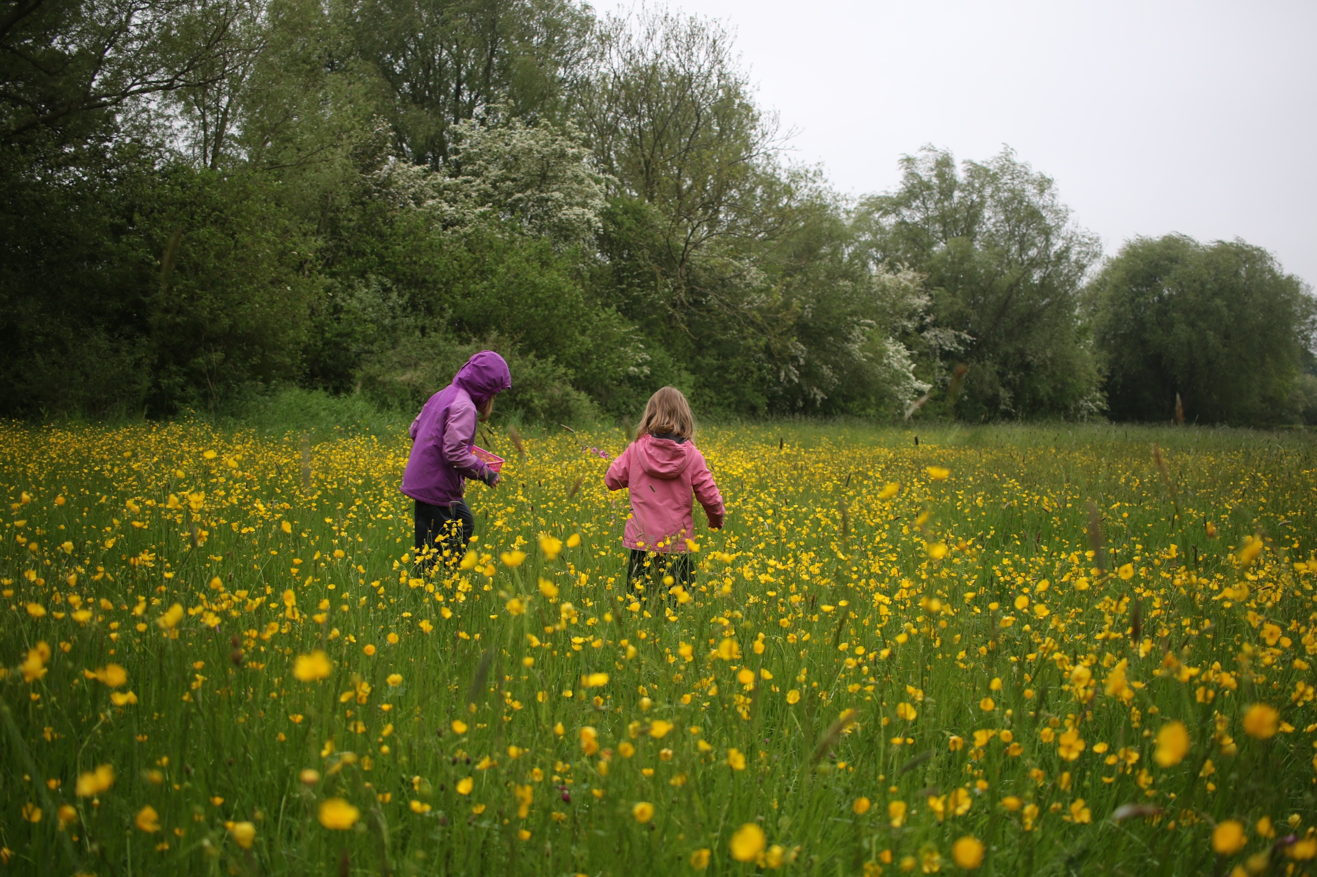
Activity day picture

Slide 11
Kids Events
Birthday Parties
Drop in Days
Explorer Days
Seasons Days
Rutland Water Park Work Experience
Rutland Water Nature Reserve Work Experience
Rutland Osprey Project

Slide 12
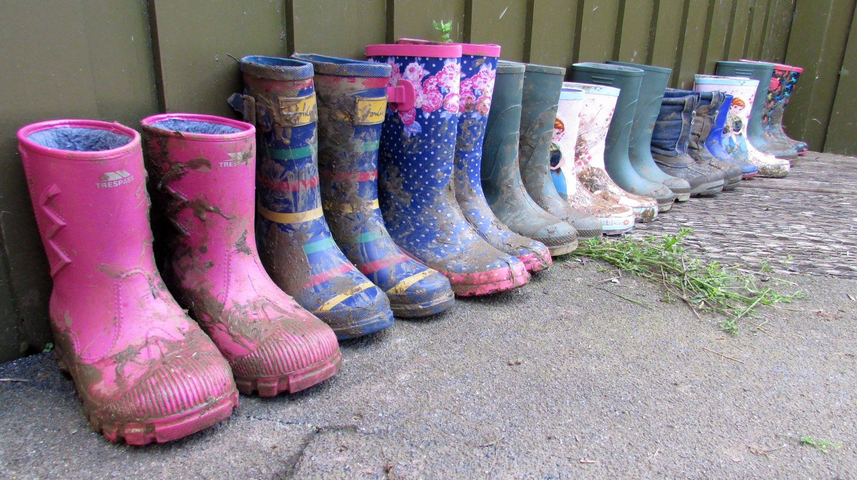
Birthday Party Picture

Slide 13
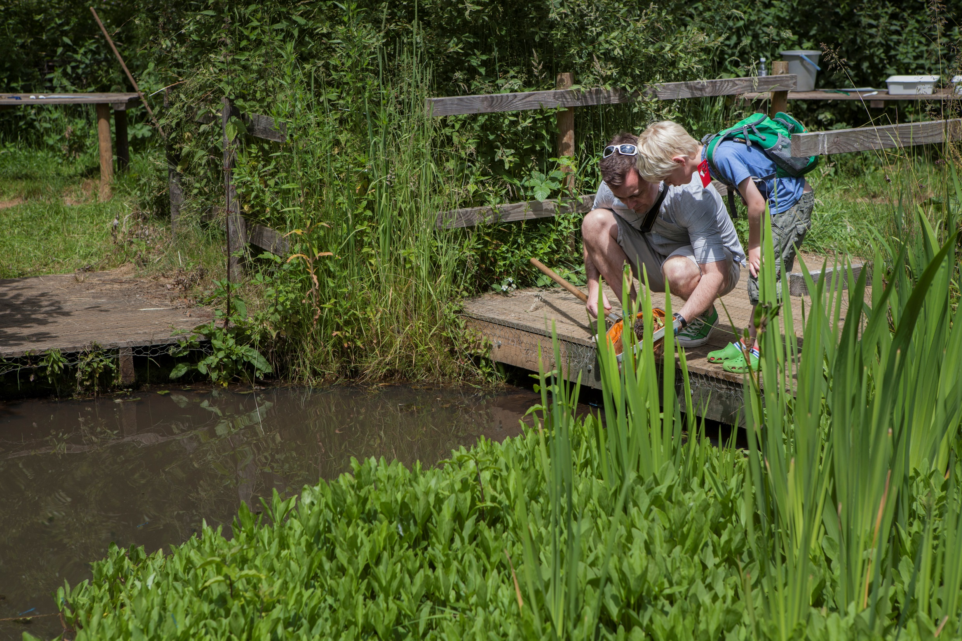
Drop in Day pictures

Slide 14
Health and Safety
Health and safety is at the forefront of what we do.
All education sessions are fully risk assessed and regularly reviewed to ensure they maintain excellent standards in safety and content.
Risk assessments and safety measures are sent out prior to any visit.
Visit the site prior to the event to assess and speak to staff.

Slide 15
More Information
For further information on the Rutland Water Park: www.anglianwaterparks.co.uk/rutland-water
For further information on the nature reserve: www.rutlandwater.org.uk
Dale Martin
education@rutlandwater.org.uk
Luke Russell
lukerussell@rutlandwater.org.uk

