Slide 1

New Front
Door Briefing
Early Help
Notes:
Welcome introduce EH coordinators
Explain why/what briefing is….

Slide 2
EARLY HELP ASSESSMENT PROCESS
EHA Principles
Consent
Assessment & Plan
Focus on outcomes
TAF Approach
Regular review
Management oversight
Pathway agreed via telephone call to one front door followed up by completion of online form with verbal consent. Self-referrers can make a request by phone only.
Early Help Assessment Pathway & Allocations Process
Due to volume, police contacts will still come in via the EH/ SC inbox
Early Help Response log contact, check systems for more info and action as per below .
Advice Point
(Signposting/ Advice/ Brief Intervention – 6 weeks)
NFA
Send directly to single agency
If there is an EHCP in place, send case summary to SENCO
EHR complete case summary and send to Hub for allocating EHA
Partnership Hub chaired by Service Manager meets fortnightly (Weds 9:30 – 12:30) to discuss requests and agree action
Agency adopts EHA principles
Agency leads on EHA & gains written consent
Send directly to agency
No further action
Step up to SC via DAS for a single assessment
LCC EHA Co-ordinator to record action on Liquid Logic
Any case stuck, high cost or escalating can go to MASP
Quarterly monitoring activity to record EHA activity undertaken by Early Help Co-ordinators and reported to Early Help Strategic Partnership Board quarterly. Monitoring of EHA practice to be undertaken by LSCB and MACFA process
Notes:
Whole process on how we do it in the City Council.
Explain the map as we go along
Set the scene – Family who need support….

Slide 3
Practitioners to have the telephone call with our Early Help Team
Know your thresholds
Ensure you have family details ready. Name/DOB/Address etc.
Know the needs of the family
Early Help & Social Care
One Front Door
Number
0116 454 1004
Notes:
City council now have 1 front door
Tel phone call – know your thresholds – 2 options
Have conversation - Know your family/needs

Slide 4
EARLY HELP ASSESSMENT PROCESS
EHA Principles
Consent
Assessment & Plan
Focus on outcomes
TAF Approach
Regular review
Management oversight
Pathway agreed via telephone call to one front door followed up by completion of online form with verbal consent. Self-referrers can make a request by phone only.
Early Help Assessment Pathway & Allocations Process
Due to volume, police contacts will still come in via the EH/ SC inbox
Early Help Response log contact, check systems for more info and action as per below .
Advice Point
(Signposting/ Advice/ Brief Intervention – 6 weeks)
NFA
Send directly to single agency
If there is an EHCP in place, send case summary to SENCO
EHR complete case summary and send to Hub for allocating EHA
Partnership Hub chaired by Service Manager meets fortnightly (Weds 9:30 – 12:30) to discuss requests and agree action
Agency adopts EHA principles
Agency leads on EHA & gains written consent
Send directly to agency
No further action
Step up to SC via DAS for a single assessment
LCC EHA Co-ordinator to record action on Liquid Logic
Any case stuck, high cost or escalating can go to MASP
Quarterly monitoring activity to record EHA activity undertaken by Early Help Co-ordinators and reported to Early Help Strategic Partnership Board quarterly. Monitoring of EHA practice to be undertaken by LSCB and MACFA process
Notes:
People who pick the call will log the conversation – advise you to fill out referral form if appropriate/ or signpost you in right direction.

Slide 5
For External Partners
Notes:
If you have to complete the referral form
If you are internal this is relevant as you can show external partners where the firm is/number/where to fond/look etc

Slide 6
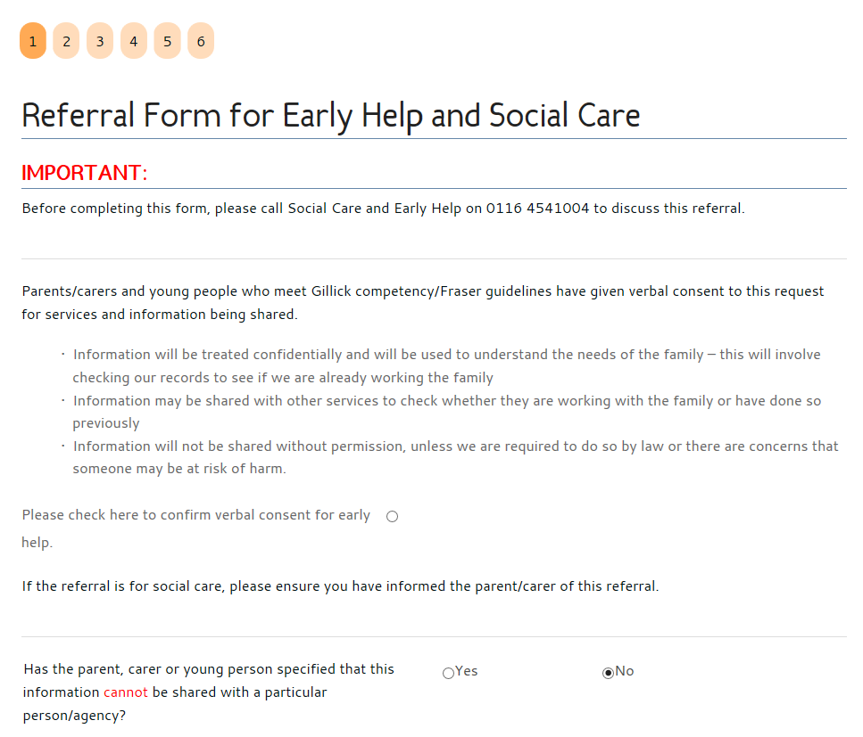
Referral Form
One form
Simplified
Verbal consent at this stage for Early Help
Online and secure
Accessible via the Leicester City Early Help web pages
Notes:
Talk through referral form –online one

Slide 7
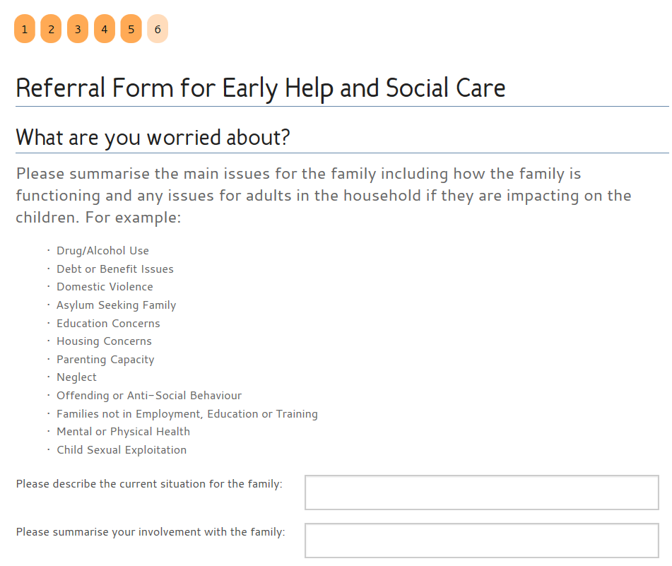
Issues list is a
guideline
Open free
text boxes
Record family
strengths

Slide 8
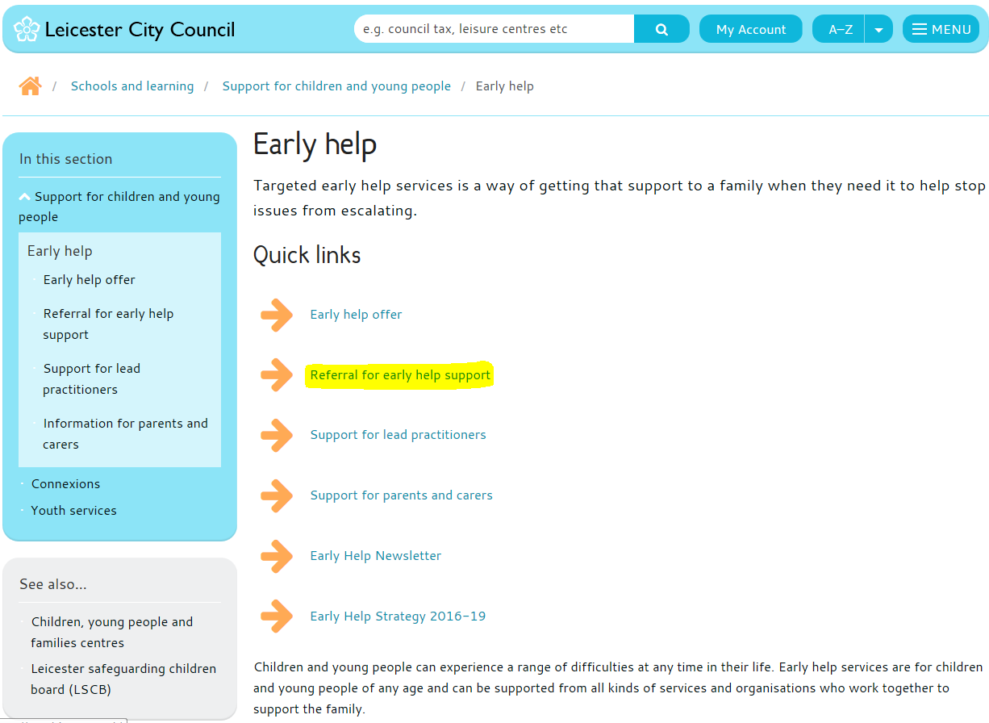
Leicester City Council Early Help web page
Info and links to other useful sites
Referral in the attachment section at the bottom of web page

Slide 9
For Internal LCC Staff
Notes:
Talk through the LL version - Our own case management system

Slide 10
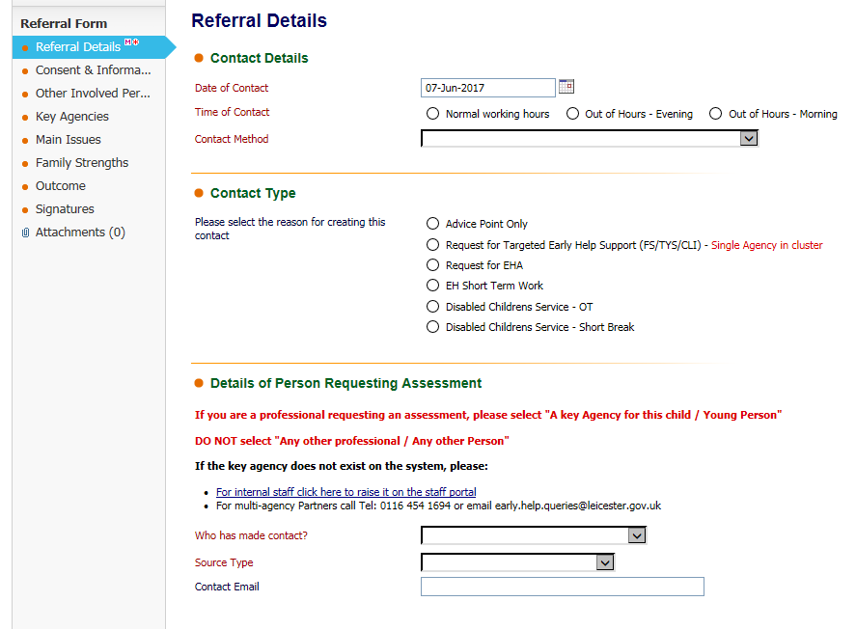
Replicates the online version form with the standard LL information gathered.
Note the banners on the left indicate what you will be looking at on the right of the screen
Notes:
Externals can get read only access to view on family records.

Slide 11
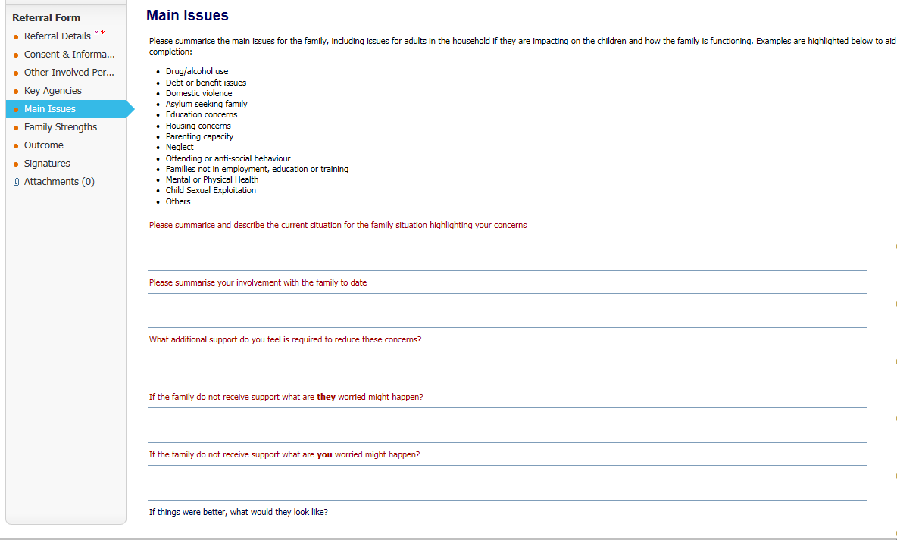
Notes:
Not we have now clicked on to main issues on the banner on the left which shows the screen to the right.
This is exactly the same as the information requested on the online form

Slide 12
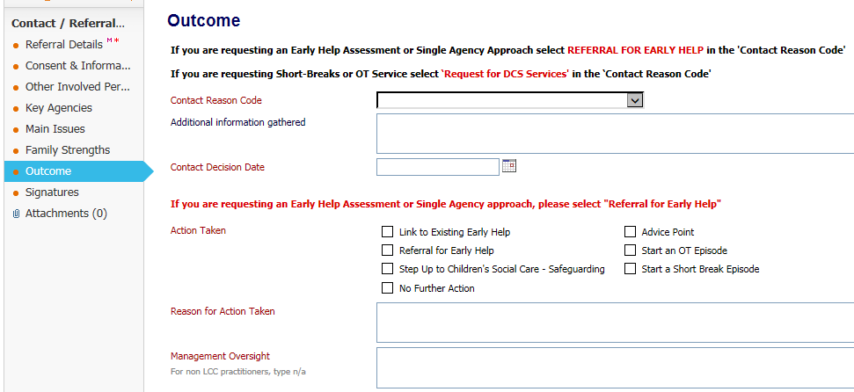
For internals - note the terminology has changed from Request for Assessment to Referral for Early Help.

Slide 13
EARLY HELP ASSESSMENT PROCESS
EHA Principles
Consent
Assessment & Plan
Focus on outcomes
TAF Approach
Regular review
Management oversight
Pathway agreed via telephone call to one front door followed up by completion of online form with verbal consent. Self-referrers can make a request by phone only.
Early Help Assessment Pathway & Allocations Process
Due to volume, police contacts will still come in via the EH/ SC inbox
Early Help Response log contact, check systems for more info and action as per below .
Advice Point
(Signposting/ Advice/ Brief Intervention – 6 weeks)
NFA
Send directly to single agency
If there is an EHCP in place, send case summary to SENCO
EHR complete case summary and send to Hub for allocating EHA
Partnership Hub chaired by Service Manager meets fortnightly (Weds 9:30 – 12:30) to discuss requests and agree action
Agency adopts EHA principles
Agency leads on EHA & gains written consent
Send directly to agency
No further action
Step up to SC via DAS for a single assessment
LCC EHA Co-ordinator to record action on Liquid Logic
Any case stuck, high cost or escalating can go to MASP
Quarterly monitoring activity to record EHA activity undertaken by Early Help Co-ordinators and reported to Early Help Strategic Partnership Board quarterly. Monitoring of EHA practice to be undertaken by LSCB and MACFA process
Notes:
Options once form is filled out…..

Slide 14
Important Information
External Partners will have read only access to the Liquid Logic Early Help Module as of the 3rd July
Online referral form will go live on 19th June 2017 (Web and Liquid Logic version)
Training is currently available if you wish to access our system

Slide 15
Externals LINK TO TRAINING for LL: http://www.childrensworkforcematters.org.uk/liquidlogic-early-help-module-part-a
LINK TO ONLINE FORM – LIVE ON 19th JUNE: http://www.leicester.gov.uk/earlyhelp
https://forms.leicester.gov.uk/default.aspx/RenderForm/?ID=ZGErWEvPMGk&TestFillID=kk1D8qmgt2t
Notes:
Get a copy of presentation if you have wrote email on register we will send links out to you.

Slide 16
ANY QUESTIONS?

