Slide 1
#EcoTeachMeet – October
4.00-4.15 Refreshments/networking opportunity
4.15-5.15 #EcoTeachMeet ideas
- Ashden, Polli:Nation, #PostcardtoParis updates
- Junk4Funk
- Wonderbag
- Pod Switch off month
- Future We Want resource
- Upcoming events
5.15-5.30 Mini tour of Mellor Primary School

Slide 2

#EcoTeachMeet October
Mellor Primary School
Lee Jowett
Environmental Education Coordinator
Leicester City Council

Slide 3

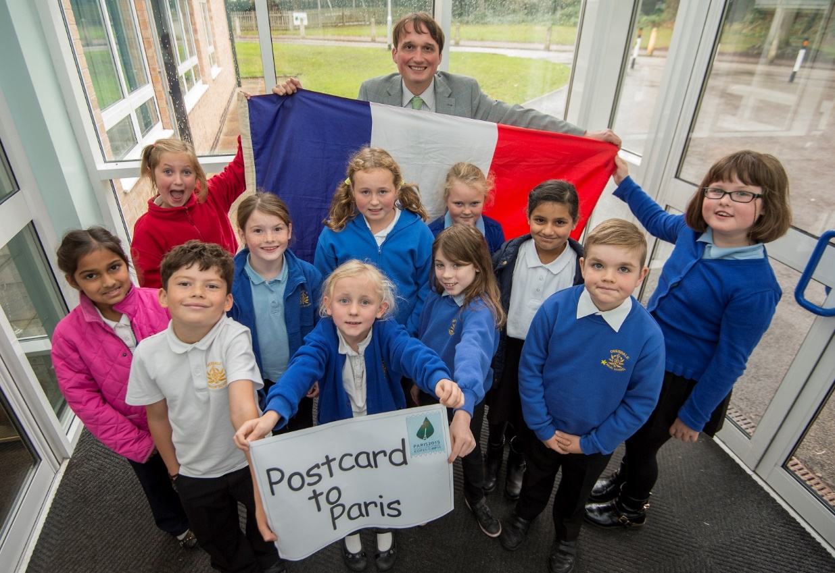

#PostcardToParis

Slide 4

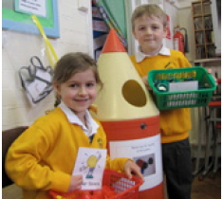
Ashden CO2 LESS programme
Secondary cluster meeting - 3 November 2015 at Ellesmere College 12.30-5pm
Primary cluster meeting - 4 November 2015 venue TBC 12.30-5pm
  2 spaces available on each cluster

Slide 5

Pod Switch off Month
November 2015 is Energy Month

Slide 6

Polli:Nation Project
Cluster approach of 4 schools
  Crown Hills Cluster (full)
  Sandfield Close Cluster (full)
  Westcoates cluster (full)
  Abbey Cluster (2 schools)
  Eyres Monsell Cluster (2 schools)
  Fosse/Inglehurst Juniors (2 schools)

Slide 7
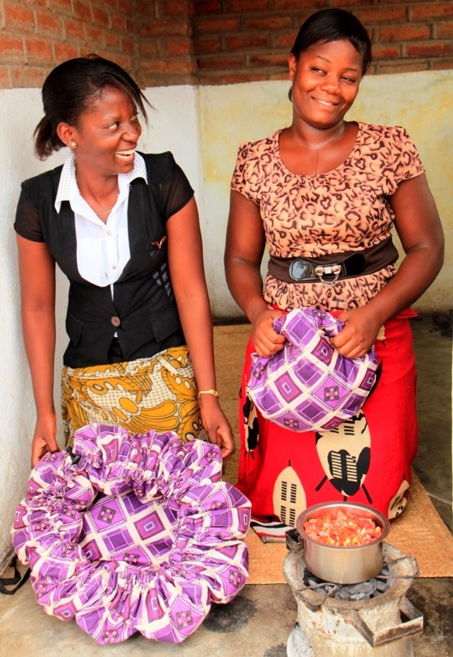
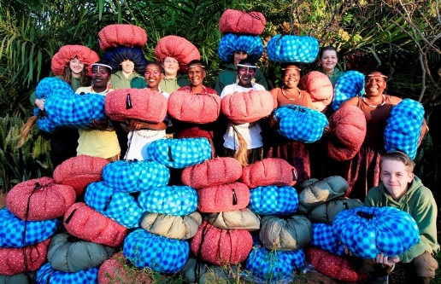
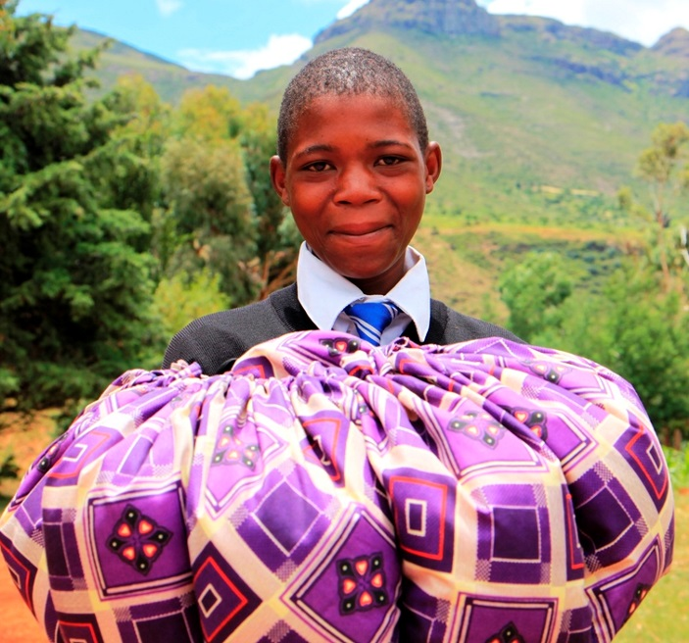
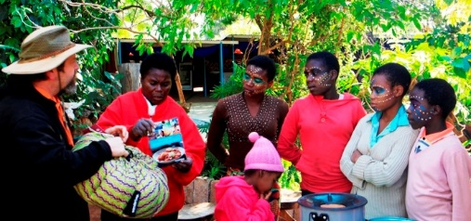

Wonderbag

Slide 8
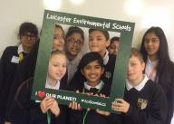
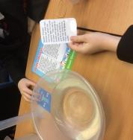
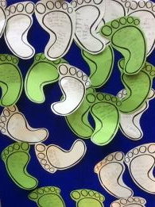

Dates for our diaries
Secondary Eco-Schools Conference 2 December 2015
Primary Eco-Schools Conference 10 December 2015
Sustainable Schools Conference 2 March 2016
Eco-Schools Sponsored Run 19 March 2016
Eco-Schools Celebration Event – TBC June 2016

