Slide 1
Energy and Water Reduction
English Martyrs’ Catholic School
Lee Jowett
Environmental Education Coordinator
Leicester City Council

Slide 2
Energy and Water Reduction
4.00-4.15 Eco-Martyrs / English Martyrs’ School
4.15-4.30 General energy saving ideas
4.30-5.00 DynamatLite access demo and play
5.00-5.30 Mini tour (if appropriate)

Slide 3

Practical Fast Track
Whole School Savings
Active labelling of lights and plug sockets
  Light switches shut off
  ICT equipment shut off
Out of hours surveys
Permanently sealing windows (old builds)

Slide 4
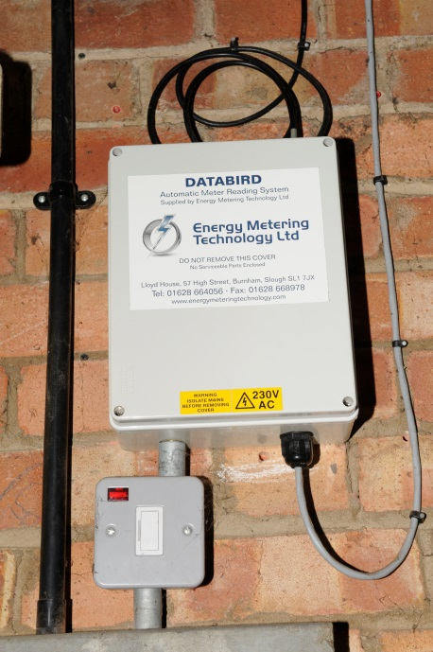
What is DynamatLite?
Monitoring software to influence behaviour change with your building
Connected to Databird hardware in school
Up to date (daily download) energy (electricity and gas) and water consumption

Slide 5
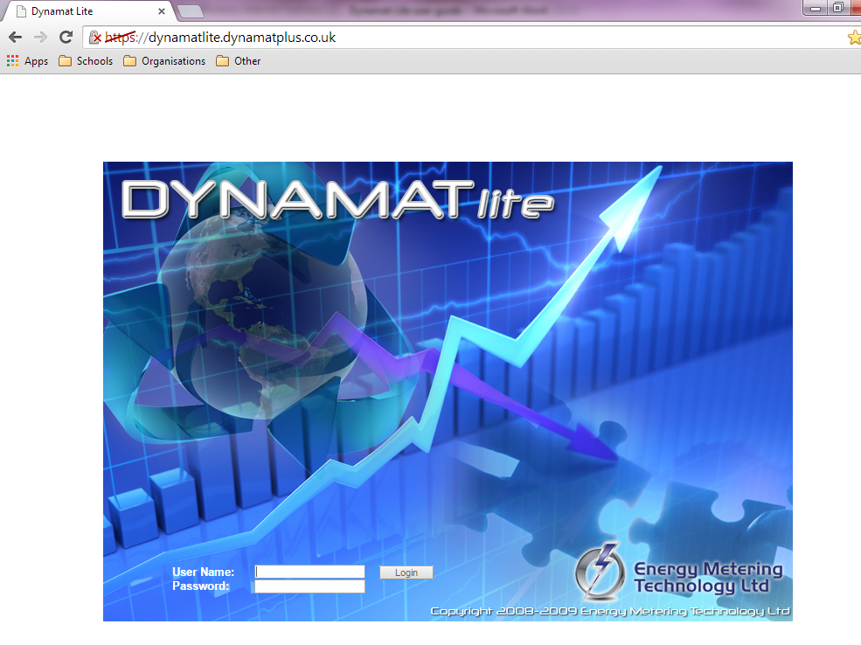

Slide 6

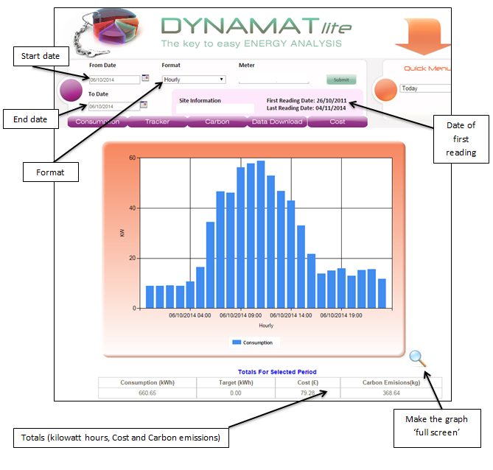

Slide 7
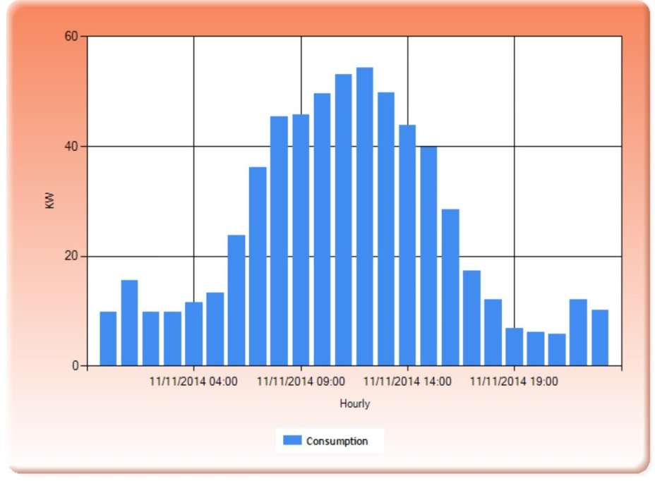
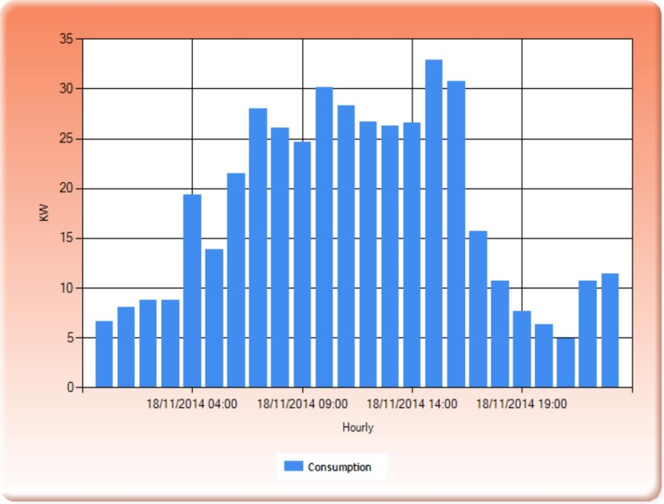
Comparing data
Tuesday 11th November
Tuesday 18th November

Slide 8
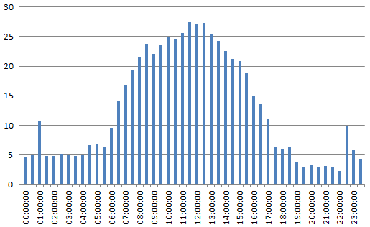
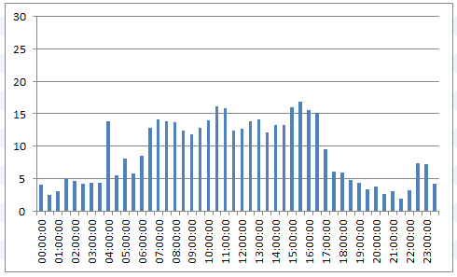
Comparing data
Tuesday 11th November
Tuesday 18th November

Slide 9

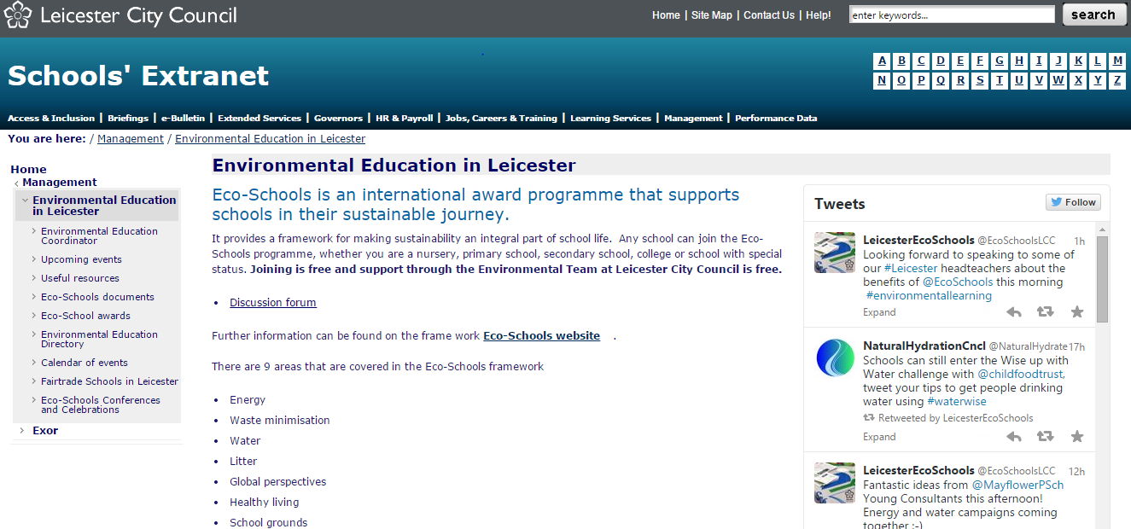
Lee.Jowett@Leicester.gov.uk
0116 454 2271
@EcoschoolsLCC
Web: schools.leicester.gov.uk/eco-schools

