Slide 1



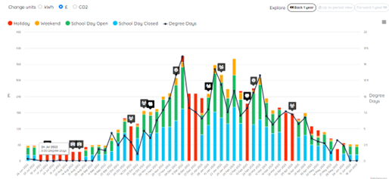


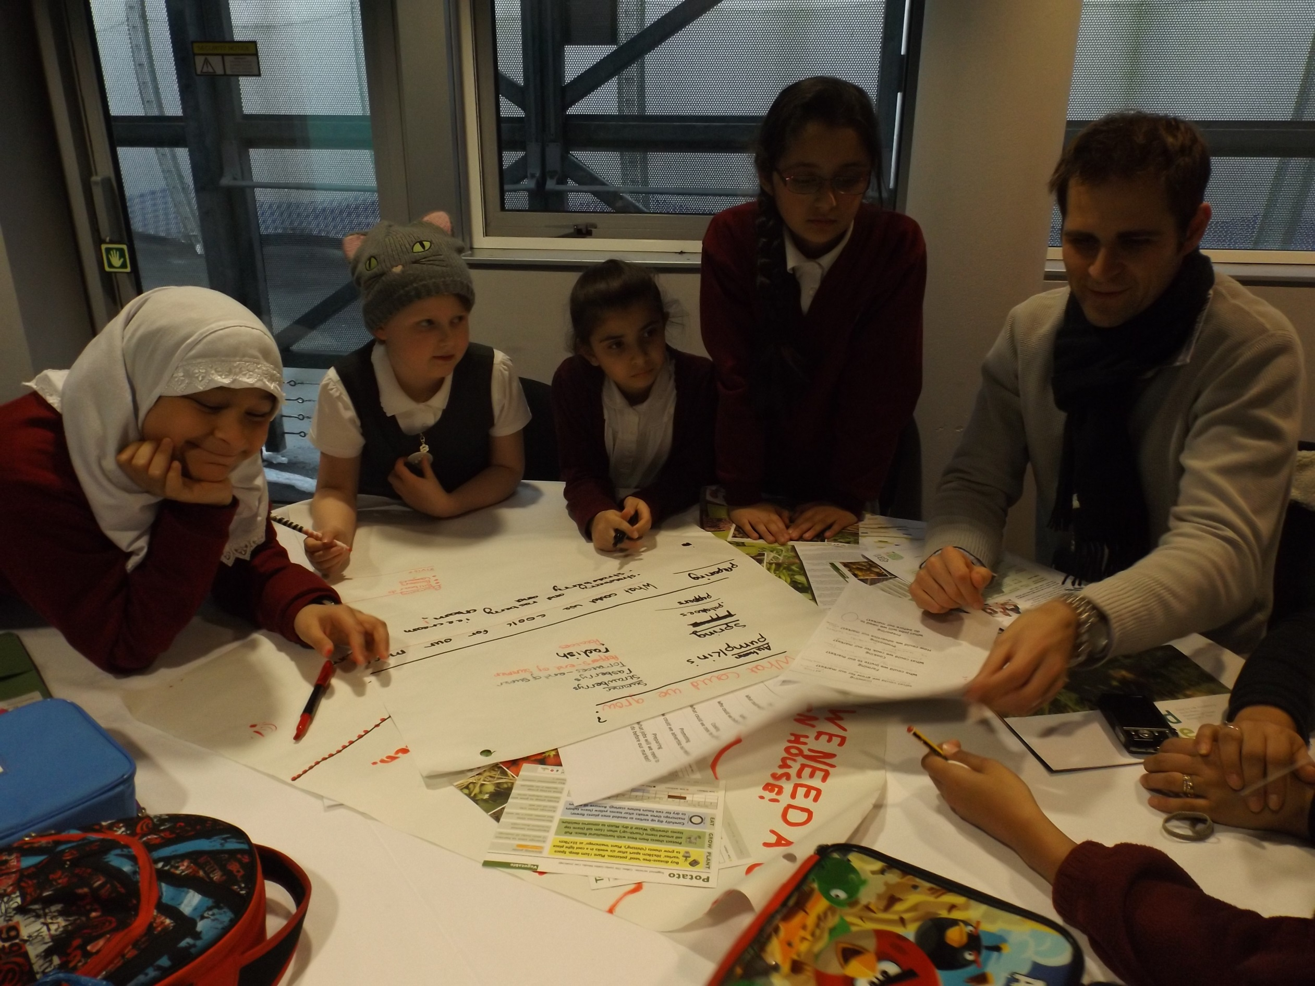
BESS Energy Enhanced 2026-2027
12 Month Subscription
Worried about increasing energy costs? Wanting to save money and improve your environmental credentials?
Energy makes up one of the biggest spends for schools after staffing. Leicester City Council has worked closely to develop an offer as part of BESS schools to develop tools and reports to empower staff and students to take control of their energy use.
This offer is open to all schools in Leicester City at cost price as part of our Climate Emergency Declaration commitment
What is included in the service?
All the benefits of BESS Energy Core:
Online monitoring of gas and electricity via Energy Sparks.
Wrap around support by the Sustainable Schools’ team for onboarding, general advice, educational and energy specific support
Provision of data for school’s preferred DEC provider
About Energy Sparks
An online energy analysis tool and energy education programme specifically designed to help schools reduce their electricity and gas usage through the analysis of smart meter data.
Using a school’s electricity, gas and solar data, shows staff (and pupils) how much energy the school is using. The online tool presents bespoke analysis of the energy data with suggestions of actions the school could take to save energy and reduce carbon emissions.
Provides adult and pupil dashboards tailored to meet the specific needs of the students and staff at a school.
Automated alerts to let schools know when energy use changes
Plus BESS Energy Enhanced:
Identification and reporting of excessive use/wastage (including visits)
Provision of your annual DEC certificate (or subsidised 7 year DEC certificate)
Online or face to face training
10 hours of bespoke support per school (including technical, analysis and education support for staff and pupils) – see our separate flyer on next page
“Through monitoring our electricity we discovered our thermal heater timers had a fault, meaning that they were being left on at the weekend - once resolved, this saved hundreds of pounds over the school holidays” Business Manager, Leicester
For more information please contact:
Marc Tench
marc.tench@leicester.gov.uk
0116 454 6746
schools.leicester.gov.uk/BESS-Energy
Priced at £1195
This service will start in September 2026
Sign up to BESS Energy by 31 July 2026 by completing our online form

Slide 2


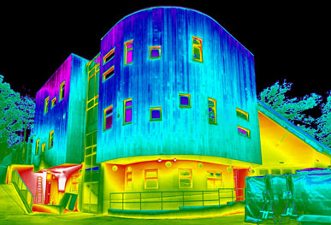
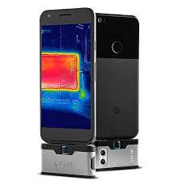
Individual support in BESS Energy Enhanced
Schools and academies that sign up for BESS Energy Enhanced will received
up to 10 hours of bespoke support. This time is allocated and agreed on an individual basis depending on the needs of your school.
Below are examples of bespoke services which can be provided:
Technical Support
Work with individual school or academy staff:
  Premises team walk round to identify heat/energy wastage
  ICT shutdown procedure and/or software shutdown
Analysis Support
Working with the business manager, finance officer and/or premises officer to:
  Evaluate utility bills for value for money, climate levy and VAT rating
  Provide advice about changing and comparing tariffs
  Provide advice and support around historical FIT tariffs
  Detailed analysis of Energy Sparks data and graphs (daily, weekly) to identify excessive use (e.g. during the day), wastage (e.g. high baseloads overnight and weekends) or leaks (e.g. water).
Educational Support
Working with whole school staff:
  Deliver twilight, inset or staff meetings (typically 30-45 minutes) on energy savings
  Energy Sparks training (data analysis with departments or teams)
  Develop mechanisms for reporting problems with classroom heating/lighting
Work with individual classes, your school council and/or Eco-Schools team:
  Active labelling of lights and equipment that can be switched off/remain on
  Active thermometers in classrooms and offices to report temperature extremes
  Assemblies on saving energy
  Designing of posters or ‘corporate’ posters displayed around schools
  Developing whole school policy and shutdown procedure
  Energy monitoring job descriptions
  Curriculum activities and quizzes
  Switch off hour/day campaign
  Detailed analysis of Energy Sparks graphs (daily, weekly, monthly, annually)
  Energy Sparks training
  Campaign and/or national awareness day activities
  Energy walk around using thermal imaging camera/s (iPad and Android tablet)
  Audits and competitions (class or department focused)

