Slide 1



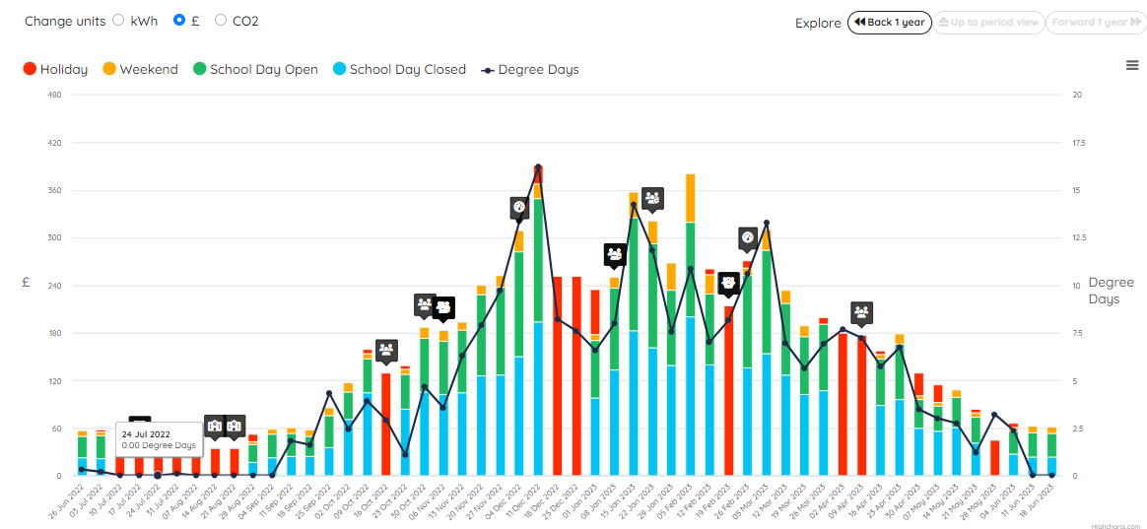
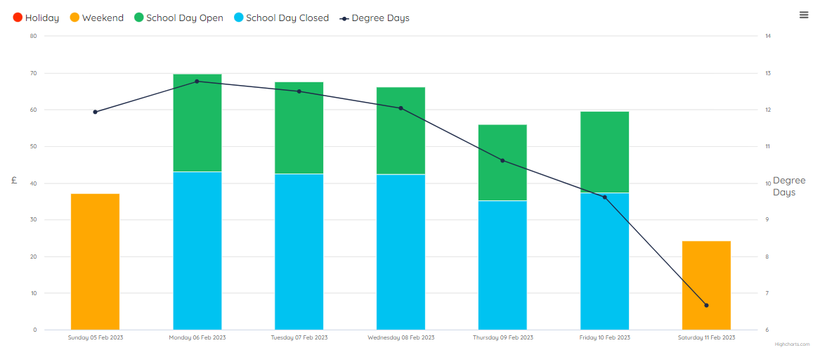
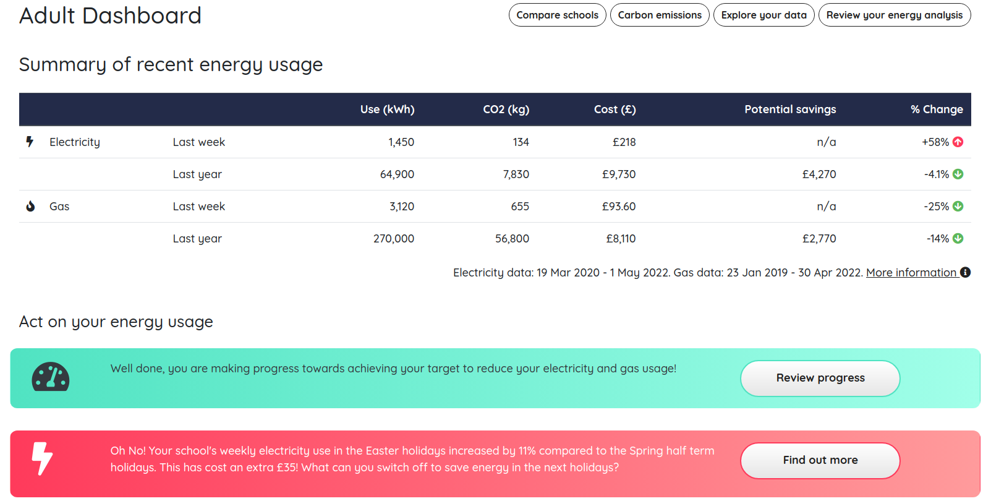


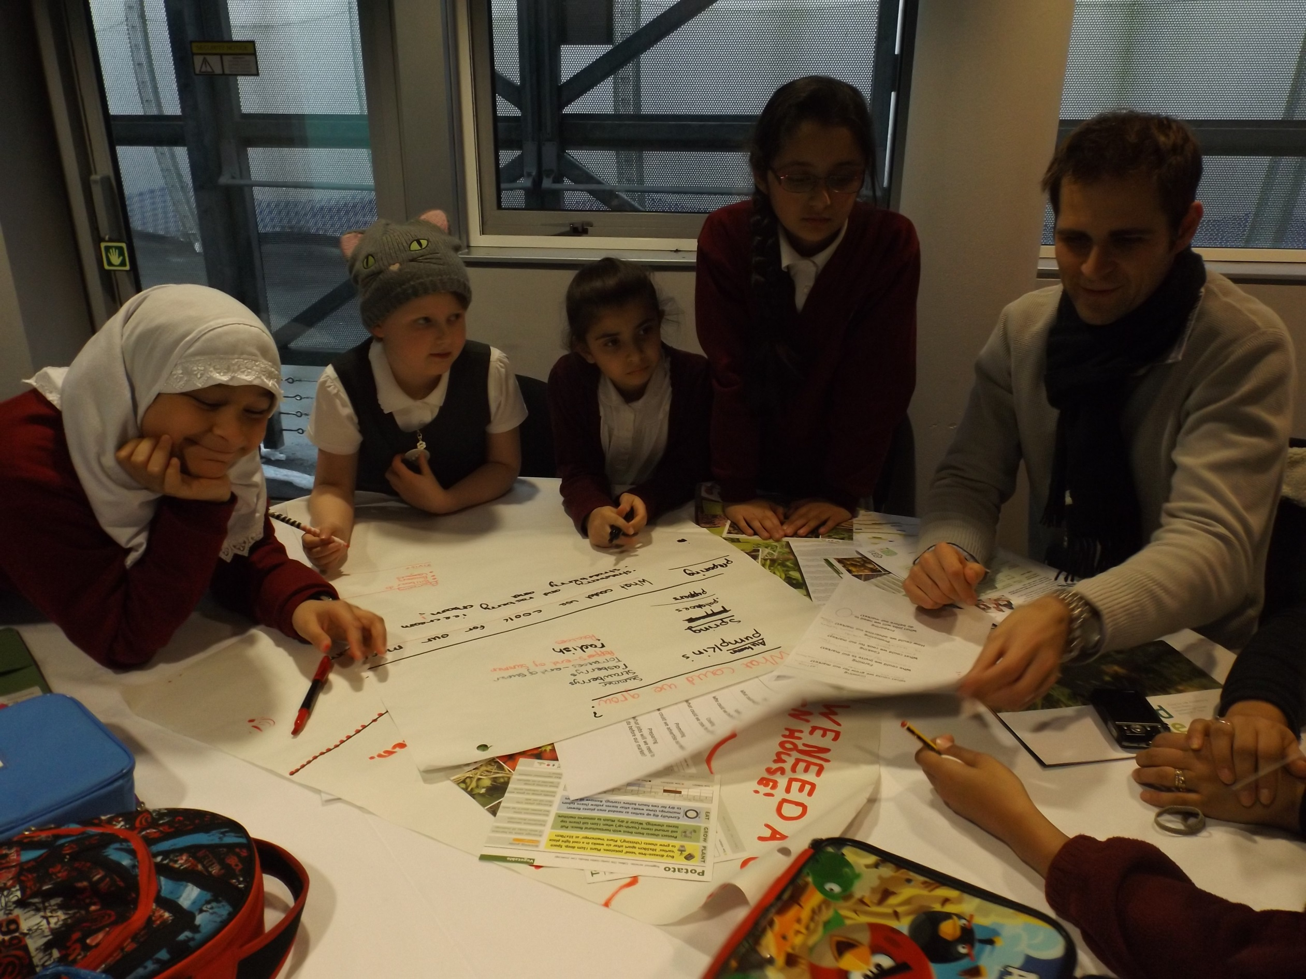
BESS Energy Core 2026-27
12 Month Subscription
Worried about increasing energy costs? Wanting to save money and improve your environmental credentials?
Energy makes up one of the biggest spends for schools after staffing. Leicester City Council has worked closely to develop an offer as part of BESS schools to develop tools and reports to empower staff and students to take control of their energy use.
This offer is open to all schools in Leicester City at cost price as part of our Climate Emergency Declaration commitment
What is included in the service:
Online monitoring of gas and electricity via Energy Sparks.
Wrap around support by the Sustainable Schools’ team for onboarding, general advice, educational and energy specific support
Provision of data for school’s preferred DEC provider
About Energy Sparks
An online energy analysis tool and energy education programme specifically designed to help schools reduce their electricity and gas usage through the analysis of smart meter data.
Using a school’s electricity, gas and solar data, shows staff (and pupils) how much energy the school is using. The online tool presents bespoke analysis of the energy data with suggestions of actions the school could take to save energy and reduce carbon emissions.
Provides adult and pupil dashboards tailored to meet the specific needs of the students and staff at a school.
Automated alerts to let schools know when energy use changes
For more information please contact:
Marc Tench
marc.tench@leicester.gov.uk
0116 454 6746
schools.leicester.gov.uk/BESS-Energy
This service will start in September 2026
Priced at £820
This service will start in September 2026
Sign up to BESS Energy by 31 July 2026 by completing our online form

