Slide 1




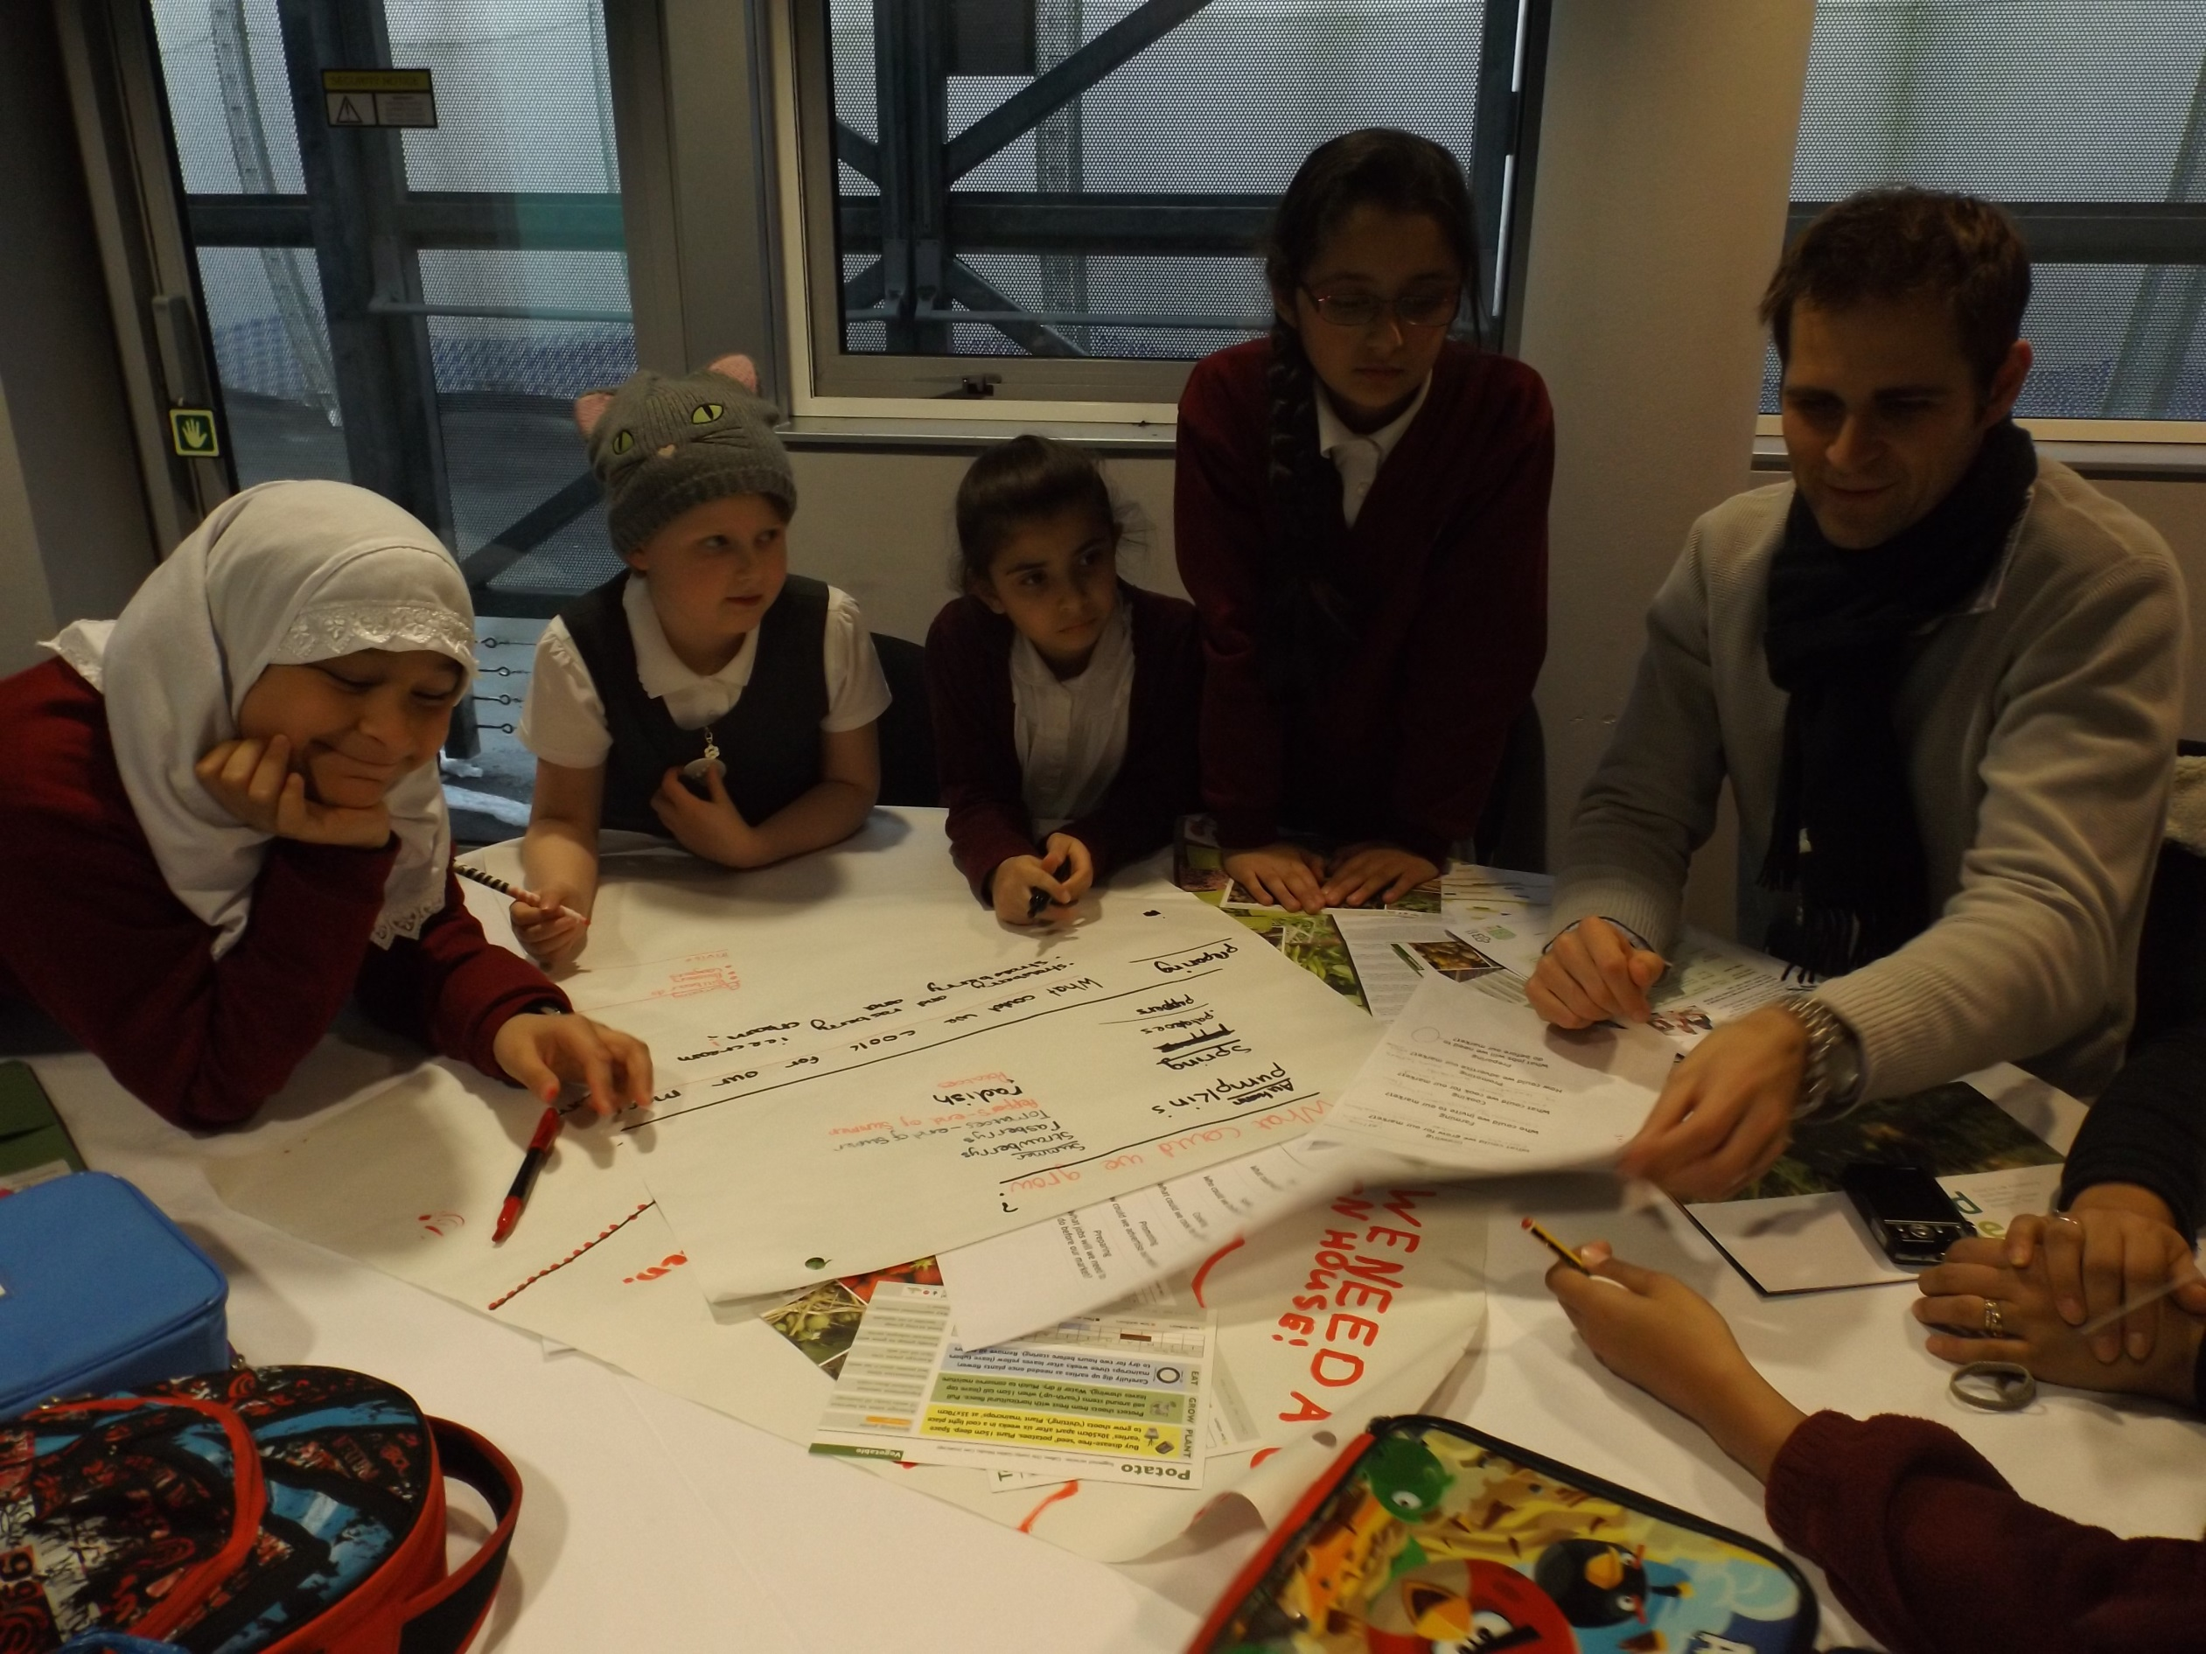
Built Environment School Service (BESS) Energy Academies 2026-27
Annual Energy and Carbon Report
From 1 April 2020, academy trusts will need to report on environmental reporting regulations. Regulations require large companies that consume more than 40,000 kWh of energy in a reporting period to include certain information about energy efficiency measures. Large companies are defined by sections 465-466 of the Companies Act 2006 as companies which meet 2 out of the following 3 criteria:
Gross income of £36 million or more;
Balance sheet assets of £18 million or more; and
250 employees or more
The reporting period for academy trusts will be 1 September 2025 to 31 August 2026.
www.gov.uk/government/publications/environmental-reporting-guidelines-including-mandatory-greenhouse-gas-emissions-reporting-guidance
Academies in Leicester City that also subscribe to BESS Energy Core or BESS Energy Enhanced will receive a discounted rate of £170 (instead of £185) per academy.
What is included in the service?
Reports which covers:
Annual carbon and energy usage reports
Analysis of energy trends/patterns of usage
Identifying the impact of energy efficiency improvements
Data in a format required as part of Energy and Carbon Reporting regulation (from September 2020):
  UK energy use (in kWh) including purchased electricity, gas and transport fuel
  Associated greenhouse gas emissions (in tonnes of carbon dioxide equivalent)
  At least one ‘intensity ratio’ that expresses the academy trust’s annual emissions in relation to a quantifiable factor associated with its activities
  Information about energy efficiency action taken during the year
  Methodologies used in the calculation of disclosures
Provision of a collated MAT report provided
Provision of data for school’s preferred Display Energy Certificate (DEC) provider
This offer is open to all Multi-Academy Trusts in England
Priced at £185 per academy
£170 for Leicester BESS Energy schools
For more information please contact:
Marc.tench@leicester.gov.uk
0116 454 6746
schools.leicester.gov.uk/BESS-Energy
This service is available from September 2026
Sign up to BESS Energy by 31 July 2026 by completing our online form

